Slide 1
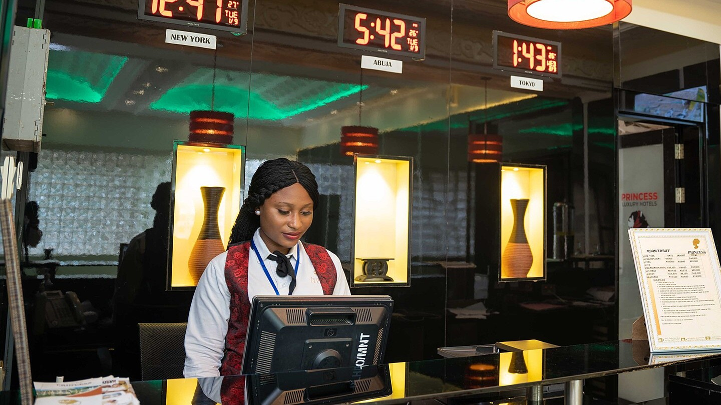

FRONT OFFICE OPERATIONS
Cash Handling and Hotel Documentation
Hospitality Programme · Year 2
Documents
Cash operations
Shift and reconciliation

Slide 2




OVERVIEW
Four skills of a front desk cashier
Documents
Cash operations
Read, complete and file every guest document.
Take payments, advances and deposits; make refunds.
Shift routine
Reconciliation
Open, run and close the cash shift correctly.
Match the cash drawer with the system to the last coin.
Notes:
Four skills. Each is covered by a sample document or dashboard in this session.

Slide 3






DOCUMENT MAP
Every stage of the stay leaves a document
1
2
3
4
5
6
Booking
Arrival
Stay
Payment
Departure
Shift close
Booking confirmation; guarantee or prepayment receipt.
Registration card; key card issue record.
Guest folio; service orders; minibar and laundry slips.
Fiscal receipt; card slip; deposit record.
Final folio; closed registration card; key return.
Z-report; shift handover log; incident reports.
No document, no payment, no protection in a dispute.

Slide 4
SAMPLE DOCUMENT 1
The registration card
REGISTRATION CARD No. 000214
Altyn Zhol Hotel
1
Identity
Copy details from the original document, not from memory.
FULL NAME
DATE OF BIRTH
Aigerim Akhmetova
14 Mar 1991
NATIONALITY
ID DOCUMENT
Kazakhstan
No. [hidden]
2
Dates and rate
PHONE
ARRIVAL
Must match the booking and the folio.
+7 7•• ••• ••-••
05 Oct 2026 · 14:00
DEPARTURE
ROOM
07 Oct 2026 · 12:00
312 · Deluxe Twin
3
Signature
RATE
PAYMENT
Signed by the guest, with consent to data processing.
BB · 28,000 KZT / night
Online prepayment + card
Guest signature: ______________
Received by: E. Smirnova
Fictional guest. Fields vary by country.

Slide 5




CASH OPERATIONS
Four operations, four documents
Payment
Advance
Deposit
Refund
For services already provided. Document: fiscal receipt and folio entry.
Money in advance for a future stay. Document: prepayment receipt, applied at check-out.
A guarantee for property, not revenue. Document: card hold slip or signed receipt.
Money back to the guest. Document: refund receipt, guest request, manager signature.
A deposit is never part of shift revenue. Show it on its own line in every report.

Slide 6
SAMPLE DOCUMENT 2
The fiscal receipt: five checks
1
ALTYN ZHOL HOTEL LLP
1
Seller details
BIN [000000000000]
Name, tax number, register number.
Cash register [serial no.]
2
Number and time
2
RECEIPT No. 000418
07.10.2026 11:42 · Cashier E. S.
Links the receipt to the shift and the folio.
3
Accommodation
56,000
3
Items and total
Restaurant
14,600
Extras
10,900
Same lines as the guest folio.
Advance applied
-28,000
TOTAL, KZT
53,500
4
Payment method
Cash and card are separate lines.
4
Bank card
53,500
5
Fiscal sign and QR
5
Fiscal sign [•••••••••]
Proof that the receipt is registered.
Sample with placeholder details. Required fields depend on national law.

Slide 7





CASH SHIFT
Six steps from handover to handover
1
2
3
4
5
6
Take over
Open shift
Operate
Bank cash
Close shift
Hand over
08:00 · Count cash with the previous cashier; test the register and the card terminal.
08:15 · Open the shift on the register and log in to the PMS.
All day · Every payment: receipt and PMS posting. Refunds need approval.
At the limit · Move excess cash to the safe with a signed record.
19:45 · Print the Z-report; compare it with the PMS; count cash.
20:00 · Complete the log; two signatures; safe keys.
Illustrative times: shift 08:00–20:00. The cash limit follows hotel policy.

Slide 8
DASHBOARD 1
Shift report · 07 Oct 2026 · 08:00–20:00
1,600,000
312,000
18 / 22
74
Shift revenue, KZT
Cash received, KZT
Arrivals / departures
Receipts issued
Illustrative data. Both views add up to 1,600,000 KZT: if not, look for an error.

Slide 9
DASHBOARD 2
Cash reconciliation: finding 2,500 KZT
Cash movement during the shift | KZT
Opening float | 50,000
Cash received | +312,000
Cash refunds | -12,000
Moved to safe | -250,000
Expected in drawer | 100,000
Counted in drawer | 97,500
Shortage | -2,500
DIFFERENCE
-2,500 KZT
2.5% of the expected 100,000
1
Recount with a colleague
2
Compare Z-report with PMS cash
3
Look for an operation of the same amount
4
No cause found: write an incident report
Never top up from your own money and never hide a shortage.

Slide 10
SAMPLE DOCUMENT 3
The shift handover log
SHIFT 07.10.2026 · 08:00–20:00
Handing over: E. Smirnova
1
Figures
Item | Received | Handed over
Cash in drawer, KZT | 50,000 | 97,500
Z-report No. | 0156 | 0157
Deposits held, pcs | 4 | 5
Open folios, rooms | 2 | 3
Cash difference, KZT | 0 | -2,500
From the count, not from memory.
2
Open issues
In writing, never verbal only.
3
Signatures
Special instructions: Room 215 late check-out to 15:00. Room 108 refund of overpayment to prepare. Incident report No. 7 filed for the cash difference.
Two signatures or the shift is not accepted.
Handed over: ____________
Received: ____________

Slide 11






RISK
Six cash desk errors that cost money
Payment without receipt
PMS does not match cash
Change without a count
Money taken, no proof: a dispute with guest and tax authority.
Payment taken but not posted; the folio stays open.
A shortage falls on the cashier.
Shared login
Advance not applied
Shift left open
No proof of who took the money.
Guest pays twice, or the hotel loses revenue.
Next day sales land in yesterday's report.
Prevention: a document at the moment of the operation.

Slide 12
KEY TAKEAWAYS
Document every operation. Count every shift.
Documents
Cash
Reconciliation
Read and file each one: card, folio, receipt, log.
Every payment has a receipt and a PMS posting.
Expected equals counted, or an incident report.
Photo: Mrkunmee, Wikimedia Commons, CC BY-SA 4.0. All hotels, guests and figures are fictional.

