Slide 1
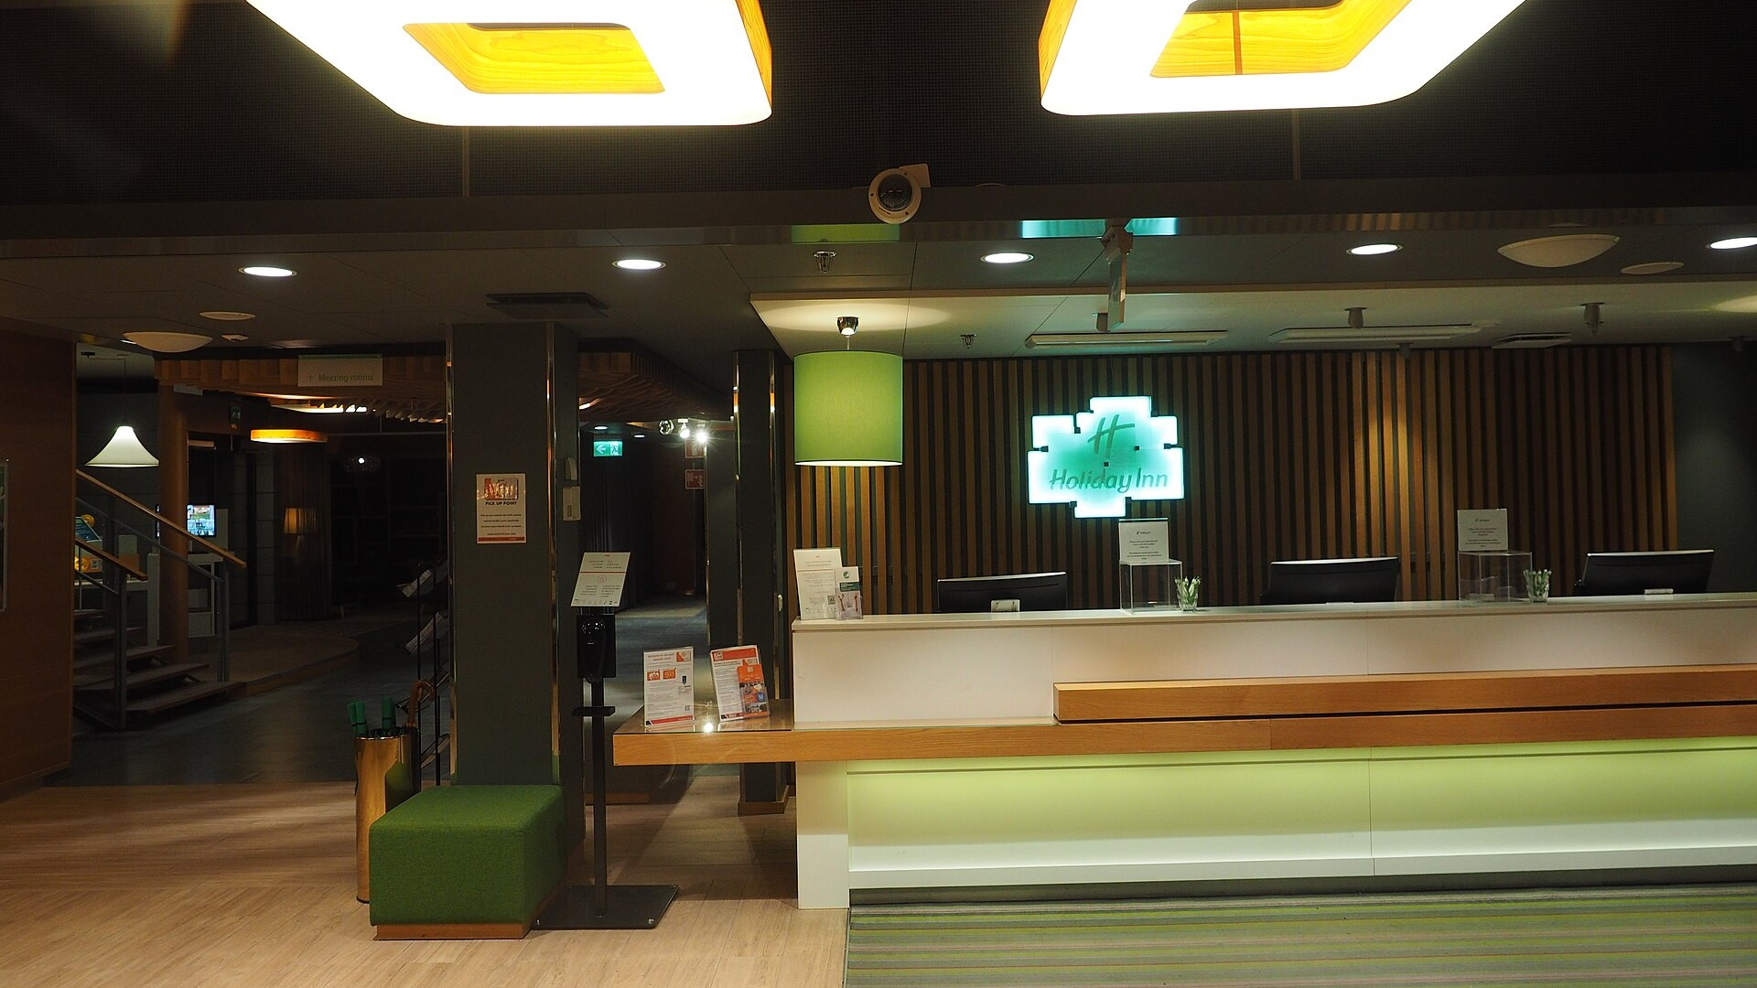

PROFESSIONAL MODULE 3 · LO 3.3
Guest Complaint Handling and Service Recovery
Hospitality Programme · Year 2
Listen
Resolve
Record and prevent

Slide 2



WHY IT MATTERS
A complaint is feedback you can still act on
The guest tells you
You can fix it
The hotel learns
Most unhappy guests leave without saying anything. A complaint gives you a chance.
A fast, fair solution can turn an unhappy guest into a loyal one.
A logged complaint shows which process needs to change.
Professional ethics: be honest, fair, calm and respectful of guest privacy.

Slide 3





COMPLAINT TYPES
Five common sources of complaints
Room
Noise
Billing
Service
Facilities
Cleanliness, temperature, broken equipment, wrong room type.
Corridor, neighbours, construction, street.
Unknown charges, wrong rate, late check-out fee.
Waiting time, staff attitude, missed requests.
Restaurant, breakfast, spa, parking, Wi-Fi.
Billing complaints often appear at check-out. Prepare the folio in advance to prevent them.

Slide 4
METHOD
The HEARD method
H
E
A
R
D
Hear
Empathise
Apologise
Resolve
Diagnose
Listen fully. Do not interrupt or defend.
Show you understand how the guest feels.
Say sorry for the experience, sincerely.
Offer a fix within your authority, or escalate.
Log the cause so it does not repeat.
Stay calm, keep your voice low, use the guest's name and never take the complaint personally.

Slide 5
LANGUAGE
Words that help and words that harm
Say | Avoid
“I am sorry about the noise. Let me solve this now.” | “That is not our fault.”
“Thank you for telling me.” | “You should have told us earlier.”
“Here is what I can do for you.” | “That is the policy.”
“I will check and call you back by 16:00.” | “I don't know. Not my department.”
“I will pass this to my manager and follow up.” | “Calm down.”
Promise only what you can deliver, and deliver what you promise.

Slide 6
SERVICE RECOVERY
Who can decide what: the authority ladder
General manager
Handle serious incidents, legal risks and exceptional compensation.
Front office manager
Decide on disputed charges, repeated problems and larger compensation.
Duty manager
Approve room changes, discounts and free services within set limits.
Front desk agent
Apologise. Correct small errors. Offer a small gesture such as a drink or late check-out within policy.
Limits are set by hotel policy. Escalate early rather than promise what you cannot approve.

Slide 7
SAMPLE DOCUMENT 1
The guest complaint report
GUEST COMPLAINT REPORT
Ref. C-0148
1
Facts
Write what happened, not opinions.
DATE AND TIME
GUEST AND ROOM
07 Oct 2026 · 08:20
L. Smith · Room 322
RECEIVED BY
CATEGORY
E. Smirnova, front desk
Noise
2
Action
COMPLAINT
Record what you did and who approved it.
Loud voices in the corridor at 02:00. Guest could not sleep.
ACTION TAKEN
Apologised in person. Security informed. Room change offered; guest declined.
3
Follow-up
COMPENSATION
Name an owner and a date.
10% discount on the night, approved by the duty manager.
FOLLOW-UP
Call guest after check-out; remind night team about quiet hours.

Slide 8
DASHBOARD
Complaint log: week 41 summary
14
12
2
9 min
Complaints received
Resolved at the desk
Escalated
Average time to resolve
Illustrative data. Billing is the largest category: review folio checks before check-out.

Slide 9
CASE STUDY
Disputed minibar charge at check-out
GUEST
HEARD CHECK
I did not use the minibar. Remove this charge, please. I have a flight.
Hear
done in the dialogue
RECEPTIONIST
Empathise
Thank you for telling me. I understand you are in a hurry. Let me check right now.
done in the dialogue
Apologise
RECEPTIONIST
done in the dialogue
The room report shows one item missing, but it may be a posting error. I will call housekeeping.
Resolve
done in the dialogue
Diagnose
RESULT
log the posting error
Housekeeping confirms the item was in place. Charge removed; folio reprinted and signed.
Time at the desk: about 4 minutes. Cause logged: minibar item posted to the wrong room.

Slide 10



PRACTICE
Role play cards and assessment
Noise at night
Late check-out fee
Dirty room
Guest in 322 reports corridor noise at 02:00. It is now check-out time.
Guest refuses to pay the fee; says nobody explained it at check-in.
Guest found hair in the bathroom and wants a full refund of the night.
Observer checklist | Not yet | Partly | Yes
Listens without interrupting
Shows empathy and apologises
Offers a solution within authority
Escalates correctly
Records the complaint

Slide 11
KEY TAKEAWAYS
Hear first. Fix fast. Log the cause.
Hear
Resolve
Record
Let the guest finish; show you understand.
Act within your authority or escalate early.
Log facts, actions and follow-up for every complaint.
Photo: JIP, Wikimedia Commons, CC BY-SA 4.0. All guests and figures in the samples are fictional.

