Slide 1
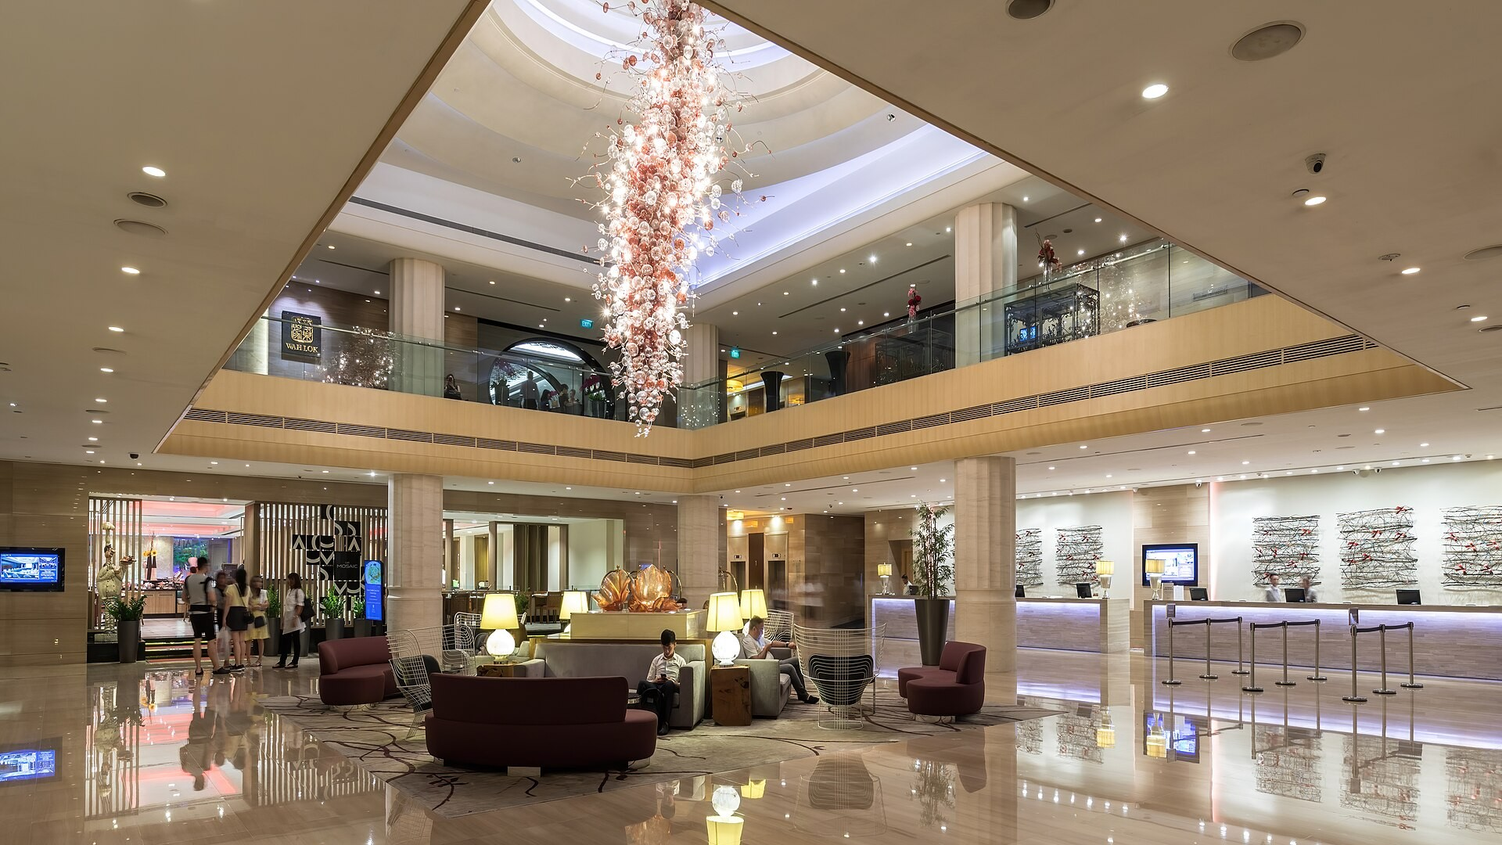

PROFESSIONAL MODULE 3 · LO 3.2
Guest Database and PMS Records
Hospitality Programme · Year 2
Accurate records
Clean guest profiles
Privacy by default

Slide 2





DATA LIFECYCLE
From first booking to deletion: five stages
1
2
3
4
5
Capture
Verify
Store
Use
Retire
Collect only the data the hotel needs, with the guest's knowledge.
Check spelling, contacts and ID against the original.
One profile per guest in the PMS. Access by role.
Personalise service; send offers only with consent.
Archive or delete according to the privacy policy.
A guest record is only as good as the person who typed it.

Slide 3
SAMPLE RECORD 1
A complete guest profile
1
Identity
AA
Akhmetova, Aigerim
Name, language and contacts, spelled correctly.
RETURNING GUEST
2
Stay history
PROFILE ID
STAYS
Dates, room type, spend and payments.
G-004281
3 (7 nights)
LAST STAY
TOTAL SPEND
05–07 Oct 2026
238,400 KZT
Preferences
3
FEEDBACK
LANGUAGE
Useful for the next stay, never sensitive guesses.
5 / 5
Russian, English
EMAIL
MARKETING CONSENT
a.•••••@••••.com
Yes · 05 Oct 2026
4
Consent
Preferences: high floor, quiet room, feather-free bedding. Late check-out to 14:00 granted.
Who agreed to what, and when.

Slide 4
PMS SCREEN
Departures list: what each status means
Front Office · Departures · Wed 07 Oct 2026
ROOM | GUEST | PROFILE | BALANCE, KZT | STATUS | DATA TASK
305 | Brown, J. | Complete | 0 | Checked out | None
312 | Akhmetova, A. | Complete | 53,500 | Settling | Add feedback score
318 | Nurlan, K. | Email missing | 0 | Folio ready | Ask for email
322 | Smith, L. | Duplicate? | 12,800 | Balance due | Merge profiles
ROOM STATUS FLOW
Occupied
Check-out
Vacant Dirty
Cleaning
Inspected
Vacant Clean
Sample screen, fictional data.

Slide 5
DATA QUALITY
Common entry errors and the correct record
Item | Wrong | Right
Name | akhmetova aigerim | Akhmetova, Aigerim
Email | aigerim@gmial.com | aigerim@gmail.com
Phone | 87771234567 / +7 777 123 45 67 | +7 777 123 45 67 (one format)
Nationality | KZ / Kazakh / Kazakhstan | Kazakhstan (from the list)
Notes | Difficult guest!! | Prefers quiet room; asked for late check-out
Profile | Two profiles for one person | One merged profile
Notes must be factual and polite. The guest has the right to see what you write.

Slide 6
DASHBOARD
Guest database health: October 2026
1,248
38%
91%
17
Guest profiles
Returning guests
Profiles with email
Duplicates to merge
Illustrative data. Lowest completeness: preferences (54%). Ask at check-out.

Slide 7

PRIVACY
Personal data: what to do and what to avoid
DO
AVOID
Collect only what the hotel needs.
Write card numbers in profile notes.
Record marketing consent explicitly.
Photograph IDs on a personal phone.
Share data only with authorised staff.
Share guest details with callers.
Correct errors when the guest asks.
Keep sensitive guesses, such as health or religion.
Lock the screen when you leave the desk.
Leave printed folios at the desk.
Follow the hotel privacy policy and national data protection law.

Slide 8





END OF DAY
From check-out to the night audit report
1
2
3
4
5
Check-outs
Late postings
Profiles
Night audit
Reports
All departures closed in the PMS with zero balance.
Restaurant, spa and minibar charges posted to the right folios.
Stay data and preferences saved for each departed guest.
Day closed; room revenue posted; balances checked.
Departures, revenue, cash and occupancy reports saved.
If an open folio remains after the audit, the next day's report will be wrong.

Slide 9
CASE STUDY
Two profiles for one guest: merging steps
Profile ID | Name | History | Phone | Email
G-003917 | Smith, L. | 1 stay · 12 Jun 2026 | +7 701 000 00 00 | No email
G-004302 | Smith, Lena | 1 stay · 05 Oct 2026 | +7 701 000 00 00 | lena.smith@mail.com
1
Confirm identity
Same phone and name; check with the guest at the desk.
2
Choose the master record
Keep the profile with the most complete data and history.
3
Merge stays and notes
Combine history; keep the latest contact details.
4
Delete the duplicate
Record the merge in the audit log with date and name.

Slide 10
KEY TAKEAWAYS
Accurate records make personal service possible.
Capture
Maintain
Protect
Only needed data, spelled correctly, with consent.
One profile per guest; fix duplicates and gaps.
Privacy policy first; no card numbers in notes.
Photo: Basile Morin, Wikimedia Commons, CC BY-SA 4.0. All guests and figures in the samples are fictional.

