Slide 1
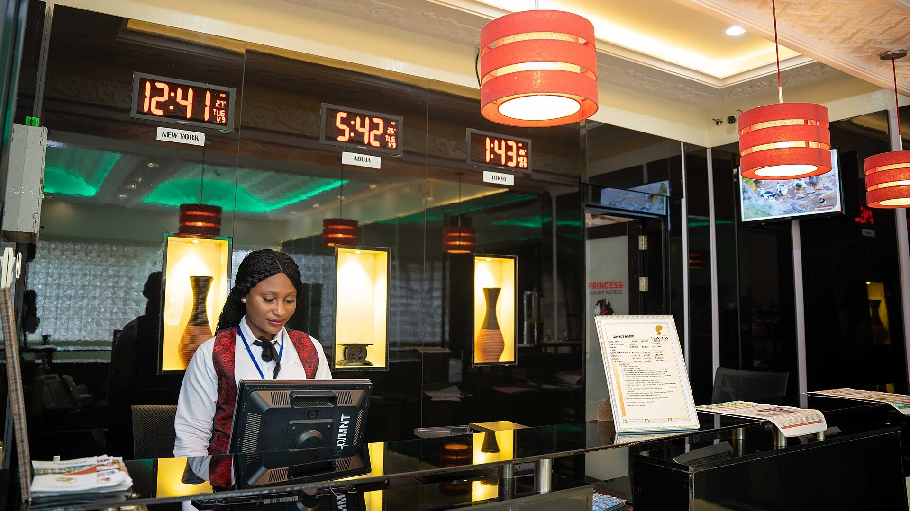

PROFESSIONAL MODULE 3
Guest Check-out and Settlement
Front Office Operations · Hospitality Programme
LO 3.1 Documentation
LO 3.2 PMS & guest database
LO 3.3 Complaints
Notes:
Welcome. This module covers the final stage of the guest cycle: check-out, settlement and complaint handling.

Slide 2




MODULE OVERVIEW
Three learning outcomes, one work placement
LO 3.1
LO 3.2
LO 3.3
Prepare check-out documents
Record the departure
Handle complaints
Guest folio, invoice, receipt and departure checklist.
Update the PMS and the guest database accurately.
Listen, apologise, resolve and log in a professional way.
Work placement: apply each outcome at the front desk and record it in the placement log.

Slide 3





PROCESS
The check-out cycle in six steps
1
2
3
4
5
6
Departure notice
Folio review
Settlement
Keys and room
PMS update
Farewell
Guest confirms departure; late check-out request is checked.
Go through every charge with the guest.
Take payment, release the deposit, issue the receipt.
Collect key cards; housekeeping checks the room.
Check the guest out; room becomes Vacant Dirty.
Thank the guest and invite feedback.
Target
Rule
Under 5 min
at the desk for a standard departure
No document, no departure
Notes:
Walk through the six steps. Step 3 is highlighted because money and documents meet here.

Slide 4
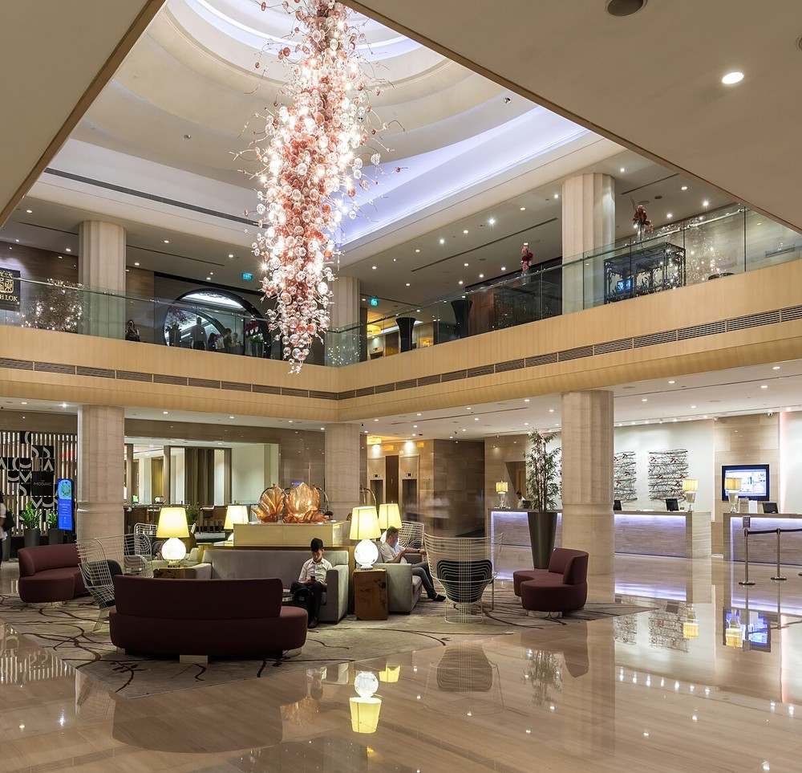
FRONT DESK
A departure day at the front desk
06:00
Check the departure list and the folios ready to print.
08:00
Peak begins: one agent on settlement, one on keys and luggage.
11:00
Highest volume. Confirm late check-out requests with the duty manager.
12:00
Standard check-out time. Late check-out charges follow hotel policy.
14:00
All departures closed in the PMS; rooms released to housekeeping.
Lobby and reception, Carlton Hotel Singapore
Notes:
Photo: Carlton Hotel lobby. Timings are an example; adapt to the hotel's own check-out time.

Slide 5
LO 3.1 · DOCUMENTATION
The guest folio: check every line before printing
1
Identity
ALTYN ZHOL HOTEL
GUEST FOLIO / INVOICE
Name and room match the registration card.
GUEST
ROOM
Ms Aigerim Akhmetova
312 · Deluxe Twin · BB
ARRIVAL
DEPARTURE
05 Oct 2026
07 Oct 2026 · 2 nights
2
Stay dates
Date | Description | Amount, KZT
05 Oct | Room charge · Deluxe Twin BB | 28,000
06 Oct | Room charge · Deluxe Twin BB | 28,000
06 Oct | Restaurant · dinner | 14,600
06 Oct | Minibar | 2,400
06 Oct | Laundry | 4,500
07 Oct | Parking · 2 days | 4,000
 | Total charges | 81,500
05 Oct | Prepayment (online) | −28,000
07 Oct | Payment · bank card (POS) | −53,500
 | Balance | 0
Nights and rate match the booking.
3
Charges
Each extra is confirmed by the guest.
4
Payments
Prepayments and deposits are applied.
Deposit hold of 10,000 KZT released at check-out.
Notes:
Sample document, fictional hotel and guest. Amounts are illustrative: 81,500 − 28,000 = 53,500.

Slide 6




LO 3.1 · DOCUMENTATION
The check-out document pack
Final folio / invoice
Payment receipt
Registration card
Itemised charges, signed or confirmed by the guest.
Fiscal or card receipt matching the folio total.
Closed with actual departure date and time.
Key card return
Minibar and damage report
Feedback form
Number of cards issued and returned.
Housekeeping check before the folio is closed.
Offered to every guest at the desk.

Slide 7



LO 3.1 · SETTLEMENT
Settlement methods at check-out
Bank card
Authorise, hand over the slip, release the deposit hold.
Cash
Count in front of the guest, give change, record in the shift cash.
Corporate bill
Check the authorisation letter and move charges to the master account.
Prepaid / OTA
Confirm what is included and collect incidentals only.
Illustrative data for a 60-room hotel.

Slide 8
LO 3.2 · PMS
Departures screen and room status
Front Office · Departures · Wed 07 Oct 2026
ROOM | GUEST | NIGHTS | BALANCE, KZT | STATUS | NEXT ACTION
305 | Brown, J. | 3 | 0 | Checked out | Room to housekeeping
312 | Akhmetova, A. | 2 | 53,500 | Settling | Take payment, print receipt
318 | Nurlan, K. | 1 | 0 | Folio ready | Collect keys
322 | Smith, L. | 2 | 12,800 | Balance due | Review minibar charge
410 | Chen, W. | 4 | 0 | Checked out | Update guest profile
ROOM STATUS FLOW
Occupied
Check-out
Vacant Dirty
Cleaning
Inspected
Vacant Clean
Sample screen, fictional data. Real systems (Opera, Fidelio, Exely, Shelter) use the same logic.

Slide 9


LO 3.2 · GUEST DATABASE
Update the guest profile at check-out
WHAT TO UPDATE
AA
Akhmetova, Aigerim
Stay dates, room type and rate
RETURNING GUEST
Total spend and payment method
STAYS
LAST STAY
3
05–07 Oct 2026
Preferences learned during the stay
TOTAL SPEND
FEEDBACK
238,400 KZT
5 / 5
Complaints and compliments
RATE PLAN
MARKETING CONSENT
BB · Deluxe Twin
Yes
Contact details and consent
PREFERENCES AND NOTES
High floor, quiet room. Late check-out to 14:00 granted. Compliment: restaurant service.
Store personal data only as the privacy policy allows.
Notes:
Fictional guest profile. Remind students about consent and data protection.

Slide 10
LO 3.2 · DASHBOARD
Check-out dashboard: Wednesday, 07 Oct 2026
50
3 min 40 s
5
2
Departures
Average desk time
Late check-outs
Disputed charges
WHAT THE DATA SAYS
Peak at 11:00
Add a second agent on settlement.
5 late check-outs
Confirm policy at booking and at arrival.
2 disputed charges
Review minibar and parking posting.
Illustrative data.

Slide 11
LO 3.3 · COMPLAINTS
The HEARD method
H
E
A
R
D
Hear
Empathise
Apologise
Resolve
Diagnose
Listen fully. Do not interrupt or defend.
Show you understand how the guest feels.
Say sorry for the experience, sincerely.
Offer a fix within your authority, or escalate.
Log the cause so it does not repeat.
SAY
AVOID
“Thank you for telling me. I am sorry about the noise. Let me see what I can do for you now.”
“That is not our fault.” “You should have told us earlier.” “That is the policy.”

Slide 12
LO 3.3 · DOCUMENTATION
Complaint log and escalation
Ref | Room | Complaint | Action taken | Compensation | Status
C-0147 | 312 | Minibar item charged, not consumed | Checked with housekeeping; charge removed | None | Closed
C-0148 | 322 | Corridor noise at 02:00 | Apology; duty manager approved discount | 10% of room rate | Closed
C-0149 | 410 | Late check-out fee disputed | Policy shown in booking confirmation; sent to FOM | Pending | Open
General manager
ESCALATION LADDER
Front office manager
Serious incidents and major compensation
Duty manager
Disputed charges and repeated issues
Front desk agent
Approve discounts and room changes
Apologise, correct small errors, offer a small gesture
Notes:
Sample log. Compensation limits depend on hotel policy.

Slide 13
WORK PLACEMENT
Competency record for the production practice
Task | LO | Observed | With support | Independent
Prepare and verify the guest folio | 3.1
Take payment and issue the receipt | 3.1
Close the folio and file the documents | 3.1
Check out the guest in the PMS | 3.2
Update the guest profile | 3.2
Handle a complaint using HEARD | 3.3
Record the complaint in the log | 3.3
DAILY PLACEMENT LOG
Date
07 Oct 2026
Shift
07:00–15:00
Hotel
Altyn Zhol Hotel
Mentor
Duty manager
Tasks completed
Checked out 14 guests with the mentor.
Reviewed 6 folios before printing.
Handled 1 minor complaint (HEARD).
Reflection
Confirm each extra charge before printing.
Mentor signature: ____________________

Slide 14
KEY TAKEAWAYS
Accurate documents. Accurate records. Calm service.
LO 3.1
LO 3.2
LO 3.3
Verify the folio line by line, then settle and issue the receipt.
Close the departure in the PMS and update the guest profile.
Use HEARD, log the complaint and escalate when needed.
Photos: Mrkunmee (front desk) and Basile Morin (lobby), via Wikimedia Commons, CC BY-SA 4.0. All guests, hotels and figures in the samples are fictional.

