Slide 1
ADTA 5240 Final Project
Suhas Siddarajgari Tellatakula
Notes:
ID=d924773e-9a16-4d6d-9803-8cb819e99682 Recipe=text_billboard Type=TextOnly Variant=0 FamilyID=AccentBoxWalbaum_Zero

Slide 2

Outline
Introduction
Part 1: Strategy
Part 2: Data Preprocessing in Excel
Part 3: Data Preprocessing in OpenRefine
Part 4: Data Analysis
Conclusion

Slide 3
Introduction
Final project has 4 distinct parts testing knowledge gained in ADTA 5240 course.
First part explains a strategy to incorporate Big Data technology into a firm.
Part 2 and 3 depict the data preprocessing on a sales records dataset in Excel and Open refine respectively.
Part 4 includes the data analysis performed on the processed data in Big Query.

Slide 4
Part 1: Big Data Strategy
Based on the understanding gained on the firm’s business and data, there is a need for Big Data implementation in near future.
Google Cloud Platform is the best available cloud provider offering services ranging from Data preparation and Modelling to evaluation and deployment.
GCP Services like Cloud storage,SQL, Spanner for Data preparation; Compute Engine, Dataproc Hadoop/spark clusters for Data Modelling should be deployed.
Data Evaluation and Analysis can be performed with BigQuery, Open Refine etc., and Looker Studio serves Data visualization purpose.

Slide 5
Part 1: Big Data Strategy
In addition to this, Identity Access Management and Cloud Key Management Services offer efficient and high security to all our data and applications.
Google Cloud App or Cloud Shell can be used to easily monitor manage all our services and get notified about various tasks processing.
A detailed roadmap to implement these strategies into the firm like starting with formal employee trainings to deployment of technology through pilot projects into department phase wise is provided.

Slide 6
Part 1: Big Data Strategy
Train the technical staff on Big Data.
Pilot project in one department.
Continuous monitoring and improvement.
After developments, introduce in other departments.

Slide 7
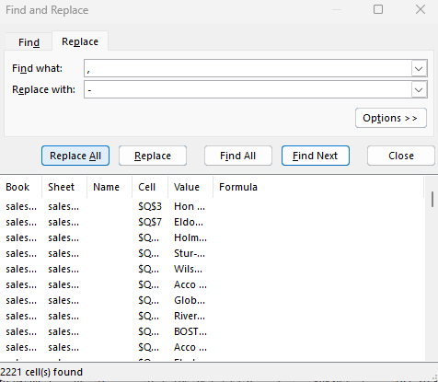
Part 2: Data Preprocessing in Excel
Microsoft Excel is used for the data preprocessing in this part.
Sales_record_1_ADTA5240 csv file is downloaded and imported in Microsoft Excel.
Select the Product Name column and click Control + H to initiate the Find and Replace feature.
Give “,” for Find what and “-” for Replace with and click on Replace All button as seen in figure 1.
This will result in replacing all commas in the column with hyphen.
Figure 1. Find and replace

Slide 8
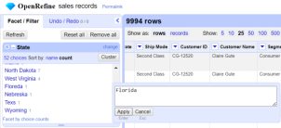
Part 3: Data Preprocessing in Open Refine
Open Refine is used for data preprocessing in this part.
Install Open Refine and create new project with default properties by uploading sales_records_2 csv file obtained in part 2.
Using Text facets on State column, I identified and fixed the 3 typos as seen in figure 2.
Floreda -> Florida
Nebreska -> Nebraska
Texs -> Texas
Figure 2. Fixing State typos in Open refine

Slide 9
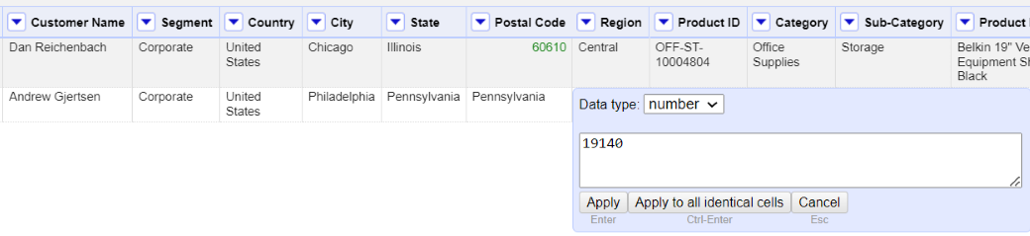
Part 3: Data Preprocessing in Open Refine
After noticing that Postal Code has only text data, I transformed the values to numeric using Common transforms feature on Postal Code.
Then, I noticed and fixed the 2 non-numeric values as Central and Pennsylvania with corresponding city zip codes.
Figure 3. Fixing typos in Postal Code

Slide 10
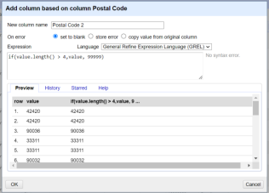
Part 3: Data Preprocessing in Open Refine
Then, I created a column Postal Code 2 for values other than length of 5 as shown in figure 4.
This will create 99999 as zip code for all such values.
State and Postal Code values are now error free.
Figure 4. Adding Postal Code 2 column

Slide 11
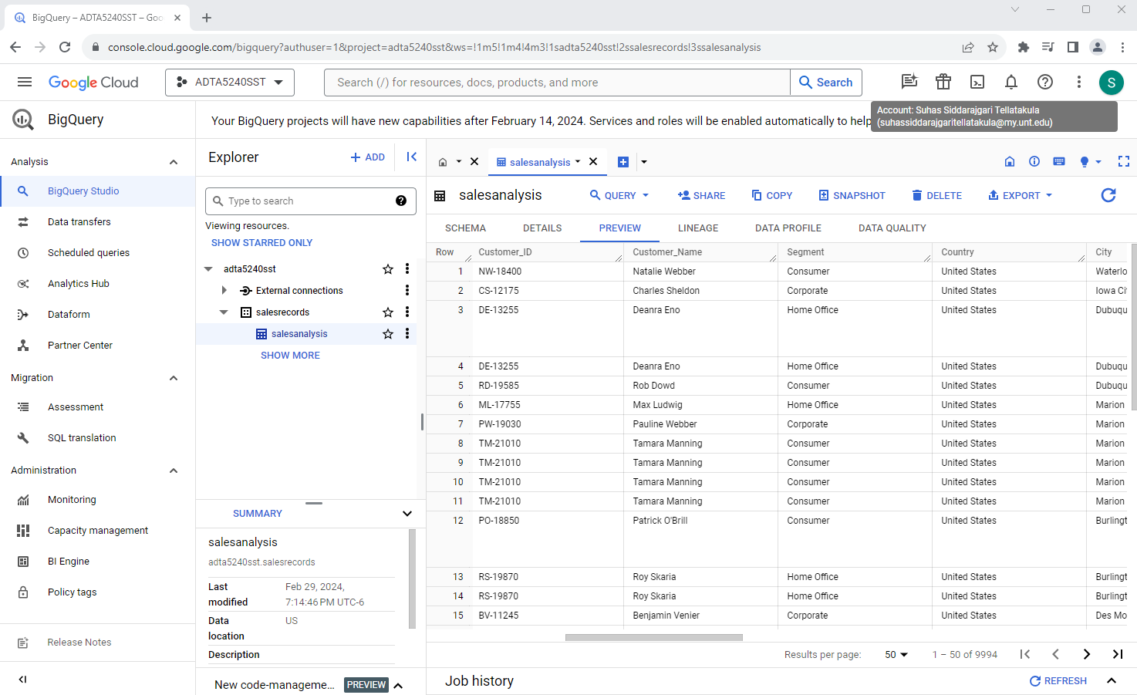
Part 4: Data Analysis
In BigQuery, I created a new dataset named salesrecords under my GCP project.
Then I created a new table named salesanalysis and uploaded the cleaned_records_3 csv file obtained in part 3.
Figure 5 shows a preview of salesanalysis under salesrecords.
Figure 5. salesanalysis

Slide 12
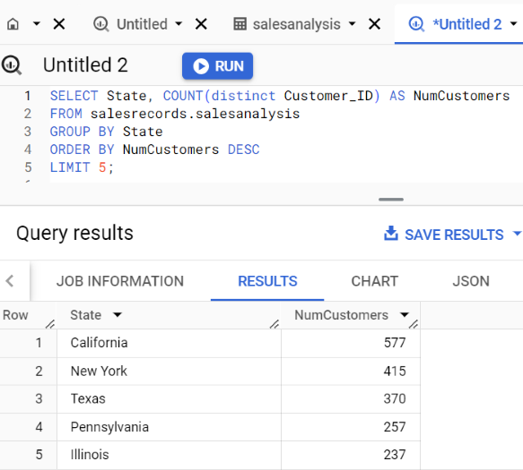
Part 4: Data Analysis
To find the top 5 states with the greatest number of customers, I ran the below query:
“SELECT State, COUNT(distinct Customer_ID) AS NumCustomers FROM salesrecords.salesanalysis GROUP BY State ORDER BY NumCustomers DESC LIMIT 5;”.
Query executed and following results are obtained as shown in figure 6. California State has highest number of customers of 577 followed by Newyork, Texas, Pennsylvania, Illinois.
Figure 6. Query 1

Slide 13
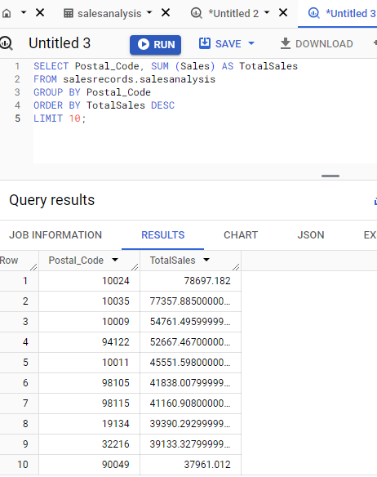
Part 4: Data Analysis
To find the top 10 postal codes with the highest sales , I ran the below query:
“SELECT Postal_Code, SUM (Sales) AS TotalSales FROM salesrecords.salesanalysis GROUP BY Postal_Code ORDER BY TotalSales DESC LIMIT 10;”.
Query executed and following results are obtained as shown in figure 7. city with postal code 10024 has the highest sales with value of 78697.182, followed by 10035 city with almost 77358, and so on with 10th position for city with 90049 with sales value of approximately 37961.
Figure 7. Query 2

Slide 14
Conclusion
Part 1 successfully strategized a firm to utilize the Google Cloud Platform services, a Big Data technology platform.
Part 2 used the find and replace all feature on Microsoft Excel for data preprocessing.
Open refine is used to fix the mistakes in State and Postal Code columns in Part 3.
In part 4, 2 queries are executed on the processed data in Big Query and generated the data analysis results.
In this way, Final project taught me range of topics like requirements gathering, Data Preparation, Preprocessing, Evaluation and Analysis.
I learnt the entire Data analytics life cycle through this project and course materials.

Slide 15
Thank You!!

