Slide 1
iOS Sync Automation
@Power by Soonr.jar

Slide 2
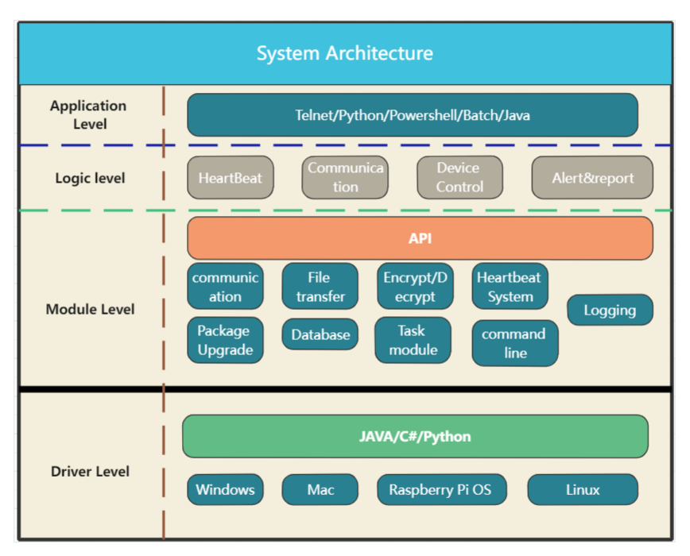
TestClient

Slide 3















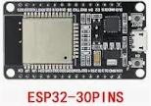
TestClient(soon.jar)
Vmware/Esxi/VitualBox
SSH
RMM Ransomware Detection/Remote Deployment/, RMM server/client, ES server/Client
RestAPI
Python/Powershell/batch/shell/AutoIT/AppleScript/Dotnet/Curl/Java/AWS CLI..
TestClient (soonr.jar)
CLI
GraphQL
ClientAPI
Workplace Server/Client: dwp/dfp/dwc/Android/iOS, RFS client
Jenkins/Gitlab/ Automaction Server...
WebAPI
RestAPI
Integration
Selenium/Appium/WinApp Driver/GRPC
Win/Mac/Linux
Web UI

Slide 4
Architecture for Soonr.jar
Web server
php
Ask for new task
telnet
Internal
Network (CLI)
soonr.jar
Return task
php+
mysql
real-time control
HeartBeat Control
call
telnet
Heartbeat
“proxy”
soonr.jar
soonr.jar
soonr.jar
Python, Java, AutoIT PHP
Local Network
Global Network

Slide 5
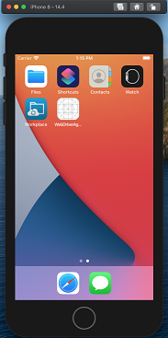
Architecture for iOS Sync Automation
http://hb.35cloud.com/liveios
Heartbeat
soonr.jar
client
Appium
Java,Python,PHP,Batch,AutoIT,Telnet CLI

Slide 6
iOS Sync Core Automation
Target & Goal
Let iOS VFS agent running like Desktop Agent
Let iOS agent been control like Desktop Agent:
Stop Agent, Start Agent, Install, Upgrade, unintall
Let Monitor server service Jenkins Pipeline running task.
new IOS build -> new testing of new build -> reporting
Let iOS share the same testing code as like Android, Win & Mac

Slide 7
iOS Sync Core Coverage
Content updates on agent and verify on the server
Hard-Sync project[done]
Create/Edit/Rename/Delete - Files/Folder/Project
Soft-Sync Project [done]
Create/Edit/Rename/Delete – File/Folder/Project
Content updates on server and verify on the device
Soft-Sync Project [done]
Create/Edit/Rename/Delete – File/Folder/Project
Hard-Sync Project [TODO]
Create/Edit/Rename/Delete –File /Folder/Project on the server, check on agent

Slide 8
iOS Sync core verification
iOS sync core database
Agent.db and Sync.db
iOS file cache
Encryption header (via 16-hex value)
Encryption body (via Kurt Ransomware Encryption tool)
Content Scanner via Apache Tika tool
iOS content compare
Take screen and do screen compare via Computer Vision

Slide 9
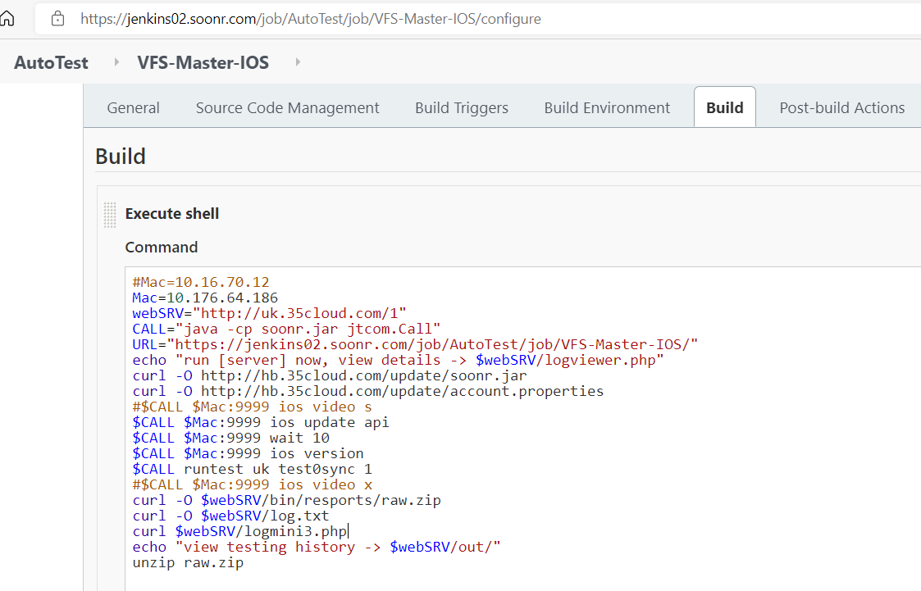
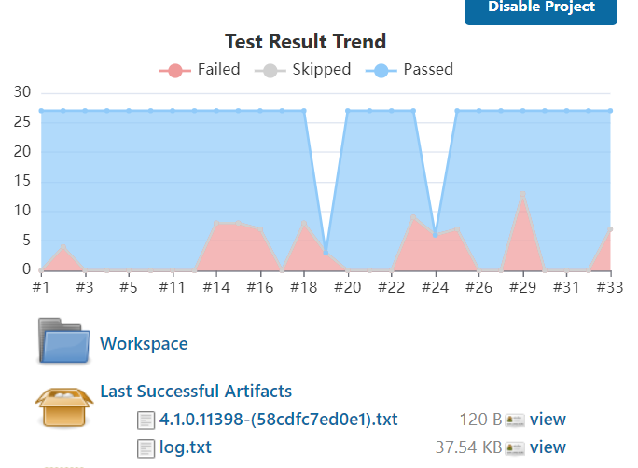
iOS Runner via Jenkins

Slide 10
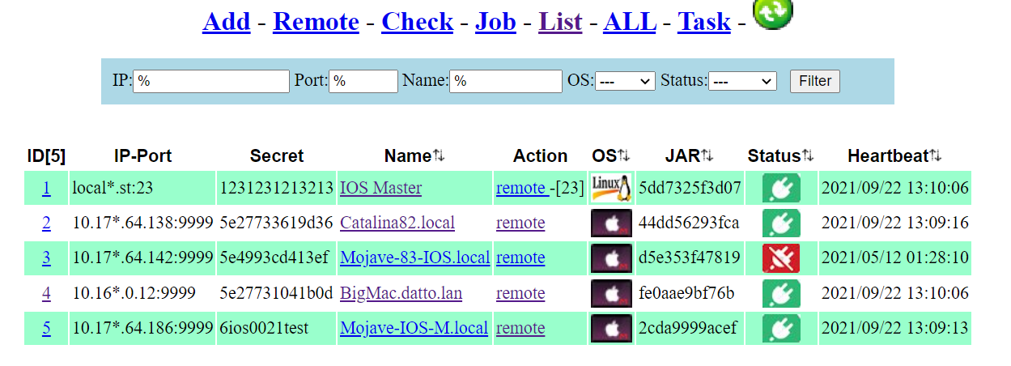
Appium Cluster via HeartBeat System

Slide 11
SDK ? CLI ? Demo ?
Regular VFS Desktop Agent without Encryption
10.3 VFS Desktop agent with Encryption
Play around iOS VFS agent
How to write testing code for VFS iOS agent
How to write script for soonr.jar client
How to build Appium cluster
How to drive via Heartbeat System as horsepower, like Jenkins

Slide 12
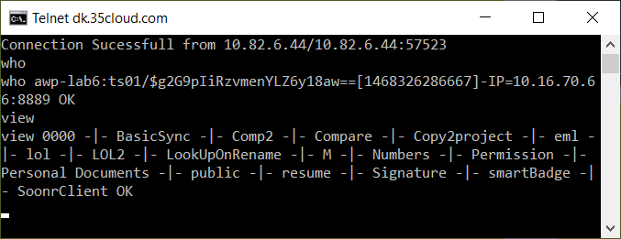
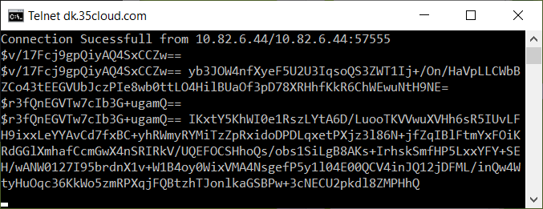
Security ? Yes -regular message -encrypt message

Slide 13
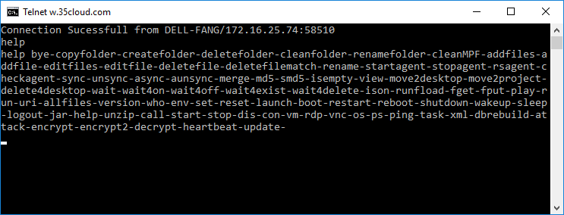
Command line inside soonr.jar
md5,smd5,upload,download..
sync,unsync, async, aunsync
wait,wait4on,wait4off..
createfolder, addfiles...
Run shell cmd, URL,Scripts..
Run Automation...
checkagent,stop/start agent...
reset,resetvfs,task,heartbeat...
encrypt, decrypt, attack,CV...
P2P Files transfer between machines..
help command [ new ☺]...
....more command....

Slide 14
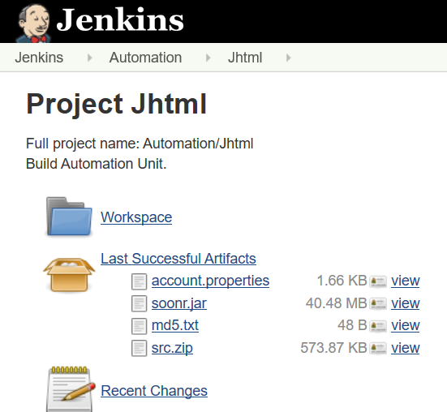
Life Cycle of Soonr.jar
Build soonr.jar
via Jenkins
Push new version to remote machine
Via p2p file transfer
Soonr.jar Auto Update
Via task 1 0 jar update

Slide 15
Deploy Automation Unit[soonr.jar]
Soonr Automation Project, Jhtml [git clone https://git.soonr.com/r/qa/jhtml]
What is it contians inside Jhtml
Automation Part
Agent remote deployment automation via AEM installation script
PSA integration + webAPI+ Backup + webUI[ Fang’s and Gabo]
Sync core automation
Operation Part
File System operation, fx: add files/folders, encrypt & decrypt,c\
Upload, Download Files/Folder. Content compare between agent and server
Multi Job runner for JUnit testing.
HeartBeat System.

Slide 16
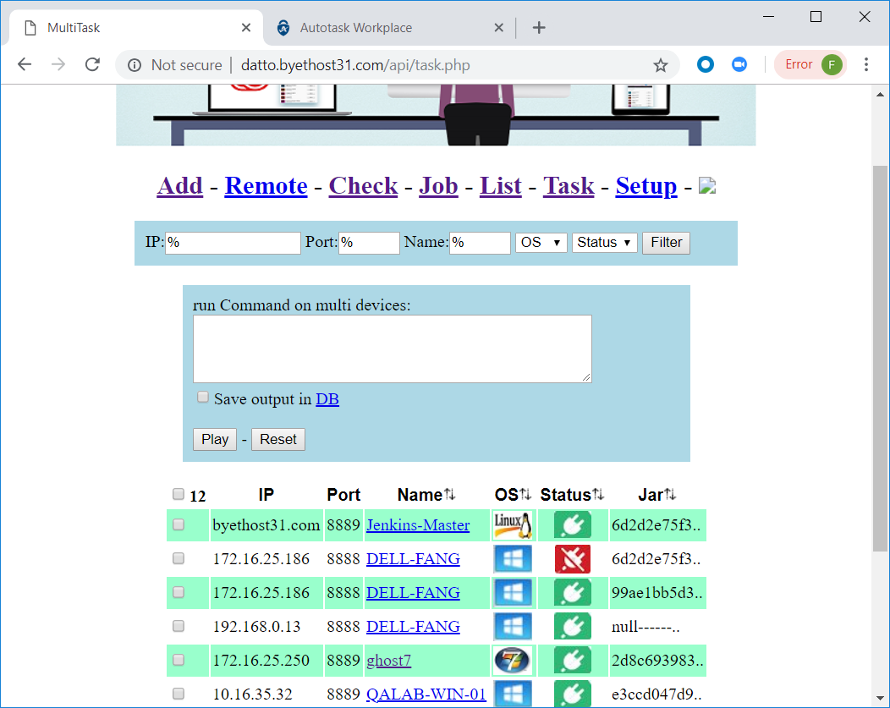
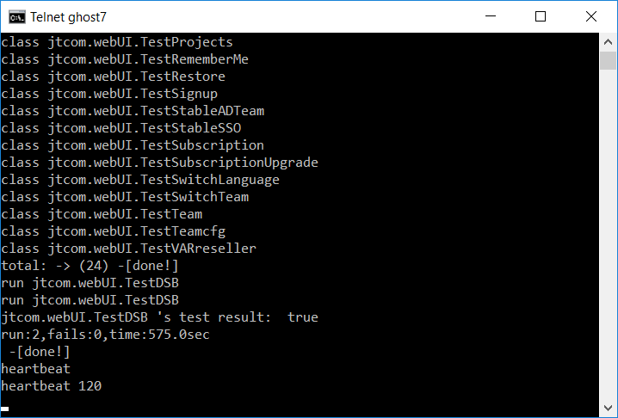
Automatio Unit[Jhtml]
Java –jar soonr.jar – to launch automation instance
Run automation via
Telnet Terminal command line
Web Portal
Heartbeat command
Heartbeat web server to collect automation resource.

Slide 17
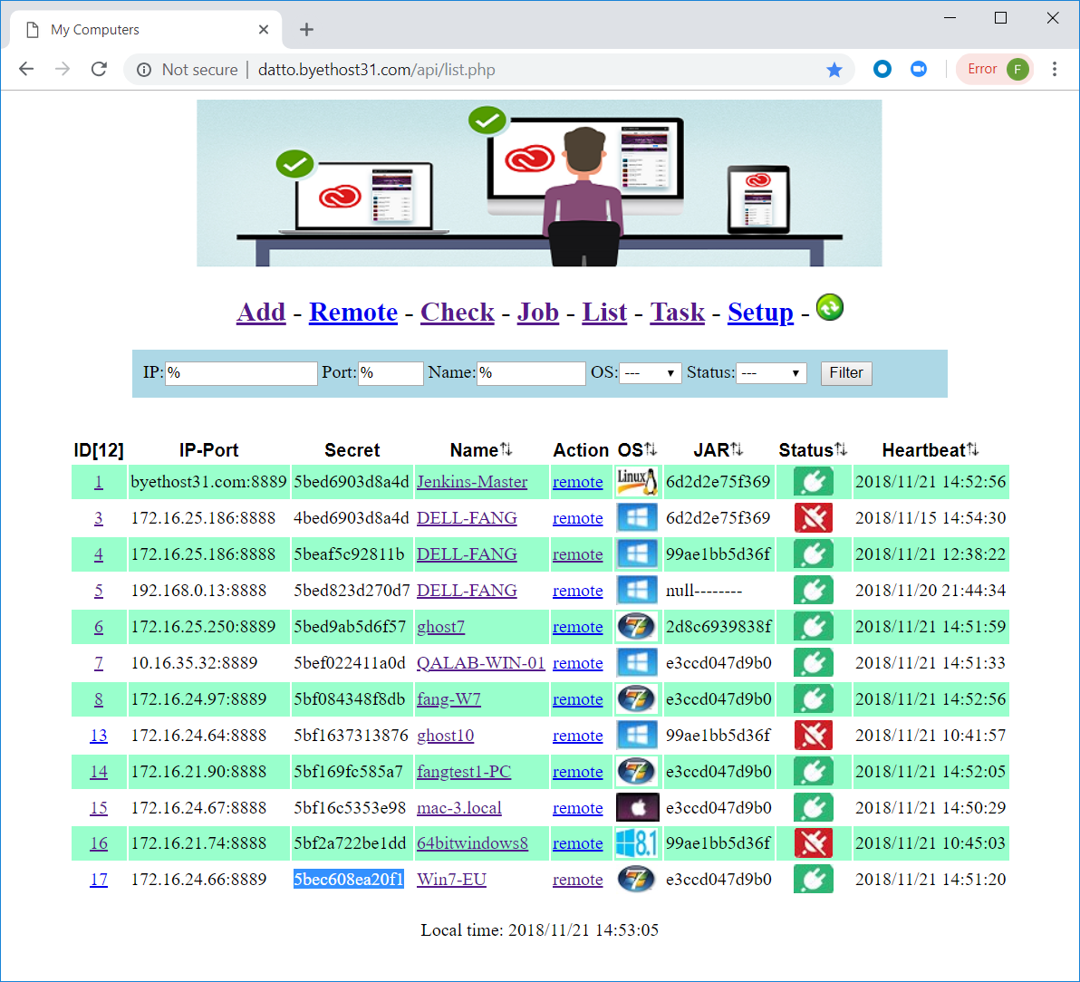
Register Autoamtion Unit
Parameters to heartbeat Server
heartbeat= 120
api=http://dk.35cloud.com/api
secret= 5bec608ea20f1
List of automation UI
Fake machine: Jenkins Master
Machine from DK office
Machine from SK office
Machine from any place

Slide 18
2 Type of Task
Private Job
Automatio Unit will ask the server in every certain periods to get private job
Public Job
If there is no private job for him, He will look for public job, which defines by one fake machines.

Slide 19
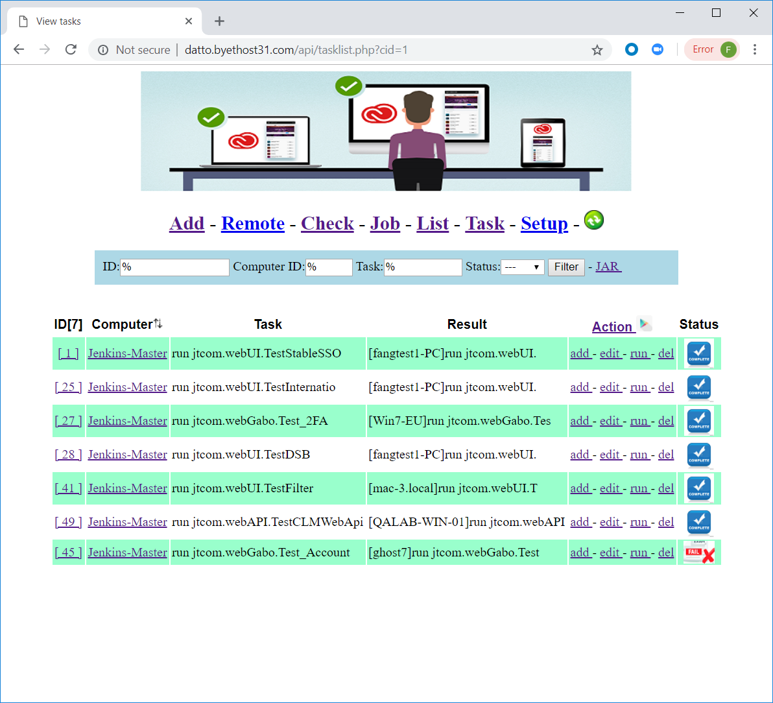
HeartBeat Server
Task exection

Slide 20
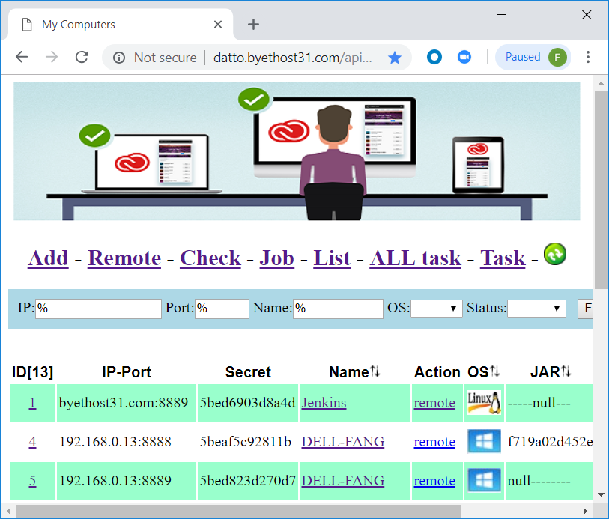
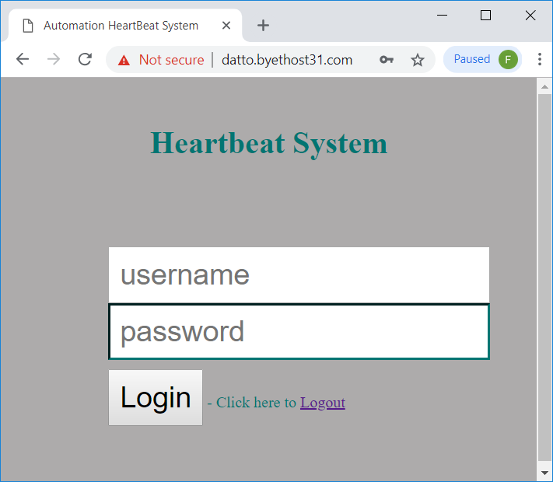
Security of HeartBeat?

