Slide 1
CSCI316 · AUTUMN 2026
Predicting Loan Default
at Origination
HEADLINE RESULT
0.183
best PR-AUC (DeepMLP) — 3.35× the 5.46% random baseline
0.802
An end-to-end big-data mining workflow on 855,969 Lending Club loans
Stage 1 — Apache Spark data exploration
Stage 2 — Spark MLlib + TensorFlow / Keras
ROC-AUC, TensorFlow MLP and DeepMLP
55%
of defaults recovered by the single-unit LogisticNN at its tuned threshold
Target: default_ind · 5.43% default (17.4 : 1) · no post-origination feature used as a predictor

Slide 2

INTRODUCTION
The Problem: Who Will Default?
Task. Binary classification of default_ind — 1 if the borrower stopped paying, 0 otherwise.
Constraint that shapes everything. The prediction must be usable at the moment the loan is approved.
Why that matters. The dataset carries 13 post-funding columns (total_pymnt, recoveries, last_pymnt_amnt, out_prncp …). They describe repayment behaviour, so a model trained on them scores near-perfectly and is worthless in production.
Business framing. A false negative is a funded loan that is written off; a false positive is forgone interest. The two errors are not symmetric, so we rank borrowers by risk rather than hand back a hard yes / no.
PROJECT OBJECTIVE
Build a reproducible, leakage-free workflow that ranks loan applications by default risk, and compare two learning stacks on the same features and the same split.
SUCCESS IS MEASURED BY
· PR-AUC — the ranking metric that survives a 17 : 1 imbalance
· Recall and precision on the default class at a tuned threshold
· ROC-AUC, reported for comparability
· Accuracy, reported but never used to choose a model
A constant “no default” rule already scores 94.53% accuracy. Accuracy alone cannot separate a good model from a useless one.
CSCI316 Big Data Mining Techniques & Implementation · Autumn 2026
2

Slide 3
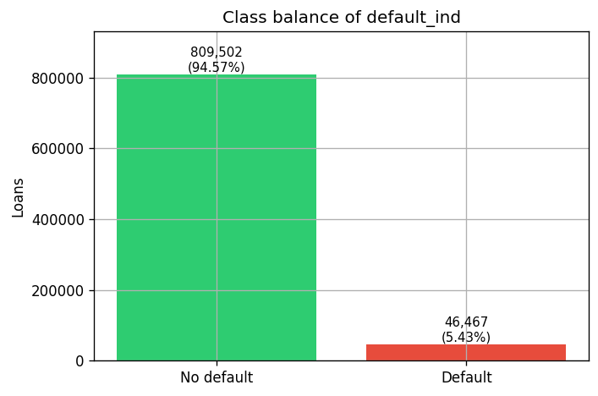
INTRODUCTION
The Dataset at a Glance
855,969
loans, verified against the raw CSV line count
73 → 48
columns after cleaning; 38 enter the models
5.43%
default rate — 46,467 defaults, 17.4 : 1
0
rows lost — 100% retained after cleaning
Mixed types. Numeric, categorical and date columns; several arrive as text — '36 months', '83.7%', dd-MM-yyyy — and are cast explicitly.
Sparsity. 42 of 73 columns are fully populated; 21 are more than half empty (the joint-application and instalment-line blocks) and were dropped.
Keys and constants. id and member_id are unique across all 855k rows; policy_code has a single distinct value; pymnt_plan is degenerate.
Quality fixes. revol_util capped at 150 and dti at 100 to tame implausible tails; no duplicate rows and no missing targets were found.
Stage 1 — class balance of default_ind
CSCI316 Big Data Mining Techniques & Implementation · Autumn 2026
3

Slide 4
METHODS
End-to-End Workflow
data.csv
855,969 × 73
raw Lending Club extract
STAGE 1
Spark EDA
DataFrame + RDD APIs
no pandas, no sklearn
data_clean.csv
855,969 × 38
single shared contract
PROCESS ONE — Spark MLlib
Logistic Regression · Random Forest · GBT
▶
▶
▶
PROCESS TWO — TensorFlow / Keras
LogisticNN · MLP (64/32) · DeepMLP (128/64/32)
WHY THIS SHAPE
One cleaning pass, two stacks
Stage 1 writes a single canonical file. Both Stage 2 processes read it, so any difference in the results comes from the model, not the preprocessing.
Identical split protocol
Stratified 64 / 16 / 20, class weights from the training fold only, threshold tuned on validation, test touched exactly once.
Spark where the data is big
Stage 1 runs over all 855,969 rows in Spark. Keras needs a dense in-memory matrix, so Stage 2 works on a shared 30% stratified sample.
Reproducible by construction
Fixed seeds, timestamped run folders, a runs.log and a pinned final/ directory that every figure in this deck comes from.
CSCI316 Big Data Mining Techniques & Implementation · Autumn 2026
4

Slide 5
01
Stage 1 — Data Exploration
Apache Spark DataFrame and RDD APIs only · no pandas, no scikit-learn

Slide 6
STAGE 1 · METHOD
How We Explored 855,969 Loans
1
Parser sanity check
Compare the parsed record count against a raw RDD line count so that a mis-quoted CSV cannot silently drop rows.
4
Statistics
Summary statistics, class balance, class-conditional means and Pearson correlations with the target.
2
Integrity
Duplicate rows, duplicate ids, null counts for all 73 columns, and a per-column schema dump.
5
Categorical risk
Default rate by grade, sub_grade, term, purpose, home_ownership, verification_status, emp_length and addr_state.
3
Typing
'36 months' → 36, '83.7%' → 83.7, dd-MM-yyyy → date, then derived ratios: loan_to_income, installment_to_income, bal_to_limit.
6
Selection
The 7 most and 7 least relevant attributes, each with a written justification, plus the leakage exclusion list.
src/stage1_eda.py — parser sanity check
# Spark only — the assignment forbids pandas / sklearn in Stage 1
raw_lines = spark.sparkContext.textFile(str(csv_path)).count() - 1
assert df.count() == raw_lines, 'the CSV parser lost or invented rows'
CSCI316 Big Data Mining Techniques & Implementation · Autumn 2026
5

Slide 7
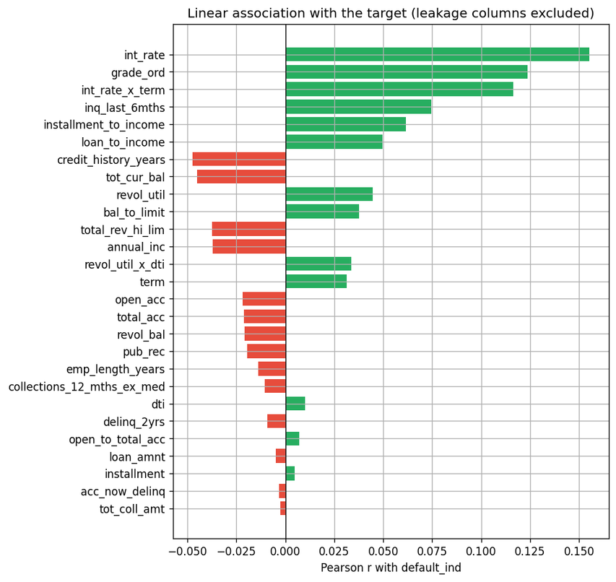
STAGE 1 · FINDINGS
What the Numbers Say
Interest rate dominates. int_rate is the single strongest numeric signal, r = +0.155. Defaults were priced at a mean 16.02% versus 13.03% for the rest, a 22.9% gap.
Everything else is weak. No other attribute passes |r| = 0.13. The relationships are individually weak and non-linear, which is exactly the regime where trees and networks earn their keep over a linear rule.
Affordability shows up as ratios. Raw annual_inc reaches only r = −0.037, but the derived loan_to_income lifts it to +0.050 and installment_to_income to +0.062 — feature engineering, not new data.
Thin files default more. credit_history_years r = −0.047 and inq_last_6mths r = +0.074: short histories and recent credit-seeking both point the same way.
CAVEAT WE RETURN TO
int_rate is Lending Club's own risk price. It is legitimately available at origination, but it means part of what we predict is what the lender already concluded.
Pearson correlation of each numeric attribute with default_ind
CSCI316 Big Data Mining Techniques & Implementation · Autumn 2026
6

Slide 8
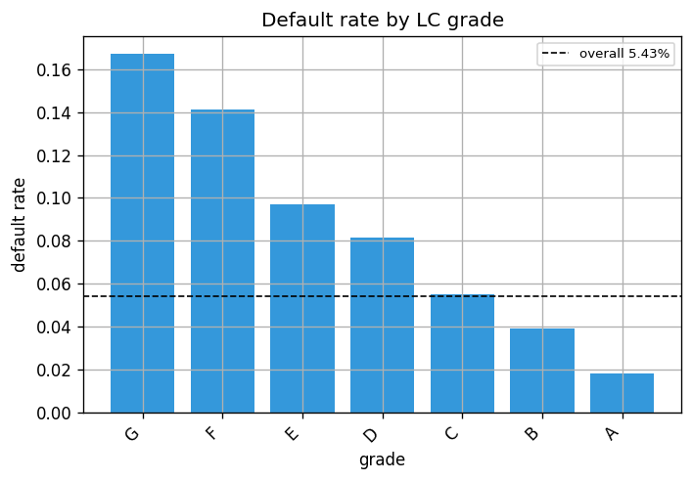
STAGE 1 · FINDINGS
Risk Is Concentrated in the Credit Grade
Grade | Loans | Default rate
A | 145,665 | 1.83%
B | 247,998 | 3.92%
C | 236,855 | 5.49%
D | 132,802 | 8.13%
E | 66,448 | 9.72%
F | 21,328 | 14.13%
G | 4,873 | 16.70%
Default rate by assigned credit grade (n = 855,969)
Monotonic, 9× spread. 1.83% at grade A to 16.70% at grade G — the cleanest separation in the data.
Term adds exposure. 60-month loans default at 6.52% against 4.96% for 36-month loans.
Purpose is noisy. 'educational' is the riskiest stated purpose at 17.18% — but on only 326 loans.
ENCODING DECISION
Grade is ordinal, so we encode it as grade_ord rather than as seven unordered dummies — the model gets the ordering for free.
CSCI316 Big Data Mining Techniques & Implementation · Autumn 2026
7

Slide 9
STAGE 1 · ATTRIBUTE RELEVANCE
The Seven Most Relevant Attributes
# | Attribute | Evidence | Justification
1 | int_rate | r = +0.155 | Strongest single numeric signal — the risk-based price Lending Club charges summarises its own underwriting view.
2 | grade / sub_grade | 9× spread | Default rate climbs monotonically from 1.83% (A) to 16.70% (G): a 14.88-point spread across seven bands.
3 | term | r = +0.031 | 1.55-point spread between the two terms; a 60-month loan is exposed for twice as long as a 36-month one.
4 | dti | r = +0.010 | The standard measure of repayment capacity, and it is available at application time.
5 | revol_util | r = +0.045 | Revolving utilisation shows how much headroom the borrower has already consumed.
6 | inq_last_6mths | r = +0.074 | Recent credit enquiries proxy active credit seeking — an early distress signal.
7 | annual_inc | r = −0.037 | Income anchors every affordability ratio; the derived loan_to_income reaches r = +0.050.
Selected on evidence, not intuition: correlation with the target for numeric attributes, and the spread in group default rate for categorical ones — both computed in Spark over all 855,969 rows.
CSCI316 Big Data Mining Techniques & Implementation · Autumn 2026
8

Slide 10
STAGE 1 · ATTRIBUTE RELEVANCE
The Seven Least Relevant — and the Ones We Banned
# | Attribute | Why it was excluded
1 | id | Surrogate loan key, unique for all 855k rows — pure noise, usable only through row order.
2 | member_id | Surrogate borrower key. Identifiers must never enter a credit model.
3 | policy_code | Constant — a single distinct value, so it carries exactly zero information.
4 | pymnt_plan | Degenerate: fewer than 10 loans take the minority value, so it cannot generalise.
5 | emp_title | Free text with tens of thousands of inconsistent spellings; unusable without NLP.
6 | title | Borrower-typed loan title that merely restates purpose, which is already encoded.
7 | zip_code | Truncated to three digits — coarse geography that addr_state covers more stably.
SEPARATELY BANNED — TARGET LEAKAGE
13 columns that only exist after the loan is funded:
out_prncp · out_prncp_inv · total_pymnt · total_pymnt_inv · total_rec_prncp · total_rec_int · total_rec_late_fee · recoveries · collection_recovery_fee · last_pymnt_d · last_pymnt_amnt · next_pymnt_d · last_credit_pull_d
These are not weak features — they are the answer. recoveries is non-zero only for loans that already defaulted. Including them would produce a near-perfect model that cannot score a single new application.
21 sparse columns (the joint-application and instalment-line blocks, all >50% empty) and 4 free-text columns were dropped as well: 73 columns in, 48 out, 38 into the models.
CSCI316 Big Data Mining Techniques & Implementation · Autumn 2026
9

Slide 11
02
Stage 2 — Predictive Analysis
Two independent processes, one shared feature contract and one shared split

Slide 12
STAGE 2 · METHOD
The Evaluation Protocol Both Processes Share
Stratified 64 / 16 / 20
Each class is split separately, so train, validation and test all carry the same 5.46% default rate. Verified and written out as split_summary.csv.
Train-only fitting
Median imputation, string indexing, one-hot encoding and standardisation are fitted on the training fold and applied to the other two. Unseen categories encode to an all-zero block.
Class weights, not resampling
Every default counts as n_neg / n_pos ≈ 17.3 rows. Nothing is duplicated or discarded, so the test set stays an honest sample of reality.
Threshold tuned on validation
0.5 is arbitrary under imbalance. We sweep 0.05 → 0.95 and keep the threshold that maximises F1 on the default class — chosen on validation, never on test.
Test used once
Model selection, hyperparameters and the threshold are all settled before the test set is scored a single time.
PR-AUC ranks the models
With 5.46% positives, ROC-AUC flatters everything and accuracy is dominated by the majority class. PR-AUC is the metric we select on.
stage2_spark.py — add_class_weights()
best_threshold() — identical in both processes
# every default counts as (n_negative / n_positive) rows
ratio = negatives / positives # 17.31 on the train fold
df = df.withColumn('weight', F.when(
F.col('default_ind') == 1.0, F.lit(ratio)
).otherwise(F.lit(1.0)))
# F1 on the default class, searched on VALIDATION data
for t in np.arange(0.05, 0.951, 0.005):
f1 = metrics_at(y_val, s_val, t)['f1_default']
if f1 > best_f1:
best, best_f1 = t, f1
CSCI316 Big Data Mining Techniques & Implementation · Autumn 2026
10

Slide 13
STAGE 2 · IMPLEMENTATION
Process One — Spark MLlib
Pipeline. Imputer (median) → StringIndexer → OneHotEncoder → VectorAssembler → classifier, assembled as one pyspark.ml Pipeline and fitted once on the training fold.
Design matrix. 138 assembled columns from 27 numeric and 6 categorical inputs, plus a bureau_data_missing indicator.
Tuning. CrossValidator with 3 folds, selecting on areaUnderPR — not on accuracy.
Engineering issue we hit. handleInvalid='keep' on both the indexer and the encoder: a category present only in validation or test would otherwise abort the run instead of encoding to zeros.
stage2_spark.py — preprocessor + tuning
stages = [Imputer(inputCols=NUMERIC, outputCols=imp,
strategy='median')]
stages += [StringIndexer(inputCol=c,
outputCol=f'{c}_idx',
handleInvalid='keep')
for c in CATEGORICAL]
stages.append(OneHotEncoder(..., dropLast=True,
handleInvalid='keep'))
stages.append(VectorAssembler(outputCol='features',
inputCols=imp + ['bureau_data_missing'] + ohe))
gbt = GBTClassifier(labelCol='default_ind',
weightCol='weight', seed=SEED)
cv = CrossValidator(estimator=gbt, numFolds=3,
evaluator=BinaryClassificationEvaluator(
metricName='areaUnderPR'))
Model | Selected hyperparameters
Logistic Regression | regParam 0.001, elasticNetParam 0.0 (pure L2)
Random Forest | numTrees 100, maxDepth 12
Gradient-Boosted Trees | maxDepth 4, maxIter 100
MODEL CHOICE
Why these three: a regularised linear baseline, a bagged non-linear model and a boosted one — increasing capacity on identical inputs, so any gain belongs to the model family.
CSCI316 Big Data Mining Techniques & Implementation · Autumn 2026
11

Slide 14
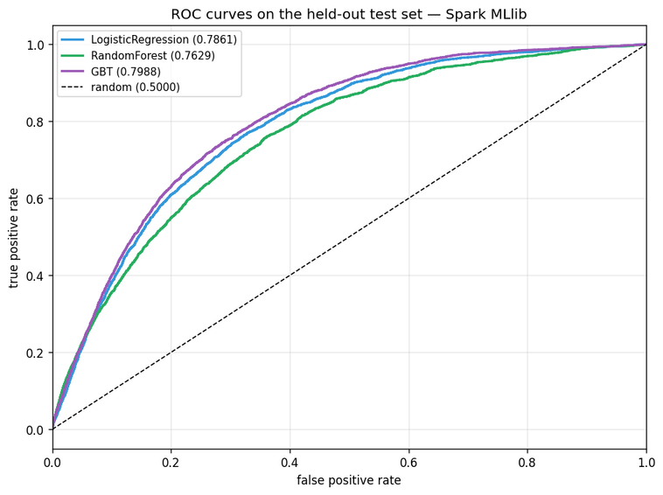
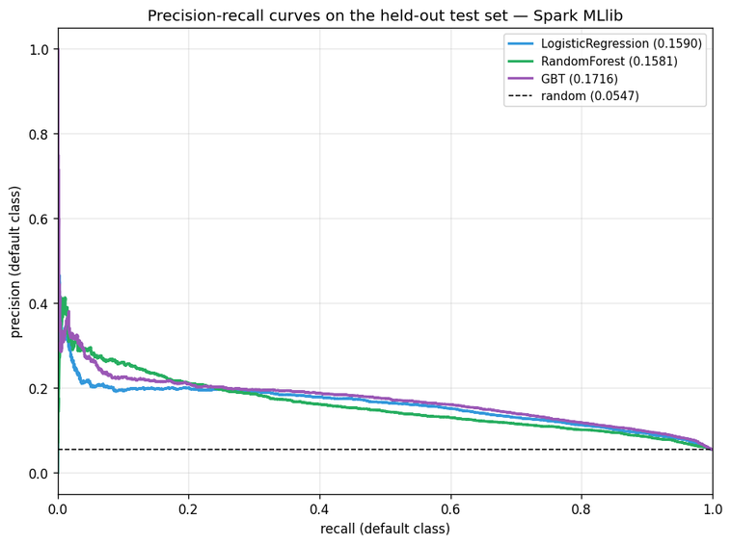
STAGE 2 · RESULTS
Process One — Results on the Held-Out Test Set
Model | ROC-AUC | PR-AUC | Threshold | Recall (default) | Precision | F1 (default) | Accuracy
Logistic Regression | 0.7861 | 0.1590 | 0.635 | 50.3% | 16.5% | 0.2490 | 83.4%
Random Forest | 0.7629 | 0.1581 | 0.615 | 27.5% | 19.0% | 0.2245 | 89.6%
Gradient-Boosted Trees | 0.7988 | 0.1716 | 0.680 | 45.0% | 18.2% | 0.2593 | 85.9%
READ IT LIKE THIS
GBT wins on PR-AUC: 0.1716, or 3.14× the 5.47% random baseline.
At its tuned threshold it finds 45.0% of defaults (1,257 of 2,793) while flagging 5,647 good loans.
Random Forest has the best accuracy and the worst recall — the clearest evidence that accuracy is the wrong yardstick here.
ROC curves — test set
Precision–recall curves — test set
CSCI316 Big Data Mining Techniques & Implementation · Autumn 2026
12

Slide 15
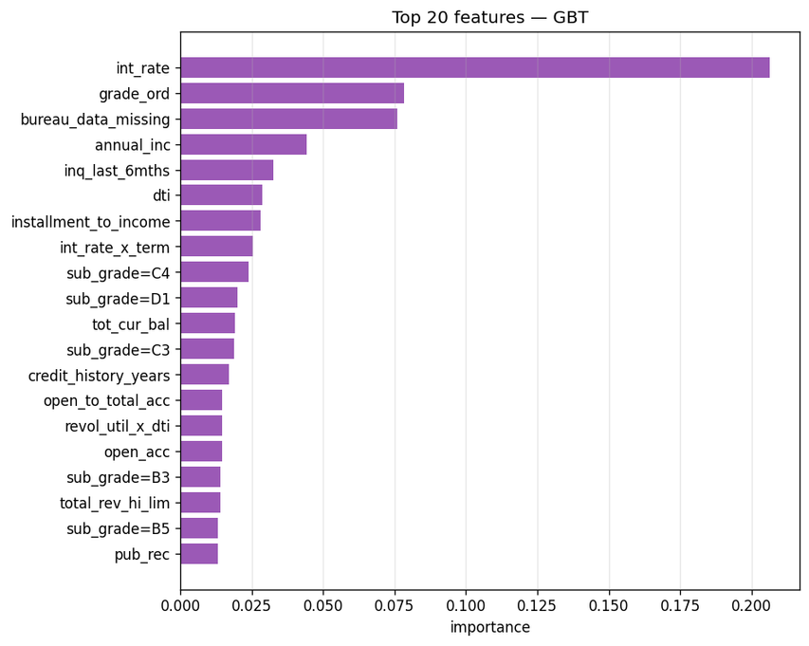
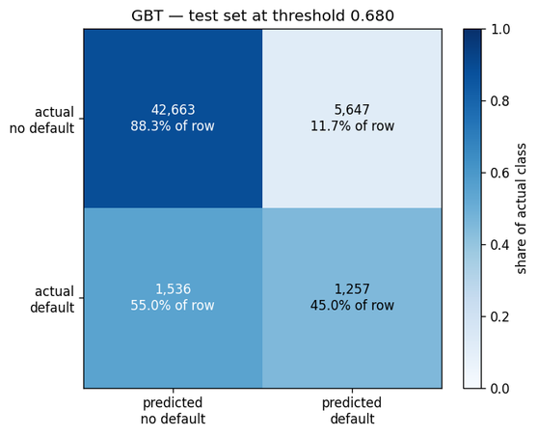
STAGE 2 · RESULTS
What Drives the Best Spark Model
int_rate, 20.7% One attribute carries a fifth of the total importance.
grade_ord, 7.8% The ordinal grade encoding earns its place.
bureau_data_missing, 7.6% The missingness flag is the third most important feature.
Then the ratios. annual_inc, inq_last_6mths, dti, installment_to_income and the int_rate × term interaction.
NEW INSIGHT
Whether a borrower has bureau data at all predicts default almost as strongly as their assigned grade. Missingness is not a nuisance to be imputed away — it is signal.
Gradient-Boosted Trees — top feature importances
GBT confusion matrix at threshold 0.680
CSCI316 Big Data Mining Techniques & Implementation · Autumn 2026
13

Slide 16
STAGE 2 · IMPLEMENTATION
Process Two — TensorFlow / Keras
LogisticNN
137 parameters
A single sigmoid unit — a neural re-implementation of logistic regression, included as the capacity floor.
MLP
10,881 parameters
Dense 64 → dropout 0.3 → dense 32 → dropout 0.2 → sigmoid. Two hidden layers, ReLU.
DeepMLP
28,673 parameters
128 → BN → 0.4 → 64 → BN → 0.3 → 32 → 0.2 → sigmoid. Batch normalisation keeps the deeper stack trainable.
stage2_tensorflow.py — DeepMLP
def build_deep_mlp(n_features, bias):
return keras.Sequential([
layers.Input(shape=(n_features,)),
layers.Dense(128, activation='relu'),
layers.BatchNormalization(),
layers.Dropout(0.4),
layers.Dense(64, activation='relu'),
layers.BatchNormalization(),
layers.Dropout(0.3),
layers.Dense(32, activation='relu'),
layers.Dropout(0.2),
# start at the true base rate
layers.Dense(1, activation='sigmoid',
bias_initializer=Constant(bias)),
])
Same contract as Process One. The same clean file, the same 64 / 16 / 20 stratified fractions and the same threshold routine — 136 design-matrix columns after encoding.
Imbalance handled twice over. Class weight 17.31 on defaults, and the output bias initialised to −2.8515 = log(p/(1−p)) so the network starts at the true base rate instead of spending its first epochs discovering that defaults are rare.
Early stopping on validation PR-AUC. Patience 8, best weights restored — not on loss, and not on accuracy.
Three capacities on identical inputs isolate one question: how much non-linear signal is actually in these features?
CSCI316 Big Data Mining Techniques & Implementation · Autumn 2026
14

Slide 17
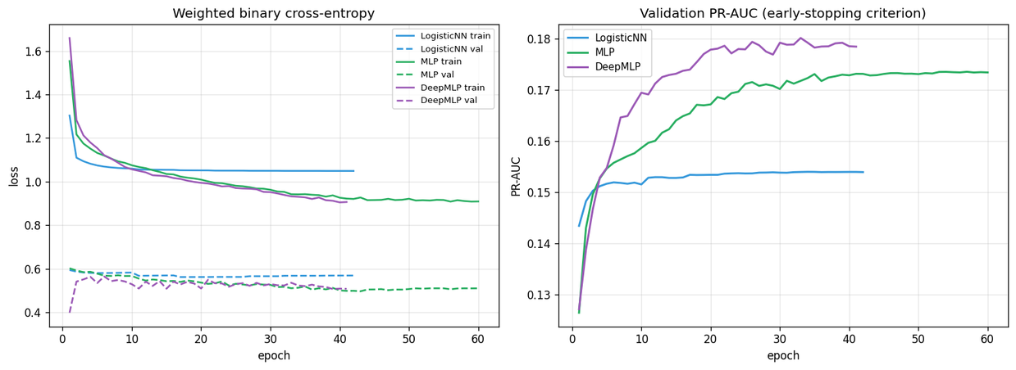
STAGE 2 · RESULTS
Process Two — Results on the Held-Out Test Set
Model | Params | Epochs | ROC-AUC | PR-AUC | Threshold | Recall (default) | Precision | F1 (default)
LogisticNN | 137 | 42 | 0.7881 | 0.1618 | 0.620 | 55.0% | 16.2% | 0.2502
MLP (64/32) | 10,881 | 60 | 0.8025 | 0.1775 | 0.710 | 46.6% | 17.8% | 0.2579
DeepMLP (128/64/32) | 28,673 | 41 | 0.8021 | 0.1830 | 0.750 | 43.6% | 19.0% | 0.2649
Depth is worth +0.0212 PR-AUC. DeepMLP 0.1830 against LogisticNN 0.1618 — that gap is a direct measurement of the non-linear signal in the features.
But it is not free. DeepMLP buys precision with recall: 19.0% precision at 43.6% recall, where the single-unit LogisticNN reaches 55.0% recall at 16.2% precision.
Early stopping did its job. Best epochs 34, 57 and 33 out of a 60-epoch budget; the deeper models start over-fitting well before the cap.
Training history — loss and validation PR-AUC, early stopping on PR-AUC
CSCI316 Big Data Mining Techniques & Implementation · Autumn 2026
15

Slide 18
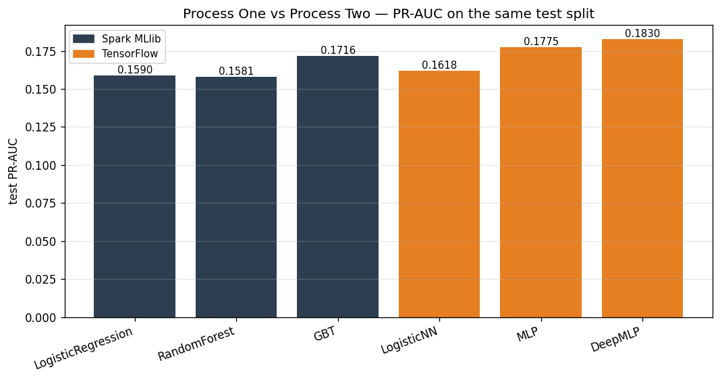
STAGE 2 · COMPARISON
Head to Head — Spark MLlib vs TensorFlow
Rank | Model | Process | PR-AUC
1 | DeepMLP | TensorFlow | 0.1830
2 | MLP | TensorFlow | 0.1775
3 | GBT | Spark MLlib | 0.1716
4 | LogisticNN | TensorFlow | 0.1618
5 | LogisticRegression | Spark MLlib | 0.1590
6 | RandomForest | Spark MLlib | 0.1581
WHAT THIS REALLY TELLS US
The honest conclusion is not “neural networks win”. Every model lands in the same narrow band, so the choice should be made on operational cost, interpretability and calibration — not on 0.01 of PR-AUC. DeepMLP does beat the best Spark model by +0.0113 PR-AUC, a real but modest 6.6% relative gain.
PR-AUC of all six models on the same test split — random baseline 0.0546
THE SPREAD IS NARROW
All six models sit between 0.158 and 0.183. The signal ceiling comes from the features, not from the library — and both stacks agree on what matters: int_rate, grade and the missingness flag.
CSCI316 Big Data Mining Techniques & Implementation · Autumn 2026
16

Slide 19
03
Critical Analysis
Strengths, weaknesses and what we would do differently

Slide 20
CRITICAL ANALYSIS
Strengths and Weaknesses of Our Approach
STRENGTHS
Leakage is controlled explicitly
13 post-funding columns are named and excluded, not merely overlooked.
One feature contract, two stacks
Both processes read the same clean file and the same split, so the comparison measures models, not preprocessing.
Imbalance handled end to end
Class weights, PR-AUC selection, a tuned threshold and an initialised output bias — four consistent decisions.
Test set touched once
Everything is chosen on validation; the reported numbers are not the best of many test peeks.
Reproducible
Fixed seeds, timestamped runs, runs.log and a pinned final/ directory behind every figure here.
WEAKNESSES
PR-AUC ≈ 0.18 is low in absolute terms
Good for ranking and pricing, not for an automatic decline.
Random split, not temporal
Loans span vintages; a deployed model predicts forward in time.
Stage 2 ran on a 30% stratified sample
256,861 rows; the full-data run is still outstanding.
The threshold optimises F1, not money
F1 weights a missed default and a rejected good borrower equally.
Partly circular features
int_rate and grade are Lending Club's own risk assessment.
Probabilities are uncalibrated
Tuned thresholds land at 0.62–0.75: the scores rank well but are not probabilities.
Lessons learned — choose the metric before the model, treat missingness as a feature, and fix split, weighting and threshold up front.
CSCI316 Big Data Mining Techniques & Implementation · Autumn 2026
17

Slide 21
DISCUSSION · NEW INSIGHTS
What We Learned
Missingness is a feature
bureau_data_missing is the 3rd most important input to the best Spark model, at 7.6%. A thin or absent credit file predicts default almost as strongly as the assigned grade does.
Accuracy is actively misleading
Random Forest posts the highest accuracy (89.6%) and the worst recall (27.5%). A constant “no default” rule beats every model on accuracy at 94.53%.
Ratios beat raw magnitudes
annual_inc alone reaches r = −0.037; installment_to_income reaches +0.062. Engineering the affordability ratio extracted signal no new data could.
Capacity buys little here
137 parameters → 28,673 parameters gains +0.021 PR-AUC. The features, not the architecture, are the binding constraint.
The two stacks converge
Six models across two independent libraries land within 0.025 PR-AUC of each other — strong evidence we are near the ceiling of this feature set.
Risk is priced, then mispriced
Grade separates 1.83% from 16.70% default, so the lender's own model is informative — but it still leaves 45% of defaults recoverable by a better one.
Bottom line — on origination-only information the best model recovers roughly 45% of defaults at a 3.35× lift over chance. That is a genuinely useful risk-ranking tool and a genuinely unusable automatic underwriter, and the difference between those two claims is the whole project.
CSCI316 Big Data Mining Techniques & Implementation · Autumn 2026
18

Slide 22
DISCUSSION
Conclusions and Future Work
We delivered a complete, leakage-free workflow: Spark exploration over all 855,969 loans, six models across two independent stacks, and a single evaluation protocol shared by both. The best model, a DeepMLP, reaches PR-AUC 0.183 — 3.35× the random baseline — and recovers 43.6% of defaults at its tuned threshold.
WHAT WE WOULD DO NEXT
1
Temporal validation
Split by issue_d — train on earlier vintages, test on later ones. The realistic deployment test, and it will lower the numbers.
2
Cost-sensitive thresholds
Replace F1 with expected loss: loss-given-default against forgone interest. The threshold should come from money, not from a symmetric metric.
3
Probability calibration
Isotonic or Platt scaling so the scores can be read as default probabilities and fed into pricing.
4
Full-data Stage 2
Re-run both processes on all 855,969 rows to confirm the 30%-sample ranking holds.
5
Interpretability
SHAP values on the GBT to give per-application reason codes — a regulatory requirement for real credit decisions.
6
Ensembling and fairness
Blend the GBT and DeepMLP scores, and audit default rates by addr_state and emp_length for disparate impact.
CSCI316 Big Data Mining Techniques & Implementation · Autumn 2026
19

Slide 23
Thank you
REPRODUCE IT
python src/stage1_eda.py
python src/stage2_spark.py
python src/stage2_tensorflow.py
PySpark 4 · TensorFlow 2.19 · Python 3.12 · JDK 17
Questions?
Every figure and table in this deck is written out by src/stage1_eda.py, src/stage2_spark.py and src/stage2_tensorflow.py into results/*/final/ — the pinned runs behind these slides.

