Slide 1
[NBA Player clustering based on defensive metrics]
[4data]
Jack, Jake and Kevin

Slide 2
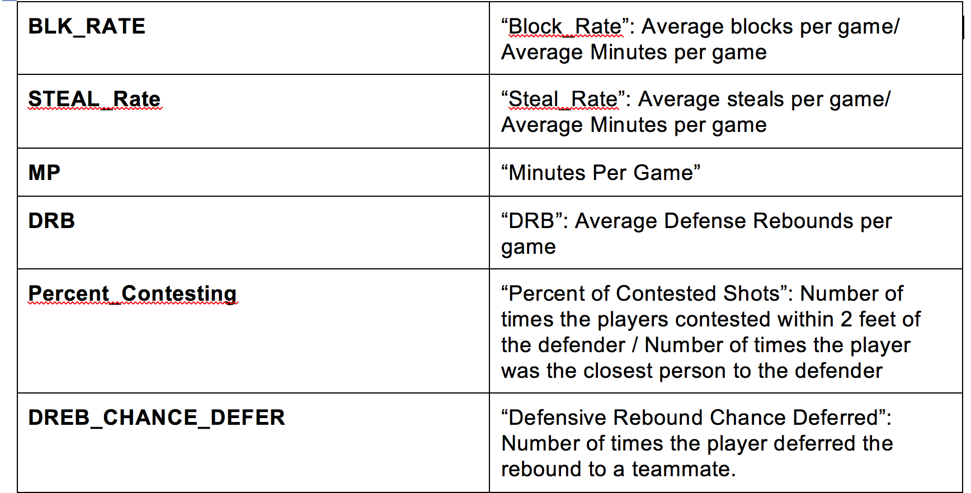
[Approach and variable selection]
Come up with defensive metrics
Cluster players based on these metrics
See if elite defending teams share the same building

Slide 3
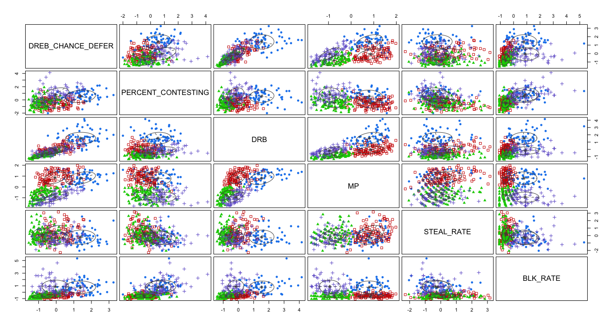
[Variable selection and graphs]
Variables:
Defensive rebound defer
Percent contesting
Defensive rebound
Minutes played
Steal rate
Block rate

Slide 4
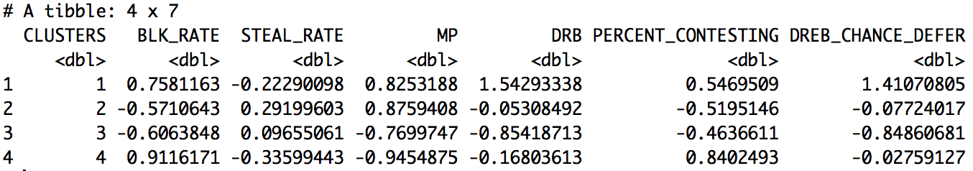
[Findings: Kings vs Spurs]
 | Cluster 1 | 2 | 3 | 4
Total # of players | 69 | 111 | 102 | 80
Avg % on winning teams | 26.3% | 25.8% | 33.1% | 14.8%
Top minute played players | category
Rajon Rondo | 2
DeMarcus Cousins | 1
Rudy Gay | 2
Darren Collison | 2
Omri Casspi | 1
Top minute played players | category
Kawhi Leonard | 1
LaMarcus Aldridge | 1
Tony Parker | 2
Danny Green | 1
Tim Duncan | 1

Slide 5
[Future improvements]
A total of 4 groups of defenders were identified.
Each group had its characteristics.
Winning team
Need to standardize metrics better.
Need to take offensive stats into consideration as well.
Use spatial data to try to re-create what exactly happened on court.
Need better team name dataset.

