Slide 1
Secure Data Hiding in Image Using Steganography
CAPSTONE PROJECT
Presented By: Tushar Singh Amreliya
Student Name : Tushar Singh Amreliya
College Name & Department : Lakshmi Narain College of Technology and Science, Computer Science and Engineering

Slide 2
OUTLINE
Problem Statement
Technology used
Wow factor
End users
Result
Conclusion
Git-hub Link
Future scope

Slide 3
Problem Statement
The rapid growth of digital communication has raised concerns about the security and privacy of sensitive information. Steganography, the practice of hiding secret data within innocuous-looking images, offers a promising solution. This project aims to implement steganography technique to hide secret data within images.

Slide 4
Technology used
For implementing steganography in images, we will use the following libraries and platforms:
Libraries:
OpenCV (Open Source Computer Vision Library): A popular computer vision library that provides image processing and manipulation functions.
Python Imaging Library (PIL): A Python library for image processing and manipulation.
Platforms:
Python: A popular programming language for image processing and steganography.
Pycharm: A web-based interactive environment for Python development.

Slide 5
Wow factors
As I reflect on my steganography project, I realize that there are several unique features that set it apart from other projects. Here are some of the key aspects that make my project stand out:
Firstly, my project utilizes a basic steganography technique to hide secret data within images. This provides a secure way to transmit sensitive information without arousing suspicion.
Another notable feature of my project is the image encryption and decryption functionality. Users can encrypt and decrypt images using a passcode, adding an extra layer of security to the hidden data.
I've also prioritized user experience by creating a simple and intuitive interface. This makes it easy for users to encrypt and decrypt images without requiring extensive technical knowledge.
Furthermore, my project is designed to be cross-platform compatible, allowing users to run it on multiple platforms, including Windows, macOS, and Linux.

Slide 6
End users
When it comes to the end-users of this steganography project, there are several groups that come to mind.
First off, security professionals are likely to be interested in this project. These individuals, including cybersecurity experts, digital forensics investigators, and encryption specialists, are constantly on the lookout for innovative ways to protect sensitive information.
Another key group of end-users are individuals who regularly handle sensitive information. This could include business owners with confidential data, journalists with sensitive sources, or whistleblowers with classified information. For these individuals, having a reliable method for hiding sensitive information within images could be a game-changer.
Researchers and academics in the fields of computer science, cryptography, and steganography are also likely to be interested in this project. Students, professors, and researchers may use this project as a tool for learning about steganography and cryptography, or as a starting point for their own research projects.
Government agencies, including law enforcement agencies, intelligence agencies, and military organizations, may also find this project useful for their own purposes.
Finally, general users who are concerned about online privacy and security may also be interested in this project. In today's digital age, it's more important than ever for individuals to take steps to protect their personal data. This project could provide a valuable tool for individuals looking to do just that.

Slide 7
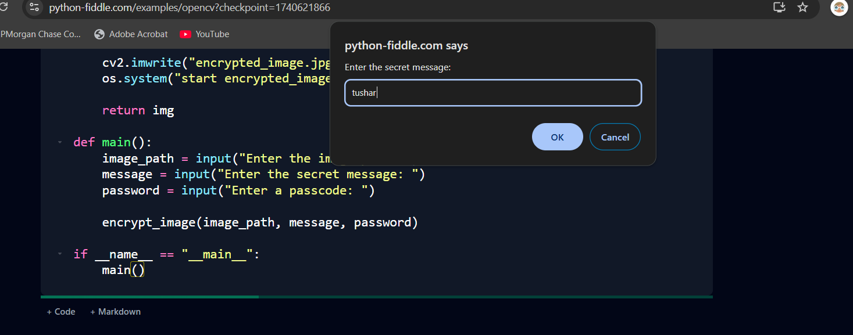
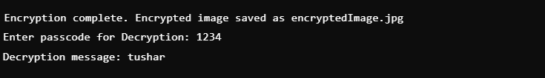
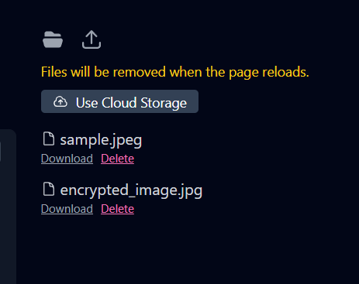
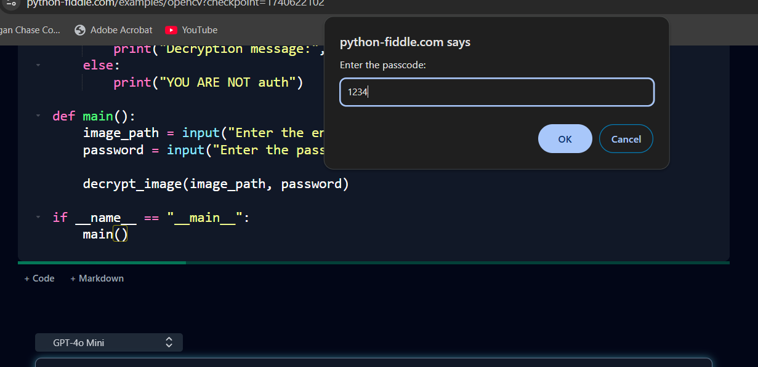
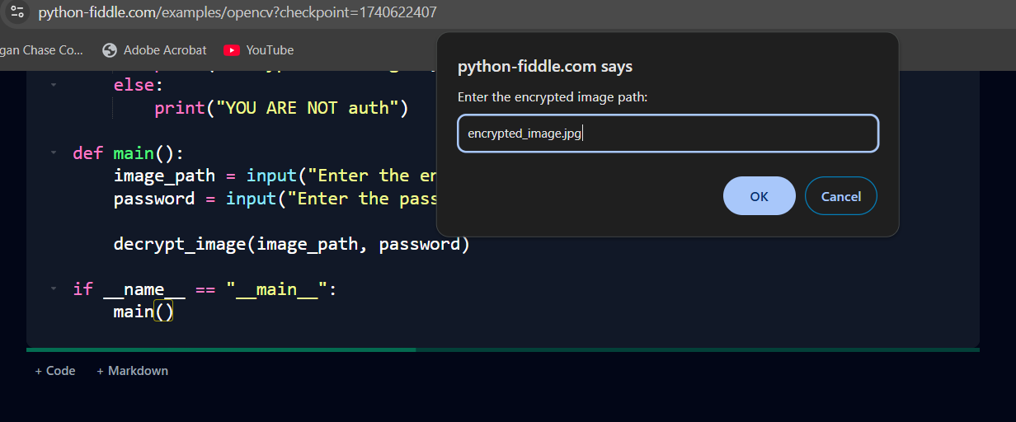
Results

Slide 8
Conclusion
The project aimed to develop a basic steganography technique to hide secret data within images. The goal was to create a secure and covert communication method that can protect sensitive information from unauthorized access.
Problem statement: The rapid growth of digital communication has raised concerns about the security and privacy of sensitive information. Existing steganography techniques are vulnerable to detection by sophisticated algorithms and malicious attackers.
Project Objectives:
1. Develop a basic steganography technique to hide secret data within images.
2. Create a secure and covert communication method to protect sensitive information.
3. Evaluate the effectiveness of the proposed steganography technique.
Methodology:
The project employed a basic steganography technique, where the secret data was hidden within the least significant bits (LSBs) of the image pixels. The project consisted of two main components: encryption and decryption.
Results and Conclusion: The project successfully implemented a basic steganography technique, hiding secret data within images. The proposed technique provided a secure and covert communication method, demonstrating its feasibility for secure data transmission.

Slide 9
GitHub Link
https://github.com/tsaamba/Stegnography

Slide 10
Future scope
To enhance the security and effectiveness of the proposed steganography technique, future work can focus on:
Developing more advanced steganography techniques, such as spread-spectrum steganography or transform-domain steganography.
Implementing encryption algorithms, such as AES or RSA, to protect the secret data.
Conducting thorough security analysis and testing to evaluate the robustness of the proposed technique.

Slide 11
THANK YOU

