Slide 1
Functional Programming in JS
Feb 2019
Make Digital Real | Execute Smart

Slide 2
Agenda
1
Functional Programming
2
Pure Functions
3
Side Effects
4
Global VS Local Scope
5
Composition
6
Immutability
7
Higher Order Functions
8
Closures and Currying

Slide 3
OOPS
FP
Programming Paradigm based on objects
Imperative in nature
Uses Classes
Inheritance for reusability
Data Mutation
Has side effects
Programming Paradigm based on functions
Declarative in nature
Uses pure Functions
Composition for Reusability
No Data mutation
No Side effects
Vs

Slide 4
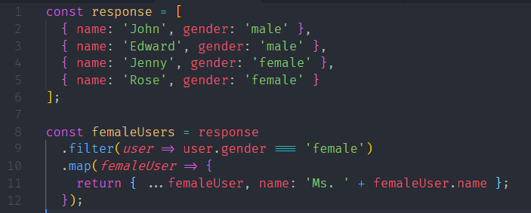
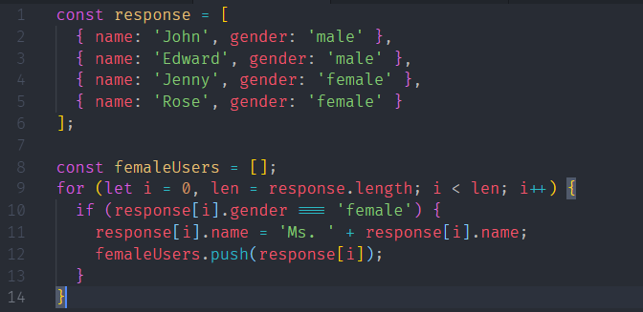
Declarative : Tell What to Do
Example : Tell function “prefix all female users with Ms”
Imperative : Tell What & how to do
Example : Tell function to loop through the collection, separate female users and then prefix Ms”

Slide 5
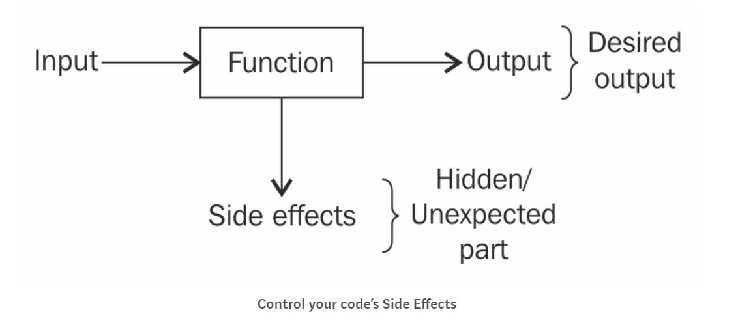
Pure Functions

Slide 6
Side Effects
Global Variable
Function doSomework()
Function doSomemorework()
Changing a global variable/property/data structure
Changing the original value of function’s argument
Throwing exception that is not caught in same function
Printing to the screen or logging

Slide 7
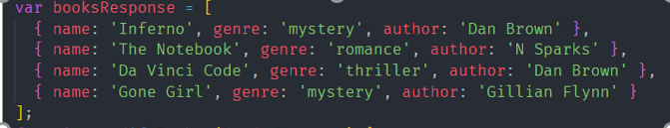


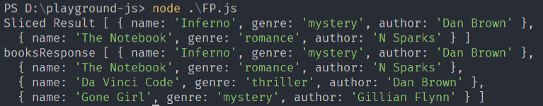
Pure Functions Vs Impure Functions

Slide 8
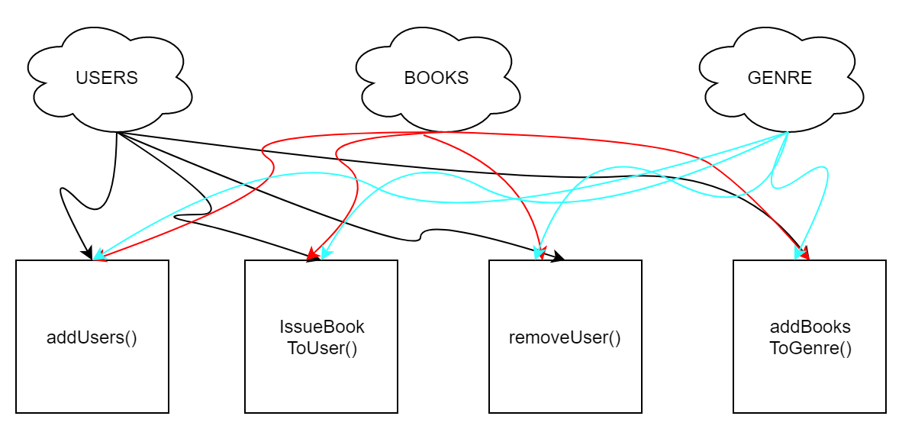
Scoping of Variables

Slide 9
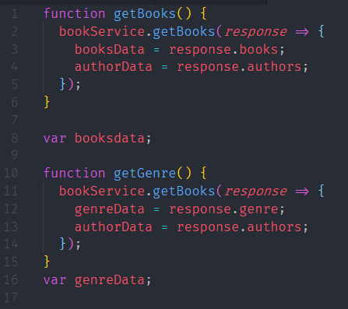
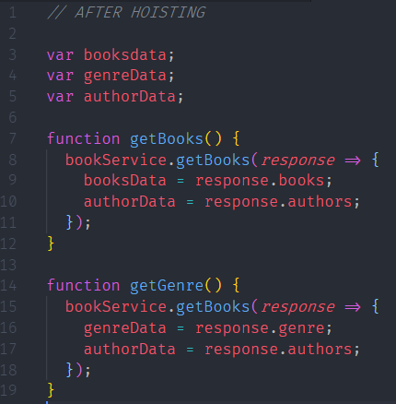
Scoping Variables
JavaScript
Hoisting

Slide 10
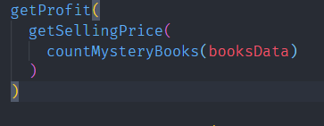
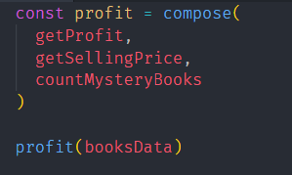
Functional Composition
Combining multiple functions together in order to create more simple logical flows for complex problem.
Better Readability and Reusability
Making our code reusable should always be one of our goals.
Nesting Functions
Composing Functions

Slide 11
Higher Order Functions
A function that takes another function as argument or returns a function.
Benefits
Increases Code Reusability.
Ex: Sorting of Numbers, Strings, in either Ascending or descending.
Famous Examples, Map, Reduce, Filter.

Slide 12
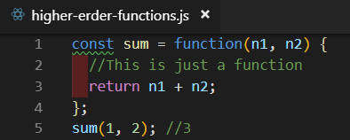
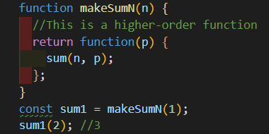
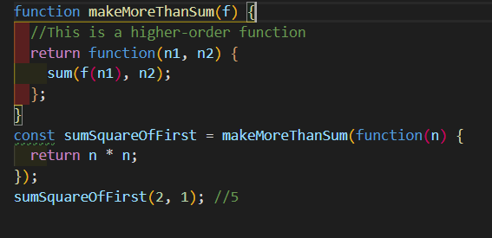
Code Samples

Slide 13
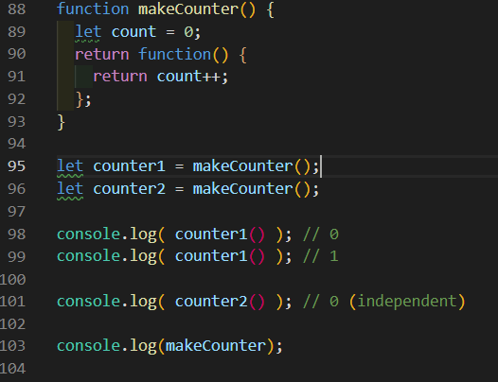
Closures:
Data Encapsulation with Functional Scoping.
Create Independence between various invocations.

Slide 14
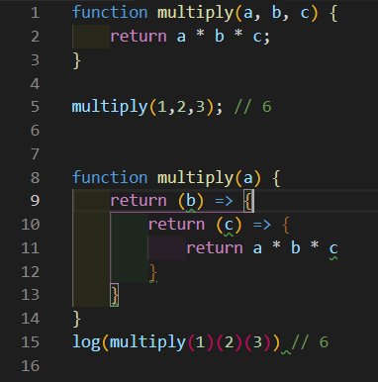
Currying:
Provides a form of dependency Injection.
Multiple Configurations Possible.
Configure Once, Run Multiple times.
Avoid frequently calling a function with the same argument

Slide 15
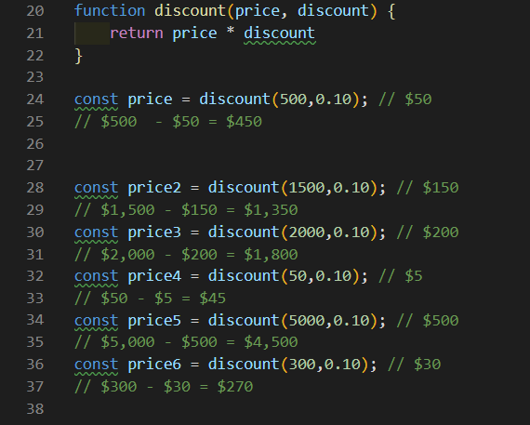
Code Without Currying:

Slide 16
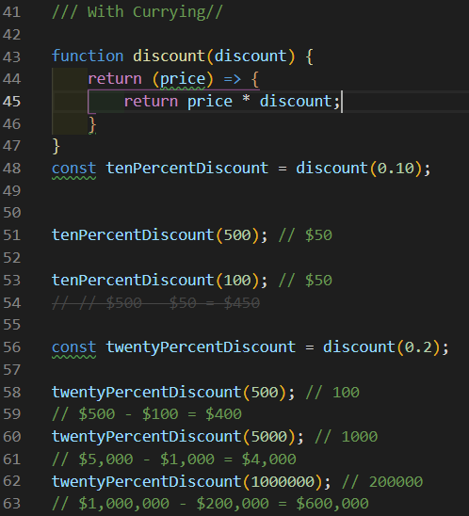
Code With Currying:

Slide 17
Quick recap:
Functional Programming Helps with
1. Predictability
2. Accessibility
3. Modularity
4. Maintainability
5. Performance
To Achieve all that
1. Use Pure Functions
2. Use Declarative Programming
3. Be cautious of variable scopes
4. Avoid mutating data
5. Use HOF
6. Use Currying/Composition often

Slide 18
Thank You

