Slide 1
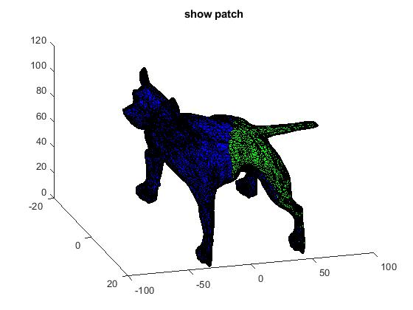
Implementation for “Correspondence-Free Region Localization for Partial Shape Similarity via Hamiltonian Spectrum Alignment”
By Tsachi Blau

Slide 2
Goal
We are given a full shape and a partial shape
Find the corresponding vertices of the partial shape on the full shape

Slide 3
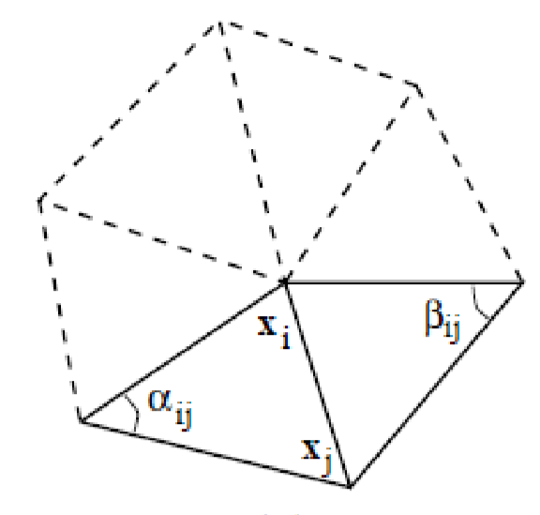
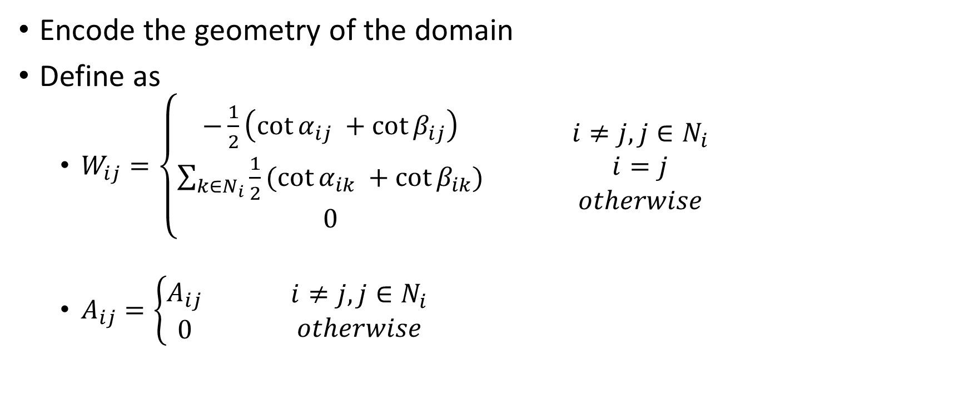
Background-Laplace Beltrami
Encode the geometry of the domain
Define as
$W_{ij}=\left\{\begin{aligned}−\frac{1}{2}\left(\cot{α_{ij} }+\cot{β_{ij}}\right) \\ \sum_{k∈N_{i}}{\frac{1}{2}(\cot{α_{ik} }+\cot{β_{ik}})} \\ 0\end{aligned}\right.$ $\begin{matrix}i≠j, j∈N_{i} \\ \begin{aligned}i=j \\ otherwise\end{aligned}\end{matrix}$
$A_{ij}=\left\{\begin{aligned}A_{ij} \\ 0\end{aligned}\right.$ $\begin{matrix}i≠j, j∈N_{i} \\ otherwise\end{matrix}$

Slide 4

Background-Laplace Beltrami properties
$Δ_{x}φ_{i}=λ_{i}φ_{i}$
Eigenvalues of the Laplacian corresponding to the frequencies
The eigenfunctions are orthogonal to each other
The Laplacian Beltrami is isometry invariant

Slide 5
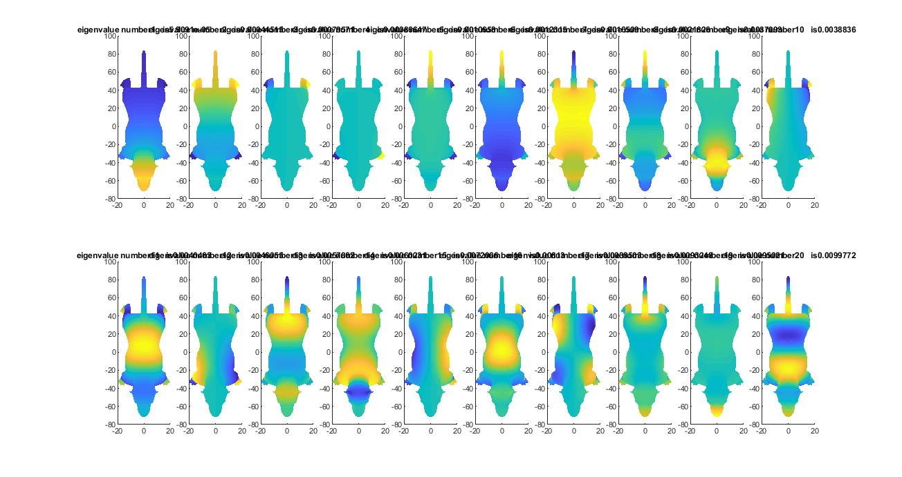
Background-Laplacian Beltrami
Every eigenfunctions corresponding to some frequency
Sorted in ascending order

Slide 6
Background-Laplace Beltrami-with Dirichlet boundary condition
We will use the Dirichlet boundary condition
It will keep correct eigenfunctions and eigenvalues

Slide 7

Background-Laplacian Beltrami-with Dirichlet boundary condition
Define as
$W_{ij}=\left\{\begin{aligned}−\frac{1}{2}\left(\cot{α_{ij} }+\cot{β_{ij}}\right) \\ 0 \\ \sum_{k∈N_{i}}{\frac{1}{2}(\cot{α_{ik} }+\cot{β_{ik}})} \\ 1\end{aligned}\right.$ $\begin{matrix}e_{ij}∈E_{int} \\ \begin{aligned}i≠j and (i∈V_{bdr} or v_{j}∈V_{bdr}) \\ i=j and v_{i}∈V_{int} \\ i=j and v_{i}∈V_{brd}\end{aligned}\end{matrix}$
$A_{ij}=\left\{\begin{aligned}A_{ij} \\ 0\end{aligned}\right.$ $\begin{matrix}v_{i}∈V_{int} \\ v_{i}∈V_{bdr}\end{matrix}$

Slide 8
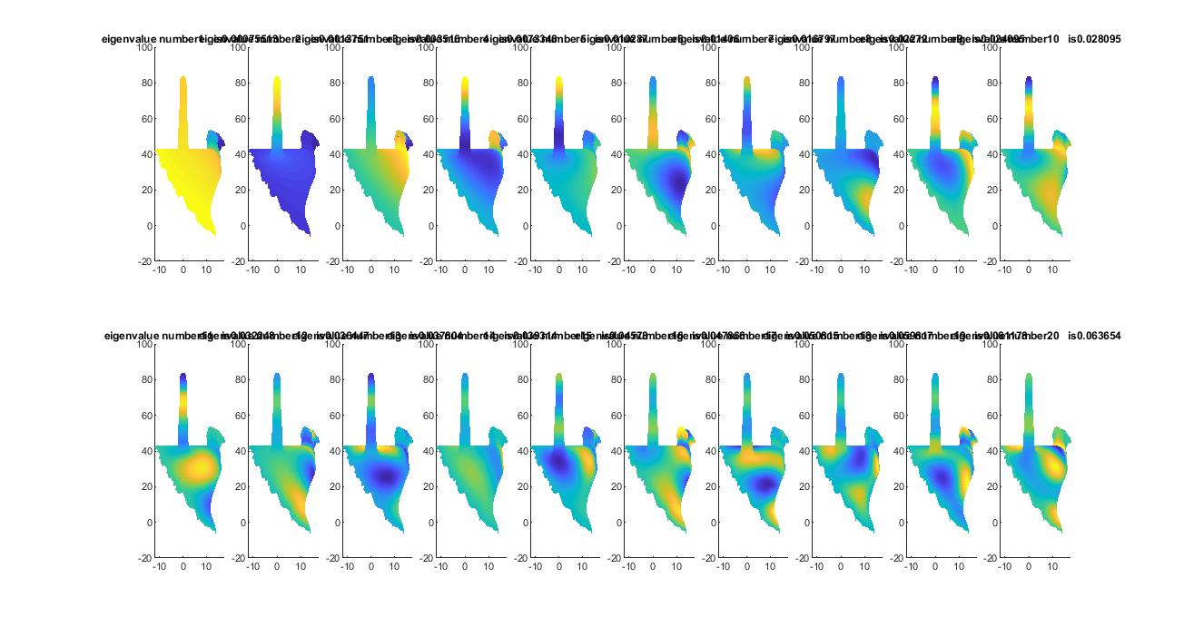
Background-Laplacian Beltrami-with Dirichlet boundary condition

Slide 9

Background-Hemiltonian
Potential function
$v_{τ}=\left\{\begin{aligned}0 \\ τ\end{aligned}\right.$ $\begin{matrix}x∈R \\ else\end{matrix}$
$H_{x}= ∆_{x}+v_{τ}$

Slide 10
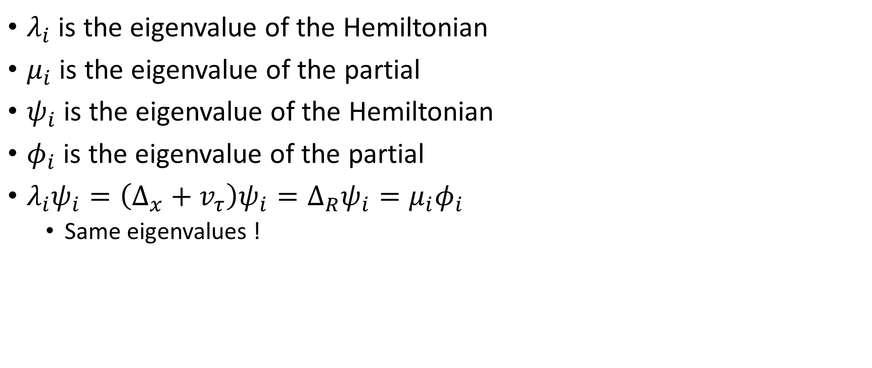
Background-Hemiltonian
$λ_{i}$ is the eigenvalue of the Hemiltonian
$μ_{i}$ is the eigenvalue of the partial
$ψ_{i}$ is the eigenvalue of the Hemiltonian
$φ_{i}$ is the eigenvalue of the partial
$λ_{i}ψ_{i}=\left(∆_{x}+v_{τ}\right)ψ_{i}=∆_{R}ψ_{i}=μ_{i}φ_{i}$
Same eigenvalues !

Slide 11
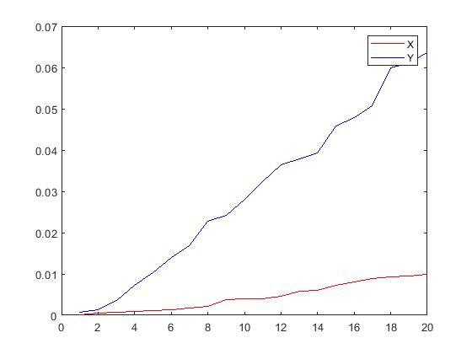
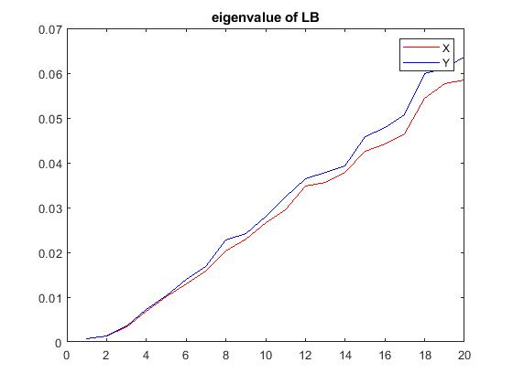
Experiment – Sanity check
The eigenvalues are not equal

Slide 12
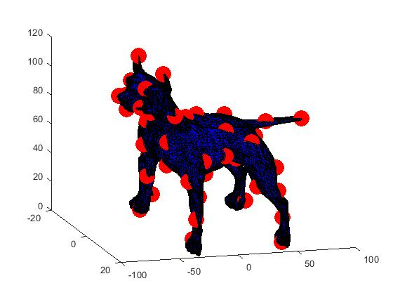
Initilization

Slide 13

Future work
Add another constraint on V
$\min_{v≥0}⁡\left({\left\|λ\left(Δ_{x}+diag\left(v\right)\right)−μ\right\|}_{w}^{2}+ {\left\|v\right\|}_{2}^{2}\right)$
Add scale invariant Laplacian

Slide 14
Questions

