Slide 1
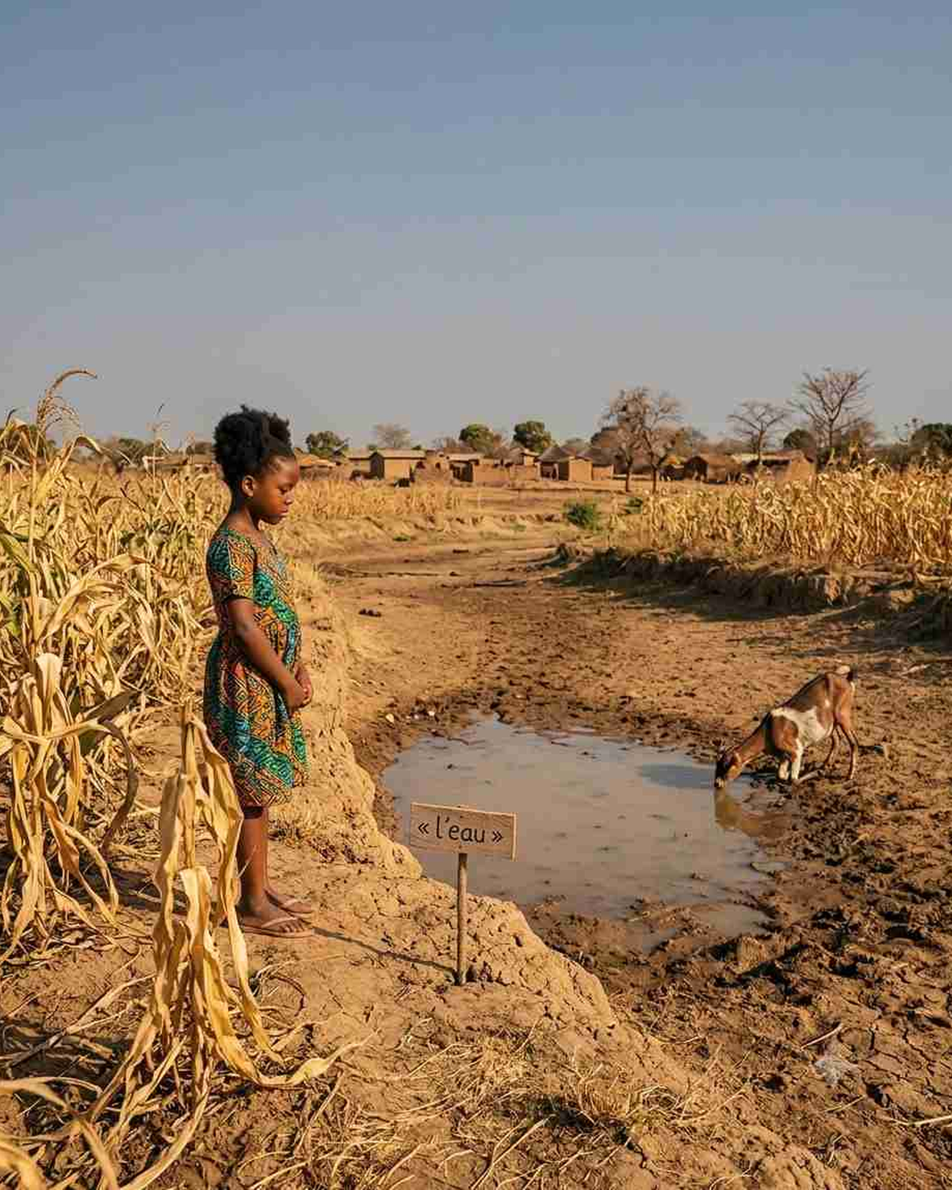
EC
EduCam
by Mansa Musa Academy
A child never chooses where they’re born — but today, where they’re born decides the education they get.
EduCam — the daily operating system for the primary classroom.
Investor briefing · 2026

Slide 2
01 · THE PROBLEM
EC
The quality of a child’s education is a lottery — of where they’re born and which teacher they get.
1
Lessons aren’t standardized
Classroom variance
SUB-SAHARAN AFRICA
Every teacher builds from scratch. Quality swings class to class, and the best teachers cluster in cities — leaving rural classrooms behind.
89%
2
4 months of silent learning loss
No feedback loop
Between report cards, directors and parents operate blind. A child who slips in October goes unnoticed until grades fall in February.
Learning poverty
The gap isn’t school access — it’s the absence of standardized, verified learning, every day.
3
Existing edtech breaks here
Infrastructure gap
Power cuts and costly mobile data make pure-cloud, device-per-child software unusable in ordinary schools.
World Bank · UNESCO · UNICEF — State of Global Learning Poverty, 2022
WHO BEARS THE COST
Directors compete on results, fly blind
Teachers heavy prep, no data
Parents pay 500–700 CAD/yr, locked out
01

Slide 3
02 · SOLUTION
EC
One standard of teaching, in every classroom — and proof it’s working.
✓
The same strong lesson, everywhere
Standardized
THE PLATFORM
Every classroom gets a ready-made, visual lesson — quality no longer depends on teacher luck or geography.
The daily operating system for the primary classroom.
✓
Every day becomes visible
Real-time
Hardware battery projector + solar
A daily 5-minute check reveals who understood: directors see school-wide trends; parents get a message home the same evening.
Software teacher, director & parent apps
Content daily curriculum-aligned lessons
✓
Built to run anywhere
Offline-first
TURNKEY — WE EQUIP EVERY SCHOOL
Runs through blackouts with no internet — battery projector, solar power, and download-the-week sync.
For the school: Guarantee quality and win parents’ trust.
For the child: The same chance to learn — wherever they are.
02

Slide 4
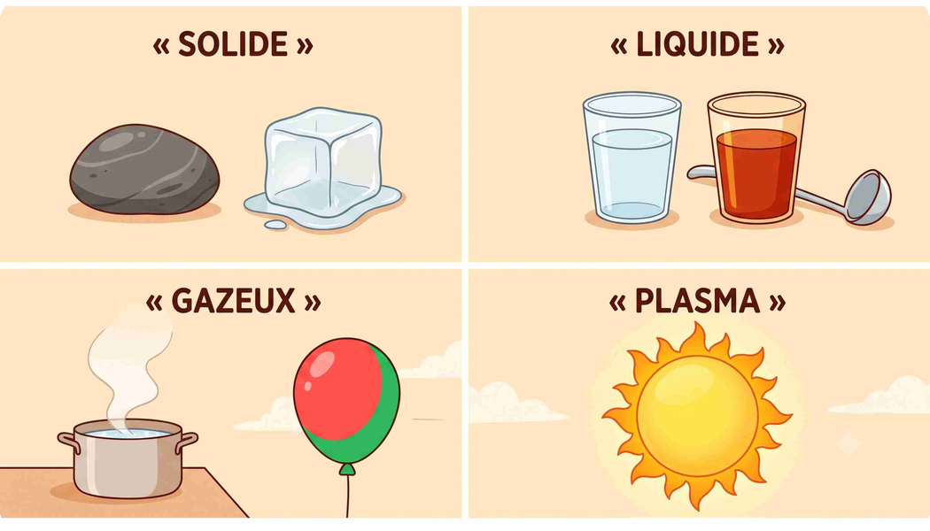
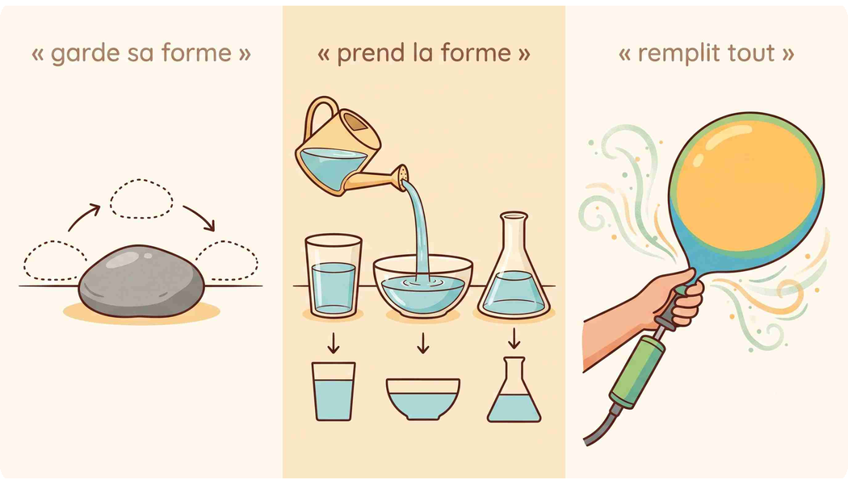
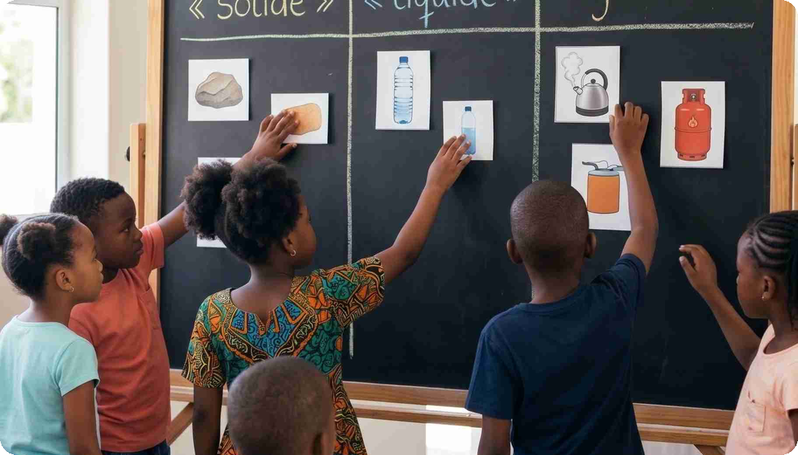
03 · THE LESSON
EC
We teach the way the brain remembers: by picturing it.
Most edtech digitizes the textbook. We turn each concept into a picture the child keeps — one real CM1 science lesson: the states of matter.
1
SEE IT
2
GRASP IT
3
PRACTISE IT
→
→
Each state shown as something real — a stone, water, steam, the sun.
Its behaviour made visible — keeps its shape, takes the shape, fills the space.
Then the class applies it — sorting real things into solid, liquid, gas.
Visual encoding
Made concrete
Active recall
Grounded in learning science — dual-coding theory & the multimedia principle.
The craft is the moat. In-house, curriculum-mapped lessons — illustrated and animated in our own style — are expensive to build, hard to copy, and why adoption sticks.
03

Slide 5
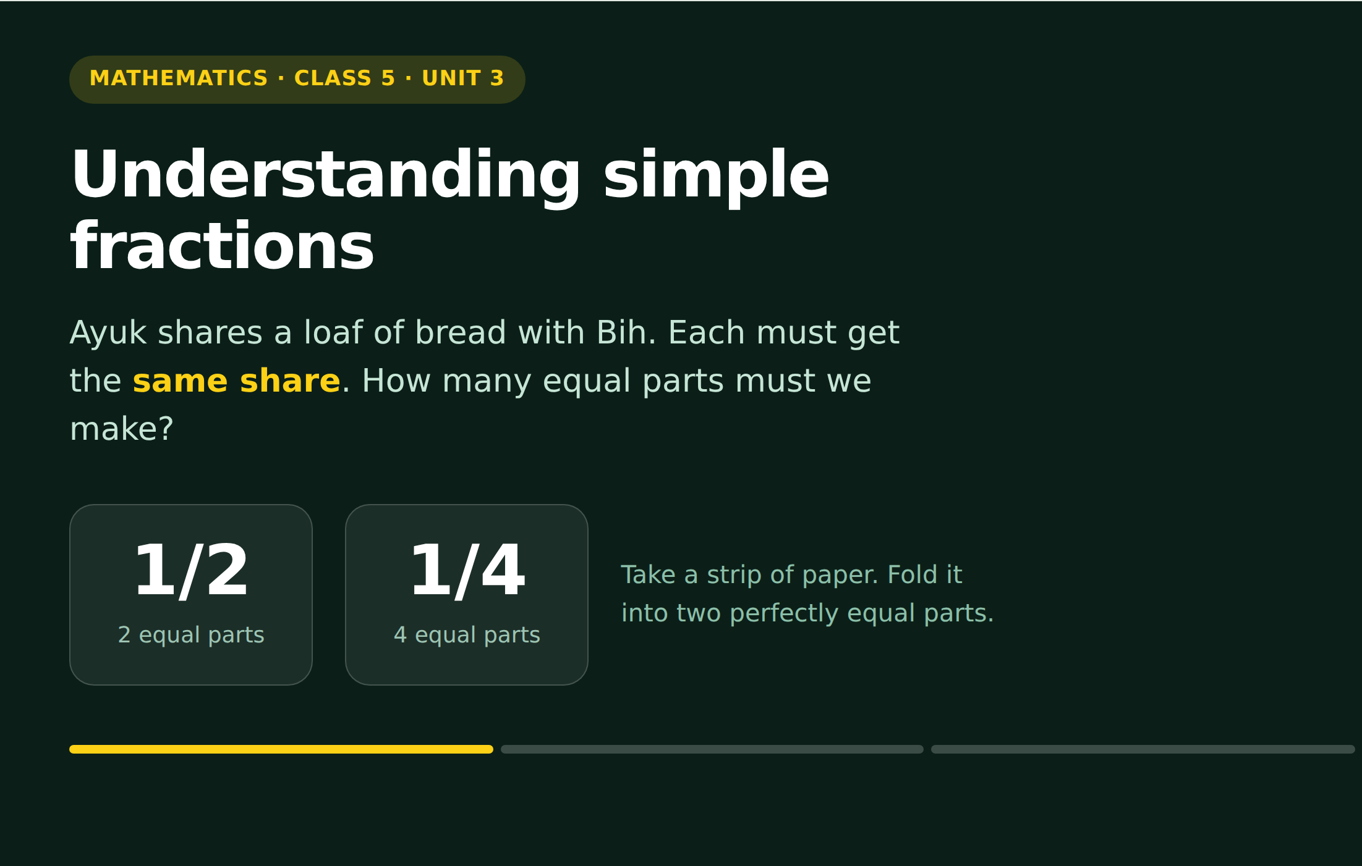
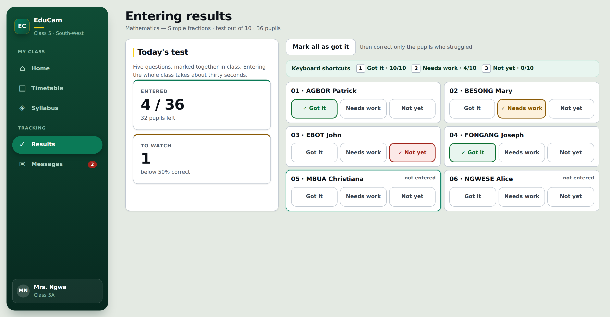
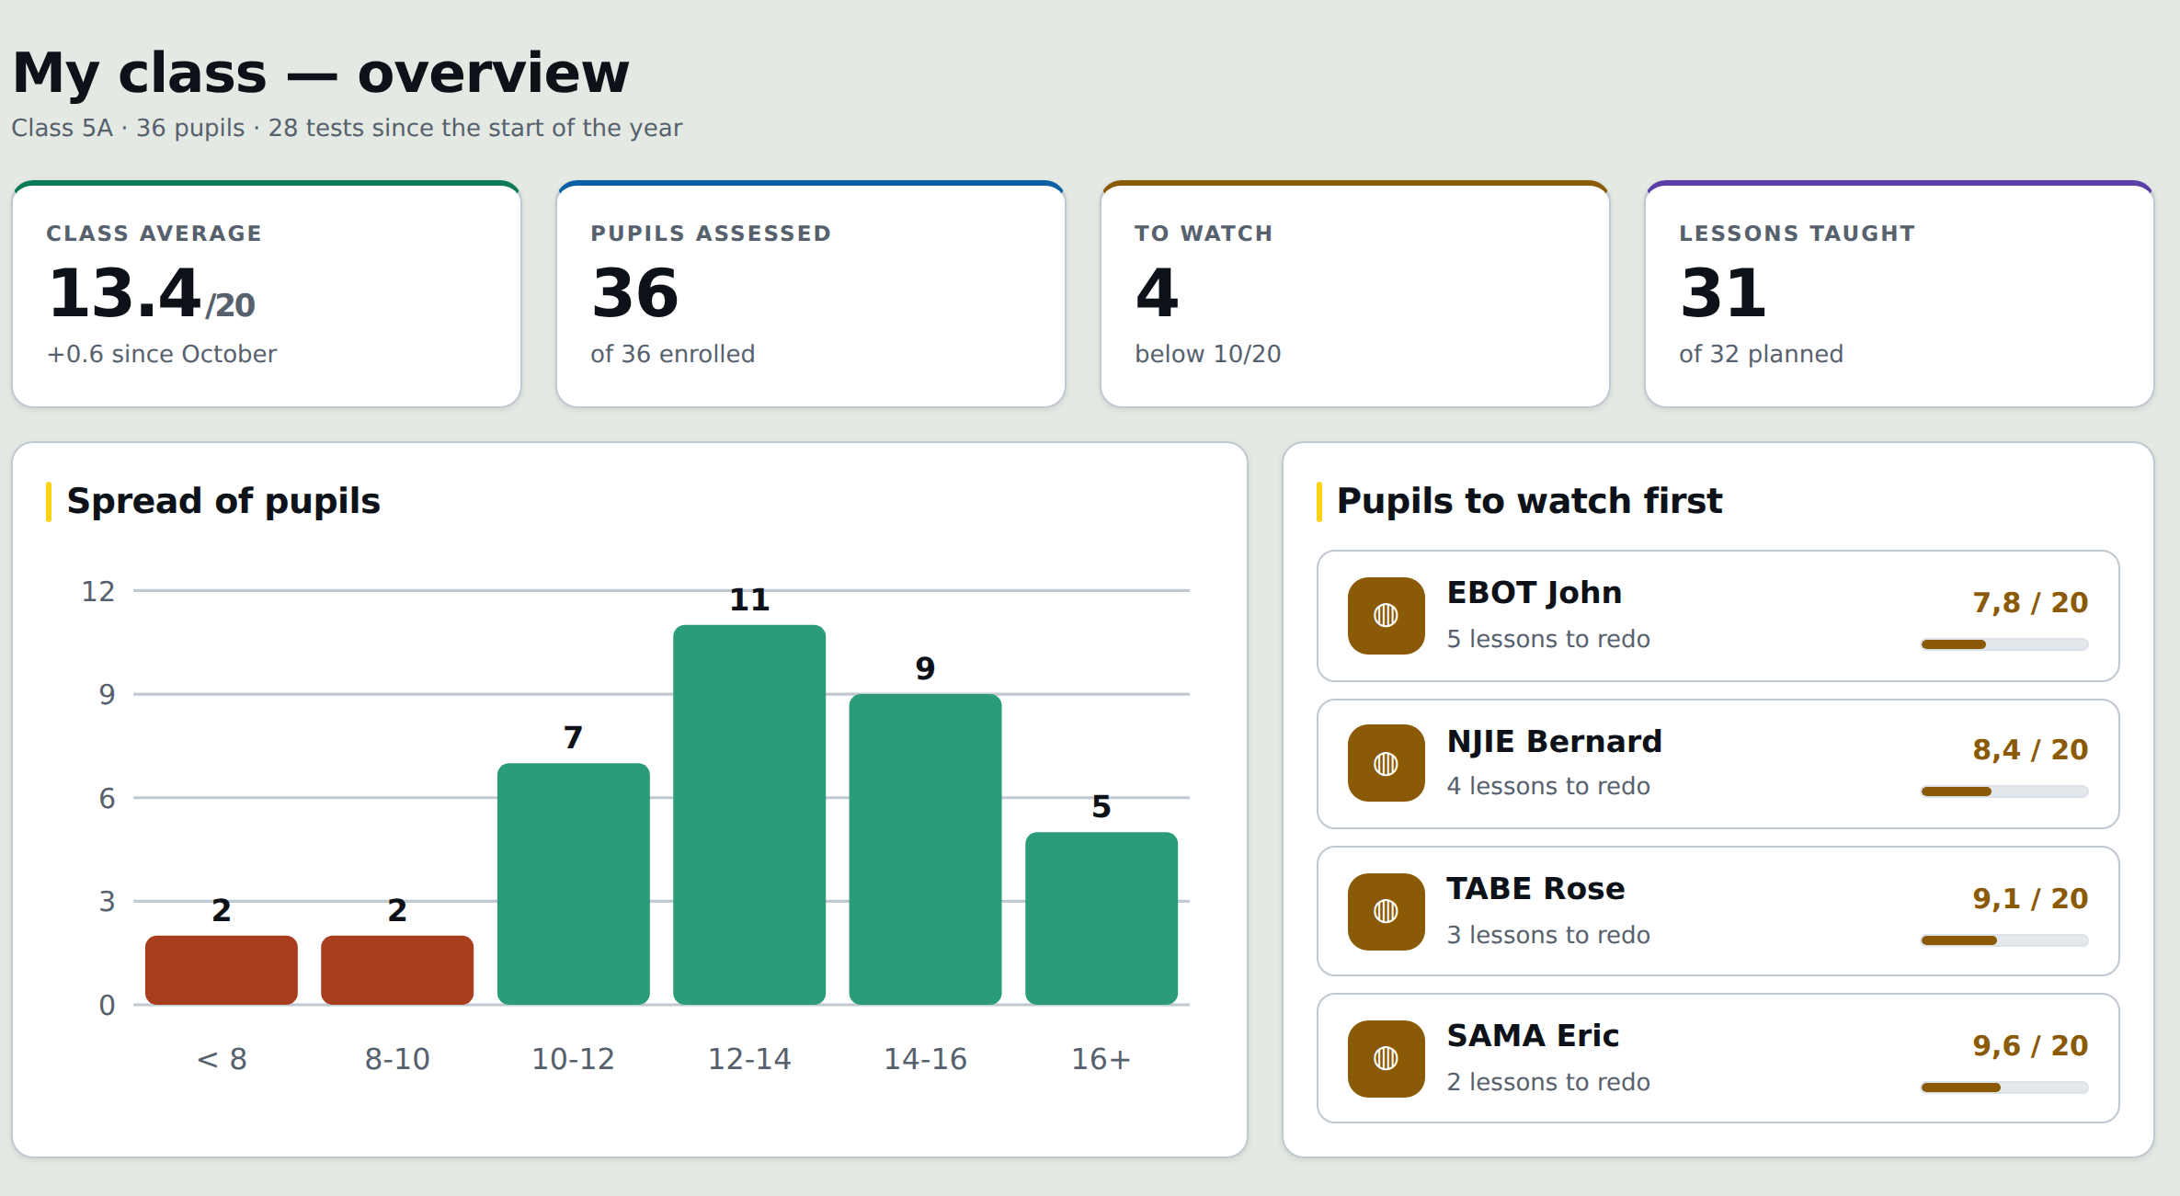
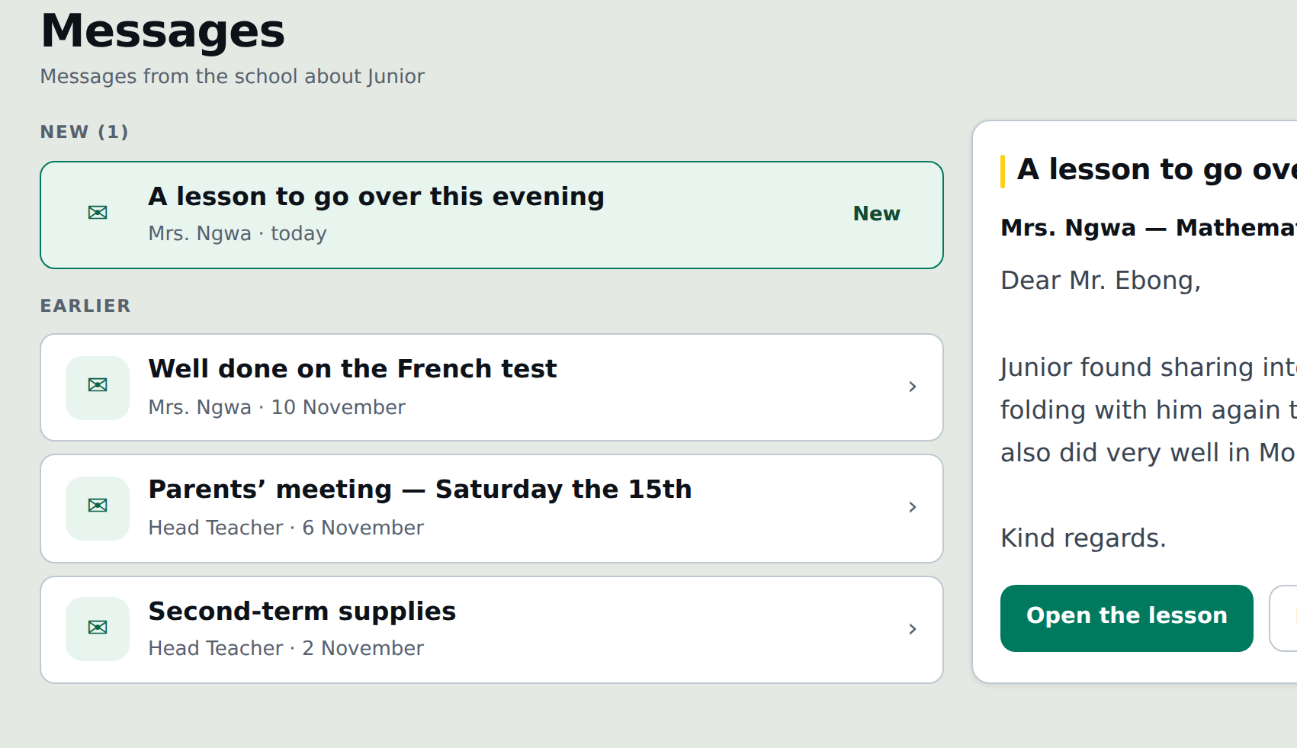

04 · HOW IT WORKS
EC
One daily loop turns each school day into learning — and data.
Fully offline, on real working software. The same four-step routine runs every school day — turning each day into data the school can act on.
1
TEACH
2
CAPTURE
Teacher
Teacher
The day’s visual lesson on the projector — a short paper check, corrected together in class.
~5 minutes: three taps per pupil — Got it · Needs work · Not yet. Strugglers flagged automatically.
3
SEE & ACT
4
INFORM
Director
Parent
Teacher and director see it live — who’s behind, and which class needs to catch up.
A message goes home the same evening — the exact lesson to review with the child.
↻ Repeats every school day · syncs automatically when a network is available
Fully offline-first
See it running · 2-min demo
04

Slide 6
05 · MARKET OPPORTUNITY
EC
Why now: a paying generation demanding quality, follow-up, and tech.
We size bottom-up from a real beachhead — not top-down from a continent. The demand is already here and paying.
FOUR DEMAND TAILWINDS
WILLINGNESS TO PAY IS ALREADY PROVEN
25%
2 incomes
of primary is private
time-poor families
100 CAD / student / year
a paying middle class — and the share is rising
both parents work — they pay the school to follow up
is just 15–20% of the 500–700 CAD parents already pay in fees.
Quality
96%
Funded by a small fee increase — zero new cost to the family.
the new battleground
mobile reach
schools must deliver it — and prove it — to keep parents
every family is reachable on a phone; internet at 42%
BOTTOM-UP SIZING · the expansion story, at 100 CAD / student / yr
SOM
→
SAM
→
TAM
20M CAD/yr
80M+ CAD/yr
1B+ CAD
≈ 200k pupils × 100 CAD
+ secondary higher ARPU · ~0 CAC
≈ 0.8M pupils × 100 CAD (+ secondary)
bilingual proven → new countries
the ceiling
Beachhead — Douala + Yaoundé, private primary CE1–CM2
Cameroon — private primary nationwide, then secondary
Private K–12 — francophone + anglophone Africa
Cohort LTV: enter a child at CE1 and keep them through secondary — up to ~11 school years per child, at near-zero repeat acquisition cost.
Sources: World Bank — private share of primary enrolment 25% (2024), 4.94M primary pupils (2022); DataReportal Digital 2026 — mobile 96%, internet 42%. Market figures are EduCam estimates at 100 CAD ARPU.
05

Slide 7
06 · BUSINESS & REVENUE MODEL
EC
The economics work from day one — with built-in operating leverage.
The school is the customer: 100 CAD / student / year, all-inclusive and annual recurring — funded by a small fee increase.
UNIT ECONOMICS — POSITIVE FROM DAY ONE
REVENUE ARCHITECTURE — CORE ENGINE + EXPANSION UPSIDE
Per school (CAD)
4 classes
8 classes
THE CORE ENGINE — 100% B2B, ANNUAL RECURRING
Today · proven
– Revenue
18,000
36,000
100 CAD / student / year
– Material
3,000
6,000
– Référent, internet, misc
7,000
7,000
All-inclusive — content, dashboards, parent app, equipment, on-site référent, connectivity.
Contribution
8,000 44%
23,000 64%
Zero school capex · annual contract lock-in · the whole business today.
EXPANSION UPSIDE · ROADMAP — future monetization unlocked by proprietary per-child data
+
Enrichment marketplace sell relevant courses to parents — matched to the child’s own results
to parent
✓ Positive from day 1
✓ Hardware payback < 1 yr
TWO LEVERS OF MARGIN EXPANSION
+
Follow-up classes revision via our teacher network for the families the data flags
to parent
School size 44% → 64% — more classes share the fixed per-school cost
Near-zero added CAC · direct to parent. Optionality on top of the core — not the day-one plan.
Référent clustering ~53% / 68%+ — one référent across 2–3 nearby schools
Services for adoption · software & content for leverage. Permanent on-site référents secure daily retention; reusable software and content drive long-term margin.
06

Slide 8
07 · GO-TO-MARKET & GROWTH
EC
Land a school with proof, expand with the cohort, and let results sell the next.
We sell to the director — differentiate on quality, give parents the follow-up they demand, at ~15–20% of fees and zero capex.
THE GO-TO-MARKET MOTION
ONE ENGINE, TWO TRACKS
1
Land a lighthouse school
CAC: high
TRACK 1 · THE ENGINE
Investor-funded · profitable
A free proof pilot in one class — the director sees quality, parent engagement, and results first-hand.
Win in the cities
Lighthouse pilot · free
▼
Profitable private schools in Douala + Yaoundé. This is what the raise funds — the commercial core that proves the model.
2
Expand with the cohort
CAC: near-zero
One class → every primary grade → secondary as the cohort ages up. The subscription grows at near-zero CAC.
Class → school → secondary
TRACK 2 · THE MISSION IT UNLOCKS
Ring-fenced funding
▼
Reach the underserved
3
Results sell the next
CAC: ~0
Happy parents and director networks win neighbouring schools — clustered so one référent serves 2–3 schools.
Proven results + brand bring EduCam to rural schools at reduced cost — funded by partnerships, foundations & grants, not investor capital.
Density-first · Douala + Yaoundé
↻ Acquisition cost falls at every stage — a proof-and-reference flywheel; lighthouse schools free, everyone after pays from proof.
The unlock is proof of concept — commercial investors fund the engine; impact funders back the mission.
07

Slide 9
08 · COMPETITIVE ADVANTAGE
EC
Today we’re alone. Tomorrow we’re hard to follow.
A blue field — but not an empty one. The status quo (chalkboards, répétiteurs) leaves parents blind; Western pure-cloud edtech breaks on the ground. No one has solved primary school here.
WHY WE’RE ALONE — THREE BARRIERS KEPT EVERYONE OUT
WHY WE’RE HARD TO FOLLOW — THE MOAT
→
Proprietary full stack
Power
The grid is unreliable
Battery projector + solar
✓
HERO MOAT
Localized curriculum, custom illustrations & animation, and an offline-first codebase — years of craft, built from scratch.
→
Turnkey zero-capex distribution
Internet
Data is patchy and costly.
Offline by design
✓
Structural moat
All-inclusive hardware + on-site support removes every adoption barrier — and locks schools into an annual ecosystem.
→
Accumulating learning data
Capex
Schools won’t spend up-front.
Free, full-service delivery
✓
Structural moat
Daily assessment data deepens personalization and builds student histories that are hard to copy.
Western pure-cloud edtech fails on all three — which is why it isn’t here.
Incumbents won’t come: hyper-local, offline, services-heavy, low-glamour — exactly what global players avoid.
The barriers that blocked everyone are exactly what we solved — and rebuilding the full stack, the delivery, and the data is the barrier for anyone who follows.
08

Slide 10
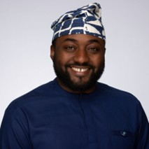


09 · TEAM
EC
One foot in North American tech, one in the Cameroonian classroom.
A lean team that has already shipped — with deep pedagogical roots on the ground where it matters.
M
J
C
Maxime TSAGUE
Jimmy Ryan
Chanceline Kenkeu
Founder & CEO
Co-founder · Technical
Head of Pedagogy
Full-time founder
Advisory · completing PhD
Key team member · local shareholder
Engineer + McGill MBA (Finance & Entrepreneurship). Leads platform build and business development.
Software engineer and PhD candidate. Guides architecture and production.
26+ years teaching. Owns lesson design and classroom rollout in Cameroon.
Québec, Canada · Build & Grow
Texas, USA · Architecture
Cameroon · Teach & On-the-ground
Already shipped: a working, offline platform with real content and a live demo. This round adds: (1) a proprietary content & animation lead — the moat; (2) local operations & référents.
Names and headshots are placeholders.
09

Slide 11
10 · THE ASK & ROADMAP
EC
This round deepens the moat and proves the market.
The ask: CAD 100K (illustrative — to confirm). Two priorities + runway; positive unit economics front-load the first cohort, not burn.
USE OF FUNDS · $20K + $60K + $20K = CAD 100K
PRIORITY 1 · THE MOAT
PRIORITY 2 · THE ENGINE
RUNWAY · 18–24 MONTHS
$20K · 20%
$60K · 60%
$20K · 20%
Own the content
Capture the market
Operations & buffer
A dedicated illustrator / animator / instructional designer building in-context images and animated videos in-house — proprietary, defensible IP.
Pilot + equipment kits + on-site référents + school recruitment across Douala + Yaoundé. Convert lighthouse schools to paying.
Operating runway and continuous product refinement through the pilot-to-paying transition.
→ A proprietary, contextualized lesson library.
→ ~15–20 paying schools · ≈ $400–600K ARR run-rate.
→ Real fundamentals for the next round.
ROADMAP
Late 2026
2027
2028
Then
Francophone lighthouse pilot
First paying cohort (DLA + Yde) · land-and-expand · English pilot
Scale the two cities · begin secondary
Foundation-funded rural track · new cities & countries
Let’s talk. info@academiemansamusa.com Building the daily operating system for the primary classroom.
10

Slide 12

THE VISION
Where you’re born should stop deciding what you learn.
We build a profitable engine in the cities — and use its proof to bring the same standard of learning to every child, wherever they’re born.
EC
EduCam by Mansa Musa Academy

