Slide 1
Classification and Prediction of road accidents in hilly area by using Neural Network and Genetic Algorithm
Submitted in the partial fulfillment for the award of the degree of
BACHELOR OF ENGINEERING
IN
COMPUTER SCIENCE ENGINEERING IN ARTIFICIAL INTELLIGENCE AND MACHINE LEARNING
Submitted by:
SAHIL THAKUR
19BCS6103
Under the Supervision of:
Ajay Pal Singh
Department of AIT-CSE
DISCOVER . LEARN . EMPOWER

Slide 2
Outline
Introduction to Project
Problem Formulation
Objectives of the work
Methodology used
Results and Outputs
Conclusion
Future Scope
References

Slide 3
Introduction to Project
Road accident prediction is one of the most important research area in traffic safety. The occurrence of road traffic accidents is mainly affected by geometric characteristics of road, traffic flow, characteristics of drivers and environment of road. Many studies have been conducted to predict accident frequencies and analyse the characteristics of traffic accidents, including studies on hazardous location/hot spot identification, accident injury-severities analysis, and accident duration analysis. Some studies focus on mechanism of accidents. Other factors include weather and light conditions of the road.

Slide 4
Problem Formulation
With the increasing number of vehicles, road safety is a matter of huge concern. Road accidents kill 1.2 million people every year. Road crashes cost $518 billion globally, costing individual countries from 1-2% of their economy. In 2017, there have been 2367 accidents with injuries reported in Hyderabad alone. Steps are being taken to combat this issue but they have been ineffective. Some studies focus on mechanism of accidents. Other factors include weather and light conditions of the road. So, ML powered web app which predicts accidents severity based on the these conditions is best solution for this problem. It is trained with accident records from the online dataset. More data means greater accuracy.

Slide 5
An ML powered web app which predicts accidents severity based on the current conditions. It is trained with accident records from the online dataset. More data means greater accuracy. I will even try to locate more precisely future accidents in order to provide faster care and precaution service. By using those properties, I train a combination of different machine learning algorithms using various ensemble methods that are not thoroughly explored in the current literature.

Slide 6
Objectives of the Work
The purpose of such a model is to be able to predict which conditions will be more prone to accidents, and therefore take preventive measures. We will even try to locate more precisely future accidents in order to provide faster care and precaution service. To provide a platform i.e. a web app for taking user input at a particular time and predict severity of an accident at a location beforehand and take precaution.

Slide 7
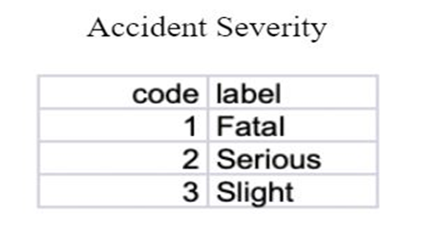
Methodology used
An ML powered web app which predicts accidents severity based on the current conditions. It is trained with 1.6 million accident records over 2005-2015. The dataset has 1.2 million records of which 80% is used to train the model and 20% to test it. I have chosen Random Forest for our Machine Learning model as it showed the highest accuracy of 86.86%. User data at a specific time will be used to predict the severity of a road accident at the given location. The severity metrics are 1= Fatal, 2= Serious, 3= Slight.

Slide 8
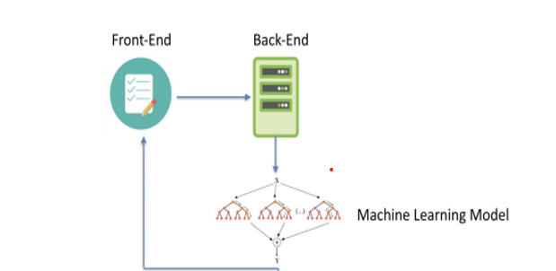

Slide 9
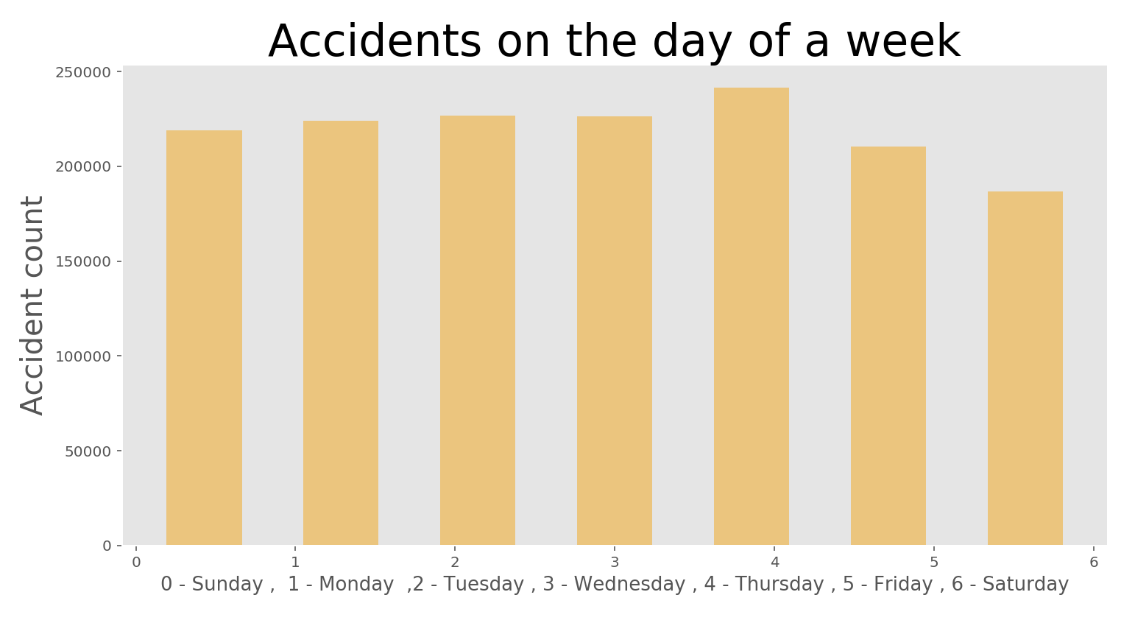
Results and Outputs

Slide 10
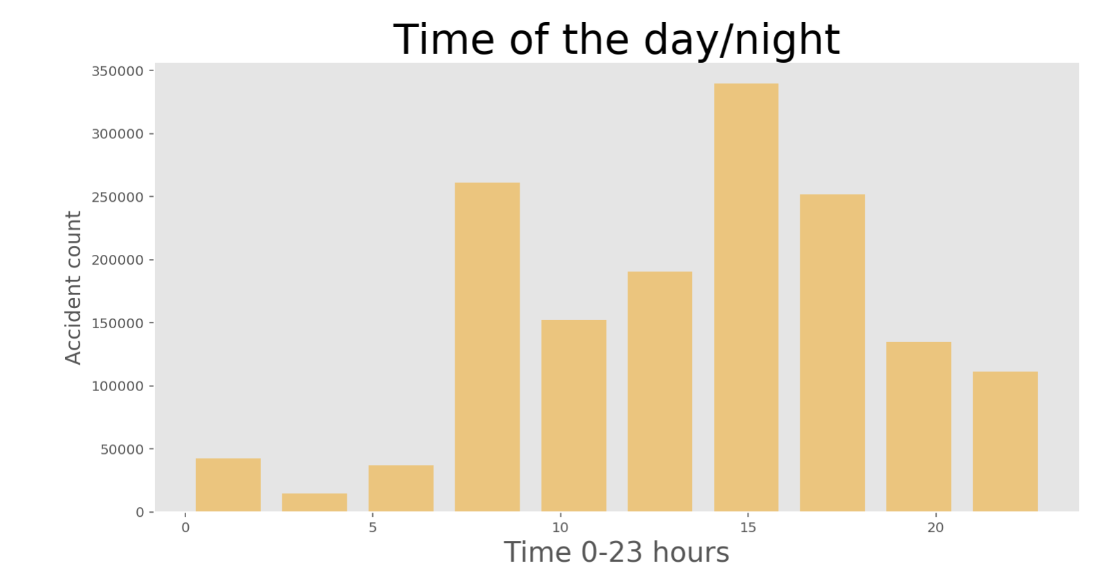

Slide 11
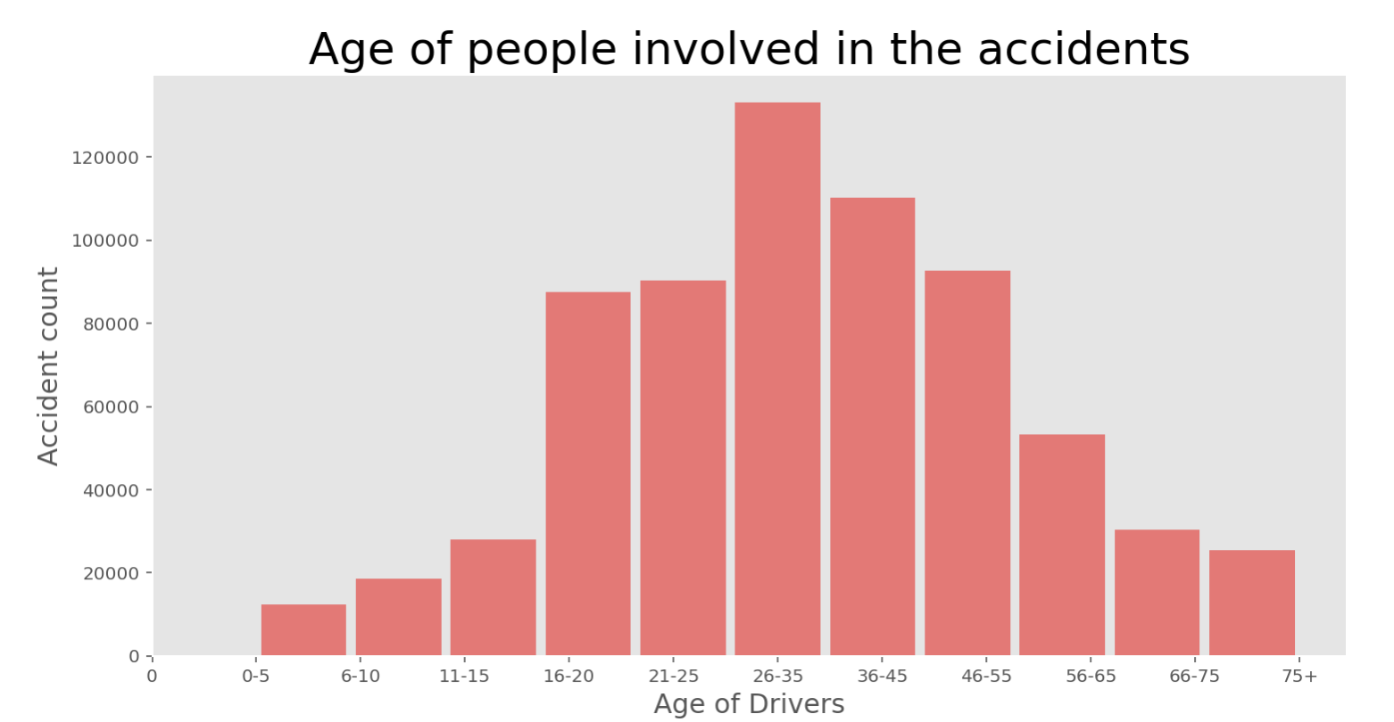

Slide 12
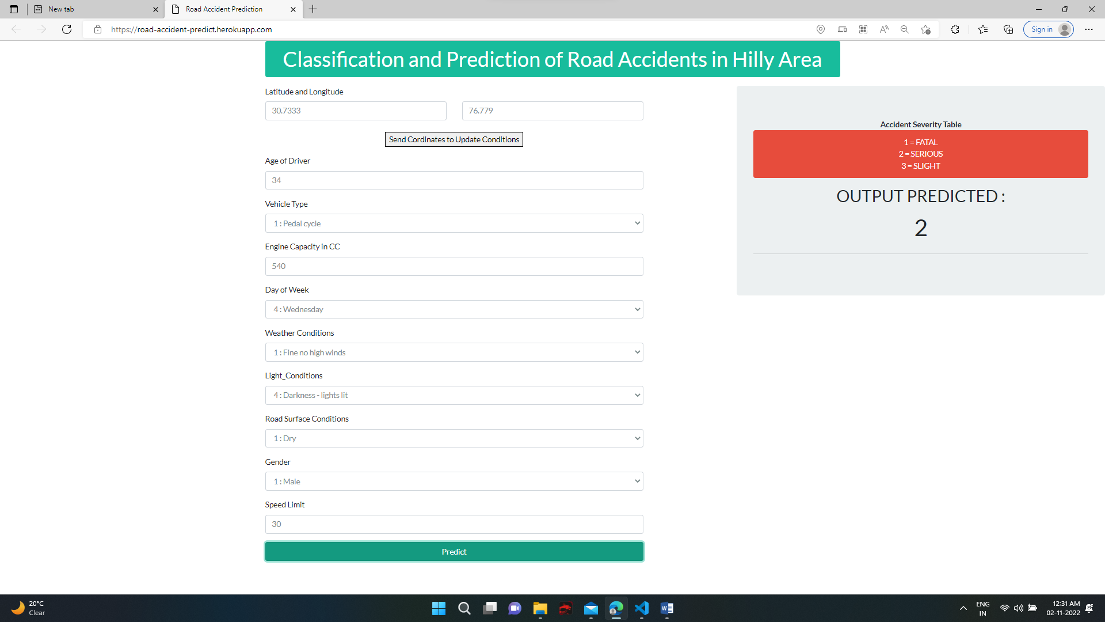

Slide 13
Conclusion
This project aims at using Machine Learning classification techniques to predict severity of an accident at any particular location. Machine Learning has enabled us to analyze meaningful data to provide solutions with a greater accuracy than with humans.
I have built a model with an accuracy greater than 10% of the conventional system [1]. A web-based app using the most accurate algorithm has been developed which can be accessed through the domain name. This project can be used by governments to prevent accidents.

Slide 14
Future Scope
With more resources, continuous prediction and alerts can be sent to the police for every location at regular intervals of time to take preventive measures. The web app can be incorporated with Google Maps which can be live tracked by the police. A fully-fledged web app for user and police interaction can be published for use in real-time. It can be used for Indian states or cities, if proper data of accidents is provided by the Indian Government.

Slide 15
References
Lu Wenqi, Luo Dongyu & Yan Menghua, “A Model of Traffic Accident Prediction” INSPEC Accession Number: 17239218 DOI: 10.1109/ICITE.2017.8056908.
Thineswaran Gunasegaram Yu-N Cheah, “Evolutionary Cross validation” INSPEC Accession Number: 17285520 DOI: 10.1109/ICITECH.2017.8079960.
Simon Bernard, Laurent Heutte and Sebastien Adam, “On the Selection of Decision Trees in Random Forests” INSPEC Accession Number: 10802866 DOI: 10.1109/IJCNN.2009.5178693.
Rafael G.Mantovan,, Ricardo Cerri, Joaquin Vanschoren, “Hyper-parameter Tuning of a Decision Tree Induction Algorithm” INSPEC Accession Number: 16651860 DOI: 10.1109/bracis.2016.018.
Fu Huilin, Zhou Yucai, “The Traffic Accident Prediction Based on Neural Network”, 2011.
(10) Abdel-Aty, M., N. Uddin, and A. Pande. Split Models for Predicting Multivehicle Collisions during High-Speed and Low-Speed Operating Conditions on Freeways. In Transportation Research Record: Journal of the Transportation Research Board, No. 1908, Transportation Research Board of the National Academies, Washington, D.C., 2005, pp. 51–58.

