Slide 1
KDD ‘99 Dataset Neural Network & its Feature Selection
Kaihua Cai
Weiqi Yao
Kc3172 & wy697

Slide 2
Outline
Introduction
Problem Statement & Objectives
KDD’ 99 dataset
Project Method
Review of Past techniques
Evaluation Results
Data Preprocessing
Neural Network Model
Results of Non-PCA
Results of PCA
Results of borrowed feature selection
Results Comparison
References

Slide 3
1. Introduction: Problem Statement & Objective
Intrusion detection, a common network security research problem:
Its aim: build a predictive model (i.e. a classifier) capable of distinguishing between “bad” connections and “good”.
“bad” connections, intrusions or attacks generated from hackers,
“good” connections, normal traffic generated from normal users.
An ideal intrusion detection system should be able to detect intrusions from hackers fast and precisely (network line-rate)
i.e. the administrator is informed of attacks the moment it reaches the network, or more formerly, detection at line-rate.

Slide 4
1. Introduction: Problem Statement & Objective
However, due to the mass size of the data to be processed in real time network, most intrusion detection system right now is offline.
Objective: a simple and rather precise machine learning classifier that is possible to deploy online.

Slide 5
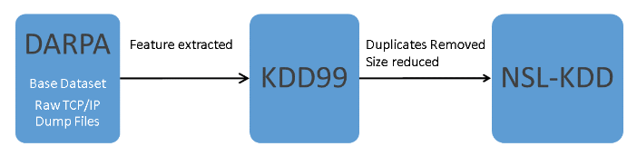
1. Introduction: KDD ’99 Dataset
KDD ‘99 Dataset
A competition held by KDD in 1999, its task was to build a network intrusion detector to distinguish between ”bad” (intrusions/attacks) and “good” normal connections.
Its trace is a wide variety of intrusions simulated in a military network environment.
Lincoln Labs acquired 9 weeks of raw TCP dump data(DARPA-sponsored IDS-event) for a local-area network (LAN) simulating a typical U.S. Air Force LAN, and mixed with multiple attacks.
Lee and Stolfo, one of the participating teams of the DARPA event, gave their feature extracted and preprocessed data to Knowledge Discovery and Data Mining (KDD) yearly competition.
To reduce deficiencies of KDD99 dataset for machine learning algorithm, Tavallaee et al. introduced NSL-KDD dataset.

Slide 6
1. Introduction: KDD ’99 Dataset
KDD ‘99 Dataset(contd.)
The KDD CUP 99 training data set consists of approximately 4,900,000 samples with 41 features and each sample is labeled as either normal or attack.
The features in KDD CUP 99 Dataset are divided into 3 sets:
Basic features of individual TCP connections, e.g. duration;
Content features within a connection suggested by domain knowledge, e.g. num_file_creations;
Traffic features computed using a two-second time window, e.g. same_srv_rate;
Statistical characteristics of network traffic based on host(100 connections), e.g. dst_host_count.
There are a total of 24 attacks, which fall into 4 main categories:
DOS: denial-of-service, e.g. SYN flood;
R2L: unauthorized access from a remote machine, e.g. guessing password;
U2R: unauthorized access to local super-user (root) privileges, e.g. various ``buffer overflow'' attacks;
probing: surveillance and other probing, e.g., port scanning.
Notes:
same_srv_rate: % of connections to the same service
dst_host_count: count of connections having the same destination host

Slide 7
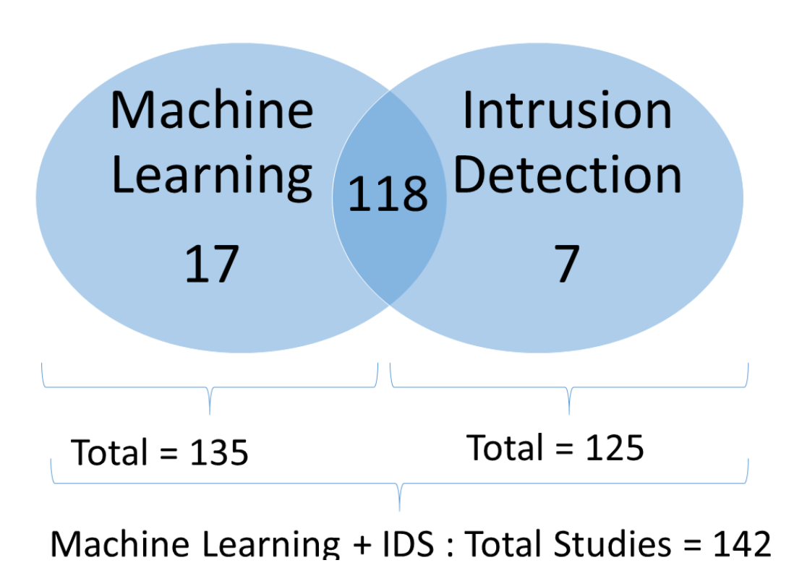
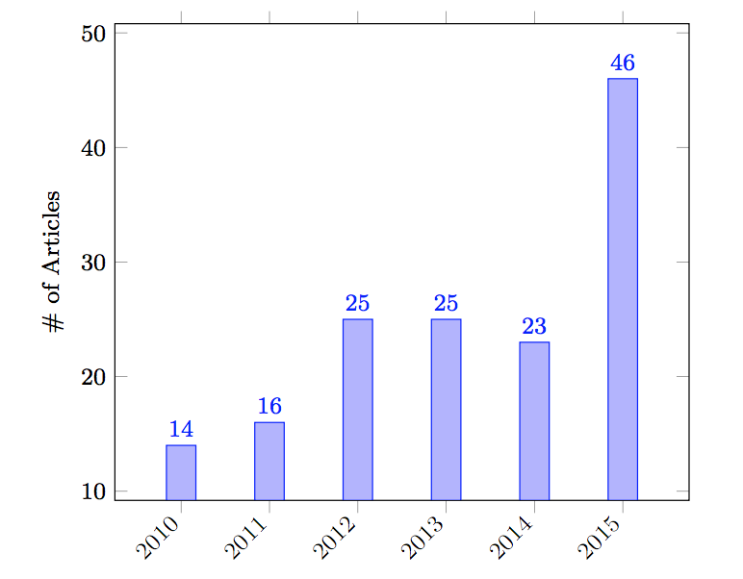
1. Introduction: KDD ’99 Dataset
KDD ‘99 Dataset(contd.)
Total of 142 articles use KDD CUP 99 in either Machine Learning or IDS between 2010 and 2015 from 149 research articles

Slide 8
1. Introduction: Project Method
Use neural network as a classifier model;
Provide a high true positive and true negative detection rate;
But compared with other classify methods, neural network will have larger training and validation time. Contradictory to our objective in keeping up with network line-rate;
Methods like: Clustering, C4.5 decision tree, SVM, K-means and K Nearest Neighbor.
Use PCA as Feature Selection to downsize the number of inputs, so to compensate for the decrease in detection speed.
Convert 120 features to only 20 principle components.
Compare the result of PCA with neural network that has all features as input.
Compare again with features selected from a recent paper [3]. Apply the features selected there to our own model.

Slide 9
2. Review of Past techniques
K-means clustering in Spark, from the book Advanced analytics with Spark: patterns for learning from data at scale (pp. 81-97)
This provide detailed information on how to build a classifier for KDD ‘99 dataset, however the techniques used here is K-means clustering and has a rather low accuracy in validation, around 91%.
J. (n.d.). Jeffheaton/t81_558_deep_learning. https://github.com/jeffheaton/t81_558_deep_learning/blob/master/tf_kdd99.ipynb
A github code from deep-learning course in Washington University of Saint Louis.
This provide the basic code for building a simple neural network on KDD ’99.
We borrowed its code for one-hot encoding and normalization of the dataset as well as the basic neural network model.

Slide 10
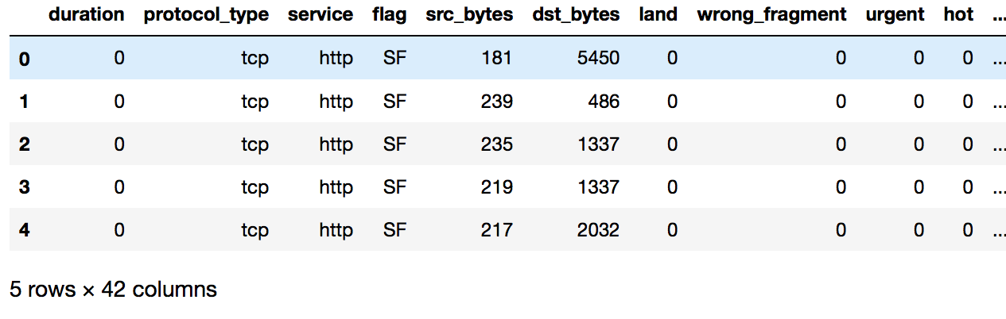
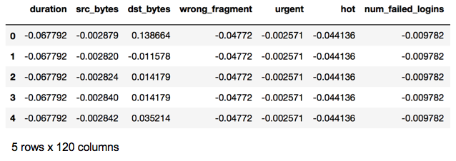
3. Evaluation Results: Data Preprocessing
Data Preprocessing
We start by working on a reduced dataset (10% dataset), where the dataset is split by 75% for training and 25% for testing.
The 10%dataset will be preprocessed to do feature scaling(normalization) and one-hot encoding, resulting in a transformation of 42 features to 120 features.
The model will be validated on the 10% testing dataset and also the complete dataset.
Dataset before Preprocess
Dataset after Preprocess

Slide 11
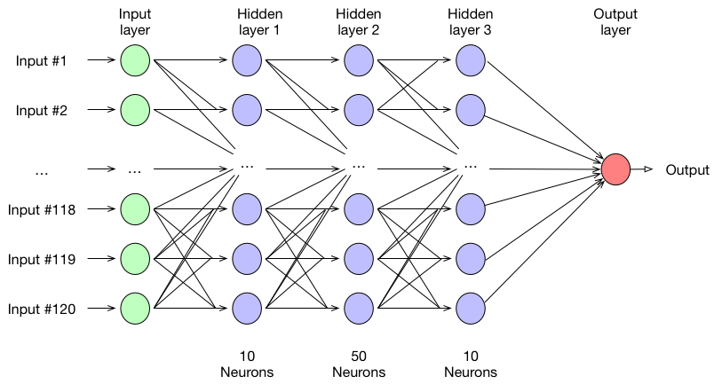
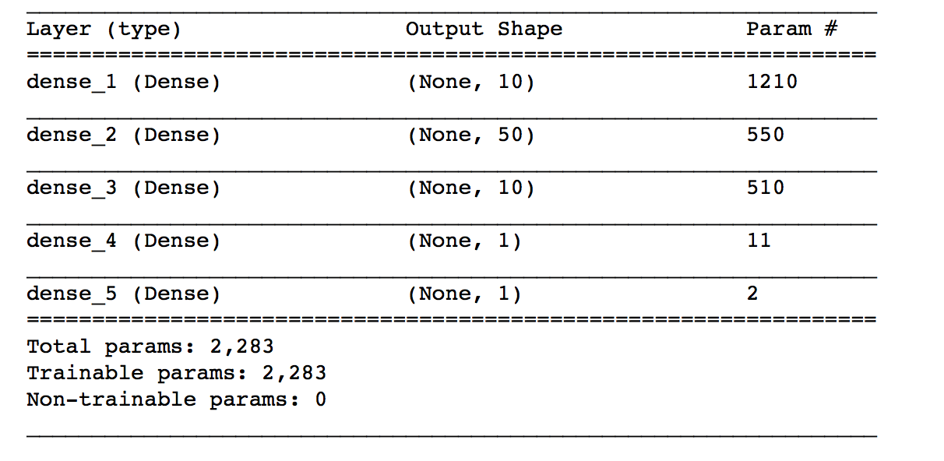
3. Evaluation Results: Neural Network Model
Neural Network Classifier
Then build a simple deep neural network model with 3 hidden layers, to classify/predict entries into 2 classes(attacks and normal).

Slide 12
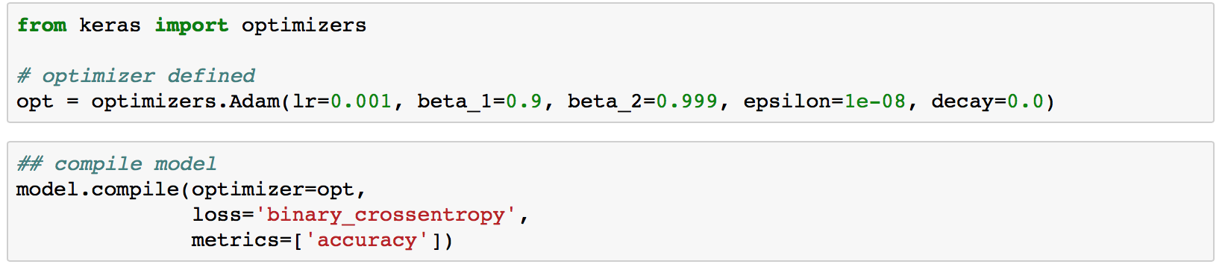
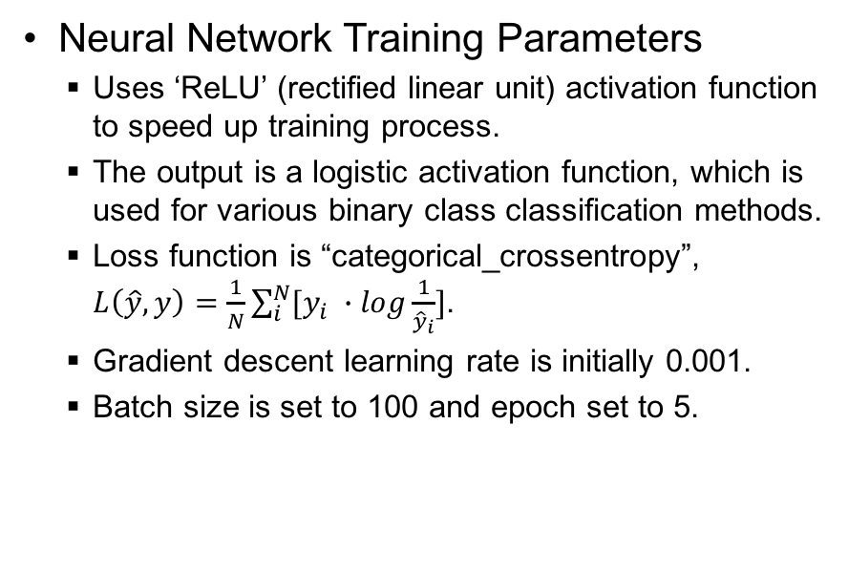
3. Evaluation Results: Neural Network Model
Neural Network Training Parameters
Uses ‘ReLU’ (rectified linear unit) activation function to speed up training process.
The output is a logistic activation function, which is used for various binary class classification methods.
Loss function is “categorical_crossentropy”, $L\left(\hat{y},y\right)=\frac{1}{N}\sum_{i}^{N}{[y_{i} ∙log\frac{1}{{\hat{y}}_{i}}]}$.
Gradient descent learning rate is initially 0.001.
Batch size is set to 100 and epoch set to 5.
ReLU activation function
Notes:
y

Slide 13
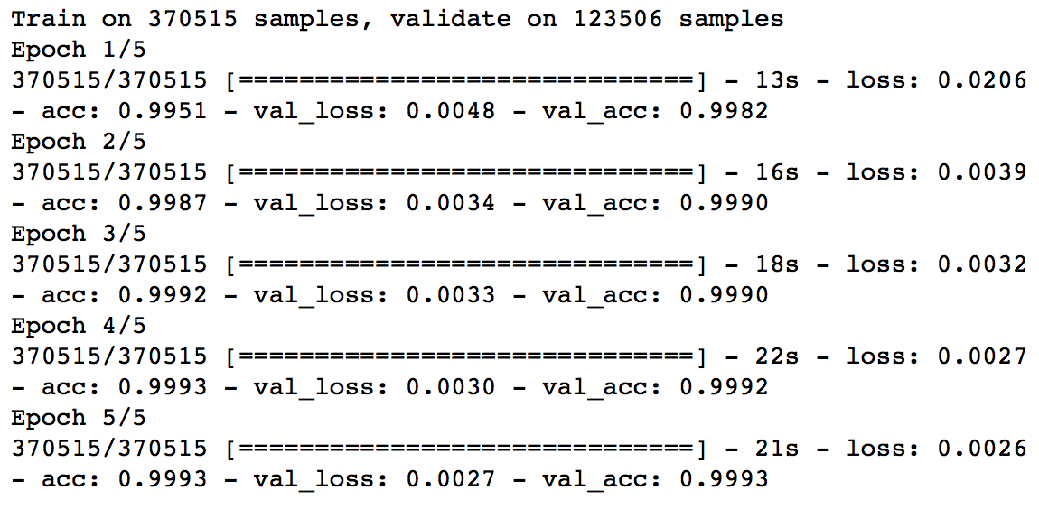
3. Evaluation Results: Results of Non-PCA
Training and validation results for no PCA set
The loss function (categorical crossentropy) value in the training dataset for the last batch in this epoch.
The categorical accuracy in the training dataset for the last batch in this epoch. (Correct accuracy)
Acc = ( argmax(y_true) == argmax(y_pred))
The loss function value of the testing dataset for the model trained at the end of this epoch
The categorical accuracy of the testing dataset for the model trained at the end of this epoch

Slide 14
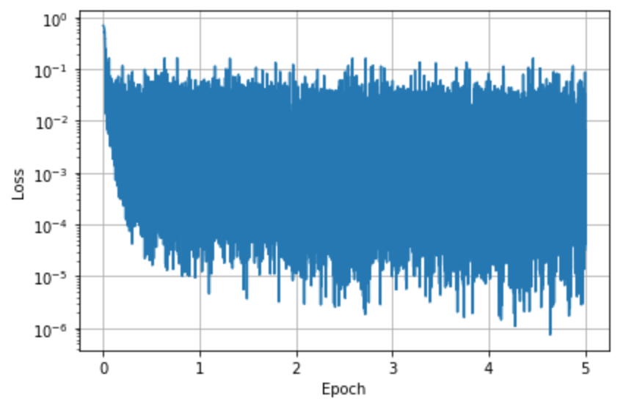
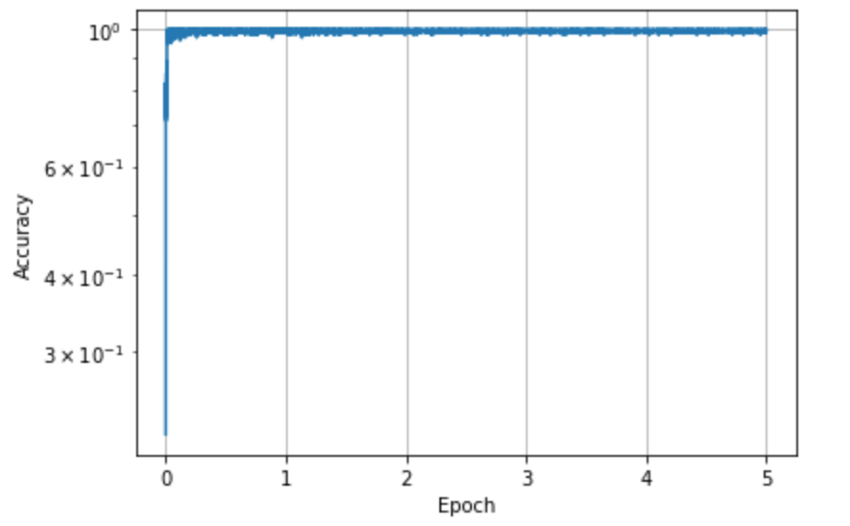
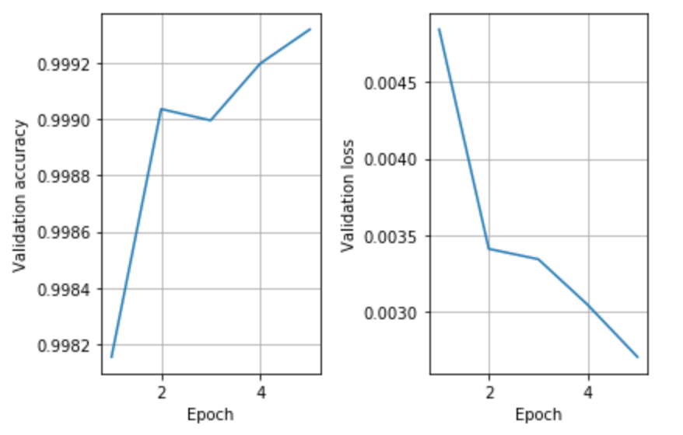
3. Evaluation Results: Results of Non-PCA
Training Loss
Training and validation results (contd.)
Loss function value is recorded at the end of each batch, the loss value for training dataset is infinitely approximating the optimal value.
While validation accuracy and validation loss is only calculated at every epoch’s end.
Training Accuracy
Testing Loss and Accuracy

Slide 15
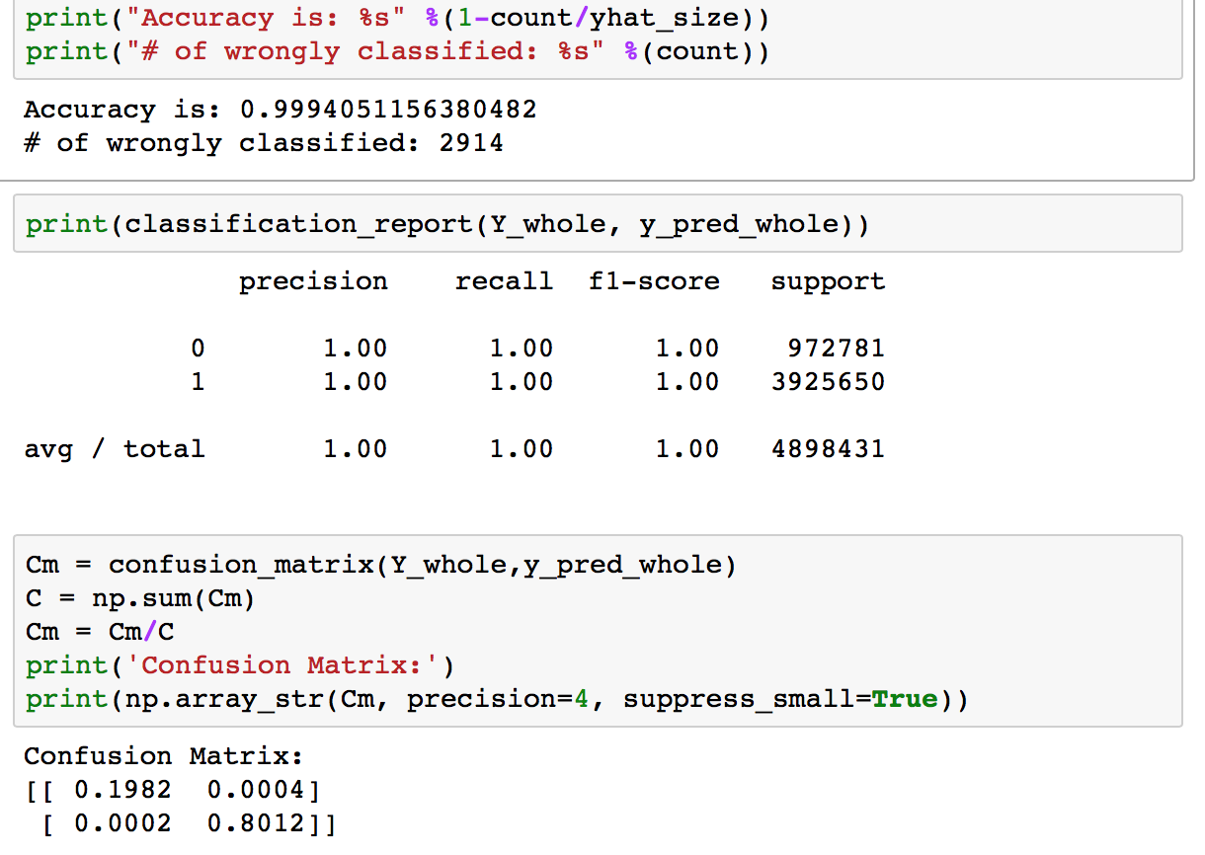
3. Evaluation Results: Results of Non-PCA
Validation on whole KDD ‘99 dataset, instead of 10%
Time to validate is approximately 240s

Slide 16
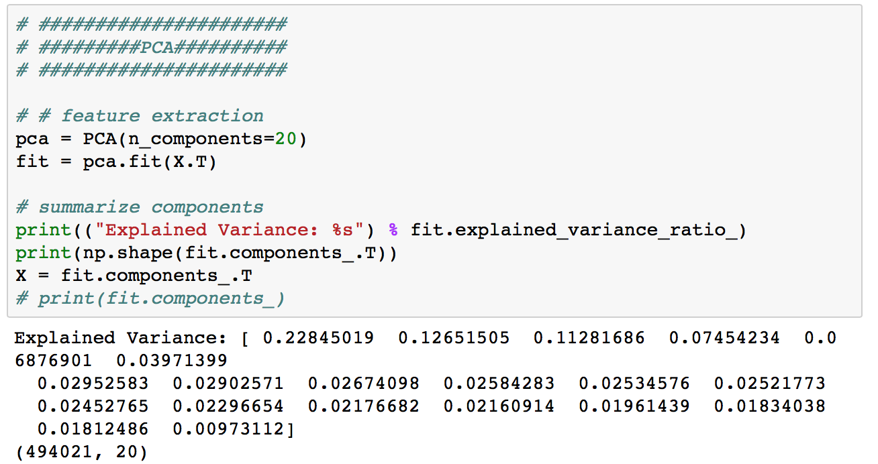
3. Evaluation Results: Results of PCA
PCA performed for both training and validation
Training dataset, from 120 features to 20 features
The variance of the 20 Principle Components, ranged from largest to smallest
The number of features now is 20

Slide 17
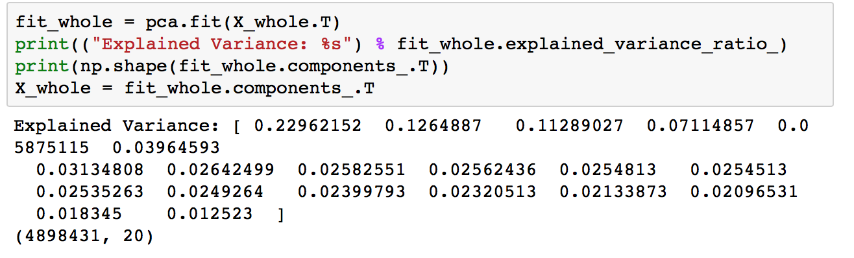
3. Evaluation Results: Results of PCA
PCA performed for both training and validation
Testing dataset, from 120 features to 20 features
The testing dataset variance is quite similar to the training
The variance of the 20 Principle Components, ranged from largest to smallest

Slide 18
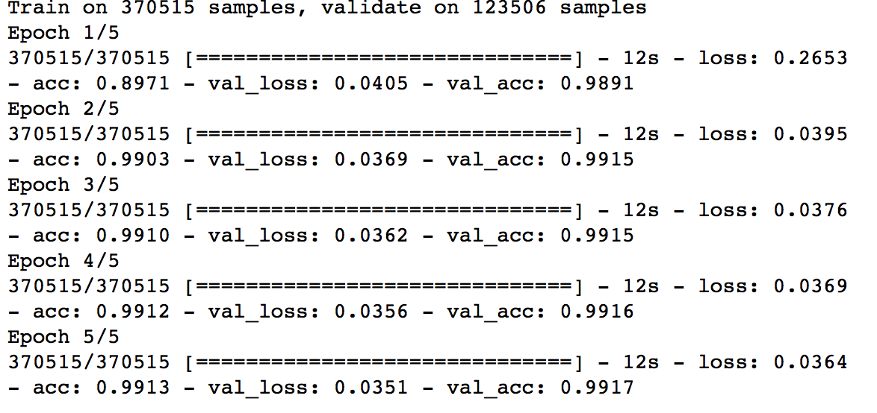
3. Evaluation Results: Results of PCA
Training and validation results for PCA set
This result is expected because features from 120 to 20 means drop in information. Thus reducing Accuracy.
The loss value increased and the accuracy dropped in the 1st epoch, compared to the results of non-PCA.
The Validation loss and accuracy is not as ideal as the results from non-PCA, but still in acceptable range.

Slide 19
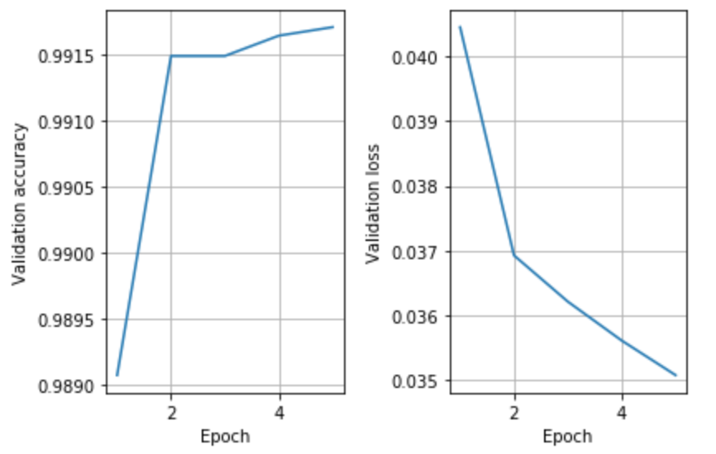
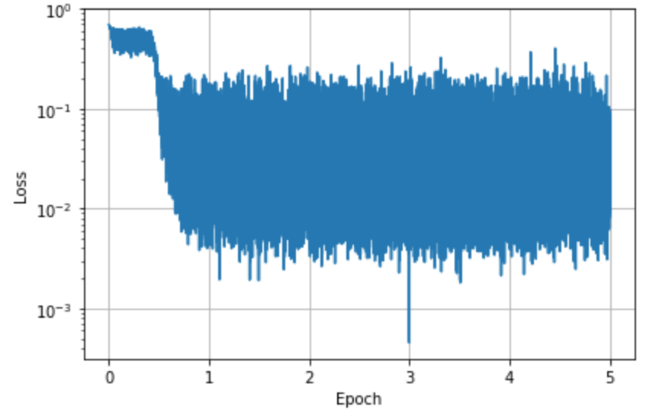
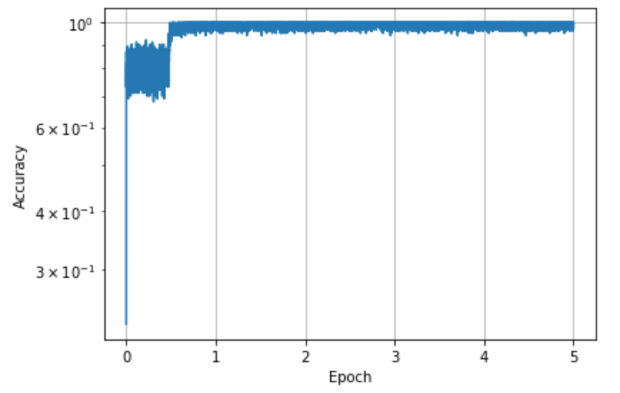
3. Evaluation Results: Results of PCA
Training and validation results (contd.)
Testing Loss and Accuracy
Training Loss
Training Accuracy

Slide 20

3. Evaluation Results: Results of PCA
Validation on whole KDD ‘99 dataset, instead of 10%
Time to validate is approximately 90s, time to validate greatly reduced!
A significant drop in accuracy in the complete dataset. From 99.94% in non-PCA validation to only 80.05%.
This is probably due to under-fitting of the model, and also great change of data pattern in training 10% dataset and testing 100% dataset.

Slide 21
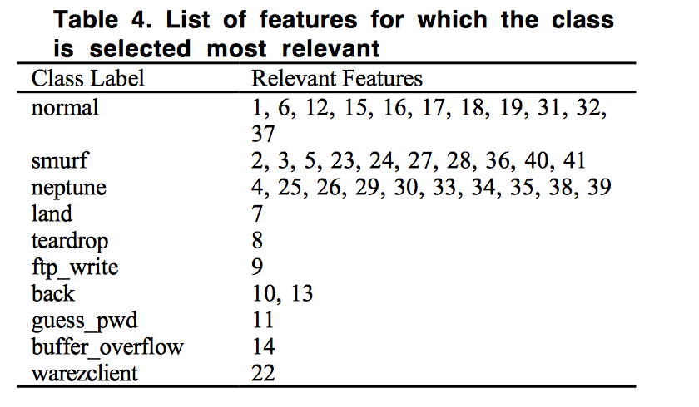
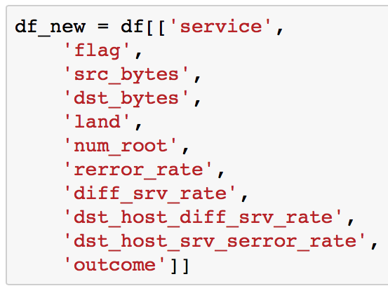
3. Evaluation Results: Results of borrowed features
From the paper, Relevance feature selection with data cleaning for intrusion detection system, which uses an information gain method to do feature selection.
Select only the features stated there in the normal class label
Then our features will downsize from 41 features to 11 features before one-hot encoding
After one-hot encoding, from 120 features to 87 features.

Slide 22
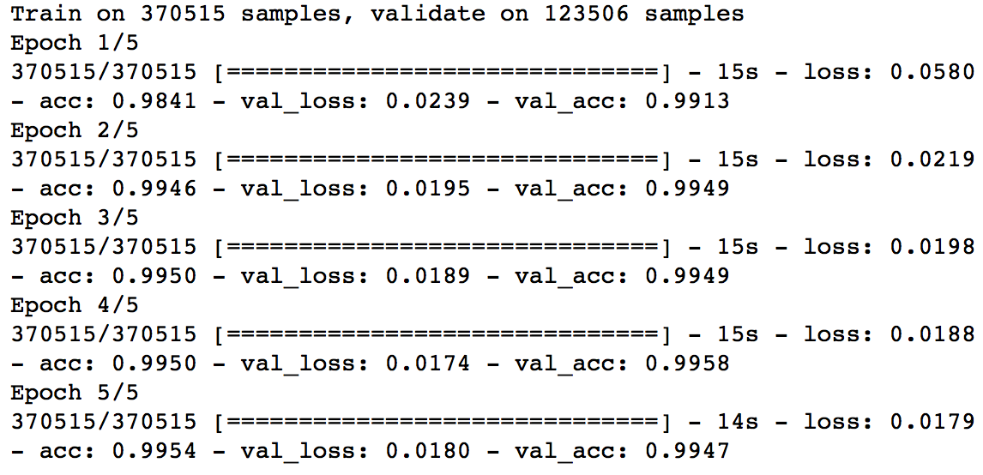
3. Evaluation Results: Results of borrowed features
Training and validation results for borrowed feature set
Compared to the results of non-PCA and PCA, its training loss and accuracy is in between them.
The loss function value and accuracy of the testing dataset is in between as well. But closer to the full dataset.

Slide 23
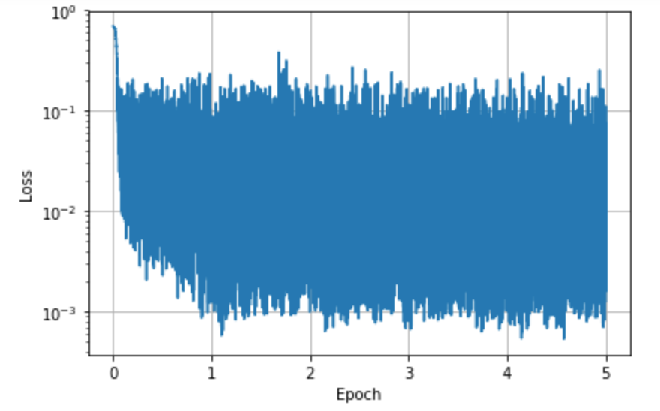
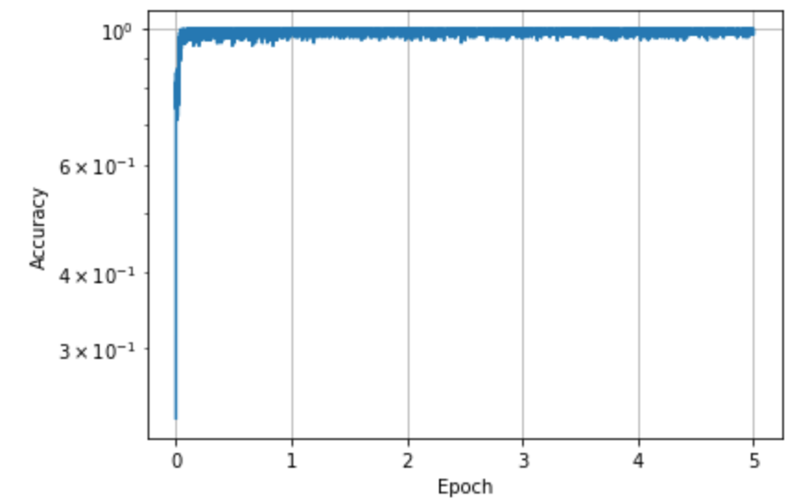
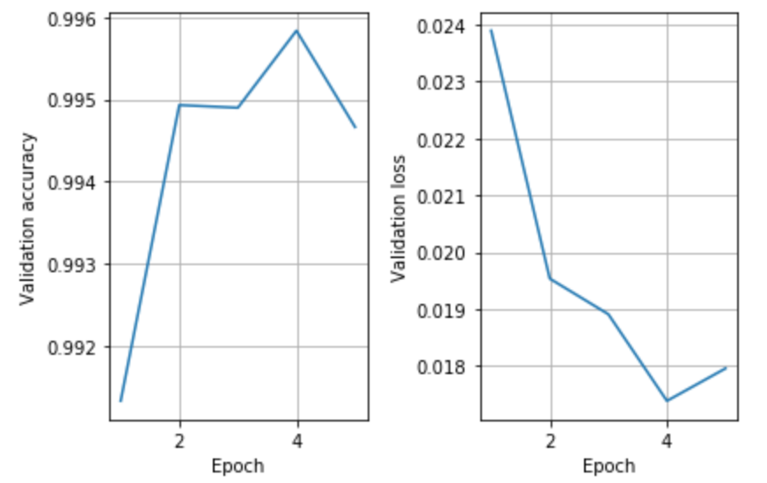
3. Evaluation Results: Results of borrowed features
Training and validation results (contd.)
Testing Loss and Accuracy
Training Loss
Training Accuracy

Slide 24

3. Evaluation Results: Results of borrowed features
Validation on whole KDD ‘99 dataset, instead of 10%
Time to validate is approximately 90s, same as the PCA set
A very close result to the non-PCA, all features as input set.
But uses half the time than the non-PCA set in validation of 4898431 rows of data while still maintaining high accuracy in detection.
OUR OBJECTIVE IS MET!!

Slide 25
3. Evaluation Results: Results Comparison
Validation Time:
For the non-PCA dataset, the validation time for classifying data on all 4,898,431 data is 240s.
While PCA set and borrowed-features set uses only 90 s.
Validation Accuracy:
For the PCA set, its accuracy is 0.8005, this is probably due to the underfitting of data.
While for the non-PCA set and the borrowed-features set, the accuracy is >=0.9977
So our objective is met when using the borrowed-features set, with low validation time yet high detection rate.

Slide 26
4. References
J. (n.d.). Jeffheaton/t81_558_deep_learning. Retrieved December 16, 2017, from https://github.com/jeffheaton/t81_558_deep_learning/blob/master/tf_kdd99.ipynb
K-means clustering in Spark. In S. Ryza, U. Laserson, S. Owen, & J. Wills (Authors), Advanced analytics with Spark: patterns for learning from data at scale (pp. 81-97). Sebastopol, CA: OReilly.
Suthaharan, S., & Panchagnula, T. (2012). Relevance feature selection with data cleaning for intrusion detection system. 2012 Proceedings of IEEE Southeastcon. doi:10.1109/secon.2012.6196965

