Slide 1


Proposal: Defense of Distributed Denial of Service (DDoS) Attacks with Machine Learning
H. Jonathan Chao and Yang Xu
High-Speed Networking Lab

Slide 2
Proposal Outline
Introduction
Research Problems
Research Challenges
Research Objectives
Survey on DDoS Defense Systems
Proposed Research Topics
DDoS Defense System
GAN-based DDoS Defense System
Project Plan
References

Slide 3
Introduction
1.A Research Problems
Distributed Denial of Service (DDoS) Attacks is one of the biggest security concerns on today’s Internet
Many large websites, such as Twitter, Microsoft, and Amazon, have suffered DDoS attacks which lead to big loss. As per the world wide infrastructure security report (WISR) [1], the volume of DDoS attack traffic has increased to around 600 Gbps in 2016.
Specifically, more and more attackers try their best to generate mimicking attack traffic that can well blend into normal traffic, Flash Crowds (FC), generated by legitimate users and escape from defense systems.
DDoS traffic is malicious which should be filtered in time, while normal traffic coming from legitimate clients should be responded timely.
In order to ensure the health of network and timely response of legitimate users’ requests, it is necessary to detect DDoS and distinguish DDoS from FC.

Slide 4
Introduction
1.B Research Challenges
Much similarity between DDoS and FC traffic [11,12]
Such as, network status, server status
Few data publicly available for research
Existing defense systems mainly depend on public data to analyze and build defense models. However, there are few data available and the existing data usually have many flaws, such as, out-of-date, few attack types.
They all make the classification problem difficult and hinder the development of defense systems.

Slide 5
Introduction
1.C Research Objectives
Develop a high-throughput and accurate DDoS defense system using machine learning to detect DDoS quickly, efficiently and with high precision .
Develop a testbed (system) to generate mimicking attack traffic and use them to improve our defense system

Slide 6
2. Survey on DDoS Defense Systems

Slide 7
2. Survey on DDoS Defense Systems
Network/transport-level flooding attacks
Application-level flooding attacks
Feature Selection
Neural Network for DDoS defense
Generative Adversarial Network (GAN)

Slide 8
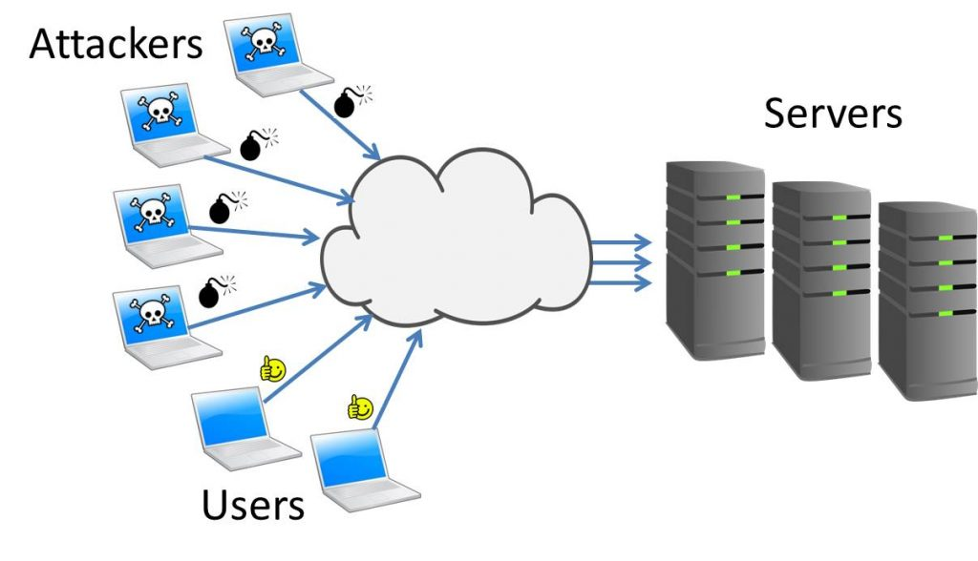
2.A Network/transport-level flooding attacks
Flooding attacks [2, 4, 10]
Protocol exploitation flooding attacks
Reflection-based flooding attacks
Amplification-based flooding attacks

Slide 9

2.B Application-level flooding attacks
Reflection/amplification based flooding attacks [7, 13]
HTTP flooding attacks
Session flooding attacks
Request flooding attacks
Asymmetric attacks
Slow request/response attacks

Slide 10
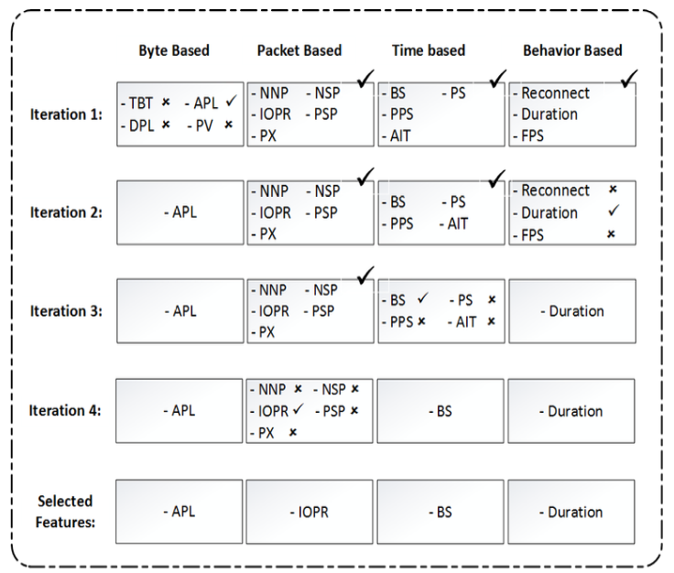
2.C Feature Selection
Simplicity, which is required for high detection rate by online/large scale detection
Flow-based features, most powerful in identification of specialized botnets.
16 widely used features selected from previous work [3]
The wrapper strategy: repetitive application of algorithm with different sets of features;
Categorized all features into 4 groups: byte-based, packet-based, time & behavior-based.
Backward elimination: Group exclusion, to remove the group contributing the least
Forward selection: Feature inclusion, to select the individual feature from the above group to increase performance
Repeat 2, 3.

Slide 11
2.C Feature Selection (Cont.)
Following the wrapper strategy, employ a Decision Tree model to evaluate features.
Result is a ranked list of features
Some implications:
Use other detection machine-learning algorithm to bring higher detection rate.
Combine flow level features with pair-level/conversation-level features.

Slide 12
2.D Neural Network for DDoS defense
Find the network anomalies by using neural network and deploy the system at distributed routers [8]
Identify the attack packets, and then filter them
Can catch DDoS attacks’ characteristic starting from multiple sources to a single victim
[9] proposed a method, using LVQ (Learning Vector Quantisation) neural network for detection of DDoS attacks
High recognition rate, and easy to identify new types of attacks

Slide 13
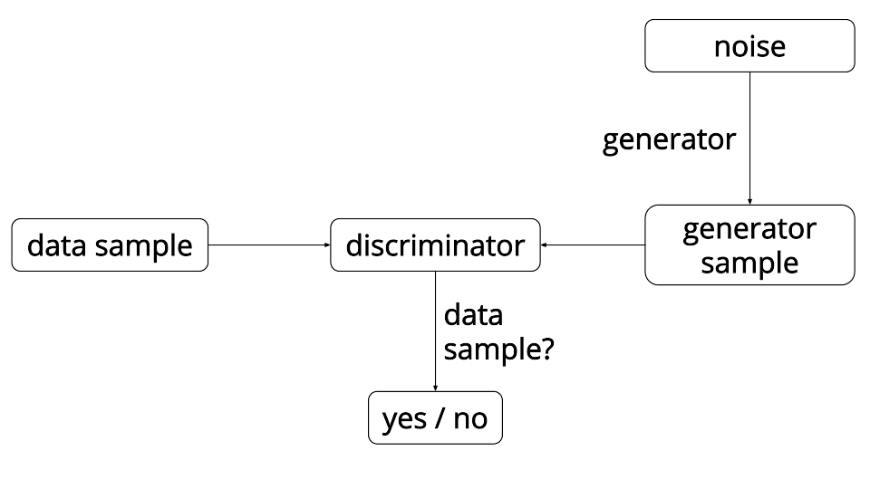
2.E Generative Adversarial Network (GAN)
Implemented by a system of two neural networks contesting with each other in a zero-sum game framework
One network generates candidates and the other evaluates them
The generator is typically a de-convolutional neural network, and the discriminator is a convolutional neural network [6]

Slide 14
2.E Generative Adversarial Network (Cont.)
Although many methods based on GAN have been proposed to generate image data [5] since Goodfellow firstly proposed GAN [6], there are hardly works to generate traffic mimicking data by GAN on attack.
To the best of our knowledge, our group may be the one attempting to take this approach.
The data generated by GAN can have much similarity with the traffic generated by legitimate users, and is hence much better than the public data that is limited to access, and the data generated by public attack tools that are more predicable.

Slide 15
3. Proposed Research Topics

Slide 16
3. Proposed Research Topics
Research Topics for DDoS Defense System
Research Topics for GAN-based DDoS Defense System

Slide 17
3.A Research Topics for DDoS Defense System
Feature Selection (Feature Engineering)
Investigate how attack streams are possibly generated
Investigate what features to be extracted
Evaluate effectiveness of time varying feature combinations
Design a feature collector to extract useful features in real time
Evaluate design platforms (Server, Smart NIC, NetFPGA)
Design calculation of statistics, such as average and standard deviation of packet sizes and arrival time of packet streams in each time interval with sampling, stream processing techniques
Tradeoff between implementation complexity, hardware requirement, throughput, and detection accuracy

Slide 18
3.A Research Topics for DDoS Defense System
Discriminator
Investigate and design various discriminators based on Convolution neural network (CNN)
Evaluate their performance
Evaluate design platforms (Server, Smart NIC, NetFPGA)
Tradeoff between implementation complexity, hardware requirement, throughput, and detection accuracy

Slide 19
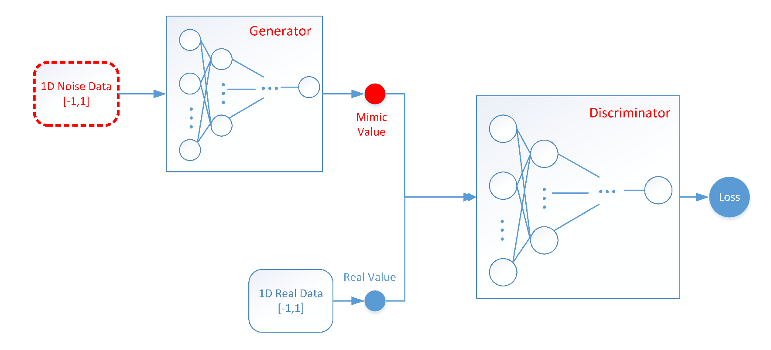
3.B Research Topics for GAN-based DDoS Defense
Generate traffic Based on GAN with Discriminator Feedback
Investigate various GAN architectural designs
Generate traffic that can blend into normal FC traffic
Train the generator based on whether the generated traffic passing the discriminator or not
Discriminator Refinement
Use the generated packet streams mimicking flash crowd
Train and refine the discriminator to improve the detection accuracy
Repeat the above two steps in multiple iterations to further train the GAN-based generator and discriminator

Slide 20
4. Project Plan

Slide 21
4. Project Plan
Phase 1: Feb 1, 2018 ~ Jan 31, 2019
Milestones
Select a set of features that are effective for DDoS defense and evaluate their performance
Use those features to train discriminators based on Convolution neural network (CNN)
Design and evaluate GAN-based generator to mimic Flash Crowd
Design and evaluate the discriminator under attack traffic generated by GAN
Phase 2: Feb 1, 2019 ~ Jan 31, 2020
Milestones
Study implementation feasibility for high-speed GAN-based generator and discriminator
Refine generator and discriminator
Prepare documentation and hold a workshop

Slide 22
5. References

Slide 23
5. References
WISR. The arbor networks wisrreport. http://www.arbornetworks.com/images/documents/WISR2016_EN_Web.pdf.
J. Mirkovic, P. Reiher, A taxonomy of DDoS attack and DDoS defense mechanisms ACM SIGCOMM Computer Communications Review, vol. 34, no. 2, pp. 39-53, April 2004.
E. Beigi, H. Jazi, N. Stakhanova, A. Ghorbani, Towards Effective Feature Selection in Machine Learning-Based Botnet Detection Approaches IEEE Conference on Communications and Network Security ’14, 2014
C. Douligeris, A. Mitrokotsa, “DDoS attacks and defense mechanisms: classification and state-of-the-art”, Computer Networks, vol. 44, no. 5, pp. 643-666, April 2004
Ian Goodfellow. Nips 2016 tutorial: Generative adversarial networks. 2016.
Ian J. Goodfellow, Jean Pougetabadie, Mehdi Mirza, Bing Xu, David Wardefarley, Sherjil Ozair, Aaron Courville, and Yoshua Bengio. Generative adversarial networks. Advances in Neural Information Processing Systems, 3:2672–2680, 2014.
S. Ranjan, R. Swaminathan, M. Uysal, E. Knightly, DDoS-Resilient Scheduling to Counter Application Layer Attacks under Imperfect Detection IEEE INFOCOM'06, 2006
Xiang, Yang and Zhou, Wanlei 2005, Mark-aided distributed filtering by using neural network for DDoS defense, in GLOBECOM '05 : IEEE Global Telecommunications Conference, 28 November-2 December 2005 St. Louis, Missouri, USA, discovery
Li, Jin, Yong Liu, and Lin Gu. "DDoS attack detection based on neural network." Aware Computing (ISAC), 2010 2nd International Symposium on. IEEE, 2010.
Bhuyan, M. H., et al. (2013). "Detecting distributed denial of service attacks: methods, tools and future directions." The Computer Journal: bxt031.
Sunny Behal and Krishan Kumar. Detection of ddos attacks and flash events using novel information theory metrics. Computer Networks, 116:96–110, 2017.
Shui Yu, Song Guo, and Ivan Stojmenovic. Fool me if y-ou can: mimicking attacks and anti-attacks in cyberspace. IEEE Transactions on Computers, 64(1):139–151, 2015.
RioRey Inc. 2009–2012 RioRey Taxonomy of DDoS Attacks RioRey_Taxonomy_Rev_2.3_2012, 2012, [online]

Slide 25
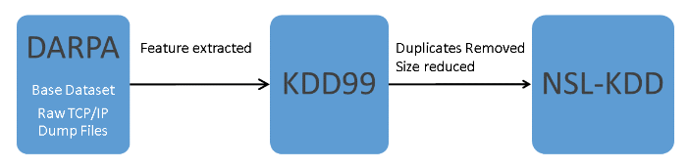
KDD ’99 Dataset Simulation
KDD ‘99 Dataset
A competition held by KDD in 1999, its task was to build a network intrusion detector to distinguish between ”bad” (intrusions/attacks) and “good” normal connections.
Its trace is a wide variety of intrusions simulated in a military network environment.
Lincoln Labs acquired 9 weeks of raw TCP dump data(DARPA-sponsored IDS-event) for a local-area network (LAN) simulating a typical U.S. Air Force LAN, and mixed with multiple attacks.
Lee and Stolfo, one of the participating teams of the DARPA event, gave their feature extracted and preprocessed data to Knowledge Discovery and Data Mining (KDD) yearly competition.
To reduce deficiencies of KDD99 dataset for machine learning algorithm, Tavallaee et al. introduced NSL-KDD dataset.

Slide 26
KDD ’99 Dataset Simulation
KDD ‘99 Dataset(contd.)
The KDD CUP 99 training data set consists of approximately 4,900,000 samples with 41 features and each sample is labeled as either normal or attack.
The features in KDD CUP 99 Dataset are divided into 3 sets:
Basic features of individual TCP connections, e.g. duration;
Content features within a connection suggested by domain knowledge, e.g. num_file_creations;
Traffic features computed using a two-second time window, e.g. same_srv_rate;
Statistical characteristics of network traffic based on host(100 connections), e.g. dst_host_count.
There are a total of 24 attacks, which fall into 4 main categories:
DOS: denial-of-service, e.g. SYN flood;
R2L: unauthorized access from a remote machine, e.g. guessing password;
U2R: unauthorized access to local super-user (root) privileges, e.g. various ``buffer overflow'' attacks;
probing: surveillance and other probing, e.g., port scanning.
Notes:
same_srv_rate: % of connections to the same service
dst_host_count: count of connections having the same destination host

Slide 27
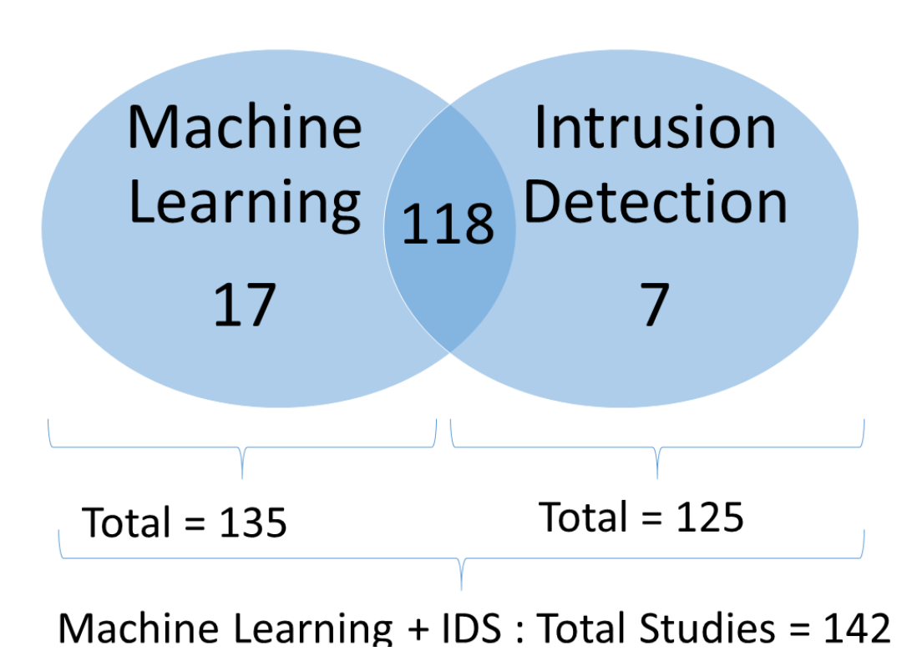
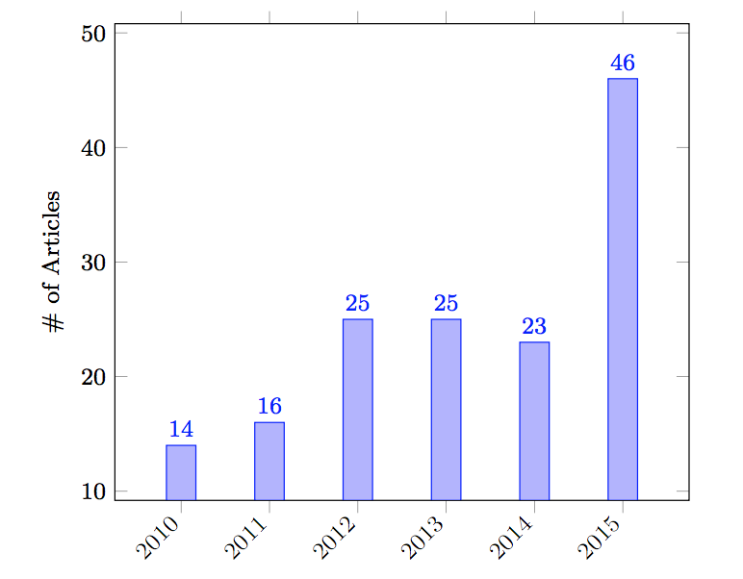
KDD ’99 Dataset Simulation
KDD ‘99 Dataset(contd.)
Total of 142 articles use KDD CUP 99 in either Machine Learning or IDS between 2010 and 2015 from 149 research articles

Slide 28
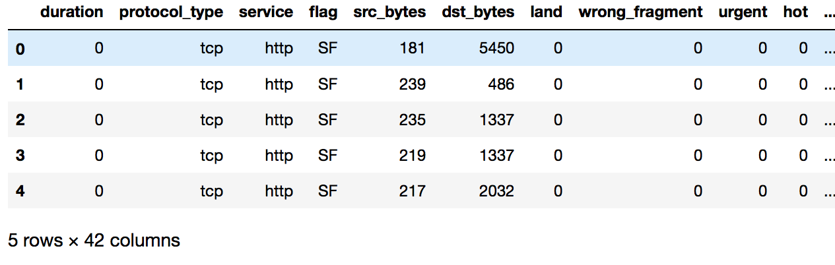
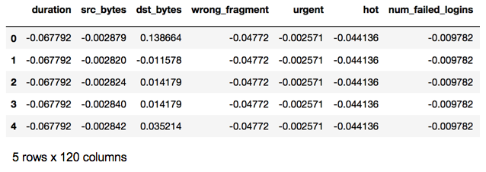
KDD ’99 Dataset Simulation
Data Preprocessing
We start by working on a reduced dataset (10% dataset), where the dataset is split by 75% for training and 25% for testing.
The 10%dataset will be preprocessed to do feature scaling(normalization) and one-hot encoding, resulting in a transformation of 42 features to 120 features.
Later, the model will be trained on the full 10% dataset and validated on the complete dataset.
Dataset before Preprocess
Dataset after Preprocess

Slide 29
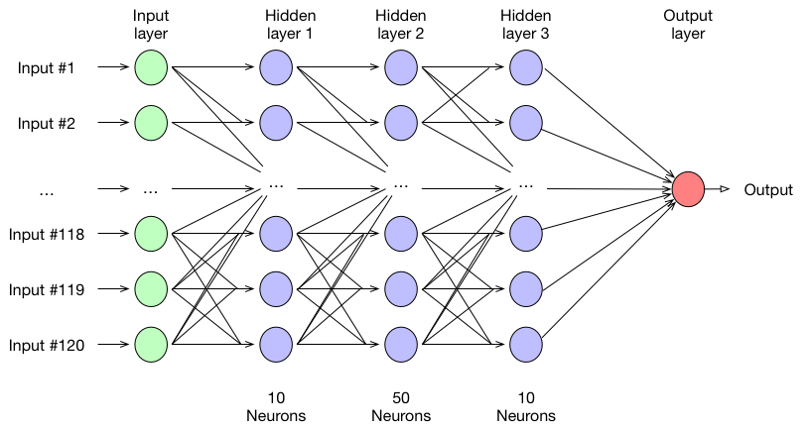
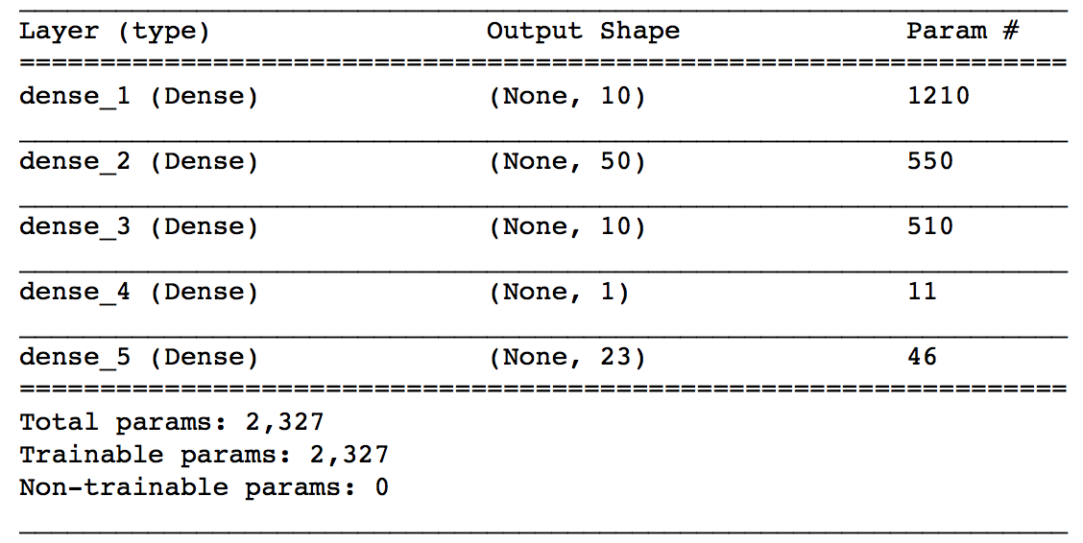
KDD ’99 Dataset Simulation
Neural Network Classifier
Then build a simple deep neural network model with 3 hidden layers, to classify/predict entries into 23 classes(22 attacks and 1 normal).

Slide 30
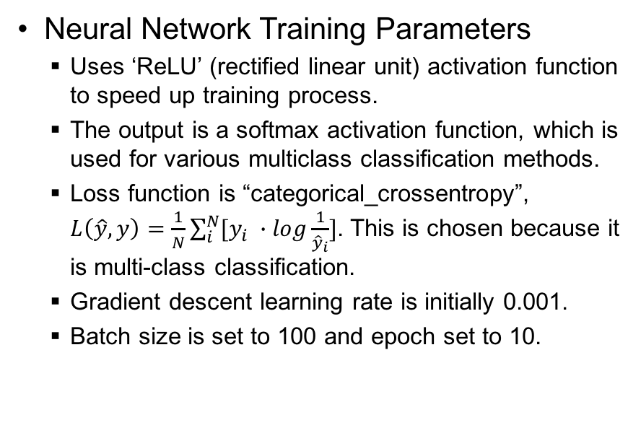
KDD ’99 Dataset Simulation
Neural Network Training Parameters
Uses ‘ReLU’ (rectified linear unit) activation function to speed up training process.
The output is a softmax activation function, which is used for various multiclass classification methods.
Loss function is “categorical_crossentropy”, $L\left(\hat{y},y\right)=\frac{1}{N}\sum_{i}^{N}{[y_{i} ∙log\frac{1}{{\hat{y}}_{i}}]}$. This is chosen because it is multi-class classification.
Gradient descent learning rate is initially 0.001.
Batch size is set to 100 and epoch set to 10.
ReLU activation function
Notes:
y

Slide 31
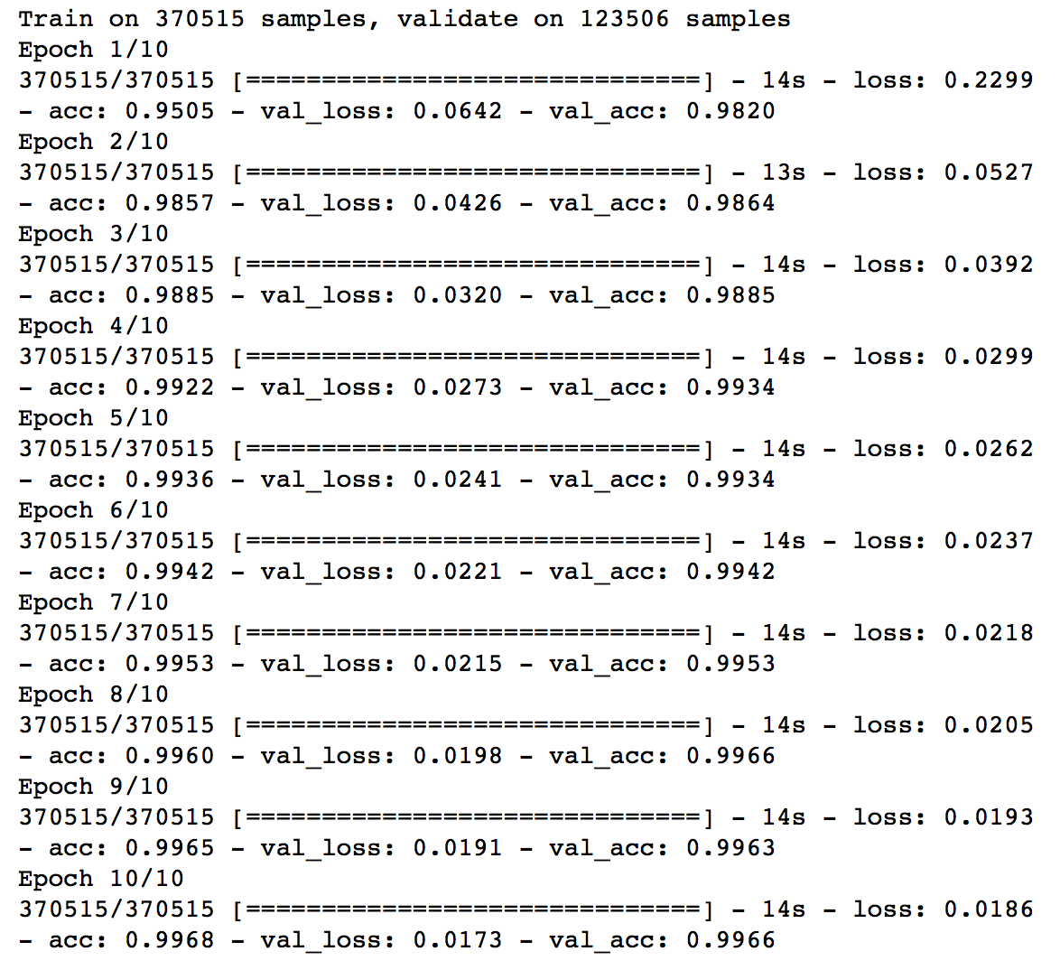
KDD ’99 Dataset Simulation
Training and validation results
The loss function (categorical crossentropy) value in the training dataset for the last batch in this epoch.
The categorical accuracy in the training dataset for the last batch in this epoch. (Correct accuracy)
Acc = ( argmax(y_true) == argmax(y_pred))
The loss function value of the testing dataset for the model trained at the end of this epoch
The categorical accuracy of the testing dataset for the model trained at the end of this epoch

Slide 32
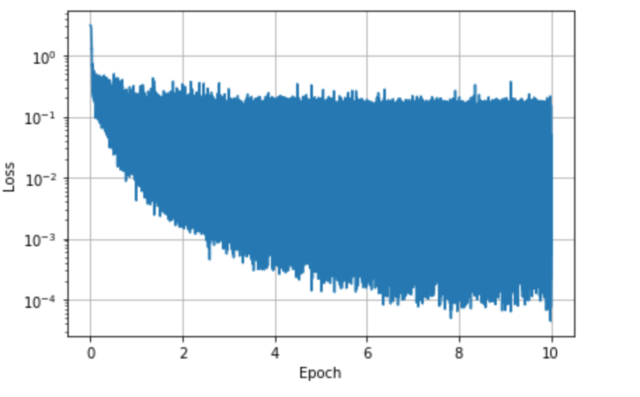
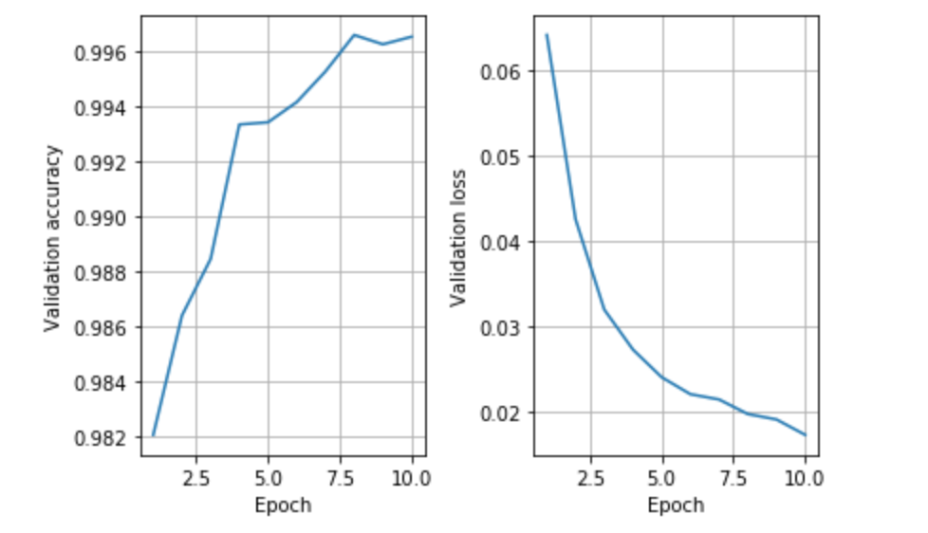
KDD ’99 Dataset Simulation
Training Loss
Training and validation results (contd.)
Loss function value is recorded at the end of each batch, the loss value for training dataset is infinitely approximating the optimal value.
While validation accuracy and validation loss is only calculated at every epoch’s end. Their value reaches convergence approximately after the 8th epoch.
Testing Accuracy and Loss

Slide 33
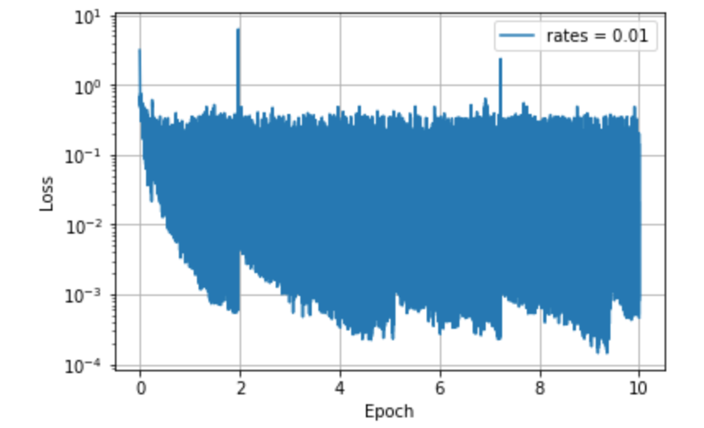
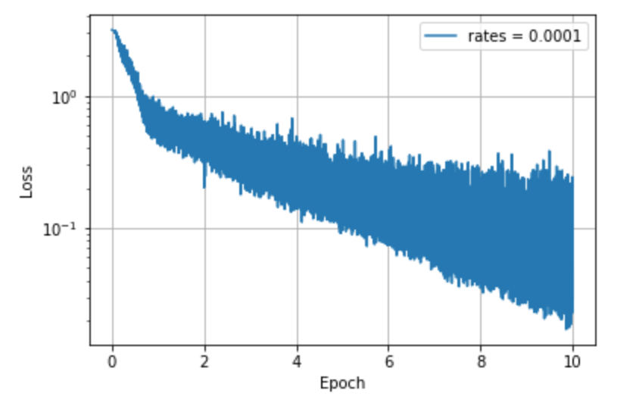
KDD ’99 Dataset Simulation
Training Loss (lr = 0.01)
Learning rate changed
Initially, the learning rate is set to 0.001
If learning rate is modified to 0.01, convergence time to the minimal training loss is reduced, but will be more likely to be unstable.
Due to a large learning rate, the model became unstable and overshoots the optimal value.
Then the network needs to adjust its weights to lower the loss function again.
If the learning rate is modified to 0.0001, convergence time will increase, but model will be less likely to be unstable
Training Loss (lr = 0.0001)

Slide 34
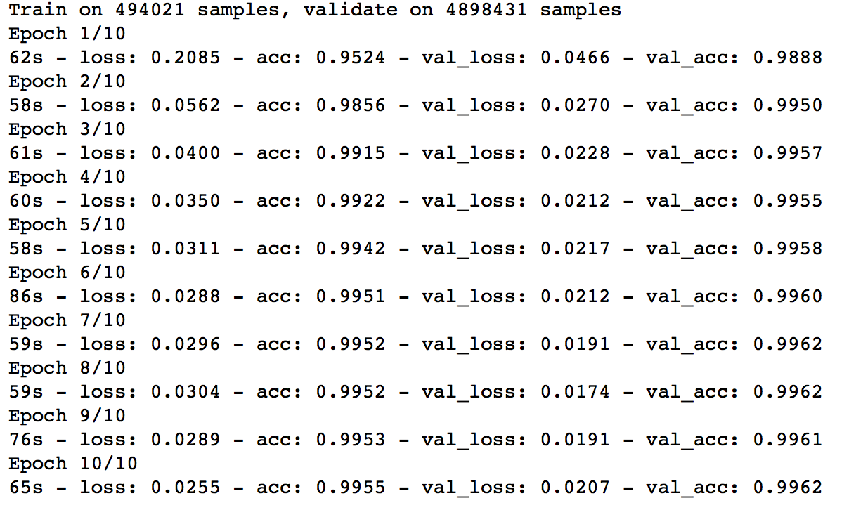
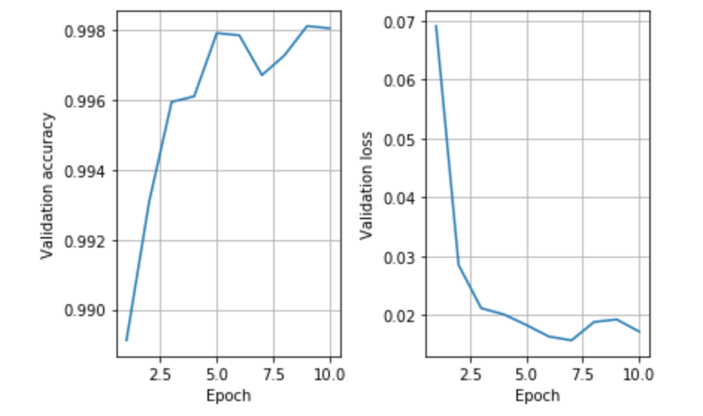
KDD ’99 Dataset Simulation
Testing on complete dataset
Amount of time used per epoch increased, due to the size of training dataset quadrupled and larger validation dataset.
Testing Accuracy and Loss
The validation accuracy and loss value does not differ much from the 10% dataset.

