Slide 1
Lane 1 2 3
Two deployments: garage and library with beam
Dataset info:
vs1-vs4 : the vibration data of sensor 1 to 4
timestamp1- timestamp4: the timestamp of vibration data (unit is microsecond)
There is a clock offset between the different sensor node
1 foot
S3
S4
sensor
drop location
Excitation ground truth:
Rule 1: drop tennis for 10 times in each drop location within 10 seconds
Rule 2: drop sequence: from lane 1 to lane 2 to lane 3. In each lane, from bottom to top.
Rule 3: 10 seconds break when changing lane.
S2
S1

Slide 2
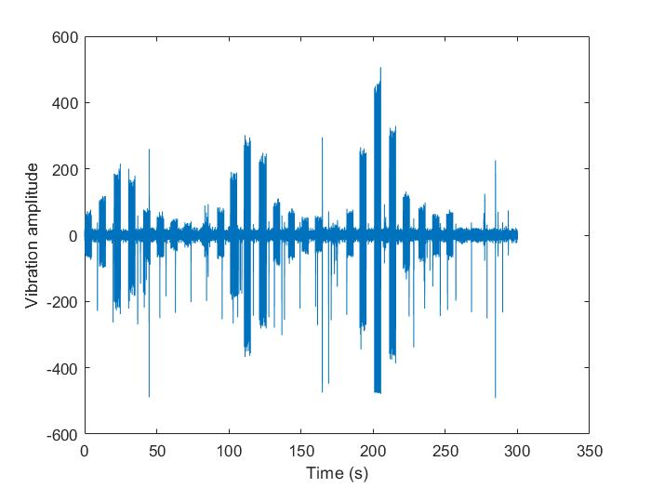
Example
If you consider the coordinate of sensor 2 is (0,0), and the coordinate of sensor 1 is (4,0)
The coordinate of the excitation between 0 to 10 seconds is (1,-4). The coordinate of the excitation between 110 to 120 seconds is (2,0)

