Slide 1
Predicting Readmittance for Diabetes Patients
CDC 2023
Elena Tsai & Katie Yoon

Slide 2
Agenda
Overview of Data
Data Investigation
Modeling the Data
Results

Slide 3
Overview
hospitalized patients with diabetes
from 130 US hospitals and integrated delivery methods
represents 10 years (from 1999 to 2008)

Slide 4

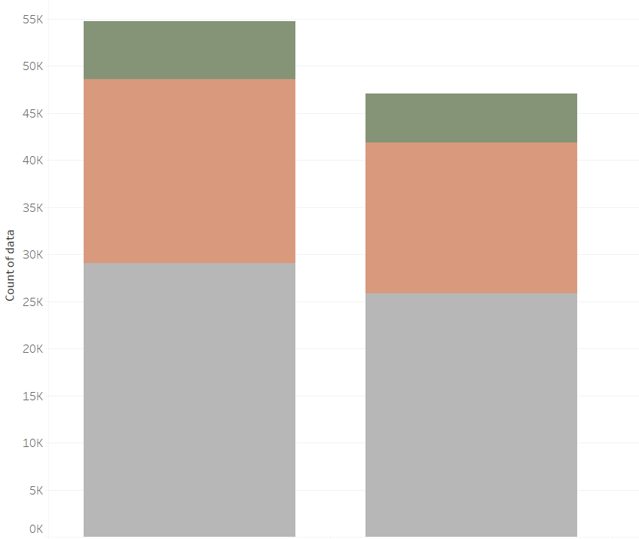
Data Investigation
female
male
gender

Slide 5
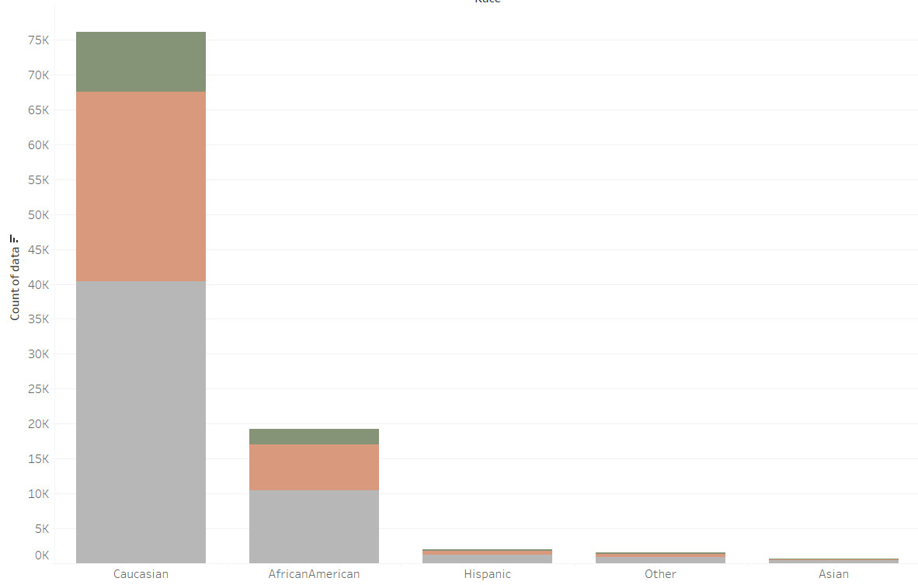
Data Investigation
race

Slide 6
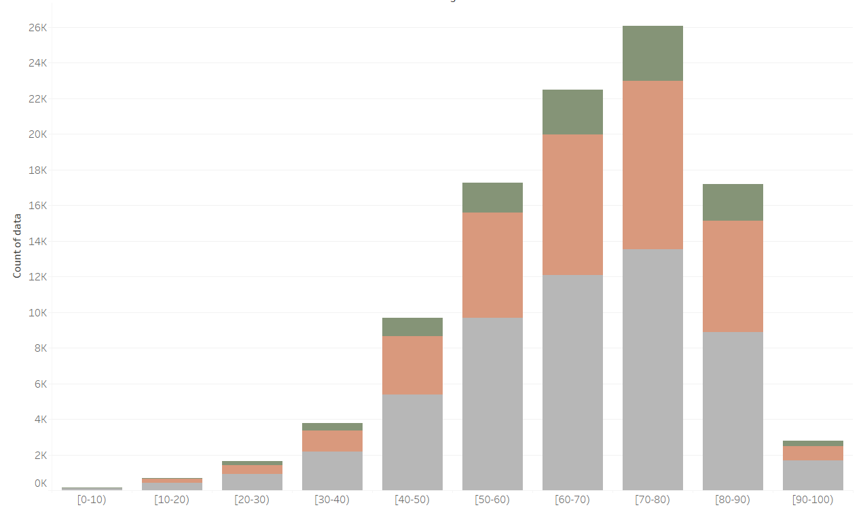
Data Investigation
age groups

Slide 7
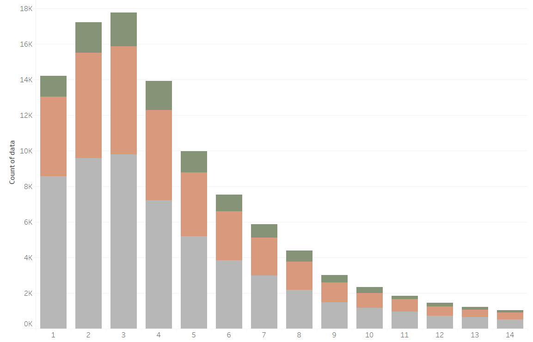
Data Investigation
time in hospital (days)

Slide 8
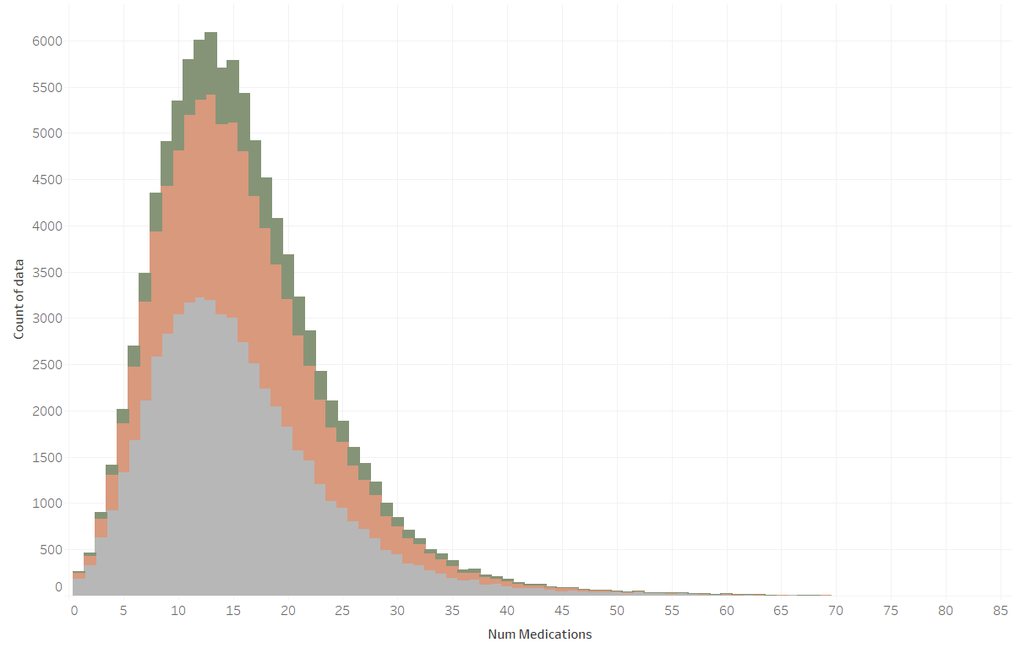
Data Investigation
number of medications

Slide 9
Data Preprocessing/Feature Selection
01
02
03
Removed data columns (missing data, multicollinearity/redundancy)
Converted categorical data to factor type
Split data into 80/20 training and testing sets

Slide 10
Most Influential Predictors of Readmittance
Class | TOP 5 PREDICTORS
<30 days | Time In Hospital, Male, Number of Medications, Change of Medications, Number of Lab Procedures
>30 days | Change of Medications, Time In Hospital, Elective Admission, Number of Medications, Number of Lab Procedures

Slide 11
Odds Ratio of Influential Predictors
<30 days | Odds | >30 days | Odds
Time In Hospital | 1.012888 | Change of Meds | 0.9840601
Male | 0.06439459 | Time In Hospital | 1.015422
Number of Meds | 1.003974 | Elective Admission | 0.9920331
Change of Meds | 1.0036249 | Number of Meds | 1.001150
Number of Lab Procedures | 1.001545 | Number of Lab Procedures | 1.000936

Slide 12
Predictive Model Results
 | Training Set
 | Precision | Accuracy
No Readmit | 9.24% | 100%
Readmit <30 | 36.21%
Readmit >30 | 30.85%
 | Training Set
 | Precision | Accuracy
No Readmit | 9.04% | 100%
Readmit <30 | 34.46%
Readmit >30 | 39.96%

Slide 13
Questions?
thank you :)

