Slide 1
Predicting winners in Dota2 matches

Slide 2
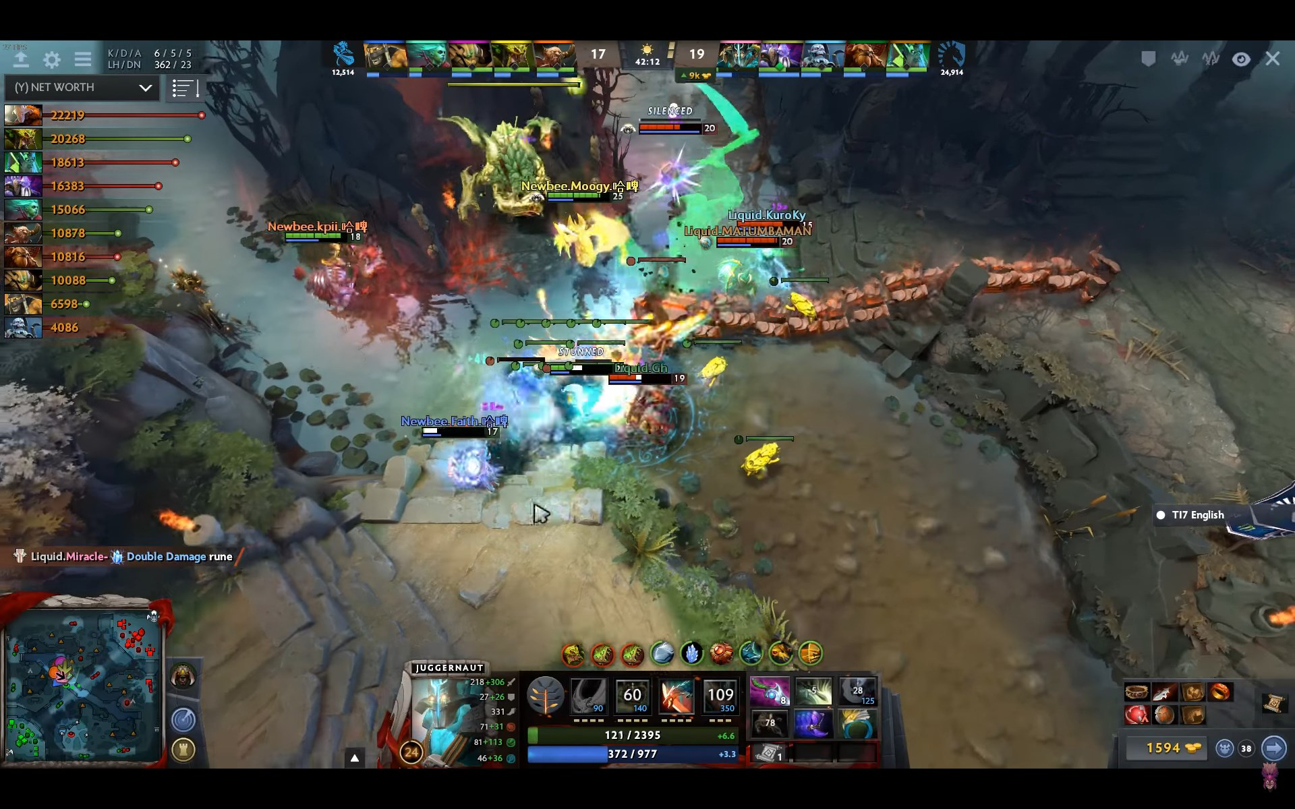

Slide 3
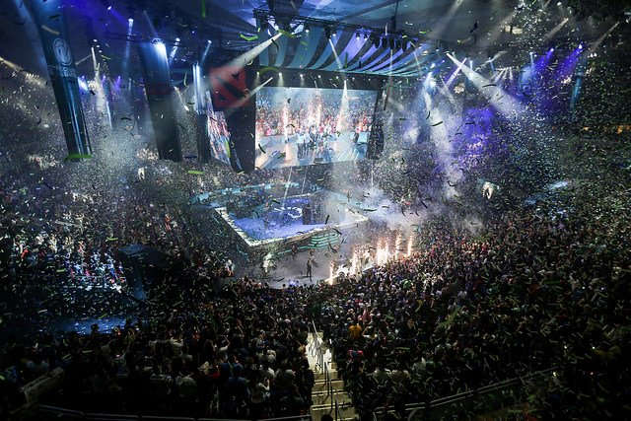

Slide 4
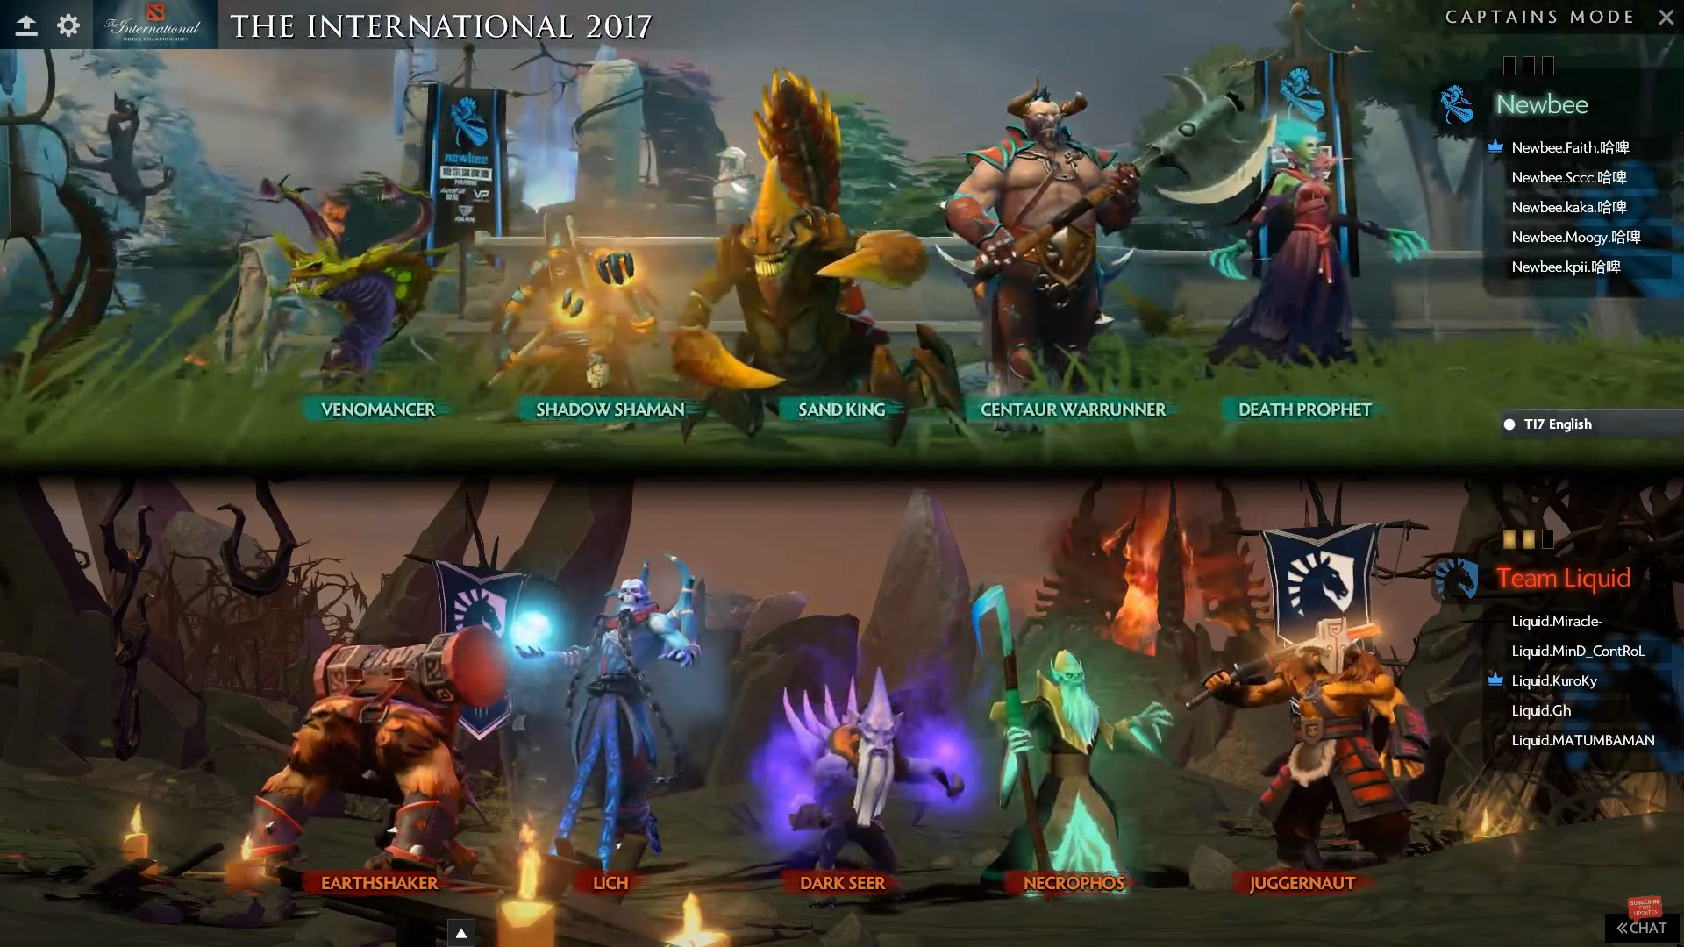
Game basics
Two teams of five players, each playing one character or “Hero”
Radiant vs Dire
Objective is to destroy the opponent’s base
Each team’s composition is determined by the two captains alternating bans and picks

Slide 5
Creating the dataset
OpenDota.com API
Has API call for match id list (games played) by team ID
Has API call for detailed match info by match id
Dataset:
Games played by the 18 teams attending the International 2019 (TI9)
Within the last 2 years

Slide 6
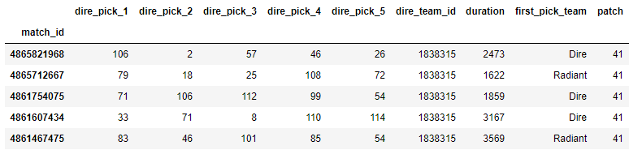
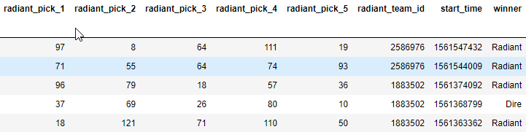
Initial Dataset

Slide 7
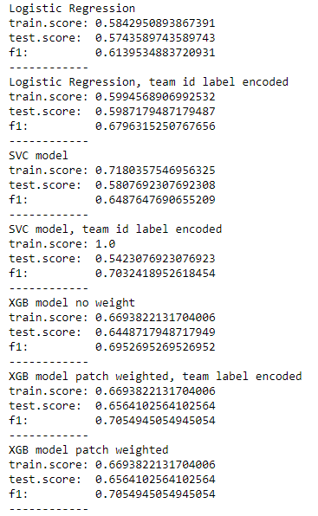
Initial model fitting
Logistic Regression
SVC model
XGBoost model
Showed the most promise
match_weight = X_train['patch']/41

Slide 8
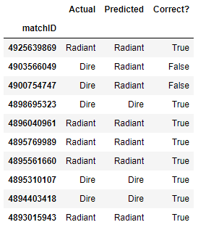
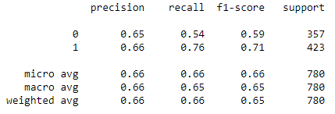
Initial Metrics
 | XGBoost predict Dire | XGBoost predict Radiant
Actual Dire win | 191 | 166
Actual Radiant win | 102 | 321

Slide 9
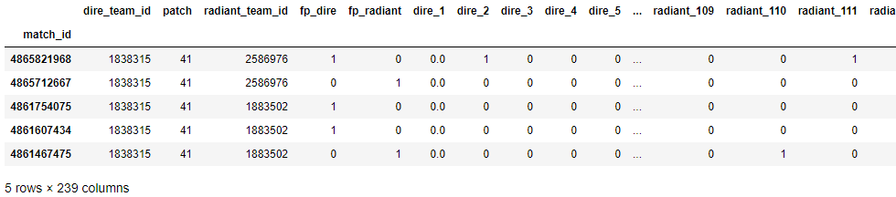
Transforming dataset
Changed each pick (dire_pick_1, dire_pick_2, etc.) to be One Hot Encoded and then merged into one set of One Hot Encoded columns
Many more features, but very sparse (5 1’s in 117 columns, twice)

Slide 10
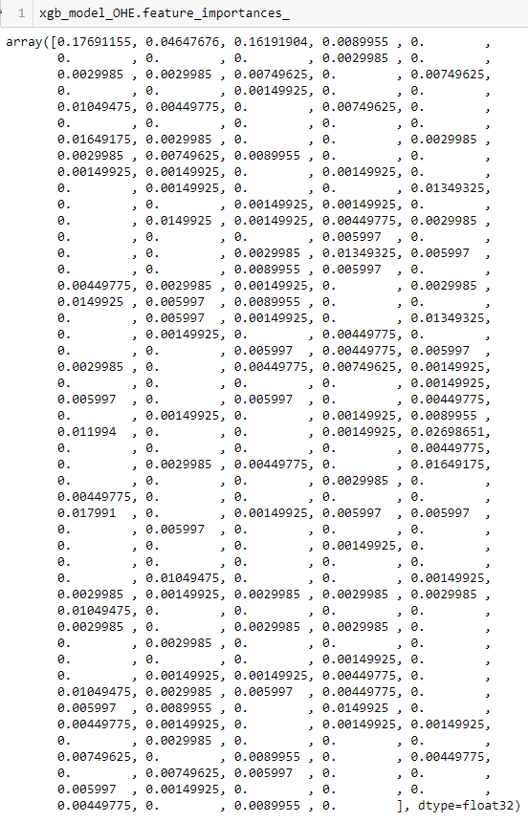
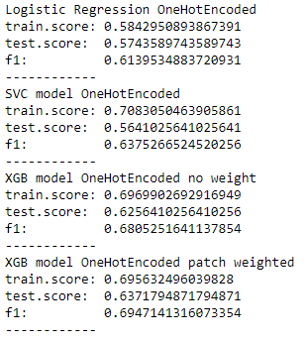
More model fitting

Slide 11
One Hot Encoded XGBoost Decision Tree

Slide 12
Problem!
XGBoost does not handle categorical columns, only numerical ones
It will make assumption that the categories are ordered
Hero ID has been One Hot Encoded, but team_id is still categorical
Team IDs: 1838315, 1883502, 726228, 39, 2163, 15, 350190,6214973,2108395, 2586976, 111474, 2626685, 6209804, 543897, 36, 7203342, 2672298, 1375614 (+ more)
However, there are 259 dire teams and 261 radiant teams in the data set, which leads to…
Xgboost manages only numeric vectors.

Slide 13
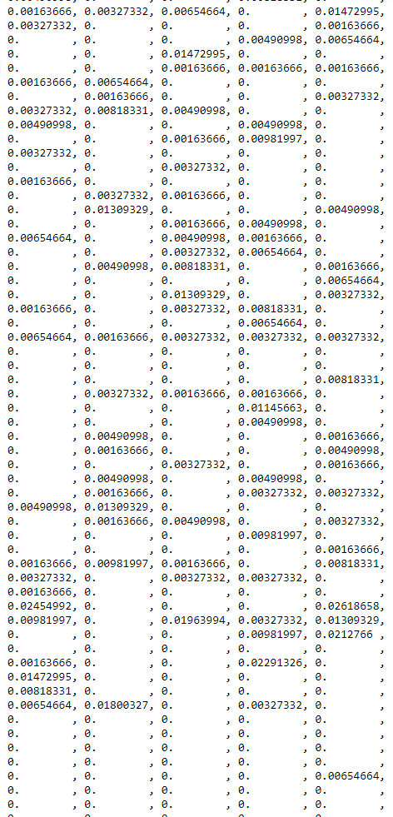
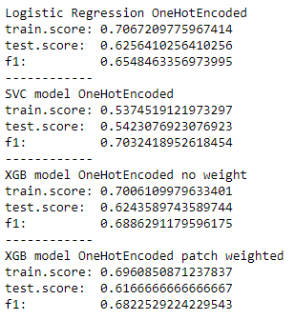
team_id one hot encoded:
757 columns
Feature importance of this data set:
625 of the 757 columns were considered to have 0 importance

Slide 14
team_id one hot encoded:
Decision tree for this data set

Slide 15
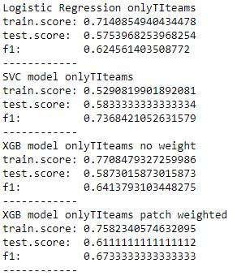
Only keeping matches where both teams are attending the International 2019
1679 rows × 271 columns

Slide 16
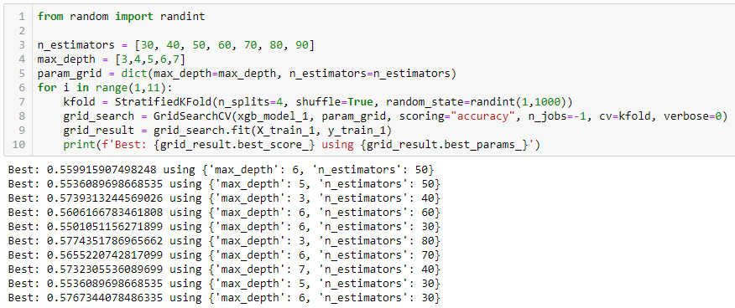
Only keeping matches where both teams are attending the International 2019
GridSearchCV to narrow down best parameters

Slide 17
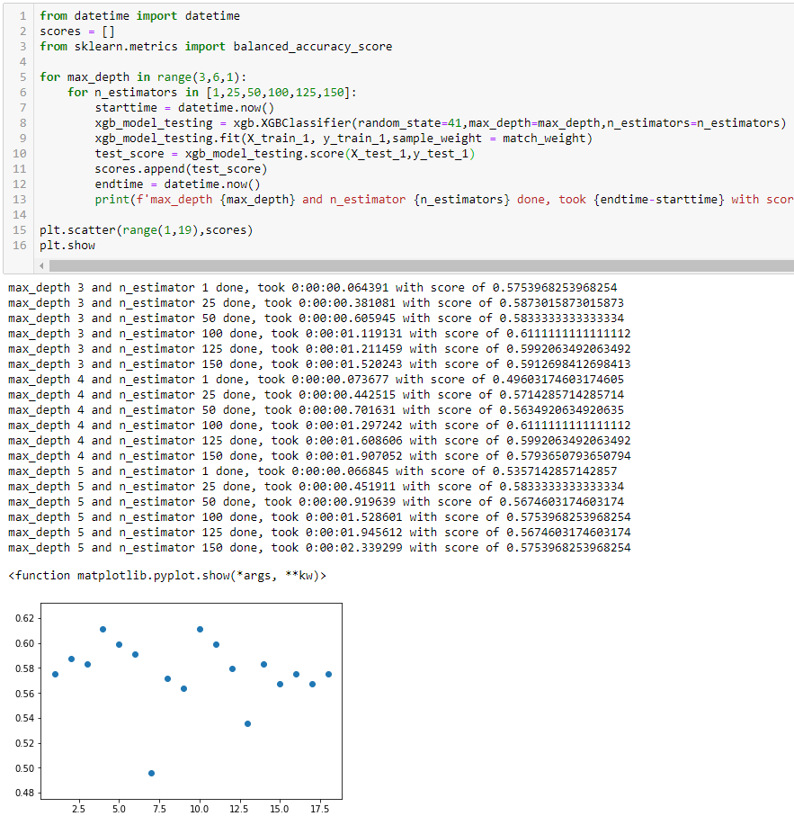
Only keeping matches where both teams are attending the International 2019
Custom loop to test fits
Interesting note: XGBClassifier’s random_state does not affect fit
Only some parameters are random, others are deterministic
If subsample=1 (default), random_state has no effect

Slide 18
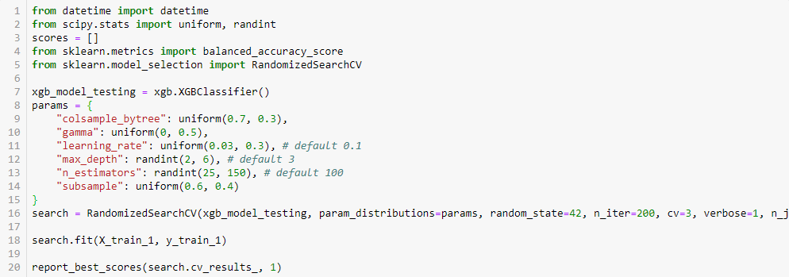
Only keeping matches where both teams are attending the International 2019
RandomSearchCV

Slide 19
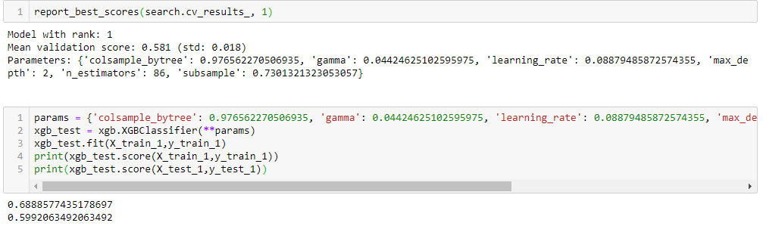
Only keeping matches where both teams are attending the International 2019
RandomSearchCV

Slide 20
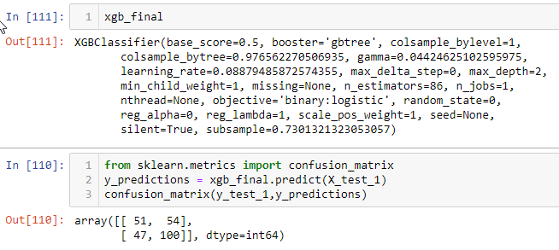
Final Model Metrics

Slide 21
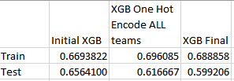
Final Model Comparison
Comparing various models:
More refined modeling shows worse test scores and a larger gap between train and test scores, despite being more “accurately” modeled

Slide 22
Final model in action
Launch flask app!

Slide 23
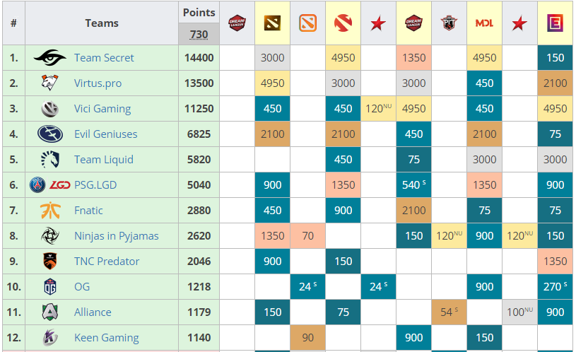
However…
Through the past “season”, teams have accumulated points for tournament results

Slide 24
However…
If a team has accumulated more points through the season, they’ve been the “better” team over the course of the season
So what is my accuracy if all I do is:
If team A is in the top 12 and team B is not, team A wins
If both teams are in top 12, higher ranked team wins
If both teams are in ranks 13-18 (regional qualifier teams), random win

Slide 25
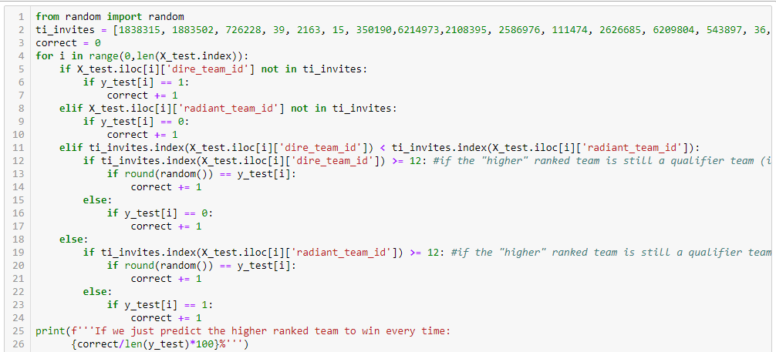
However…

