Slide 1
Research Software Tools Workshop
Version control using git
Tommy S. Alstrøm
Postdoc
Cognitive Systems

Slide 2
Getting Started - Installing Git
https://git-scm.com/book/en/v2/Getting-Started-Installing-Git
Linux:

Slide 3


Slide 4
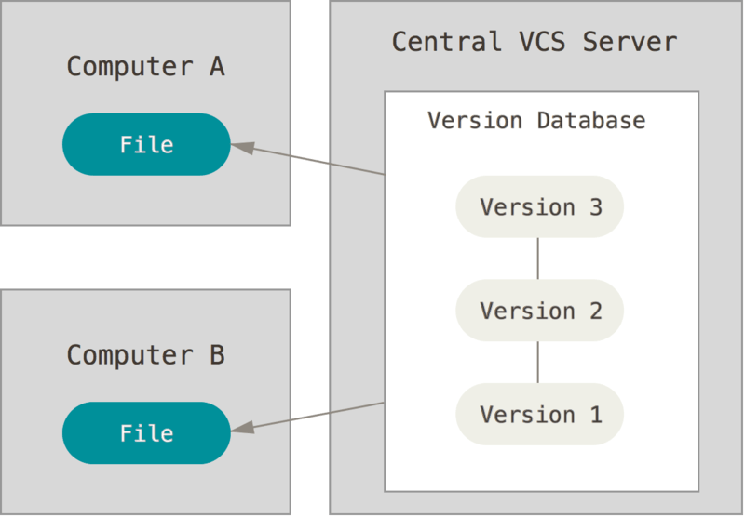

Slide 5
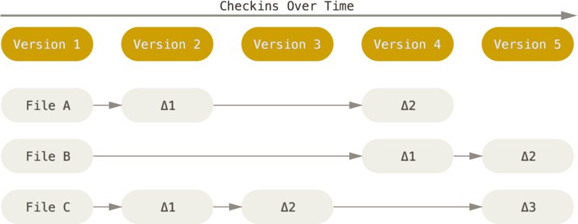

Slide 6
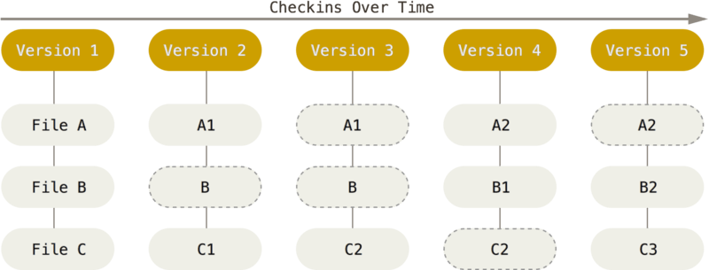

Slide 7
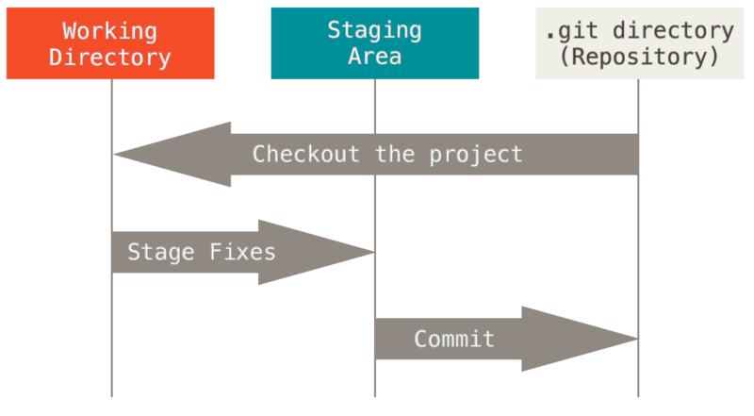

Slide 8
