Slide 1
Research Software Tools Workshop
Version control using git
Tommy S. Alstrøm
Postdoc
Cognitive Systems

Slide 2
Learning objectives for today
Understand what is gained by using a versioning control system.
Understand main concepts of a version control system such as versioning, commits, branches and merging.
Understand the basic differences of git, and how it compares to Perforce and Subversion.
Be able to set up a git environment, both locally and using remote servers.
Will be able to work with clones, commits, merging, rebasing in git.
Can read a github website.

Slide 3
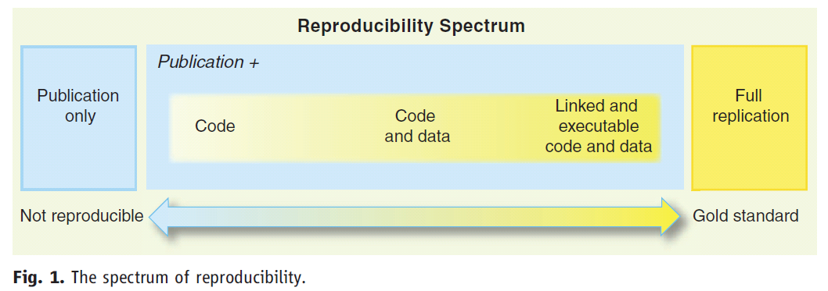
The basic principle of computational reproducible research
Roger D. Peng. "Reproducible Research in Computational Science“. Science 2 December 2011: 334 (6060), 1226-1227.

Slide 4
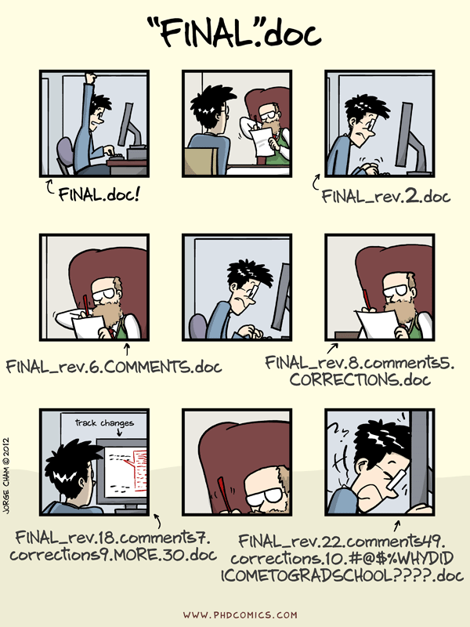
Why a versioning control system?
http://git-lectures.github.io/

Slide 5
http://www.ee.columbia.edu/~dpwe/e6891/slides/E6891_%20lecture%202.pdf

Slide 6
http://www.ee.columbia.edu/~dpwe/e6891/slides/E6891_%20lecture%202.pdf

Slide 7

Workshop 4 Version control of code using git
Git is a free and open source distributed version control system designed to handle everything from small to very large projects with speed and efficiency.
System used as primary VCS
Eclipse community survey 2014
https://git-scm.com/

Slide 8
Git | Subversion | Perforce
Free | Free | Commercial Free for personal use
Distributed | Centralized | Hybrid
Local shadow copy | Local shadow copy | None
Everything happens client-side | Client-server | Server-side copy/branching

Slide 9




Workshop 5 Data management using Perforce
Git Fusion
Version Control
Perforce Swarm
Perforce P4D
ZFS storage (72 TB)
Notes:
Swarm – DAN crowd problem solution stuff – information sharing.
Why not dropbox

Slide 10

Material covered
Chapter 1 – Getting Started
Chapter 2 – Git Basics
Chapter 3 – Git Branching
Chapter 4.1 - Git on the server – the protocols
Chapter 4.3 - Generating Your SSH Public Key
Chapter 7.11 – Submodules
The book is 574 pages long, we will cover roughly 100 pages
https://git-scm.com/book/en/v2

Slide 11
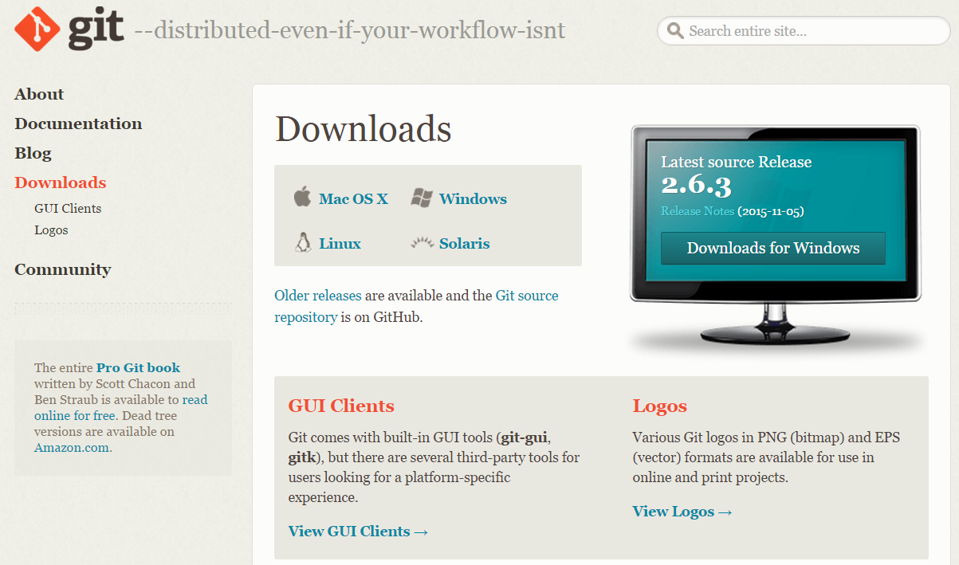
Installing git
Windows users: choose these options when installing:
“Use Git from the Windows command prompt”
Otherwise use default settings.
http://git-scm.com/downloads

Slide 12
Getting files … the git way
tommysl@tommysl-PC MINGW64 /e/DTU/courses/ResearchSoftwareTools/ws4_version_control_git (master)
$ cd “exercise directory”
$ git clone git://github.com/tsal-dtu/ws4_version_control_git.git
Cloning into 'ws4_version_control_git'...
remote: Counting objects: 14, done.
remote: Compressing objects: 100% (12/12), done.
remote: Total 14 (delta 1), reused 14 (delta 1), pack-reused 0
Unpacking objects: 100% (14/14), done.
Checking connectivity... done.
$ ls -l
total 0
drwxr-xr-x 1 tommysl 197121 0 Nov 15 12:02 ws4_version_control_git/
$ cd ws4_version_control_git
$ ls -l
total 460
drwxr-xr-x 1 tommysl 197121 0 Nov 15 12:02 latex/
-rw-r--r-- 1 tommysl 197121 470824 Nov 15 12:02 version_control_git.pptx

Slide 13

Exercise material is very brief google issues or use the book
http://www.theallium.com/engineering/computer-programming-to-be-officially-renamed-googling-stackoverflow/

Slide 14


Slide 15
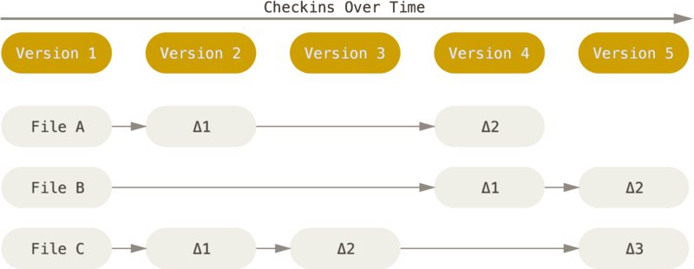

Slide 16
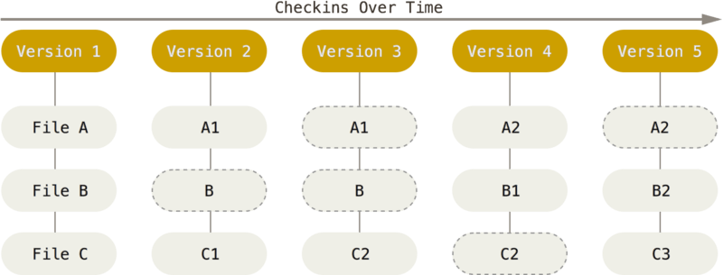

Slide 17
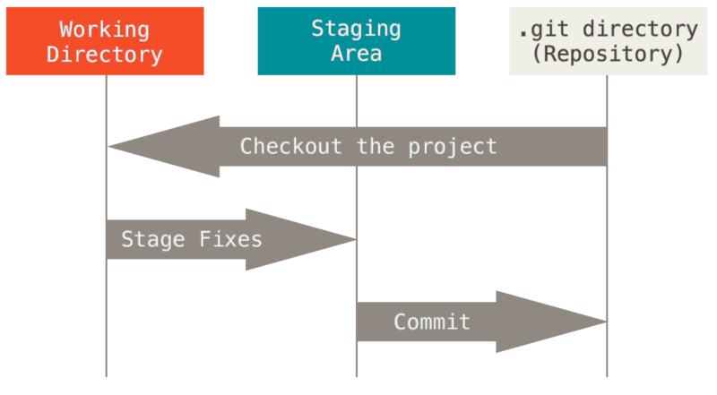

Slide 18
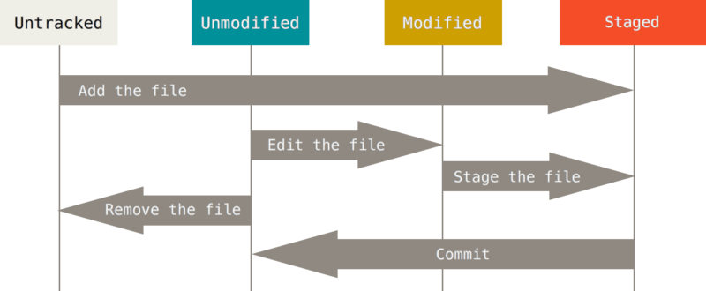

Slide 19
tommysl@tommysl-PC MINGW64 /e/DTU/courses/ResearchSoftwareTools/ws4_version_control_git (master)
$ git status
warning: LF will be replaced by CRLF in latex/version_control_git.tex.
The file will have its original line endings in your working directory.
On branch master
Changes to be committed:
(use "git reset HEAD <file>..." to unstage)
modified: latex/version_control_git.tex
Changes not staged for commit:
(use "git add <file>..." to update what will be committed)
(use "git checkout -- <file>..." to discard changes in working directory)
modified: latex/Makefile
Untracked files:
(use "git add <file>..." to include in what will be committed)
License
book/
latex/Makefile.advanced
latex/version_control_git.pdf
refs/

Slide 20
Git diff
git diff head
git diff
git diff --staged

Slide 21
Git rm
Removing files are done with
$ git rm License
rm ‘License’
$ git status
On branch master
Changes to be committed:
(use "git reset HEAD <file>..." to unstage)
deleted: License
Changes not staged for commit:
…

Slide 22
Git log
To see commit history use
$ git log --stat -1
commit 5e99b7da063e9ed615c503384d852a1a281b822a
Author: Tommy S. Alstrøm <tsal@dtu.dk>
Date: Sun Nov 15 14:57:51 2015 +0100
Updated content of the latex file so this is no longer in bullet form.
latex/version_control_git.tex | 143 ++++++++++++++++++++++++++++--------------
1 file changed, 95 insertions(+), 48 deletions(-)
Or launch the visual tool
$ gitk &

Slide 23
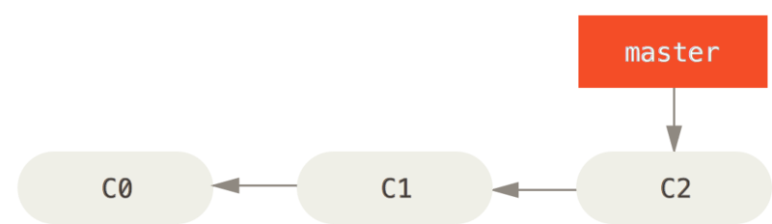
Basic branching and merging

Slide 24
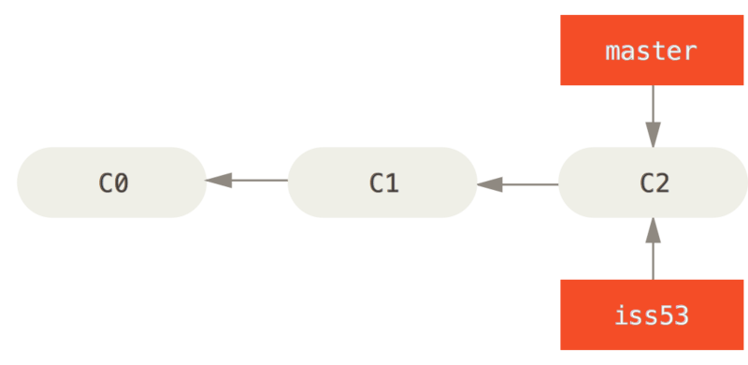
Basic branching and merging

Slide 25
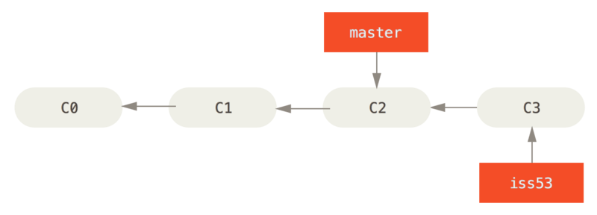
Basic branching and merging

Slide 26
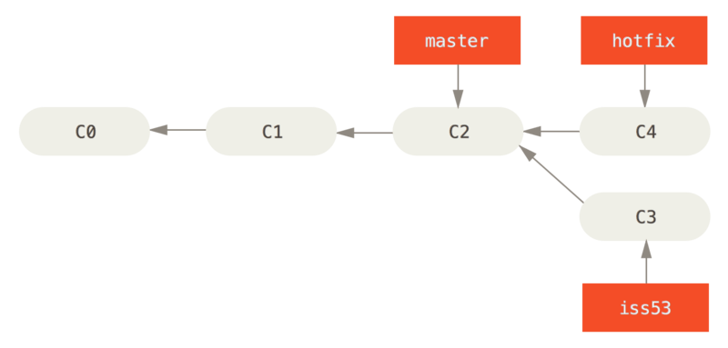
Basic branching and merging

Slide 27
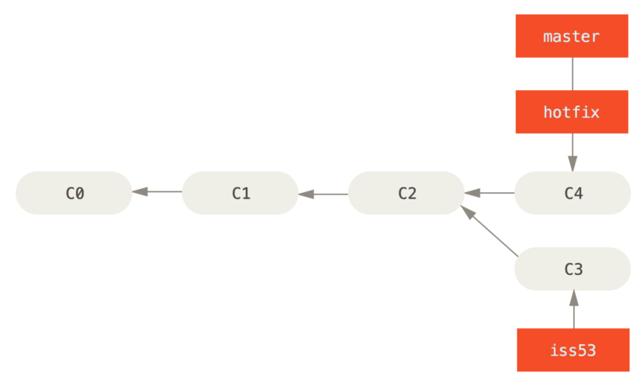
Basic branching and merging

Slide 28
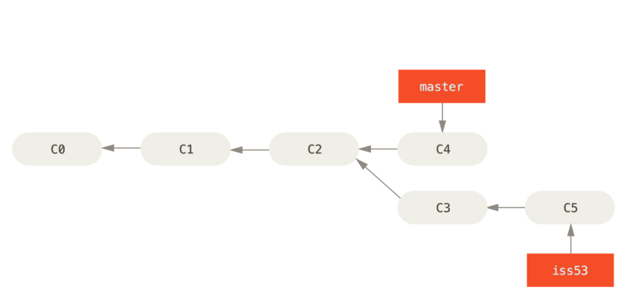
Basic branching and merging

Slide 29
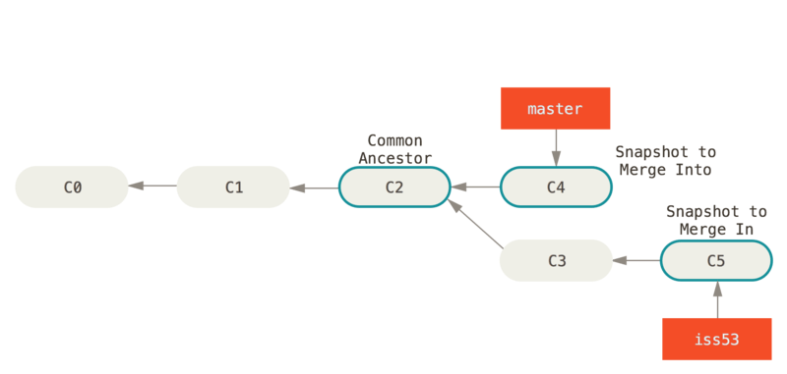
Basic branching and merging

Slide 30
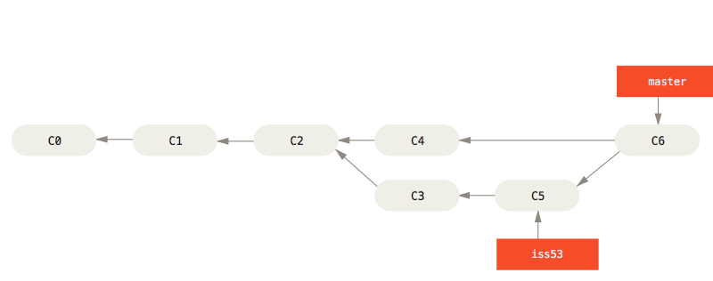
Basic branching and merging

Slide 31
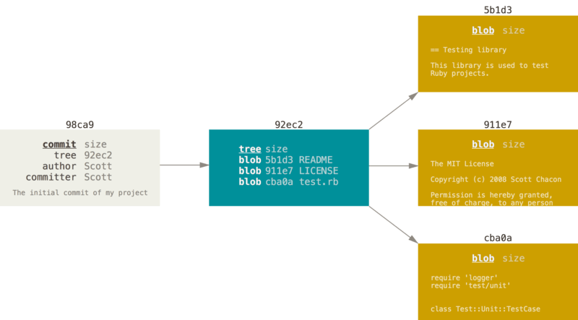
How is branching and merging implemented in git

Slide 32
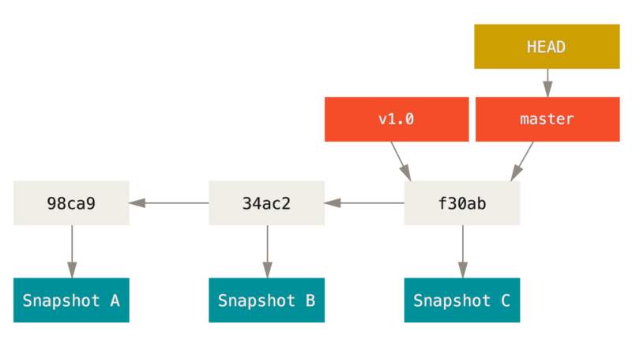
How is branching and merging implemented in git

Slide 33
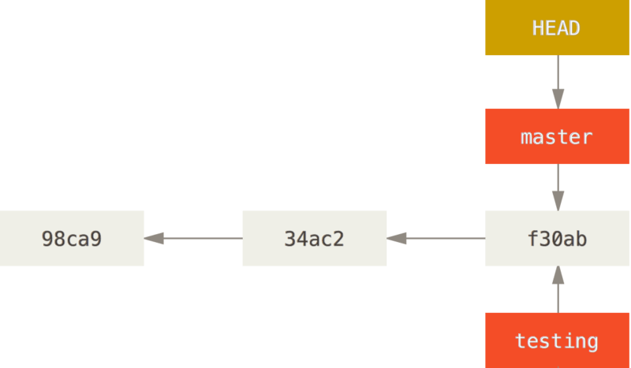
How is branching and merging implemented in git

Slide 34
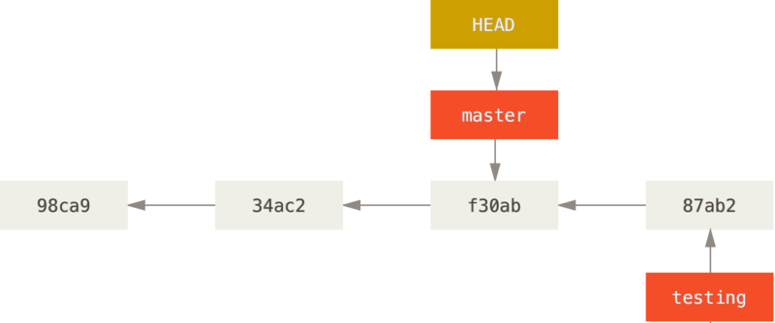
How is branching and merging implemented in git

Slide 35
Git branch
See current branches
$ git branch
* master
Create a new branch with
$ git branch <new branchname>
Delete a branch using
$ git branch –d <branchname>

Slide 36
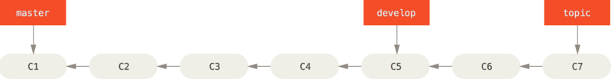
Branching workflows

Slide 37
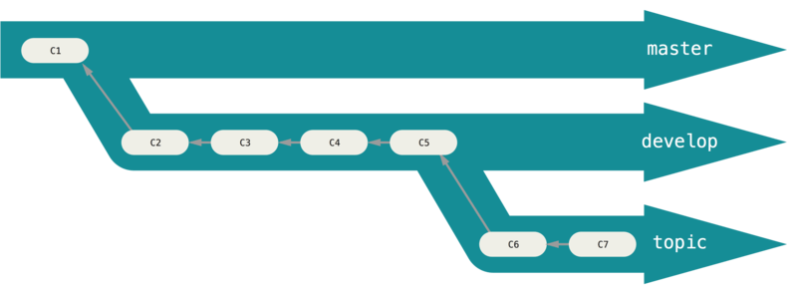
Branching workflows

Slide 38
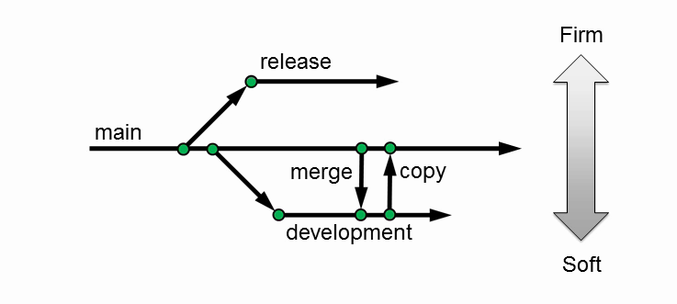
Branching – the mainline model
https://www.perforce.com/resources/tutorials/mainline-model

Slide 39
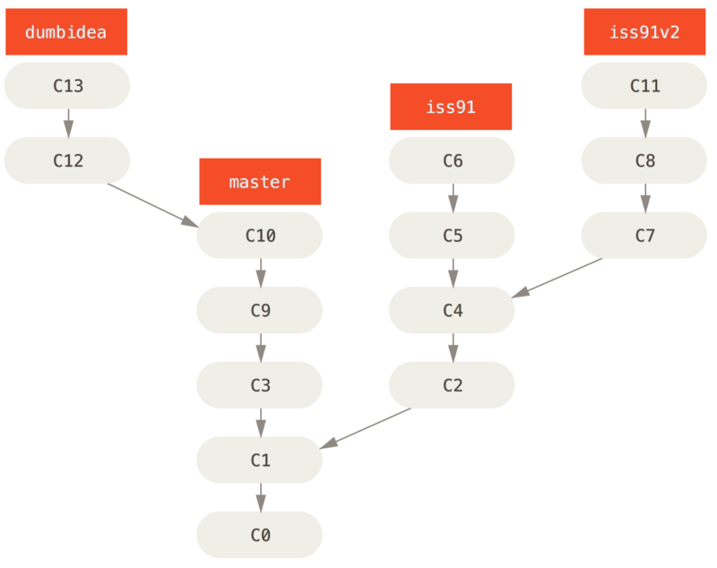
Branching workflows

Slide 40
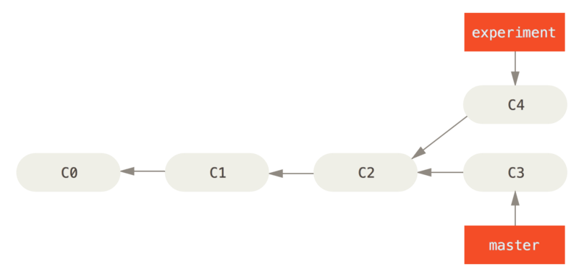
Branching workflows

Slide 41
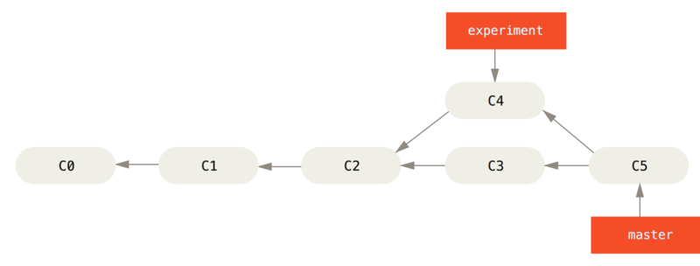
Branching workflows

Slide 42
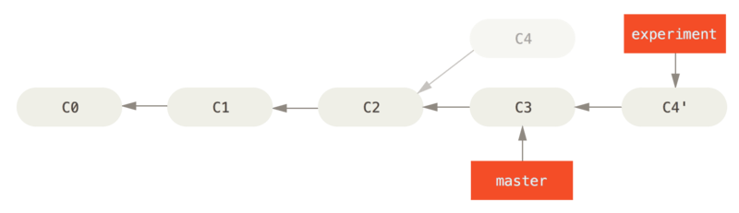
Branching workflows

Slide 43
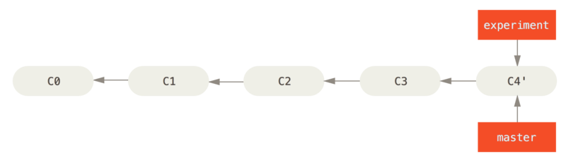
Branching workflows

Slide 44
Branching workflows
See current branches
$ git branch
* master
Create a new branch with
$ git branch <new branchname>
Delete a branch using
$ git branch –d <branchname>

Slide 45
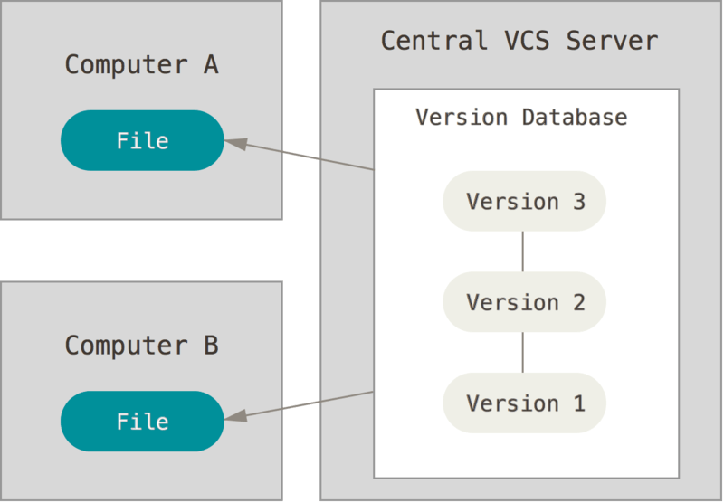

Slide 46
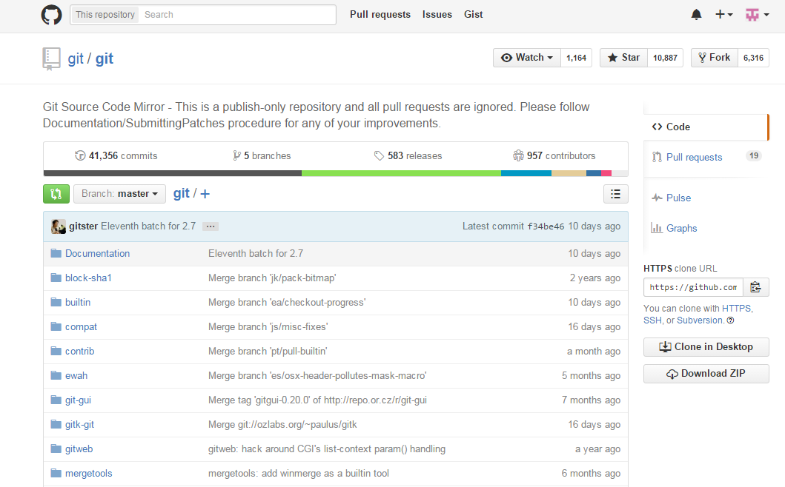
Now lets look at github web: https://github.com/git/git

Slide 47
Git remotes
see current remotes
$ git remote -v
* master
Push changes to remote
$ git push origin master
Pull changes from remote
$ git branch –d <branchname>

Slide 48
Two protocols – ssh or https
https use username and password.
ssh use public keys. A public key can be generated using the keygen.
$ cd ~/.ssh
$ ssh-keygen
$ ls -l
$ ls -l
total 9
-rw-r--r-- 1 tommysl 197121 1766 Nov 14 19:40 id_rsa
-rw-r--r-- 1 tommysl 197121 400 Nov 14 19:40 id_rsa.pub
-rw-r--r-- 1 tommysl 197121 1199 Nov 14 19:41 known_hosts

Slide 49
Git vs perforce
User perspective
Most version control commands
GIT
PERFORCE

Slide 50
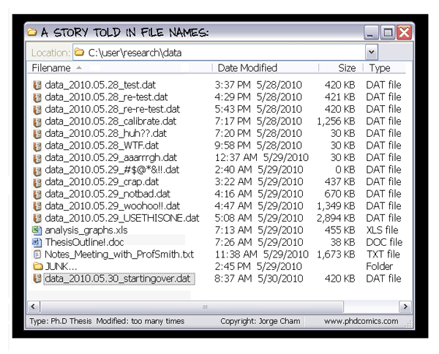
http://git-lectures.github.io/

Slide 51
Workshop 5 – 30 November Data management using Perforce
Git Fusion
Version Control
Perforce Swarm
Perforce P4D
ZFS storage (72 TB)
Notes:
Swarm – DAN crowd problem solution stuff – information sharing.
Why not dropbox

