Slide 1
Word2Vec Representations
man
king
woman
queen
Male-Female Analogy

Slide 2
Doc2Vec Representations
lyric a
closer
good annotation
bad annotation
lyric b
further
Good vs. Bad Annotations

Slide 3
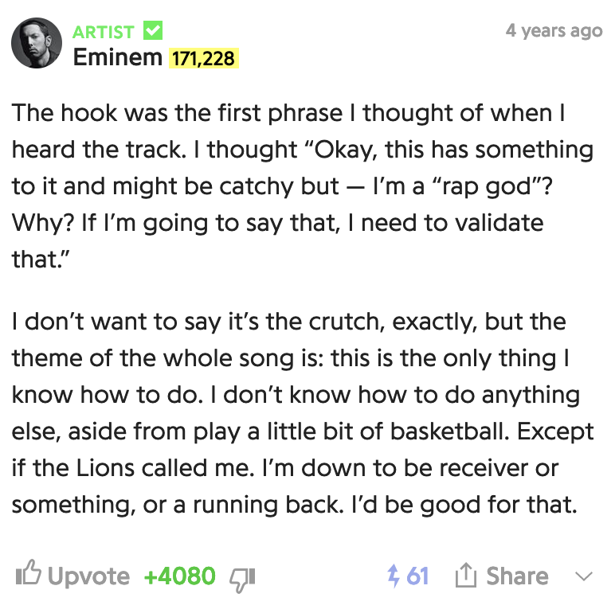
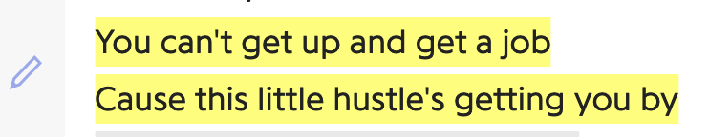

Annotation
Lyric

Slide 4
Lyric
Annotation

Slide 5
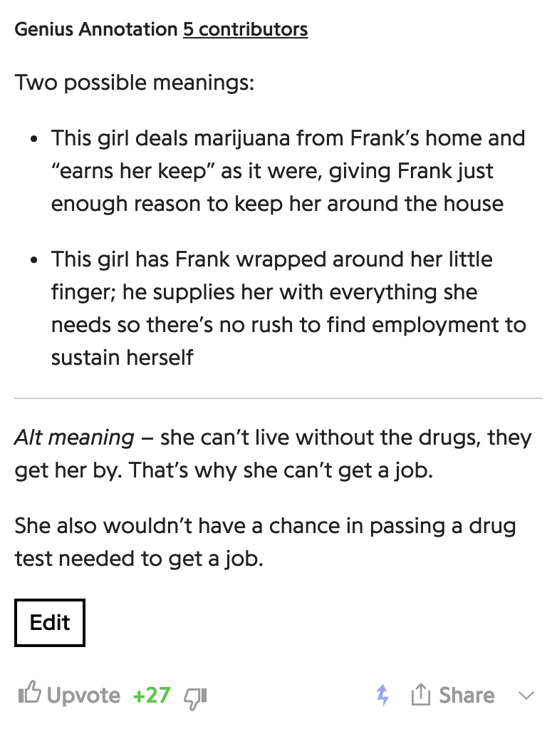
Lyric
Annotation

Slide 6
Annotation
Lyric

Slide 7
Lyric
Annotation

Slide 9
lyric a
good annotation
closer
bad annotation
lyric b
further
Good vs. Bad Annotations

Slide 10
lyric a
closer
good annotation
bad annotation
lyric b
Good vs. Bad Annotations

