Slide 1
Modeling Cortical Synchronization on Brain-Like Networks
Taj Sangha
September 22, 2014
"As long as our brain is a mystery, the universe, the reflection of the structure of the brain, will also be a mystery."
-Santiago Ramon y Cajal (1852 - 1934)
“The mind is everything. What you think you become.”
- Gautama Buddha

Slide 2
Main References
1. Acebrón, Juan A.; Bonilla, L. L.; Vicente, Pérez; Conrad, J.; Ritort, Félix; Spigler, Renato (2005). "The Kuramoto model: A simple paradigm for synchronization phenomena". Reviews of Modern Physics 77: 137–185.
2. Strogatz S (2000). "From Kuramoto to Crawford: Exploring the onset of synchronization in populations of coupled oscillators".Physica D 143 (1–4): 1–20
3. Bullmore, E.T, Sporns, O. “Complex brain networks: graph-theoretical analysis of structural and functional systems.” Nature Reviews Neuroscience 10, 186-198
4. Newman, Mark. Networks: an introduction. Oxford University Press, 2010.

Slide 3
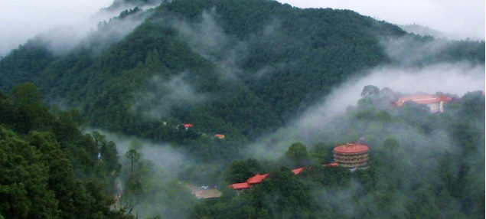
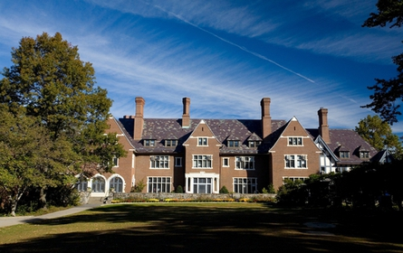
A little bit about me
Woodstock School, Sarah Lawrence College
http://www.complex-systems.meduniwien.ac.at/about/
Bard Ermentrout

Slide 4
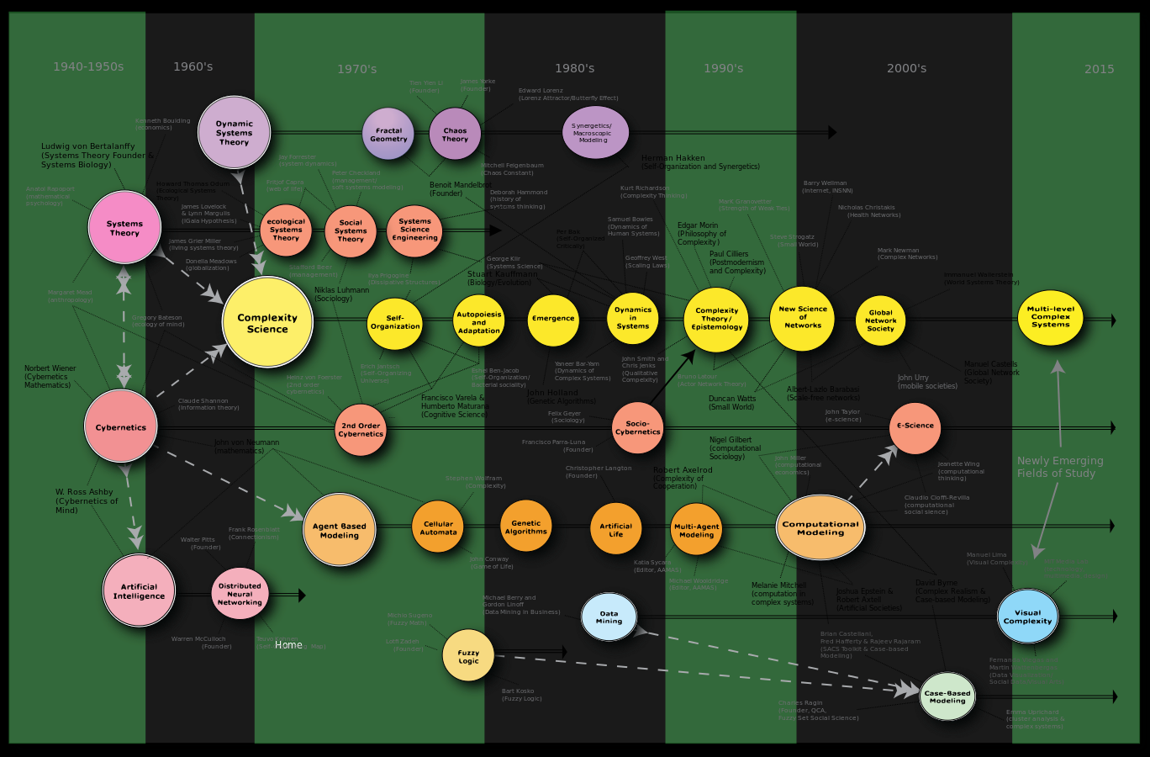
Brian Castellani: commons.wikimedia.org/wiki/File:Complexity_Map.svg

Slide 5
Fireflies in the Brain
http://www.youtube.com/watch?v=sROKYelaWbo
http://www.youtube.com/watch?v=tRPuVAVXk2M

Slide 6
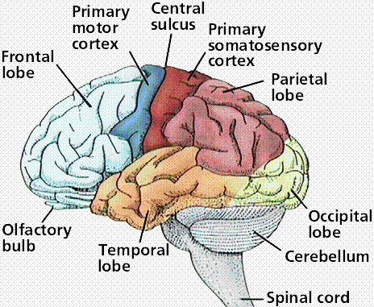
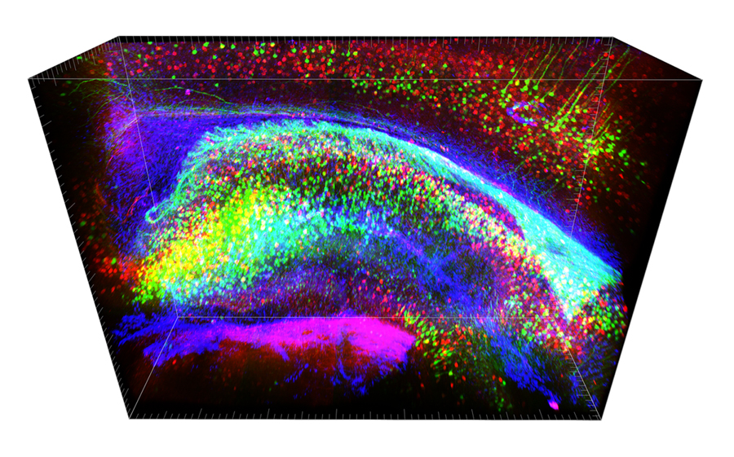
http://clarityresourcecenter.com/images/lineH_PV_GFAP_hipp.jpg
http://www2.estrellamountain.edu/faculty/farabee/biobk/biobooknerv.html
This is where the magic happens

Slide 7
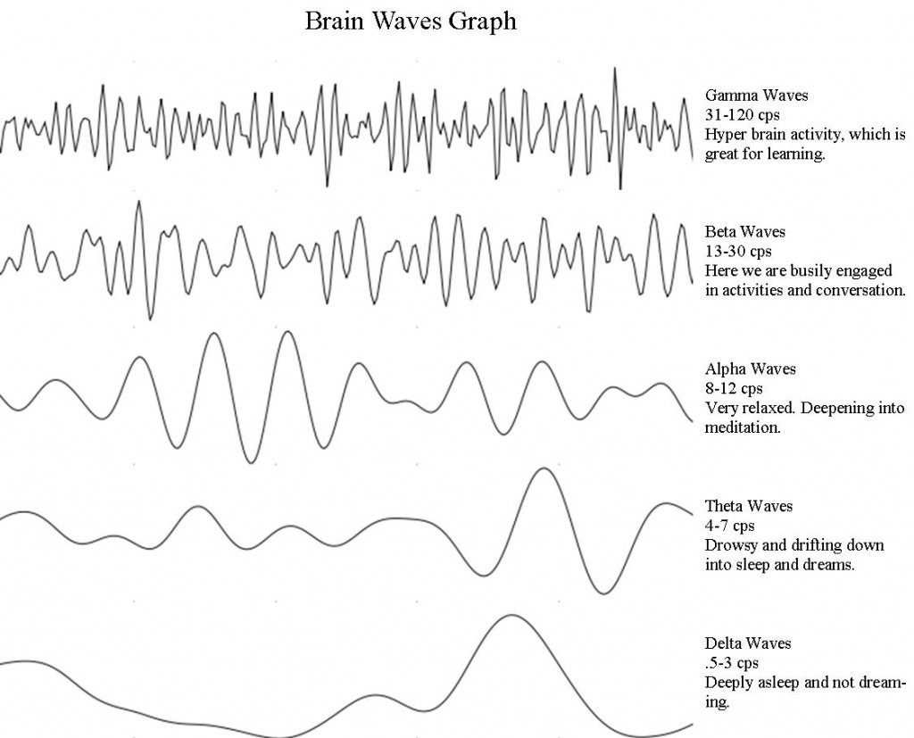
http://blog.world-mysteries.com/science/the-unity-of-life-consciousness/

Slide 8
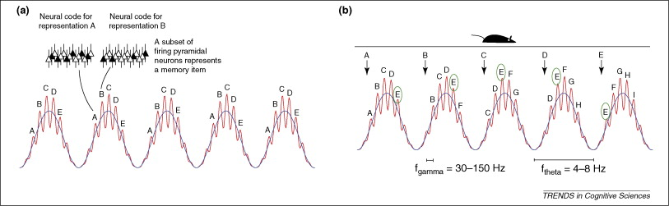
Temporal Encoding
Jensen, O, Colgin, L.L. “Cross-frequency coupling between neuronal oscillations.” Trans in Cog. Sci. 11 (7), 267-269
Interspike Intervals
Long-range communication by slow waves
Intracortical communication by fast waves
Why do we have 7 digit telephone numbers?
Notes:
Models proposing computational roles for cross-frequency interactions between theta and gamma oscillations by means of phase coding. (a) In a model for working memory, individual memory representations are activated repeatedly in every theta cycle [10] (reviewed in Ref. [11]). Each memory representation is represented by a subset of neurons in the network firing synchronously. Because different representations are activated in different gamma cycles, the gamma rhythm serves to keep the individual memories segmented in time. The number of gamma cycles per theta cycle determines the span of the working memory. (b) A model accounting for theta phase precession in rats. As a rat advances through an environment, positional information is passed to the hippocampus. This activates the respective place cell representations, which provokes the prospective recall of upcoming positions. In each theta cycle, time-compressed sequences are recalled: one representation per gamma cycle. Consider the firing of a cell participating in representation E. As the rat advances, this cell fires earlier in the theta cycle, thus accounting for phase precession. According to this scheme, the number of gamma cycles per theta cycle is related quantitatively to the phase precession [13].

Slide 9
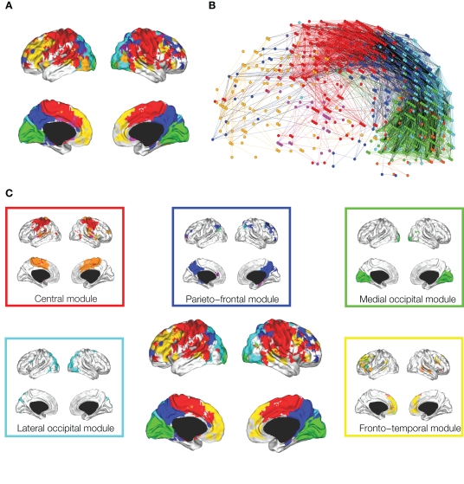
Meunier et al. “Hierarchical modularity in human brain functional networks.” Front. Neuroinformatics, 30 October 2009.

Slide 10
Synchrony in the Brain
Perception Binding Problem (γ)
Working Memory (γ & θ)
Selective Attention (α suppression, γ processing)
Multi-tasking (γ, α, β, cross frequency coupling)
Notes:
Synchronization amplifies and selectively brings to attention those neurons with receptive fields for stimuli.

Slide 11
Dynamics approach to Brain
complex (adj.): … from Latin complexus "surrounding, encompassing,“…from com- "with" (see com-) + plectere "to weave, braid, twine, entwine," from PIE *plek-to-, from root *plek- "to plait“ (etymonline.com)
Cognitive “Phase Space” & associated notions – E.g Churchland Lab, Gotham Brain Dynamics, Walter Freeman @ Berkeley
Robustness
Self-Organization

Slide 12
Matrices and Measures of Networks
The Adjacency Matrix
Edges and Nodes
Degree of a node
Path length
Clustering
Modularity

Slide 13
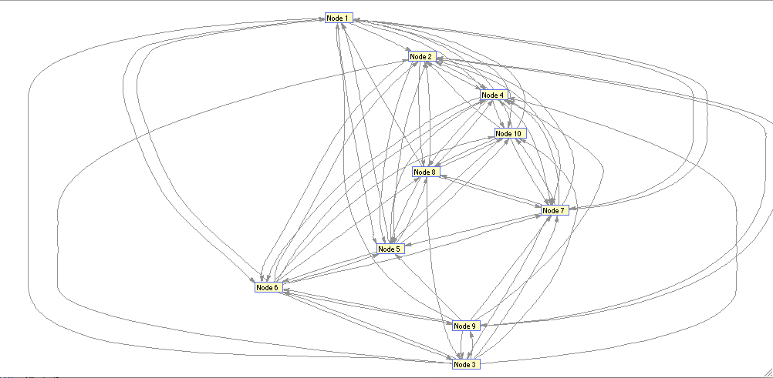
Erdos-Renyi Random Nets
Erdos Renyi Random Network with wiring probability 70%, n = 10

Slide 14
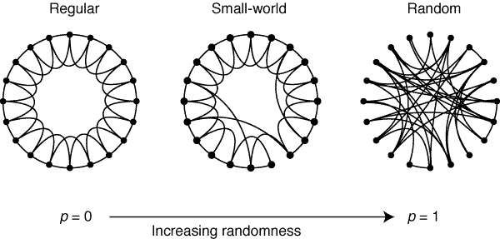
Small-World Networks
D. J. Watts, S. H. Strogatz, Collective dynamics of small-world networks Nature 393, 440 (1998). (Cited >23,000 times!)

Slide 15
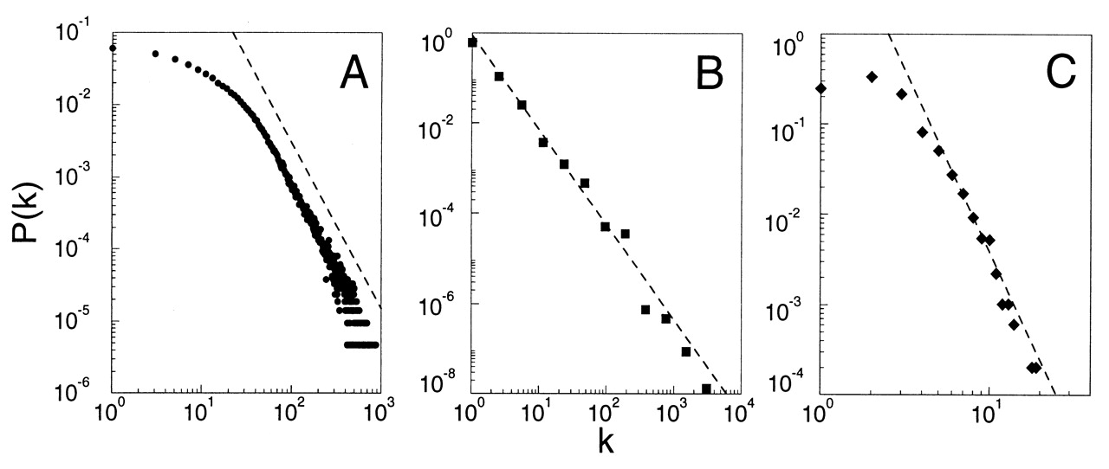
Scale-Free Networks
Barabasi, A.L., Albert, R. “Emergence of scaling in random networks.” 1999, Science 286, 509
Notes:
Actor connection network 220,000 vertices, WWW >8.0 *10^8, US power grid ~ 5000

Slide 16
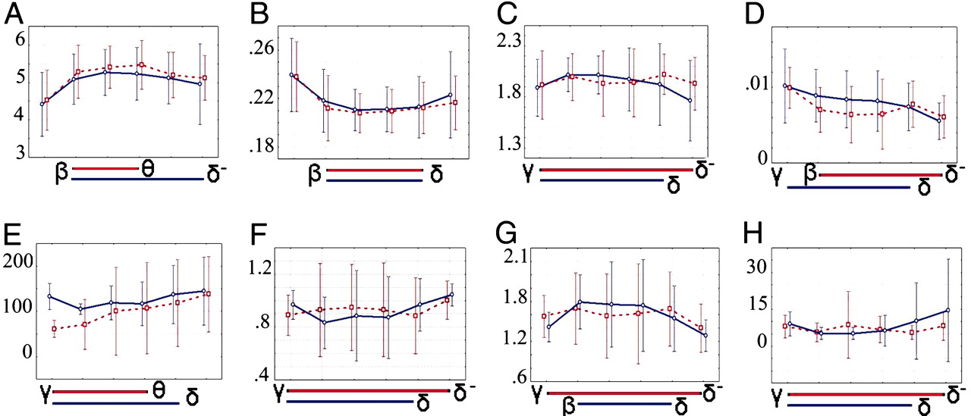
Functional Cortical Systems
Bassett, D. S., et al. “Adaptive reconfiguration of fractal small-world human brain functional networks.” Proc. Natl Acad. Sci. USA 103, 19518–19523 (2006).
Notes:
Scale-invariance of global topological and dynamical parameters of brain functional networks. Each image summarizes the group mean parameter values over all wavelet scales and in both resting (red) and motor (blue) states; error bars represent 95% confidence interval; blue and red bars below the x axis indicate the extent of the scaling regime for each parameter in both resting (red) and motor (blue) states. (A) Average path length, L. (B) Clustering, C. (C) Sigma, σ. (D) Synchronizability, S. (E) Characteristic length, ζ (mm). (F–H) Parameters of an exponentially truncated power law degree distribution of the form P(k) ≈ A kλ−1 e k/kc. (F) Coefficient, A. (G) Power law exponent, λ. (H), Exponential cut-off degree, k c.
SEE PAPER

Slide 17
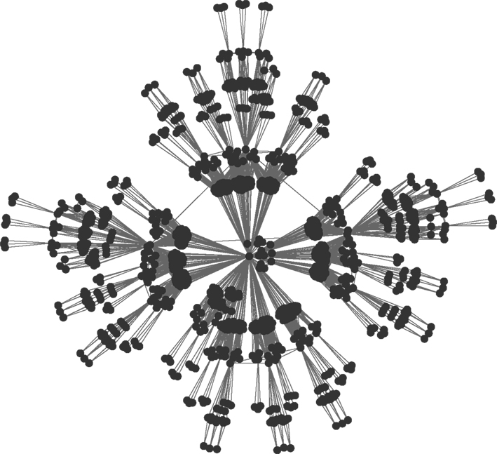
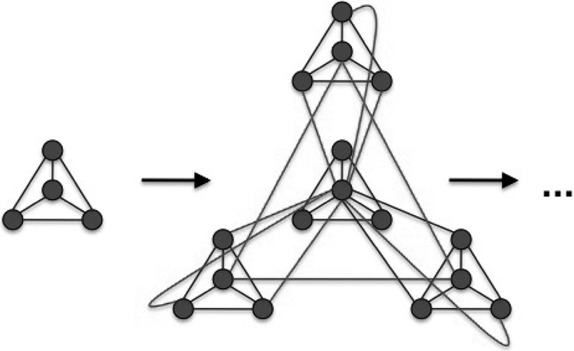
Modularity and Hierarchical Organization
Hütt M.-T., Lesne A.. Interplay between topology and dynamics in excitation patterns on hierarchical graphs. Front. Neuroinformatics (2009)

Slide 18
The Kuramoto Model
Winfree A. “Biological rhythms and the behavior of populations of coupled oscillators.” J. Theor. Biol. 16, 15-42 (1967)
Kuramoto Y. “Chemical Oscillations, Waves, and Turbulence” Springer-Verlag Berlin 1984

Slide 19
Simulations

Slide 20
The FUTURE

