Slide 1

Converter Simulation Challenge: Charging EV Li-Ion Battery using Photovoltaic Panels
Valerie Loves Buck Converters
蔡東翰 - 曾啟睿 - 徐梓錦 - 陳秉升 - 曾聖儒
EE4010: Introduction to Power Electronics

Slide 2
Why Buck-Boost Converter?
Among buck, boost and buck boost converter, the DC-DC buck-boost converter integrated with the solar PV system is the most effective solution in producing maximum PV output power at any circumstances.
We found out that:
boost converter needs higher inductance than buck converter
buck converter requires larger capacitor to smooth the discontinuous PV module input current than the boost converter
buck-boost converter is the most effective solution in tracking maximum power point (MPP) of the PV array irrespective of ambient temperature, solar irradiance, and load condition.

Slide 3
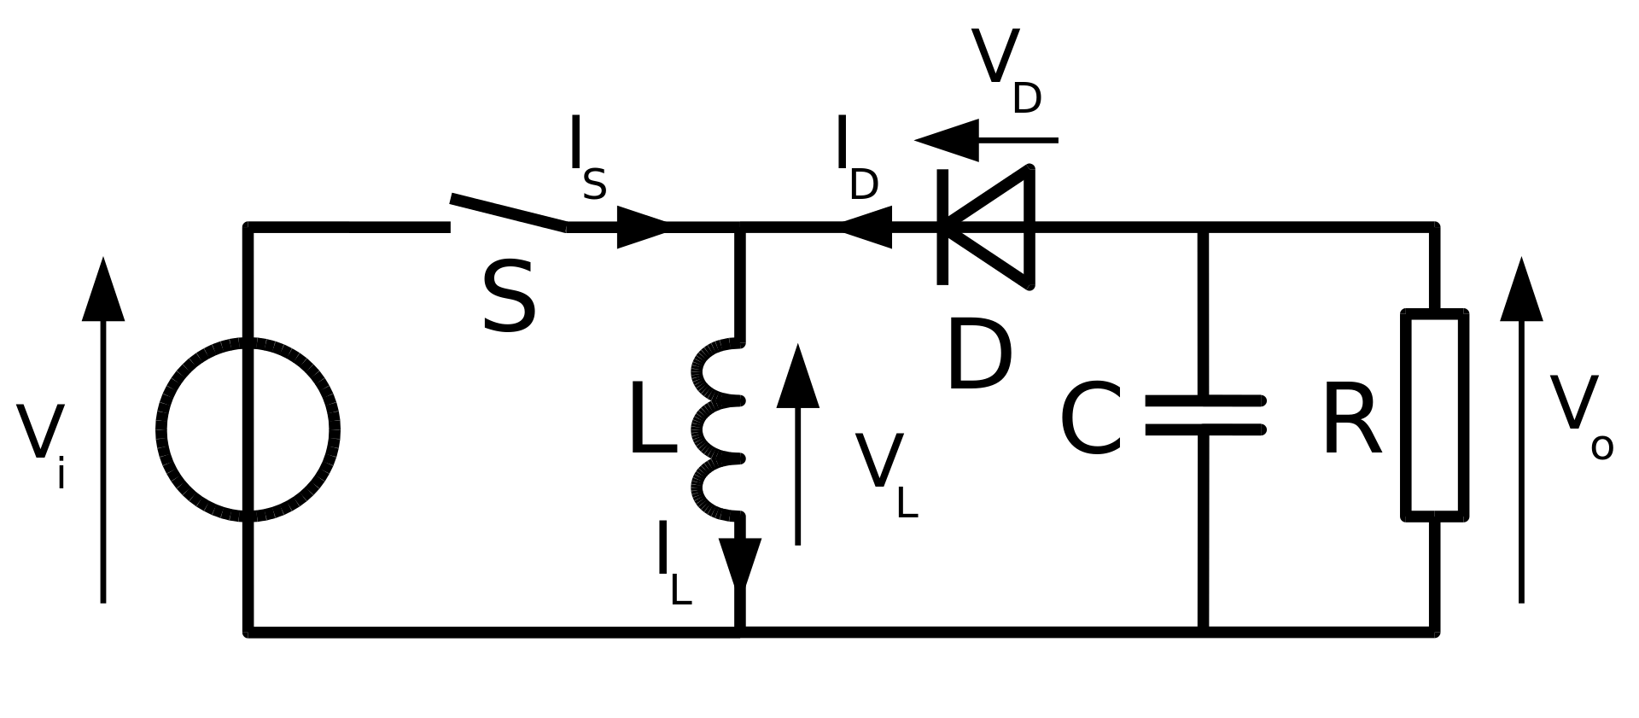
Basics about Buck-Boost Converter
The buck–boost converter is a type of DC-to-DC converter that has an output voltage magnitude that is either greater than or less than the input voltage magnitude. It is used to “step up” or “step down” the DC voltage, similar to a transformer for AC circuits.
The design of a buck-boost converter is similar to a buck converter and boost converter, except that it is in a single circuit and it usually has an added control unit.

Slide 4
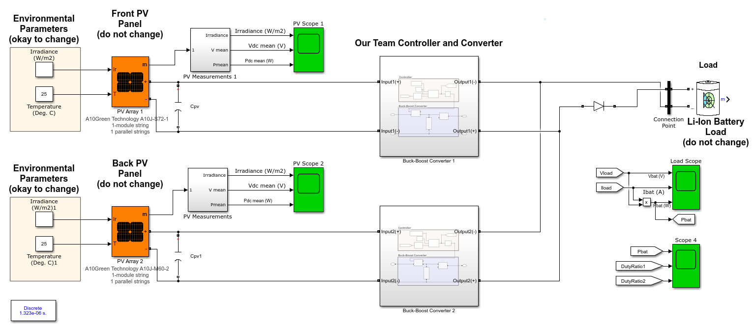
Buck-Boost Converter

Slide 5
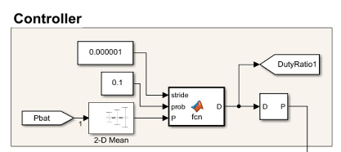
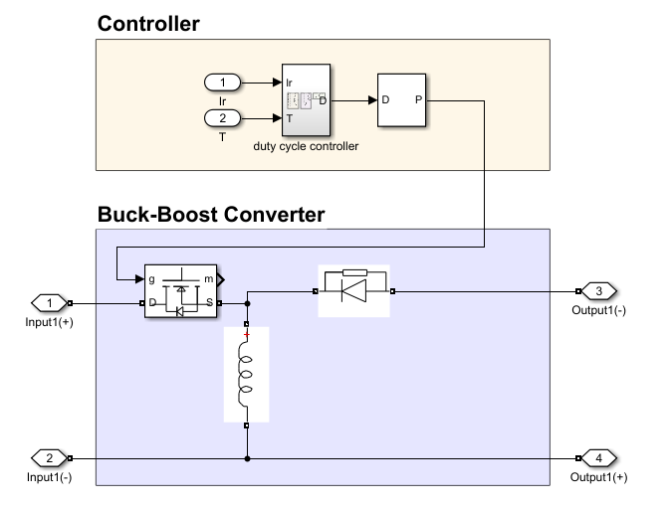
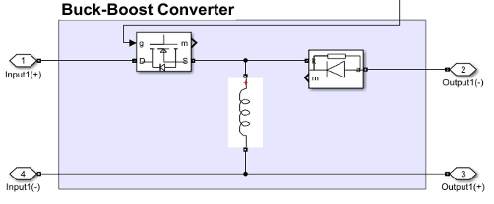
Same Converter, 2 Different Controllers
Controller 1： Duty Tracking
Controller 2: Polynomial Fitting
For both controller, we use the same Buck-Boost Converter, and controlling the duty ratio to get the maximum power output. (L=1mH).
Both front and back PV have 2 identical converter, then they’re both connected in parallel

Slide 6
Controller 1: Duty Tracking
Every time we change the duty of both converters for a little bit (0.000001) and observe the effect in output power.
If the change makes output power higher, then we keep changing the duty ratio in the same way.
If not, we change the duty ratio in the other way.
However, since both of the converters will see the same output power and thus be modified in the same way, we may lose some flexibility.
To solve this, we use a randomized process to maintain the flexibility while still preserve the trend. (90% - 10%)

Slide 7

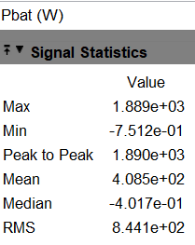
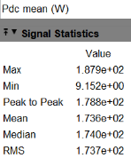

Controller 1: Duty Tracking
Efficiency = 408.5/(173.6+236.5)
= 99.61%

Slide 8
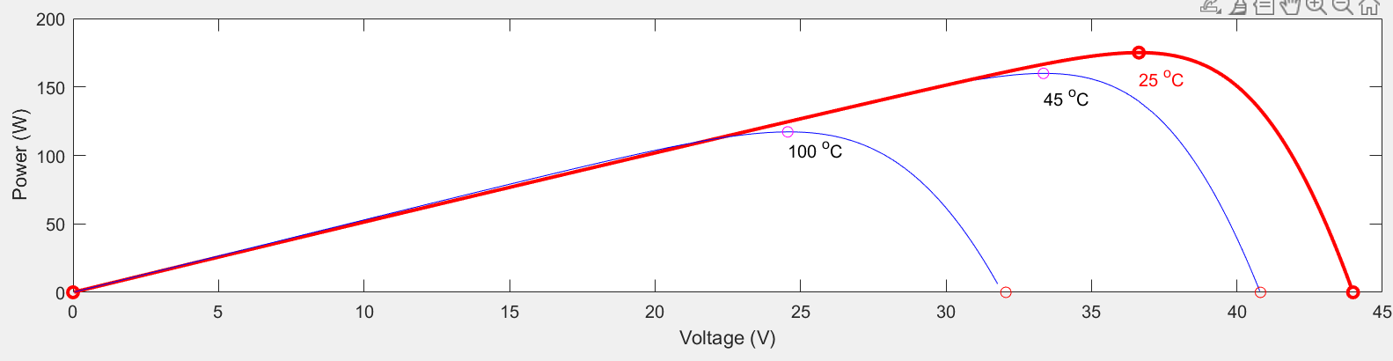
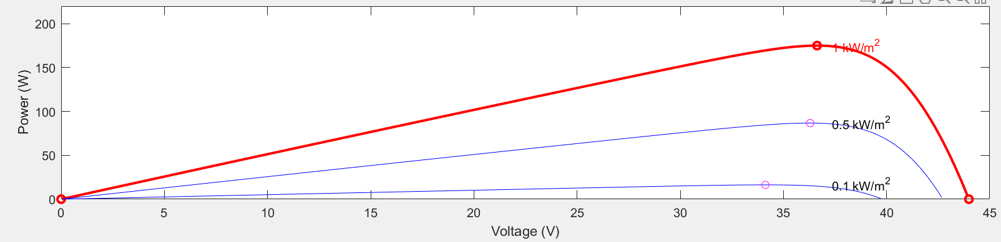
Controller 2: Polynomial Fitting
Use excel to record irradiance (1000 W/m²) as fixed variable and temperature as controlled variable (vary from 10°C to 35°C) and vise versa (fix temperature 25°C, control irradiance from 400 to 1200 W/m²).
Use the online model to polynomial fitting and assume we only need to move the series of data point vertically or horizontally to find every Vmp.
Implement it as the figure in next slide.
Calculate duty cycle based on the buck boost converter formula.

Slide 9
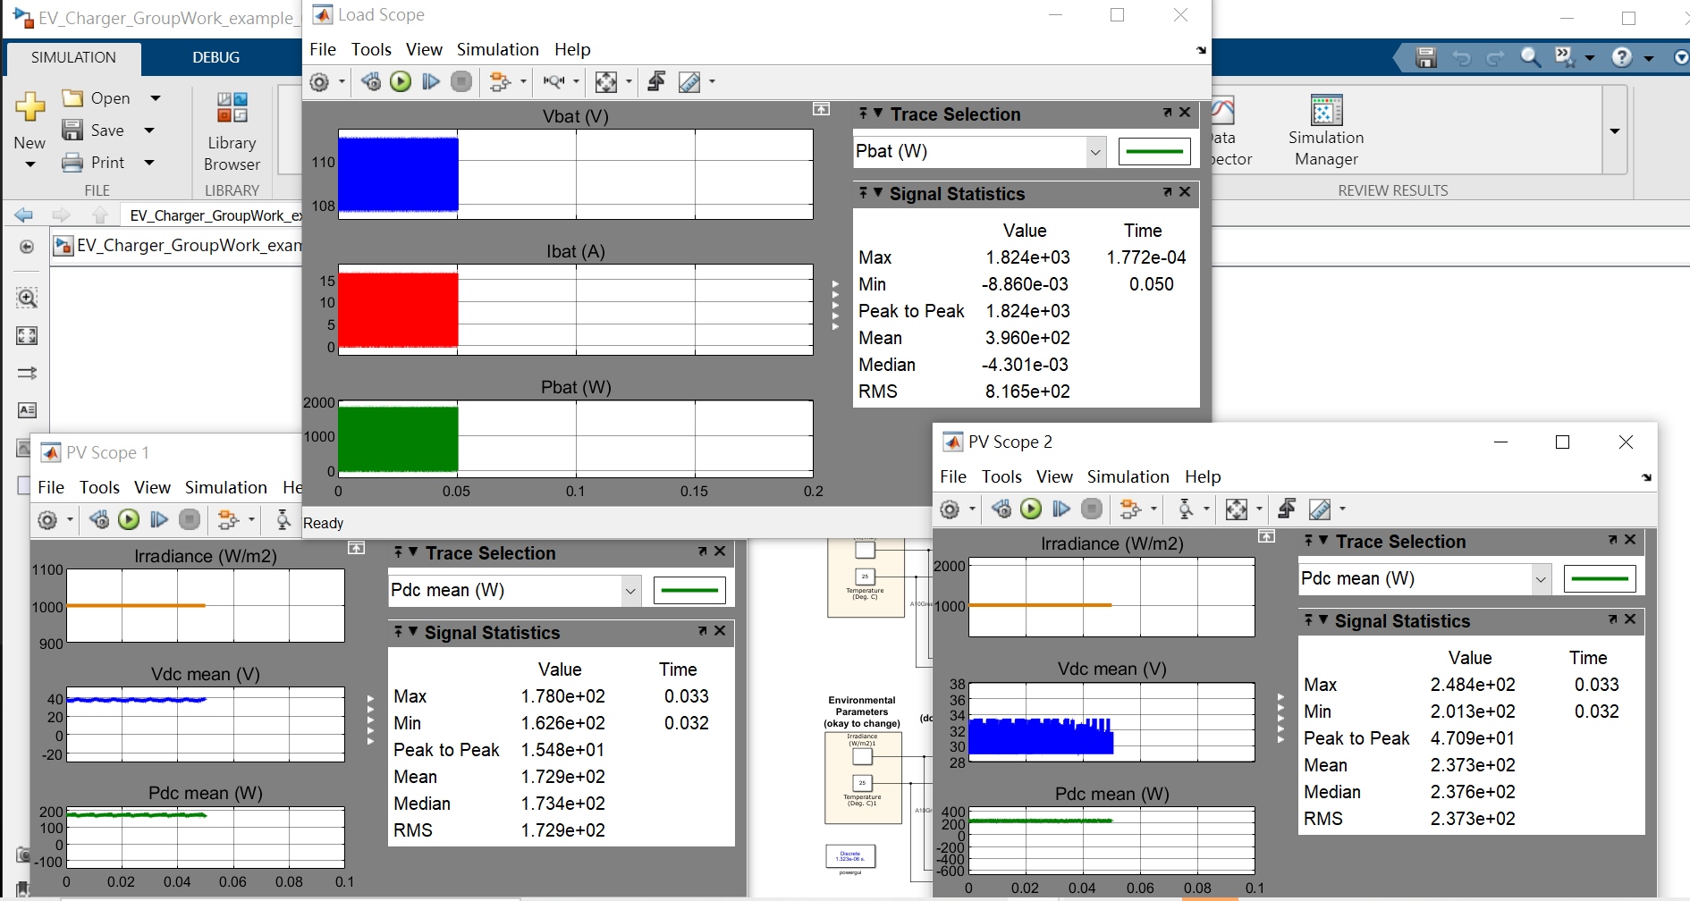
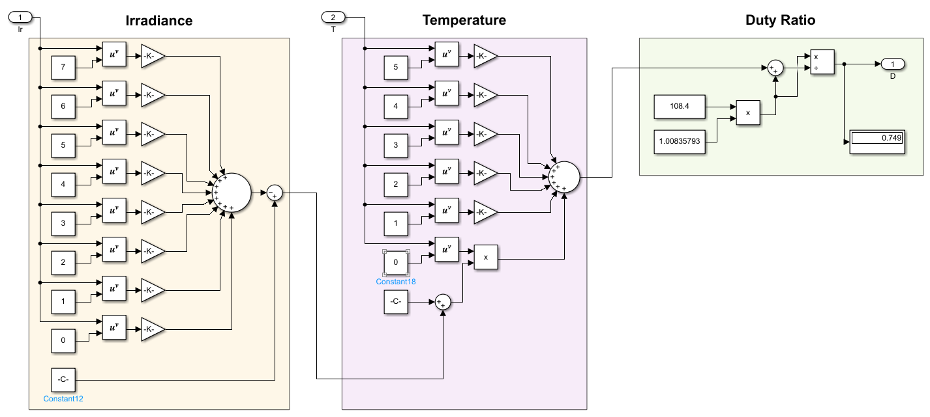
Controller 2: Polynomial Fitting
Efficiency = 396.0/(172.9+237.3)
= 96.54%

Slide 10


Advantages and Disadvantages
Advantages:
It performs step-up or step-down of voltage using minimum components
It offers lower operating duty cycle
It is the best one for accurate MPPT application, as it can operate as boost and buck. This will give these type of converters the ability to accurate search and good tracking of the maximum power point under different conditions of PV operations
Disadvantages:
Output is inverted
There is no isolation from input side to output side which is very critical for many applications.

Slide 11

Simulation Results for Case 1
Buck Boost Converter with Controller 1: Duty Tracking
Buck Boost Converter with Controller 2: Polynomial Fitting

Slide 12
Conclusion
We use 2 identical Buck-Boost Converters for both front and back panel, which then connected in parallel, as they’re the most effective solution in any circumstances (varying irradiance and temperature)
Controller 1 results in higher Pbat and higher efficiency, and will be more applicable in reality (Controller 2 that have to get irradiance and temperature data from the module, which Controller 1 directly use Pbat as an input).
Buck-Boost Converter will accommodate wider range of application (due to its ability to “step up” or “step down”), but the output polarity is inverted, and provide no isolation between input and output

