Slide 1
Data structures – Part II - Trees

Slide 2


Slide 3
Linear Data Structures
Dynamic List
Linked List
Stack
Queue
Double Linked List

Slide 4
#tbt questions
By the principle of Data Locality which of the data structures (Linked and Dynamic list) will be faster if we want to iterate from 1st to last element
Which of the data structures ( Linked and Dynamic list) will cost more space(memory) if we want to store exact count of N elements

Slide 5
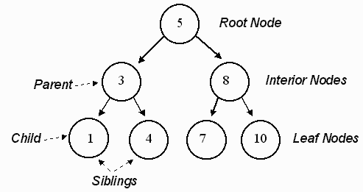
Trees

Slide 6
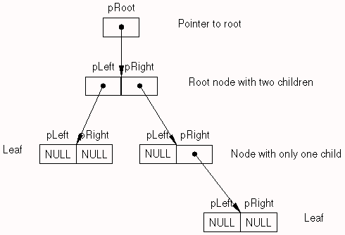
Binary Tree
Searching : O(n)
Insertion : O(n)
Deletion : O(n)

Slide 7
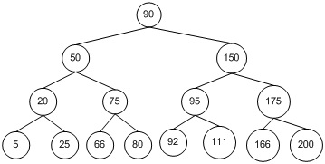
Binary Search Tree
Worst :
Searching : O(n)
Insertion : O(n)
Deletion : O(n)
Average :
Searching : O(log(n))
Insertion : O(log(n))
Deletion : O(log(n))
If AVL : Even in worst case is O(log(n))

Slide 8
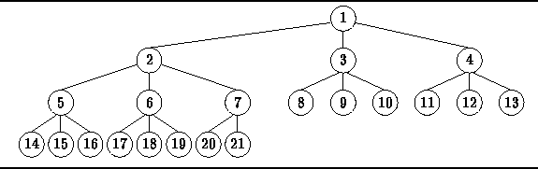
N - Tree

Slide 9
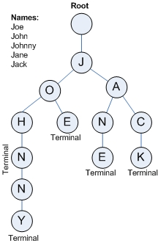
Prefix Tree

Slide 10
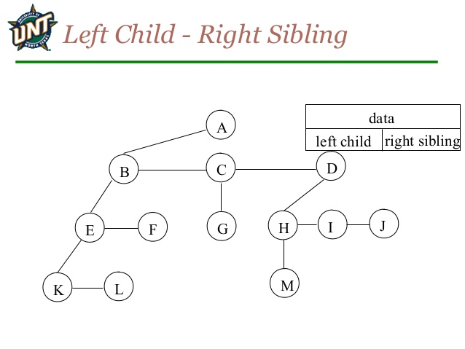
Left-child right-sibling binary tree

Slide 11
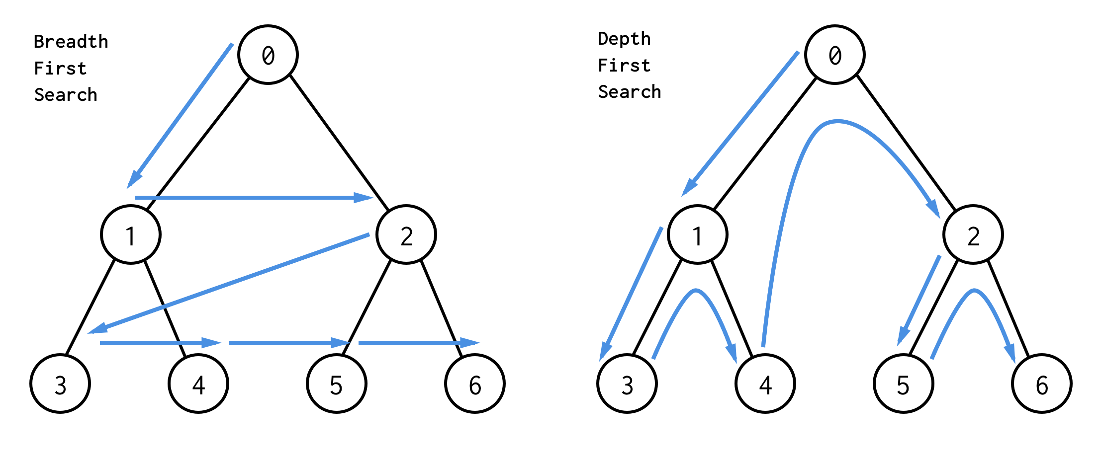
Traversing a tree
BFS and DFS

Slide 12
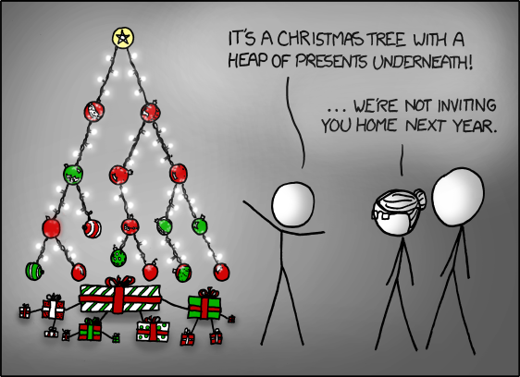

Slide 13

Thank you!

