Slide 1
Methods for Ordinary Differential Equations
Lecture 10
Alessandra Nardi
Thanks to Prof. Jacob White, Deepak Ramaswamy Jaime Peraire, Michal Rewienski, and Karen Veroy

Slide 2
Outline
Transient Analysis of dynamical circuits
  i.e., circuits containing C and/or L
Examples
Solution of Ordinary Differential Equations (Initial Value Problems – IVP)
  Forward Euler (FE), Backward Euler (BE) and Trapezoidal Rule (TR)
  Multistep methods
  Convergence

Slide 3
Application Problems
Signal Transmission in an Integrated Circuit
Signal Wire
Wire has resistance
Wire and ground plane form a capacitor
Logic
Gate
Logic
Gate
Ground Plane
Metal Wires carry signals from gate to gate.
How long is the signal delayed?

Slide 4
Application Problems
Signal Transmission in an IC – Circuit Model
resistor
capacitor
Constructing the Model
Cut the wire into sections.
Model wire resistance with resistors.
Model wire-plane capacitance with capacitors.

Slide 5







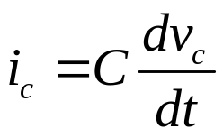

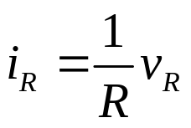

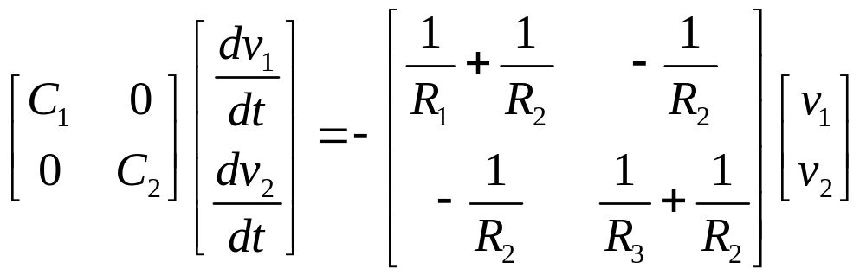
Application Problems
Signal Transmission in an IC – 2x2 example
Constitutive Equations
Conservation Laws
R₂
C₁
R₁
R₃
C₂
Nodal Equations Yields 2x2 System

Slide 6
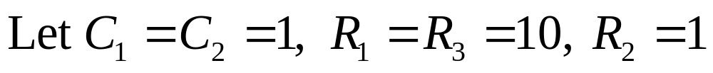
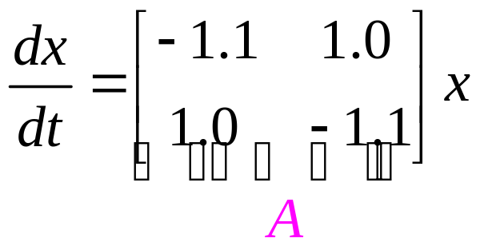
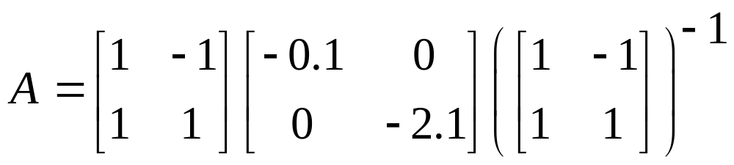
Application Problems
Signal Transmission in an IC – 2x2 example
Eigenvalues and Eigenvectors
eigenvectors
Eigenvalues

Slide 7
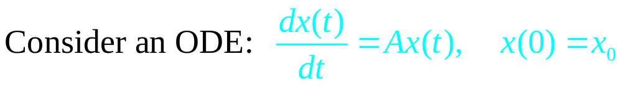
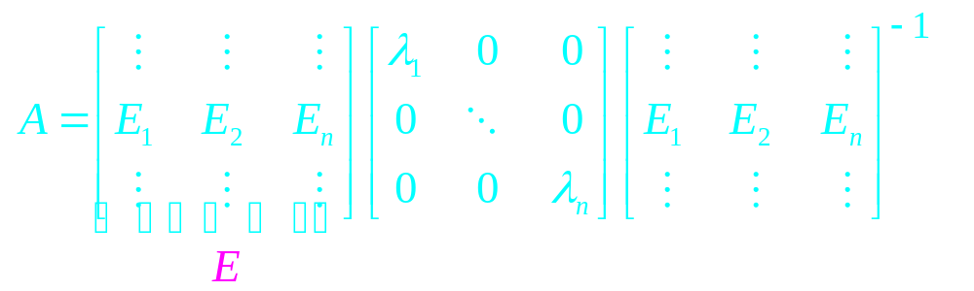
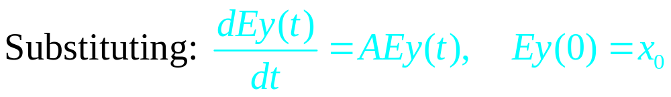
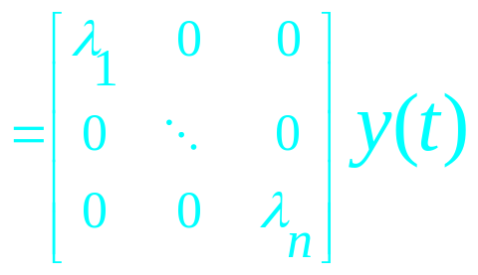
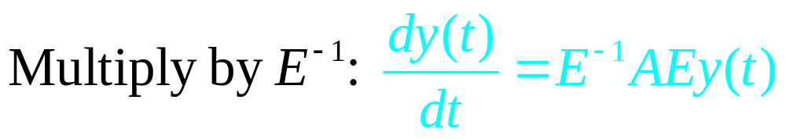
An Aside on Eigenanalysis
Eigendecomposition:

Slide 8
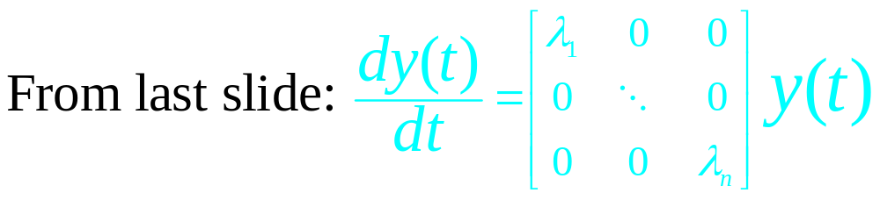
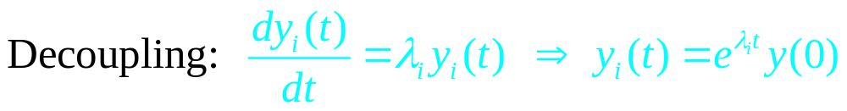
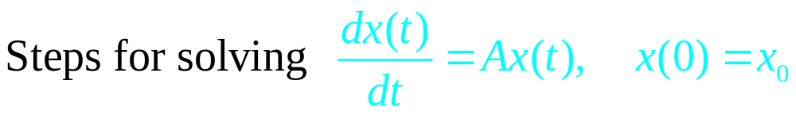
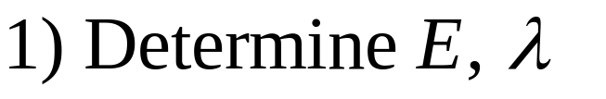
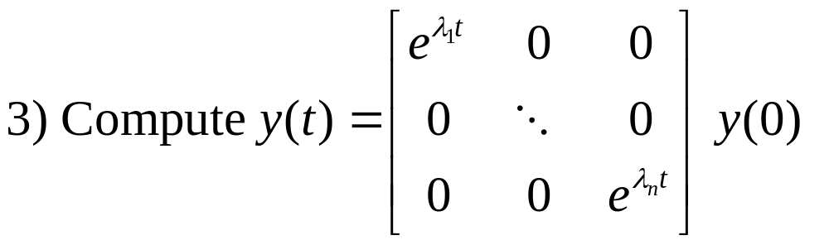
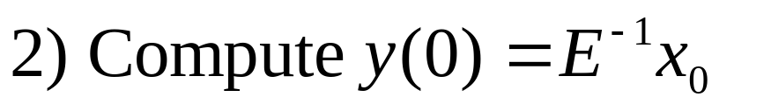
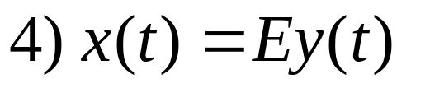
An Aside on Eigenanalysis
Decoupled
Equations!

Slide 9
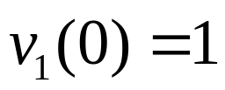
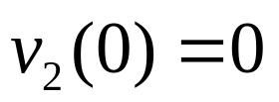
Application Problems
Signal Transmission in an IC – 2x2 example
Notice two time scale behavior
v₁ and v₂ come together quickly (fast eigenmode).
v₁ and v₂ decay to zero slowly (slow eigenmode).

Slide 10
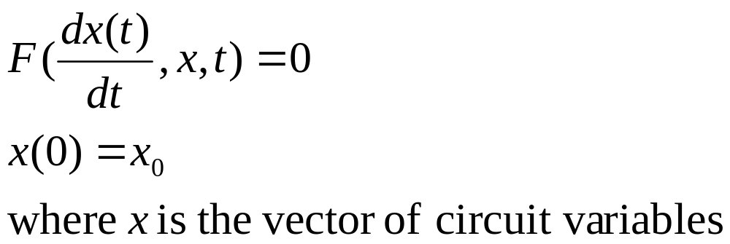
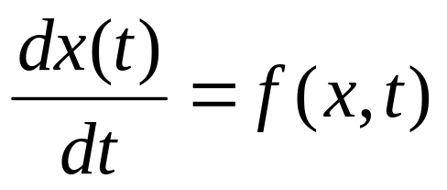
Circuit Equation Formulation
For dynamical circuits the Sparse Tableau equations can be written compactly:
For sake of simplicity, we shall discuss first order ODEs in the form:

Slide 11
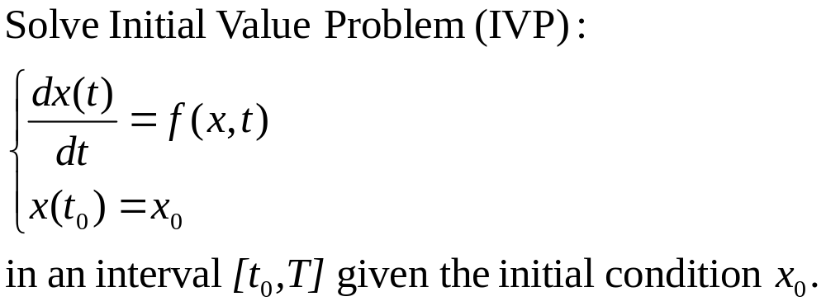
Ordinary Differential Equations
Initial Value Problems (IVP)
Typically analytic solutions are not available
⇒ solve it numerically

Slide 12
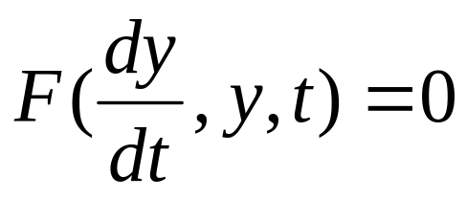
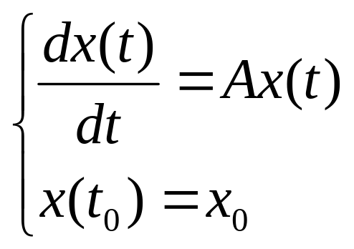
Ordinary Differential Equations
Assumptions and Simplifications
Not necessarily a solution exists and is unique for:
It turns out that, under rather mild conditions on the continuity and differentiability of F, it can be proven that there exists a unique solution.
Also, for sake of simplicity only consider
linear case:
We shall assume that has a unique solution

Slide 13




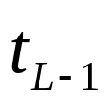
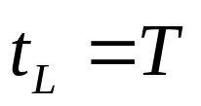


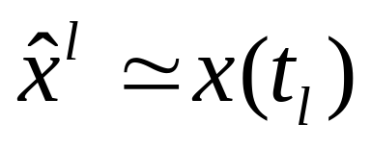




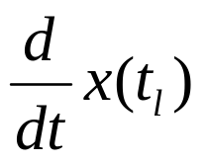
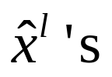
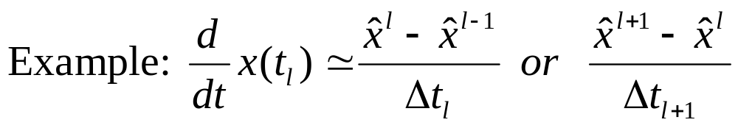
Finite Difference Methods
Basic Concepts
First - Discretize Time
Second - Represent x(t) using values at t_{i}
Approx.
sol’n
Exact
sol’n
Third - Approximate using the discrete

Slide 14
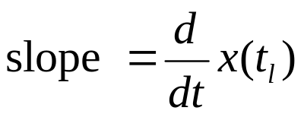

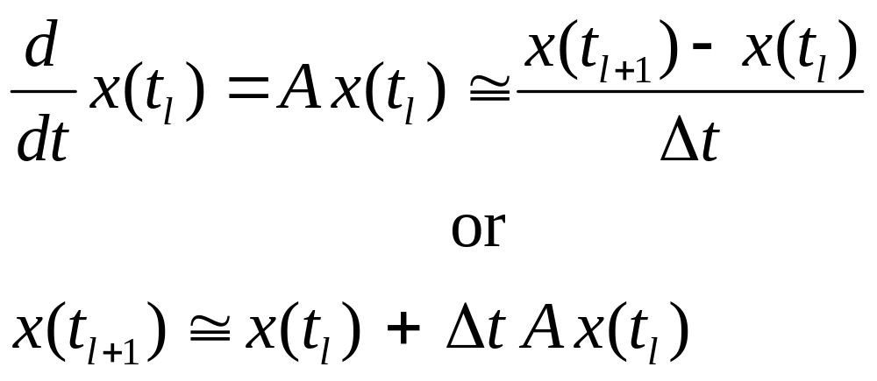

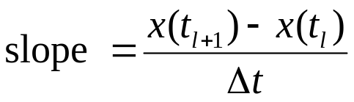

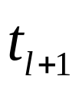

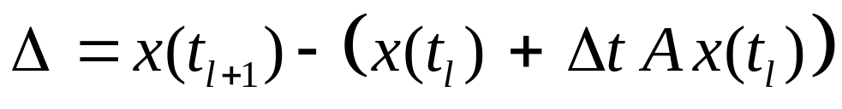
Finite Difference Methods
Forward Euler Approximation

Slide 15
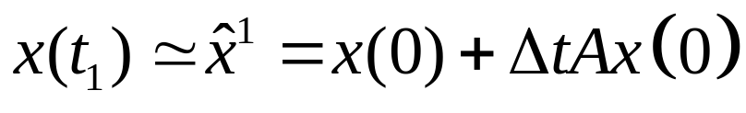
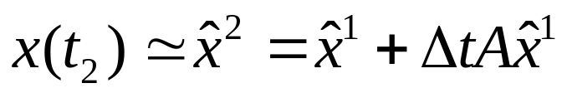

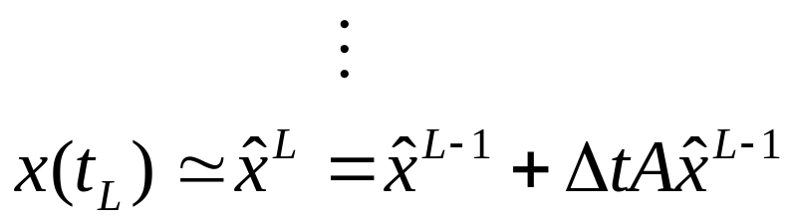

Finite Difference Methods
Forward Euler Algorithm

Slide 16
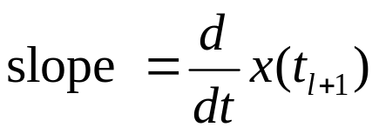
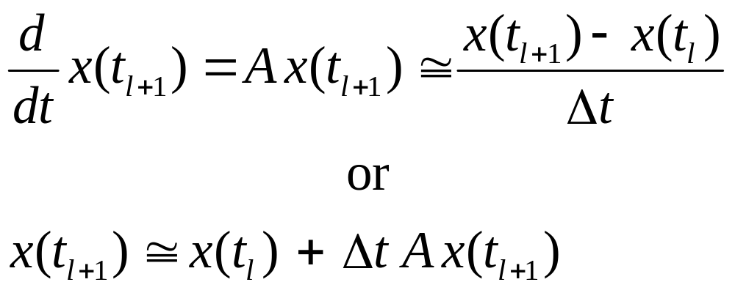

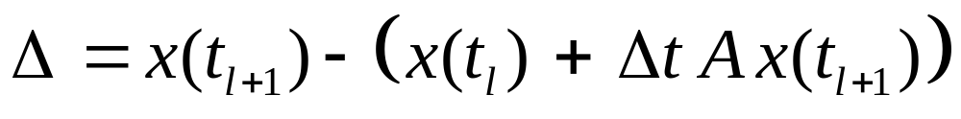
Finite Difference Methods
Backward Euler Approximation

Slide 17
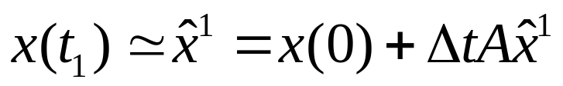
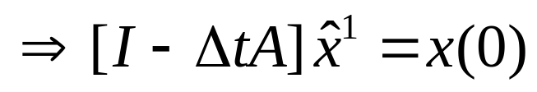

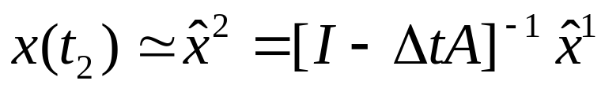

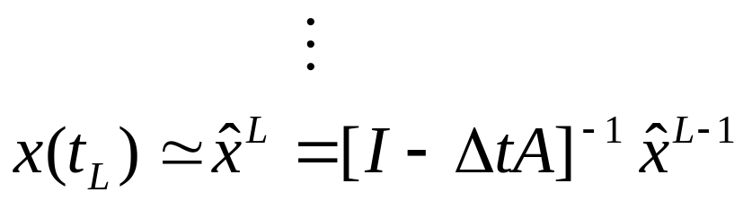
Finite Difference Methods
Backward Euler Algorithm
Solve with Gaussian Elimination

Slide 18
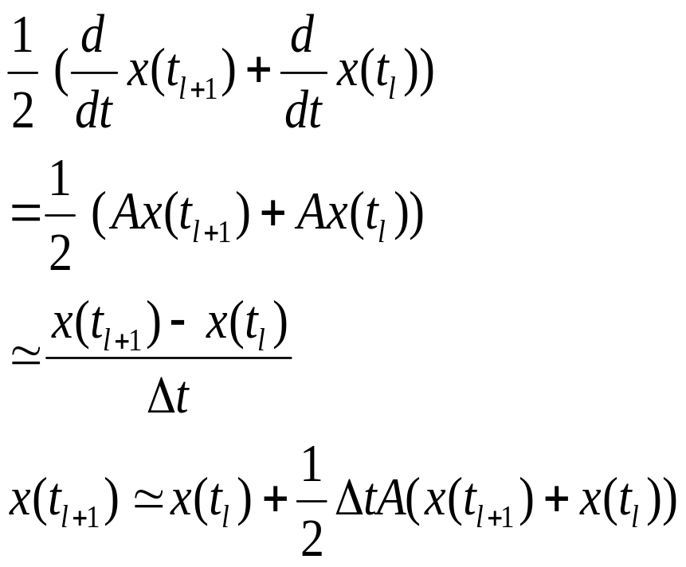
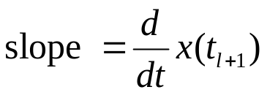


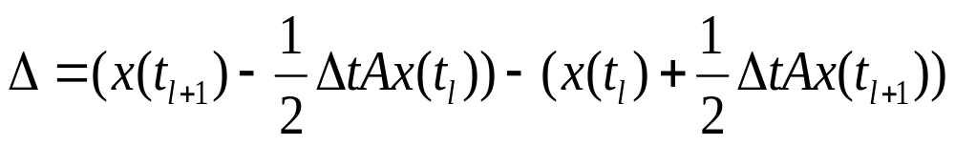
Finite Difference Methods
Trapezoidal Rule Approximation

Slide 19
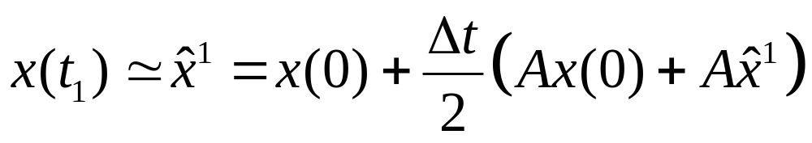


Finite Difference Methods
Trapezoidal Rule Algorithm
Solve with Gaussian Elimination

Slide 20







Finite Difference Methods
Numerical Integration View
Trap
BE
FE

Slide 21
Finite Difference Methods
Summary of Basic Concepts
Trap Rule, Forward-Euler, Backward-Euler
Are all one-step methods
Forward-Euler is simplest
No equation solution explicit method.
Boxcar approximation to integral
Backward-Euler is more expensive
Equation solution each step implicit method
Trapezoidal Rule might be more accurate
Equation solution each step implicit method
Trapezoidal approximation to integral

Slide 22











Multistep Methods
Basic Equations
Nonlinear Differential Equation:
k-Step Multistep Approach:
Multistep coefficients
Solution at discrete points
Time discretization

Slide 23







Multistep Methods – Common Algorithms
TR, BE, FE are one-step methods
Multistep Equation:
Forward-Euler Approximation:
FE Discrete Equation:
Multistep Coefficients:
BE Discrete Equation:
Multistep Coefficients:
Trap Discrete Equation:
Multistep Coefficients:

Slide 24
Multistep Methods
Definition and Observations
Multistep Equation:
How does one pick good coefficients?
Want the highest accuracy

Slide 25




Multistep Methods – Convergence Analysis
Convergence Definition
Definition: A finite-difference method for solving initial value problems on [0,T] is said to be convergent if given any A and any initial condition

Slide 26


Multistep Methods – Convergence Analysis
Order-p Convergence
Definition: A multi-step method for solving initial value problems on [0,T] is said to be order p convergent if given any A and any initial condition
Forward- and Backward-Euler are order 1 convergent
Trapezoidal Rule is order 2 convergent

Slide 27


Multistep Methods – Convergence Analysis
Two types of error

Slide 28
Multistep Methods – Convergence Analysis
Two conditions for Convergence
For convergence we need to look at max error over the whole time interval [0,T]
  We look at GTE
Not enough to look at LTE, in fact:
  As I take smaller and smaller timesteps Δt, I would like my solution to approach exact solution better and better over the whole time interval, even though I have to add up LTE from more timesteps.

Slide 29
Multistep Methods – Convergence Analysis
Two conditions for Convergence
1) Local Condition: One step errors are small (consistency)
Typically verified using Taylor Series
2) Global Condition: The single step errors do not grow too quickly (stability)
All one-step methods are stable in this sense.

Slide 30

One-step Methods – Convergence Analysis
Consistency definition
Definition: A one-step method for solving initial value problems on an interval [0,T] is said to be consistent if for any A and any initial condition

Slide 31






One-step Methods – Convergence Analysis
Consistency for Forward Euler
Proves the theorem if derivatives of x are bounded

Slide 32




One-step Methods – Convergence Analysis
Convergence Analysis for Forward Euler

Slide 33


One-step Methods – Convergence Analysis
Convergence Analysis for Forward Euler

Slide 34



One-step Methods – Convergence Analysis
A helpful bound on difference equations

Slide 35


One-step Methods – Convergence Analysis
A helpful bound on difference equations

Slide 36




One-step Methods – Convergence Analysis
Back to Convergence Analysis for Forward Euler

Slide 37
One-step Methods – Convergence Analysis
Observations about Convergence Analysis for FE
Forward-Euler is order 1 convergent
The bound grows exponentially with time interval
C is related to the solution second derivative
The bound grows exponentially fast with norm(A).

Slide 38
Summary
Transient Analysis of dynamical circuits
  i.e., circuits containing C and/or L
Examples
Solution of Ordinary Differential Equations (Initial Value Problems – IVP)
  Forward Euler (FE), Backward Euler (BE) and Trapezoidal Rule (TR)
  Multistep methods
  Convergence

