Slide 1
Solutions for Nonlinear Equations
Lecture 8
Alessandra Nardi
Thanks to Prof. Newton, Prof. Sangiovanni, Prof. White, Jaime Peraire, Deepak Ramaswamy, Michal Rewienski, and Karen Veroy

Slide 2
Outline
Nonlinear problems
Iterative Methods
Newton’s Method
  Derivation of Newton
  Quadratic Convergence
  Examples
  Convergence Testing
Multidimensonal Newton Method
  Basic Algorithm
  Quadratic convergence
  Application to circuits

Slide 3
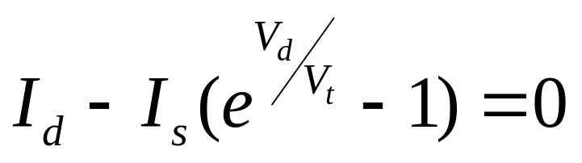
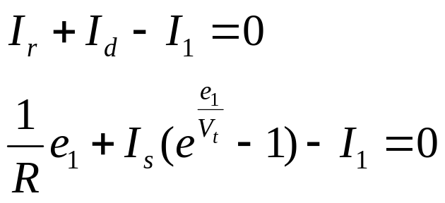

Nonlinear Problems - Example
1
I₁
I_{r}
I_{d}
0
Need to Solve

Slide 4
Nonlinear Equations
Given g(V)=I
It can be expressed as: f(V)=g(V)-I
⇒ Solve g(V)=I equivalent to solve f(V)=0
Hard to find analytical solution for f(x)=0
Solve iteratively

Slide 5
Nonlinear Equations – Iterative Methods
Start from an initial value x⁰
Generate a sequence of iterate x^{n-1}, x^{n}, x^{n+1} which hopefully converges to the solution x*
Iterates are generated according to an iteration function F: x^{n+1}=F(x^{n})
Ask
When does it converge to correct solution ?
What is the convergence rate ?

Slide 6
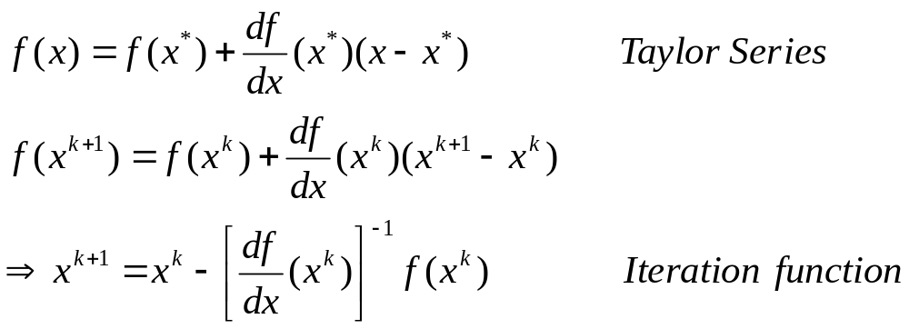
Newton-Raphson (NR) Method
Consists of linearizing the system.
  Want to solve f(x)=0 → Replace f(x) with its linearized version and solve.
Note: at each step need to evaluate f and f’

Slide 7
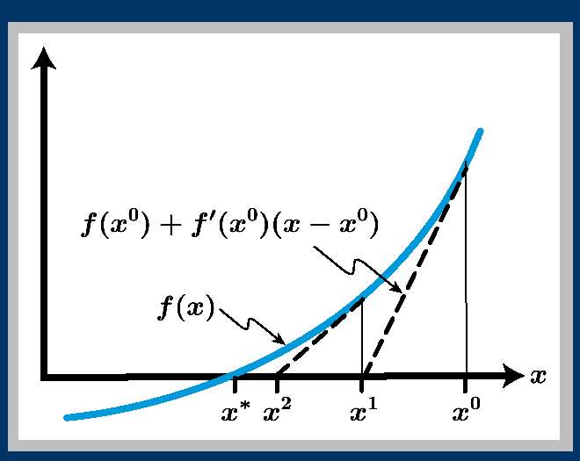
Newton-Raphson Method – Graphical View

Slide 8
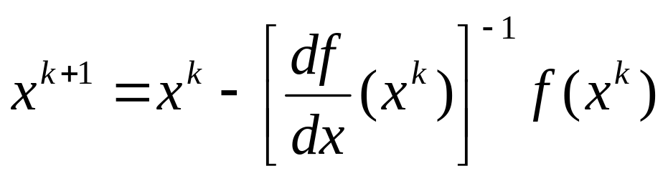
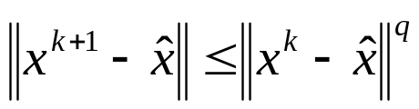
Newton-Raphson Method – Algorithm
Define iteration
Do k = 0 to ….
until convergence
How about convergence?
An iteration {x^{(k)}} is said to converge with order q if there exists a vector norm such that for each k ≥ N:

Slide 9
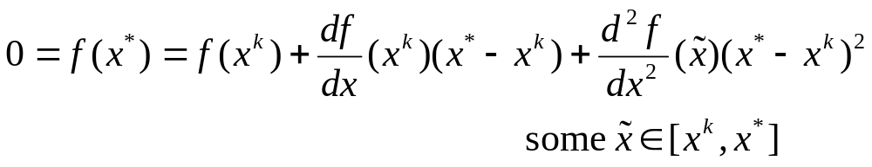
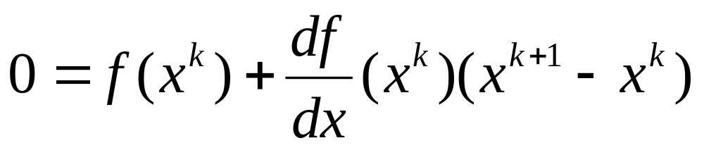
Newton-Raphson Method – Convergence
Mean Value theorem
truncates Taylor series
But
by Newton
definition

Slide 10
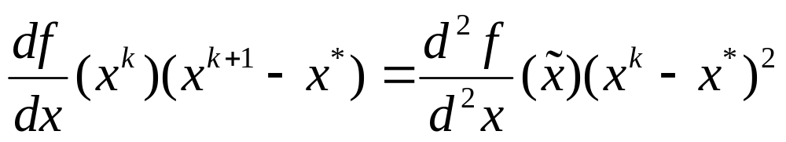
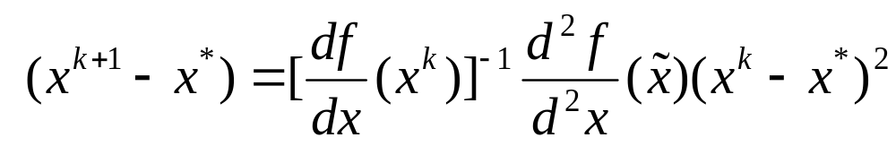
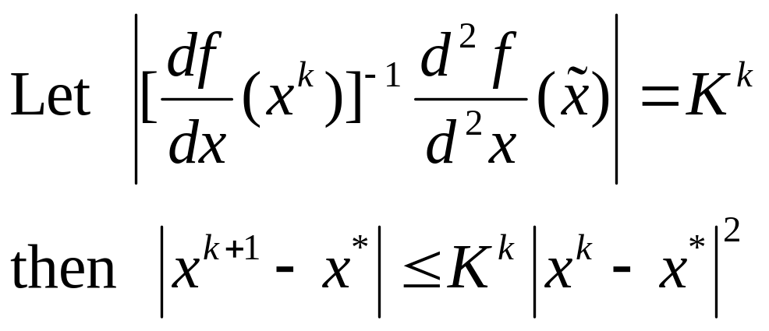
Newton-Raphson Method – Convergence
Subtracting
Dividing through
Convergence is quadratic

Slide 11
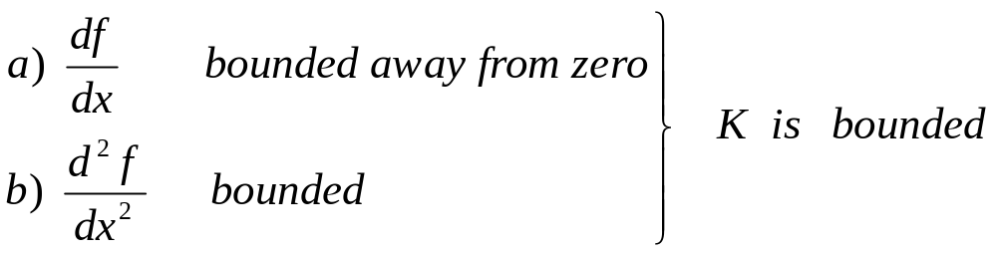
Newton-Raphson Method – Convergence
Local Convergence Theorem
If
Then Newton’s method converges given a sufficiently close initial guess (and convergence is quadratic)

Slide 12
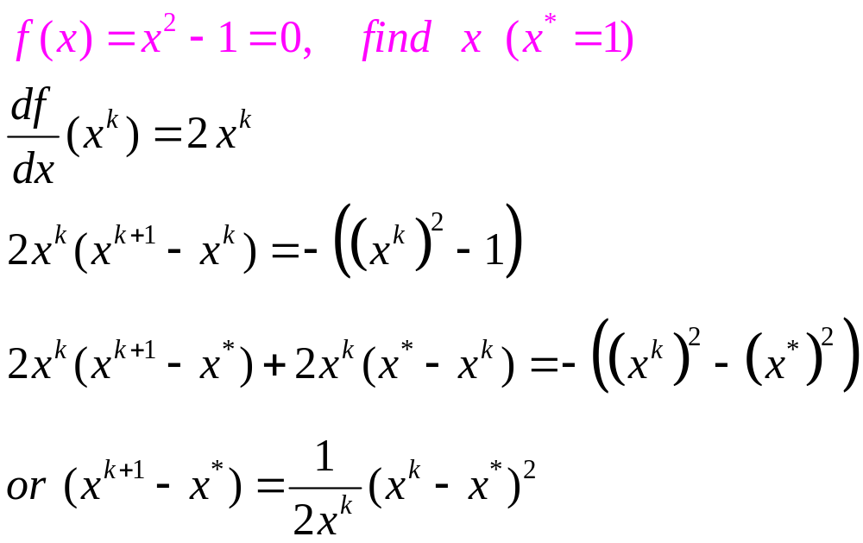
Newton-Raphson Method – Convergence
Example 1
Convergence is quadratic

Slide 13
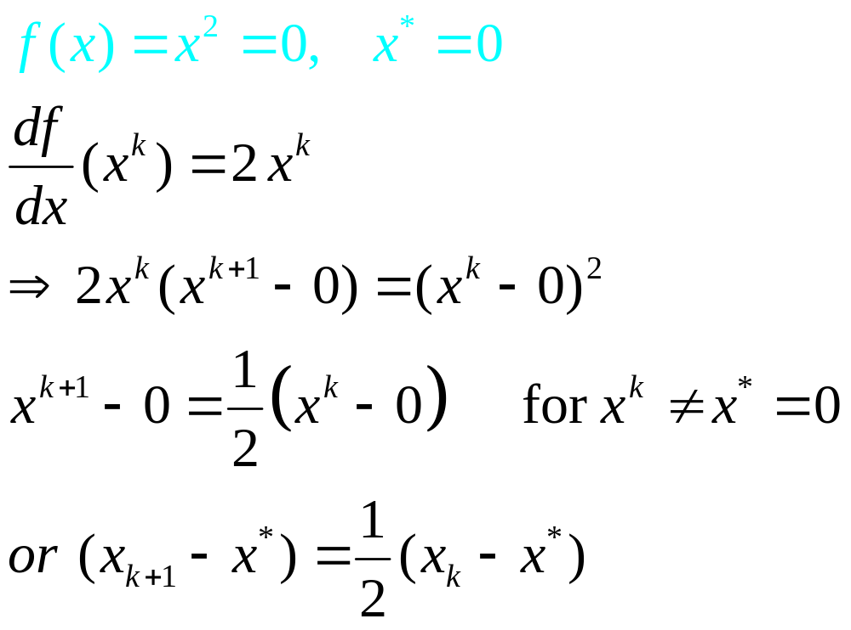
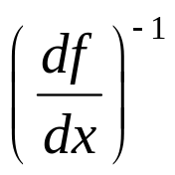
Newton-Raphson Method – Convergence
Example 2
Note : not bounded
away from zero
Convergence is linear

Slide 14
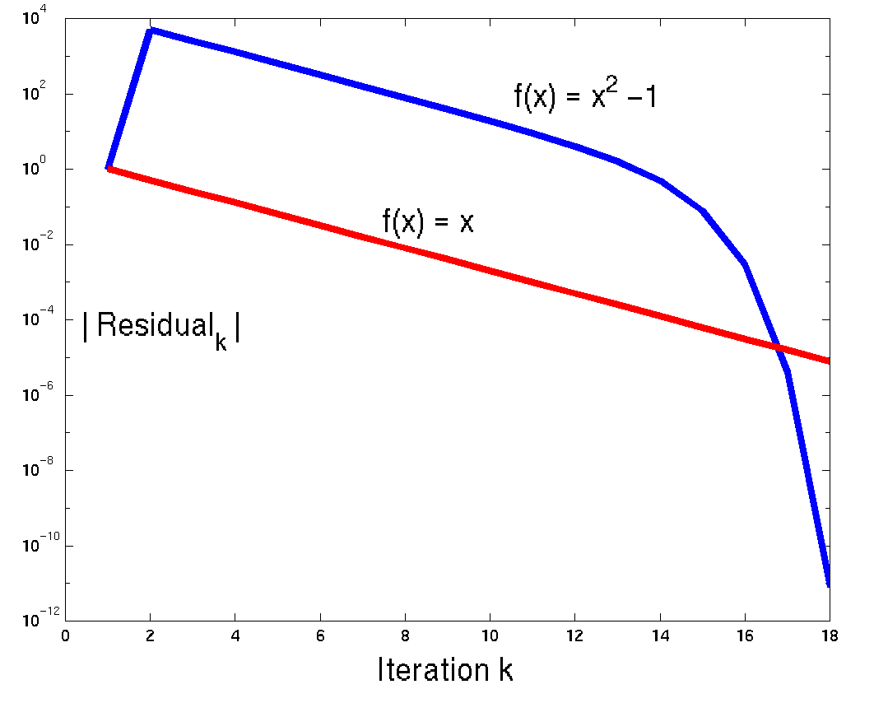
Newton-Raphson Method – Convergence
Example 1, 2

Slide 15
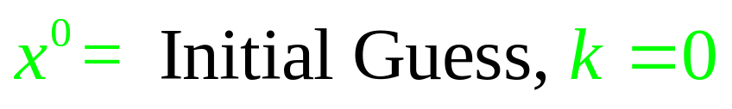

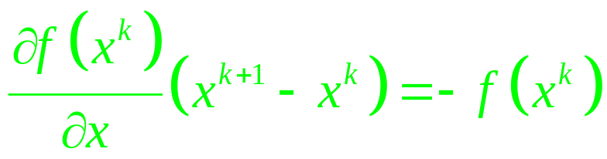


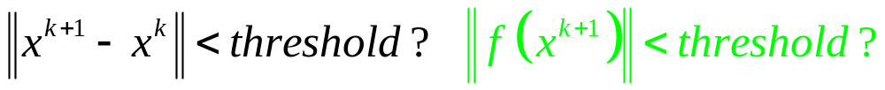
Newton-Raphson Method – Convergence

Slide 16
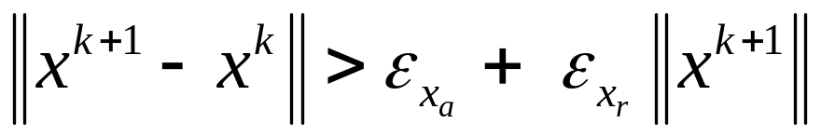
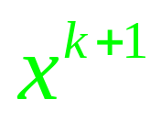
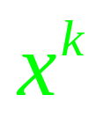

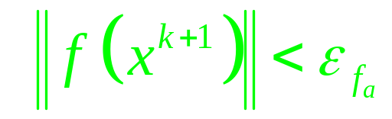
Newton-Raphson Method – Convergence
Convergence Checks
f(x)
X

Slide 17
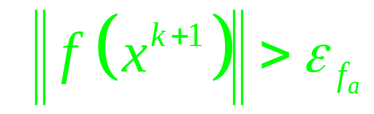
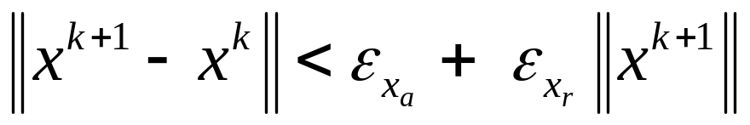
Newton-Raphson Method – Convergence
Convergence Checks
f(x)
X

Slide 18
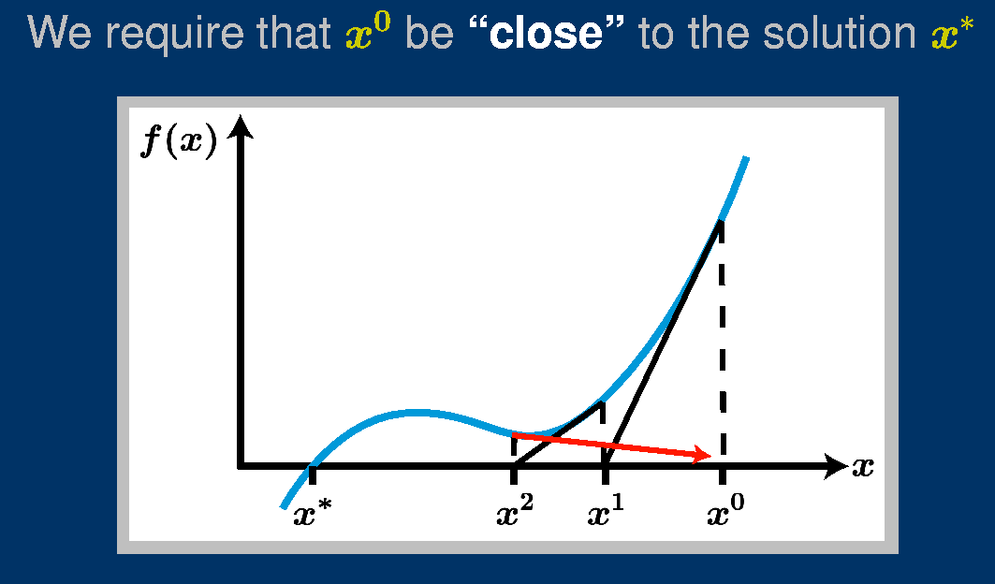
Newton-Raphson Method – Convergence
demo2

Slide 19



Newton-Raphson Method – Convergence
Local Convergence
Convergence Depends on a Good Initial Guess
f(x)
X

Slide 20
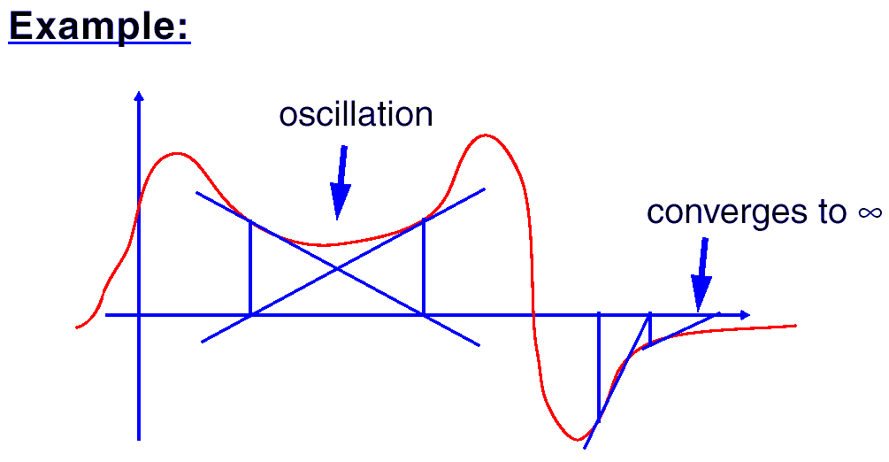
Newton-Raphson Method – Convergence
Local Convergence
Convergence Depends on a Good Initial Guess

Slide 21
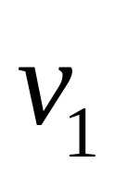
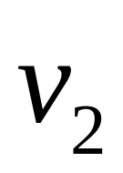





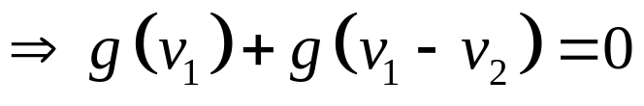



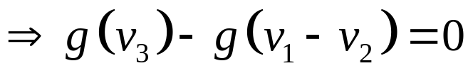
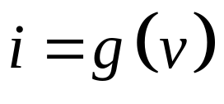
Nonlinear Problems – Multidimensional Example
+
-
Nodal Analysis
+
+
-
-
Nonlinear
Resistors
Two coupled nonlinear equations in two unknowns

Slide 22
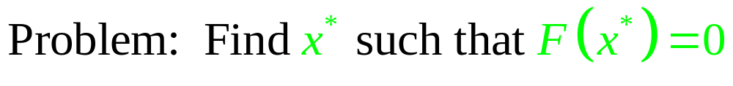

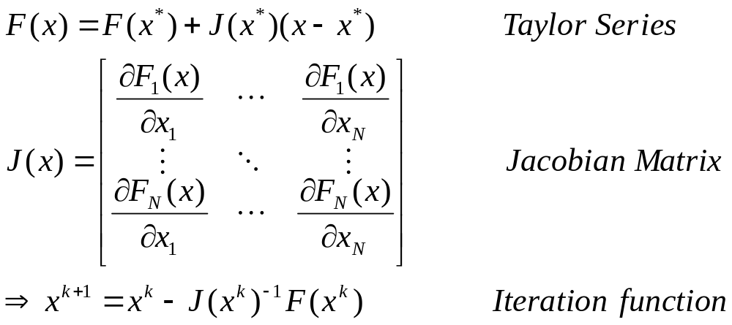
Multidimensional Newton Method

Slide 23
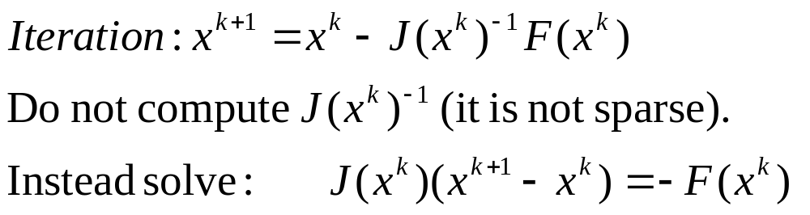
Multidimensional Newton Method
Computational Aspects
Each iteration requires:
Evaluation of F(x^{k})
Computation of J(x^{k})
Solution of a linear system of algebraic equations whose coefficient matrix is J(x^{k}) and whose RHS is -F(x^{k})

Slide 24
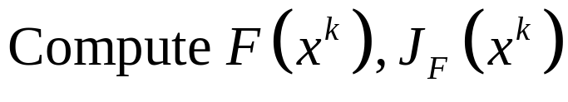
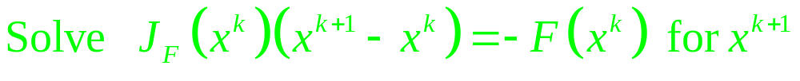


Multidimensional Newton Method
Algorithm

Slide 25
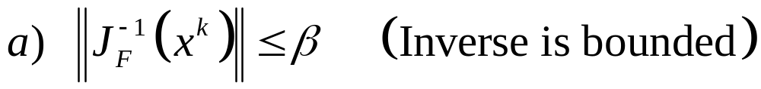
Multidimensional Newton Method Convergence
Local Convergence Theorem
If
Then Newton’s method converges given a sufficiently close initial guess (and convergence is quadratic)

Slide 26
Application of NR to Circuit Equations
Companion Network
Applying NR to the system of equations we find that at iteration k+1:
  all the coefficients of KCL, KVL and of BCE of the linear elements remain unchanged with respect to iteration k
  Nonlinear elements are represented by a linearization of BCE around iteration k
⇒ This system of equations can be interpreted as the STA of a linear circuit (companion network) whose elements are specified by the linearized BCE.

Slide 27
Application of NR to Circuit Equations
Companion Network
General procedure: the NR method applied to a nonlinear circuit whose eqns are formulated in the STA form produces at each iteration the STA eqns of a linear resistive circuit obtained by linearizing the BCE of the nonlinear elements and leaving all the other BCE unmodified
After the linear circuit is produced, there is no need to stick to STA, but other methods (such as MNA) may be used to assemble the circuit eqns

Slide 28
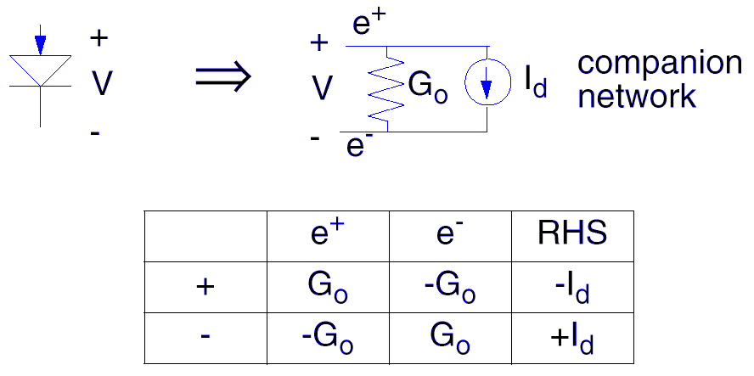
Application of NR to Circuit Equations
Companion Network – MNA templates
Note: G₀ and I_{d} depend on the iteration count k
⇒ G₀=G₀(k) and I_{d}=I_{d}(k)

Slide 29
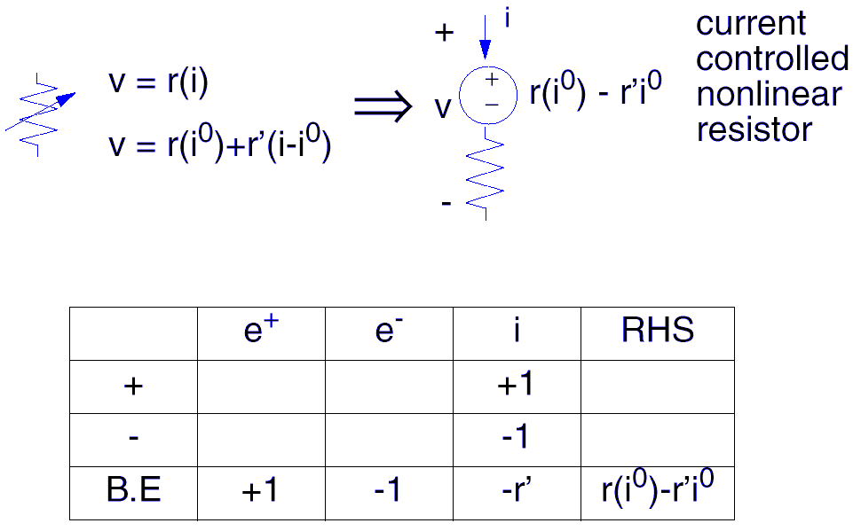
Application of NR to Circuit Equations
Companion Network – MNA templates

Slide 30
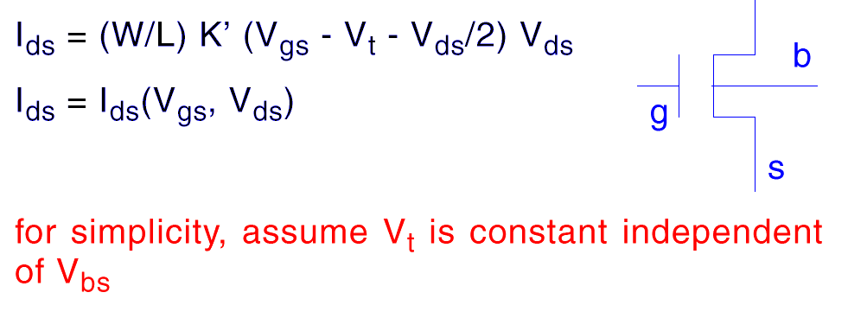
Modeling a MOSFET
(MOS Level 1, linear regime)
d

Slide 31
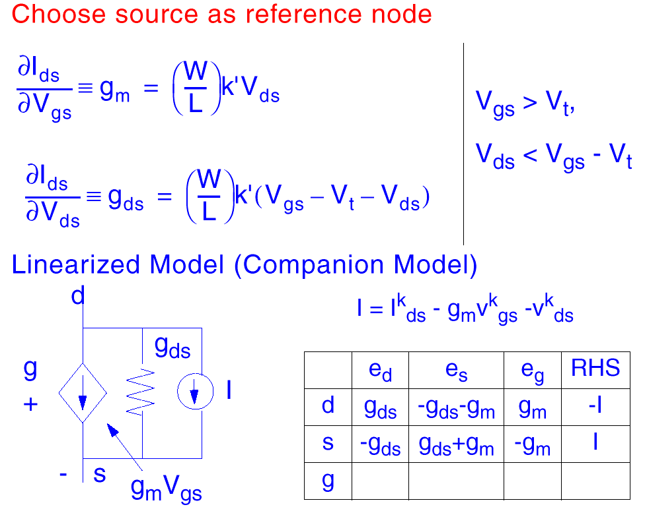
Modeling a MOSFET
(MOS Level 1, linear regime)

Slide 32
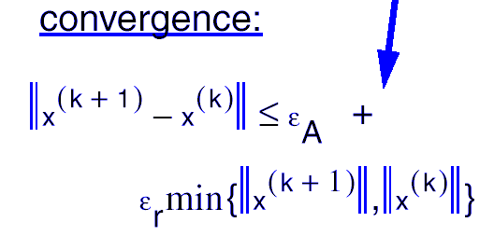
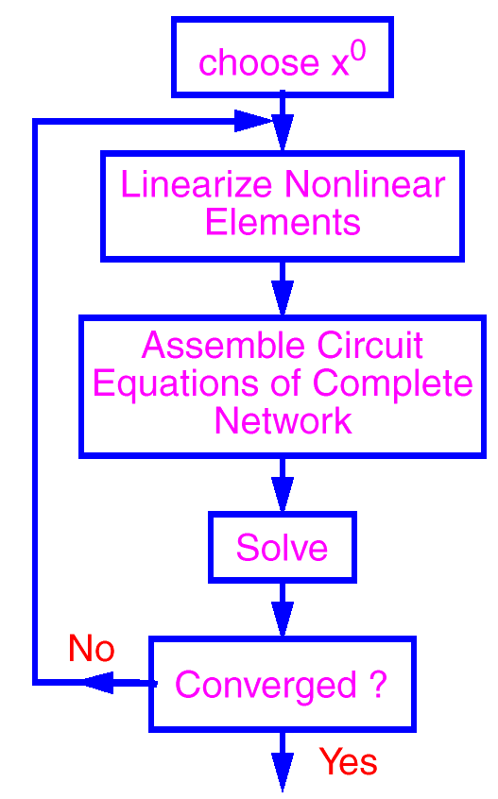
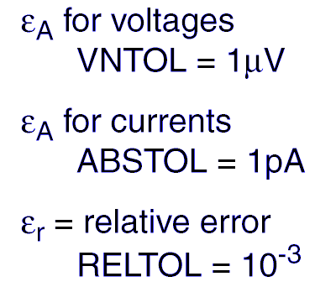
DC Analysis Flow Diagram
For each state variable in the system

Slide 33
Implications
Device model equations must be continuous with continuous derivatives and derivative calculation must be accurate derivative of function (not all models do this - Poor diode models and breakdown models don’t - be sure models are decent - beware of user-supplied models)
Watch out for floating nodes (If a node becomes disconnected, then J(x) is singular)
Give good initial guess for x⁽⁰⁾
Most model computations produce errors in function values and derivatives. Want to have convergence criteria || x^{(k+1)} - x^{(k)} || < ε such that ε > than model errors.

Slide 34
Summary
Nonlinear problems
Iterative Methods
Newton’s Method
  Derivation of Newton
  Quadratic Convergence
  Examples
  Convergence Testing
Multidimensonal Newton Method
  Basic Algorithm
  Quadratic convergence
  Application to circuits

