Slide 1
START!

Slide 2
Next Level

Slide 3
Next Level
Try Again?

Slide 4

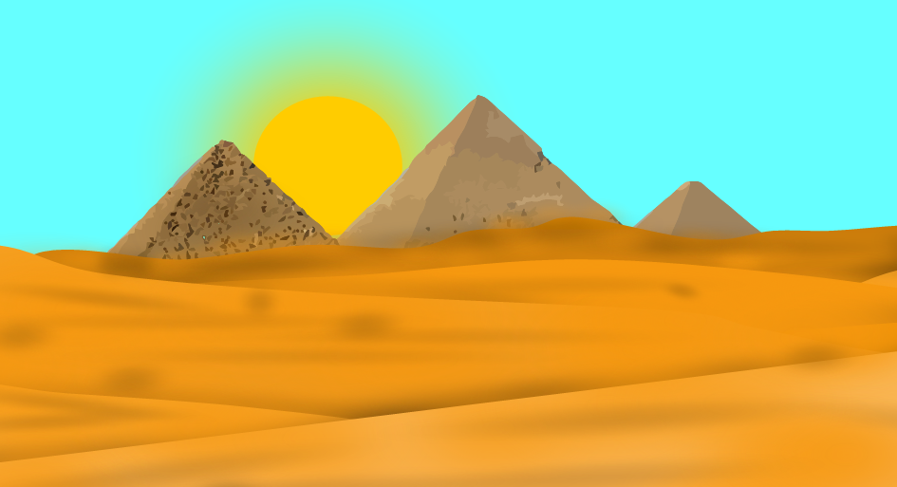
Continue

Slide 5
Try again?

Slide 6
Next Level

Slide 7
你死了
Continue

Slide 8


Next Level

Slide 9

Next Level
Try
Again?
Try again?

Slide 10
Next
Level

Slide 11
你死了
Try Again?

Slide 12
Next
Level

Slide 13
你死了
Try Again?

Slide 14
If you haven’t
figured out,
this is a button
named button.
Next
Level

Slide 15
Finally
what took you
so long?!
If you haven’t
figured out,
this is a button
named button.
Next
Level

Slide 16
Easter Egg!
Click
to go back
to Level 7.

Slide 17
你死了
If you click this button you failed at life.

Slide 18
Be Prepared!

Slide 19

Bonus Level
Quick! Press Me!
To
Level
11
To
Boss

Slide 20
Sorry, you have failed the bonus level.
Go to Matter Splatter

Slide 21
你死了
Try Again.

Slide 26
Invisible Path! Retrace your steps…

Slide 27
你死了
Try Again?

Slide 28
Invisible Path! Retrace your steps…
Next
Level

Slide 29
Next
Level

Slide 30
3
1
Next
Level
2

Slide 31
你死了
Try
Again?

Slide 32
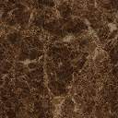

Slide 33
Next Level

Slide 34

你死了
Try
Again?

Slide 35
Next Level

Slide 36
你死了
Try Again?

Slide 37
Click here
To
Continue

Slide 38
Next
Level

Slide 39
Try again?

Slide 40
你死了
Try again?

Slide 44
Next
d

Slide 45
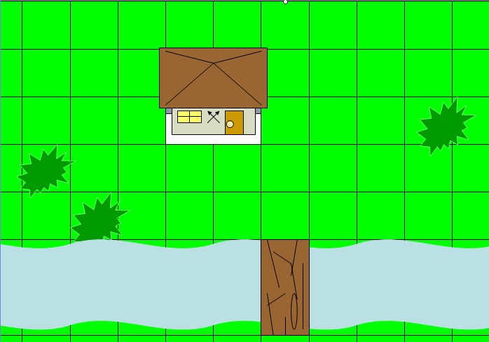
R E T R Y

Slide 48
Next

Slide 49
R E T-
R Y

Slide 51
Try
Again?

Slide 52
F

Slide 53
S
Click Here to end!

Slide 54
GO

Slide 55
Next
Level
GO

Slide 60
Escape!

Slide 63
Ni3 si3 le5

Slide 65
你死了

Slide 67
Thin paths
Long paths
Buttons
Bridges
Time limits
Moving obstacles
Dropping obstacles
Explosions
Spinning obstacles
Moving and spinning obstc.
Moving paths
Next Level

Slide 68



End.
Version 1.2

