Slide 1
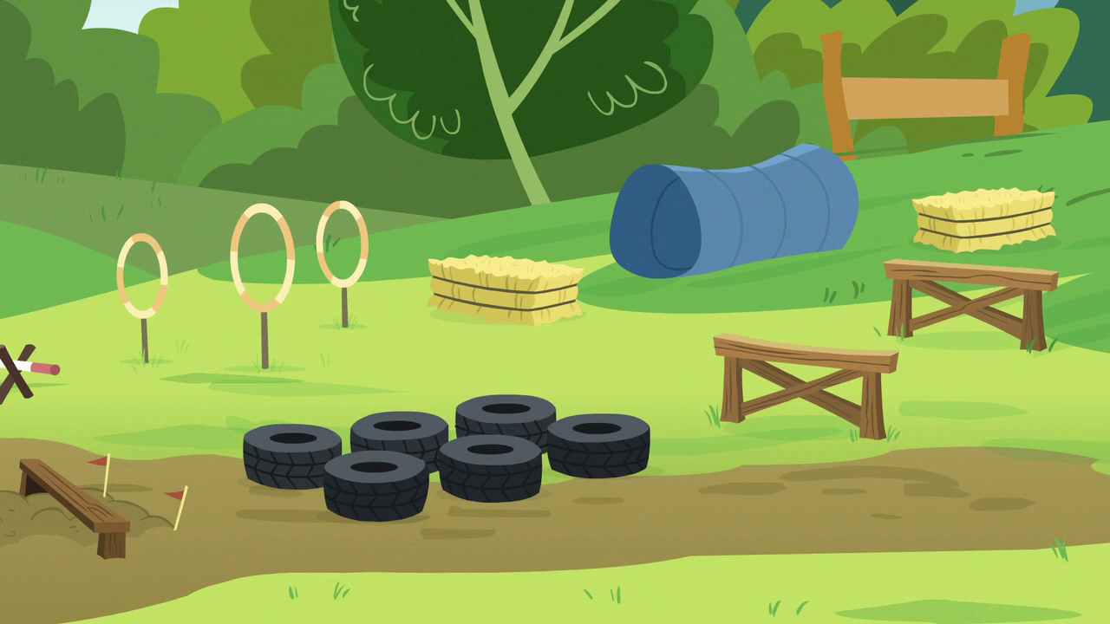
begin
WELCOME TO THE OBSTACLE COURSE

Slide 2
BEGIN
END

Slide 3

TRY AGAIN
QUIT

Slide 4


