Slide 1
Introduction to the Stack ADT

Slide 2
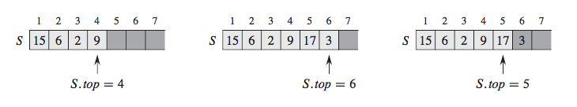
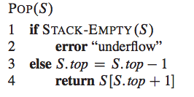

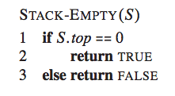
Static Stack: fixed size, implemented as array

Slide 3
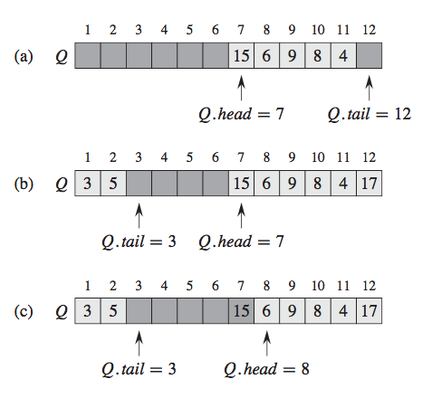
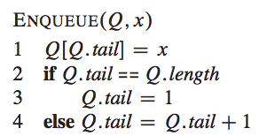
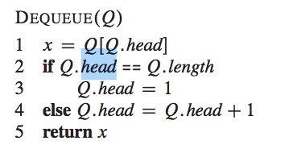
Static Queue: fixed size, implemented as array

Slide 4
Introduction to the Stack ADT
Stack: a LIFO (last in, first out) data structure
Examples:
plates in a cafeteria
return addresses for function calls
Implementation:
static: fixed size, implemented as array
dynamic: variable size, implemented as linked list

Slide 5
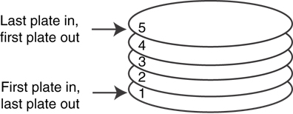
A LIFO Structure

Slide 6
Stack Operations and Functions
Operations:
push: add a value onto the top of the stack
pop: remove a value from the top of the stack
Functions:
isFull: true if the stack is currently full, i.e., has no more space to hold additional elements
isEmpty: true if the stack currently contains no elements

Slide 7
Stack Operations - Example
A stack that can hold char values:
K
E
G
K
E
E
push('E');
push('K');
push('G');

Slide 8
Stack Operations - Example
A stack that can hold char values:
E
K
E
pop();
(remove G)
pop();
(remove K)
pop();
(remove E)

Slide 9
Dynamic Stacks
Grow and shrink as necessary
Can't ever be full as long as memory is available
Implemented as a linked list

Slide 10
Introduction to the Queue ADT

Slide 11
Introduction to the Queue ADT
Queue: a FIFO (first in, first out) data structure.
Examples:
people in line at the theatre box office
print jobs sent to a printer
Implementation:
static: fixed size, implemented as array
dynamic: variable size, implemented as linked list

Slide 12
Queue Locations and Operations
rear: position where elements are added
front: position from which elements are removed
enqueue: add an element to the rear of the queue
dequeue: remove an element from the front of a queue

Slide 13
Queue Operations - Example
A currently empty queue that can hold char values:
enqueue('E');
front
E
rear

Slide 14
Queue Operations - Example
enqueue('K');
enqueue('G');
front
E | K
rear
front
E | K | G
rear

Slide 15
Queue Operations - Example
dequeue(); // remove E
dequeue(); // remove K
front
K | G
rear
front
G
rear

Slide 16
dequeue Issue, Solutions
When removing an element from a queue, remaining elements must shift to front
Solutions:
Let front index move as elements are removed (works as long as rear index is not at end of array)
Use above solution, and also let rear index "wrap around" to front of array, treating array as circular instead of linear

Slide 17
Dynamic Queues
Like a stack, a queue can be implemented using a linked list
Allows dynamic sizing, avoids issue of shifting elements or wrapping indices
null
front
rear

