Slide 1
Recursion
Reduce and Conquer
Divide (Evenly) and Conquer Sorting
1/6/16

Slide 2
Recursive algorithms - Divide and Conquer
General idea:
Divide a large problem into smaller ones
Solve each smaller one recursively
Combine the solutions of smaller ones to form a solution for the original problem
Examples:
Tower of Hanoi (Reduced and Conquer)
Fibonacci sequence (Reduced and Conquer, Dynamic Programming)
Euclidean’s Algorithm (GCD) (Reduced and Conquer)
Merge Sort, Quick Sort (Divide and Conquer)
1/6/16

Slide 3
The Recursive Factorial Function
The factorial function:
n! = n*(n-1)*(n-2)*...*3*2*1 if n > 0
n! = 1 if n = 0
Can compute factorial of n if the factorial of (n-1) is known:
n! = n * (n-1)!
n = 0 is the base case

Slide 4
The Recursive Factorial Function
def factorial (num):
{
if (num > 0)
return num * factorial(num - 1)
else
return 1
}

Slide 5
To move n discs from peg A to peg C:
move n−1 discs from A to B. This leaves disc n alone on peg A
move disc n from A to C
move n−1 discs from B to C so they sit on disc n
n
n-1
…
2
1
n-1
…
2
1
4
3
2
1
n
n
n-1
…
2
1
4
3
2
1
n

Slide 6
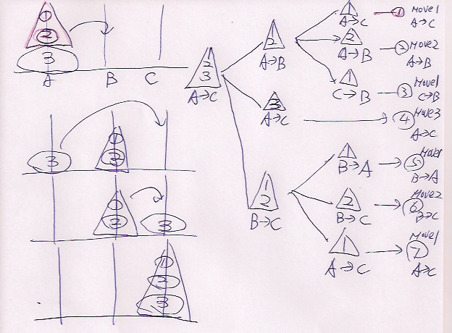
1/6/16

Slide 7
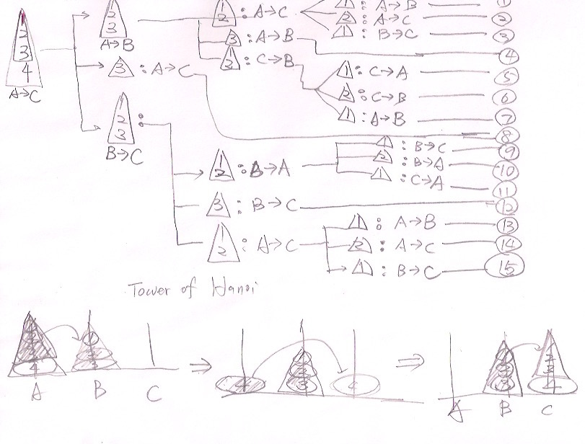
4

Slide 8
Recursive Algorithms for Tower of Hanoi
def TowerOfHanoi(n , from_rod, to_rod, aux_rod):
if n == 0:
return
TowerOfHanoi(n-1, from_rod, aux_rod, to_rod)
print ("Move disk",n,"from",from_rod,"to",to_rod )
TowerOfHanoi(n-1, aux_rod, to_rod, from_rod)
TowerOfHanoi(6, "A","B","C")
0 if n = 0;
T(n) =
2T(n-1) + 1 if n > 1.

Slide 9
Recurrence Function
0 if n = 0;
T(n) =
2T(n-1) + 1 if n > 1.
T(n) = 2* T(n-1) +1
= 2* (2*T(n-2)+1) + 1 = 4*T(n-2) + 3 = 2²*T(n-2) + 2² - 1
= 4* (2*T(n-3)+1) + 3 = 8*T(n-3) + 7 = 2³*T(n-3) + 2³ - 1
= 8* (2*T(n-4)+1) + 7 = 16*T(n-4) + 15 = 2⁴*T(n-4) + 2⁴ - 1
… = … = …
= = 2^{n}*T(0) + 2^{n} - 1
= 2^{n}-1

Slide 10
Fibonacci numbers
An recursive algorithm
fib(n) // recursive
if (n == 0 or n == 1)
return n;
else
return fib(n-1) + fib(n-2);
T(n) = T(n-1)+T(n-2) + 1
T(n) = Θ(Fn) = Θ(⏀^{n})
F(9)
F(8)
F(7)
F(7)
F(6)
F(6)
F(5)
F(6)
F(5)
F(5)
F(4)
F(5)
F(4)
F(4)
F(3)
1/7/16

Slide 11
Fibonacci numbers
An iterative algorithm
fib(n): // iterative
F[0] = 0; F[1] = 1;
for i = 2 to n
F[i] = F[i-1] + F[i-2]; // F[2]=1, F[3]= 2, F[4]=3, ….
Return F[n];
Time complexity?
T(n)
1/7/16

Slide 12
The Recursive gcd Function
Greatest common divisor (gcd) is the largest factor that two integers have in common
Computed using Euclid's algorithm:
gcd(x, y) = y if y divides x evenly
gcd(x, y) = gcd(y, x % y) otherwise
gcd(x, y) = y is the base case

Slide 13
Iteration vs. Recursion
def gcd(x, y):
while y != 0:
(x, y) = (y, x % y)
return x
def gcd_recursive(a, b):
if b == 0:
return a
else:
return gcd_recursive(b, a % b)

Slide 14
Recursion vs. Iteration
Benefits (+), disadvantages(-) for recursion:
Models certain algorithms most accurately
Results in shorter, simpler functions
May not execute very efficiently
Benefits (+), disadvantages(-) for iteration:
Executes more efficiently than recursion
Often is harder to code or understand

Slide 15
Binary Search
To find an element in a sorted array, we
Check the middle element
If ==, we’ve found it
else if less than wanted, search right half
else search left half
Example: Find 9
3
5
7
8
9
12
15
1/6/16

Slide 16
Binary Search
To find an element in a sorted array, we
Check the middle element
If ==, we’ve found it
else if less than wanted, search right half
else search left half
Example: Find 9
3
5
7
8
9
12
15
1/6/16

Slide 17
Binary Search
To find an element in a sorted array, we
Check the middle element
If ==, we’ve found it
else if less than wanted, search right half
else search left half
Example: Find 9
3
5
7
8
9
12
15
1/6/16

Slide 18
Binary Search
To find an element in a sorted array, we
Check the middle element
If ==, we’ve found it
else if less than wanted, search right half
else search left half
Example: Find 9
3
5
7
8
9
12
15
1/6/16

Slide 19
Binary Search
To find an element in a sorted array, we
Check the middle element
If ==, we’ve found it
else if less than wanted, search right half
else search left half
Example: Find 9
3
5
7
8
9
12
15
1/6/16

Slide 20
Binary Search
To find an element in a sorted array, we
Check the middle element
If ==, done!
else if less than wanted, search right half
else search left half
Example: Find 9
3
5
7
8
9
12
15
1/6/16

Slide 21
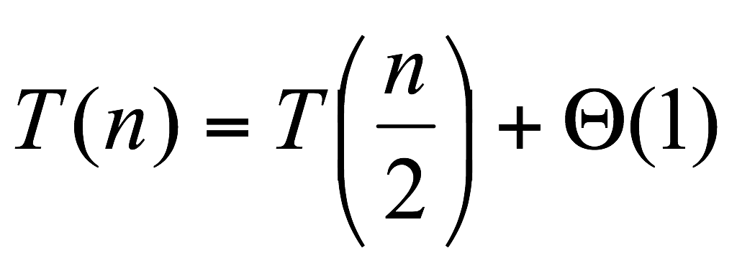
Binary Search
To find an element in a sorted array, we
Check the middle element
If ==, done!
else if less than wanted, search right half
else search left half
1/6/16

Slide 22
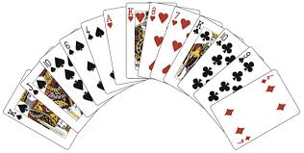
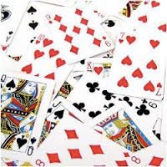
Sorting Algorithms

Slide 23
Sorting Algorithms
Selection and Insertion Sort:
Incremental approach (Reduced and Conquer)
Simple but slow
Merge and Quick Sort
Divide and Conquer

Slide 24
Selection Sort (Incremental)
Number of
Comparisons
6
5
4
3
2
1
6 | 10 | 5 | 8 | 11 | 3
Find smallest item, move to 1st location (n comparisons).
Find next smallest item, move to 2nd location (n-1 comparisons).
…
Repeat until the final location is reached.
Time complexity: n+(n-1)+(n-2)+…+1 = (n²+n)/2 = O(n²)
3 | 10 | 5 | 8 | 11 | 6
3 | 5 | 10 | 8 | 11 | 6
3 | 5 | 6 | 8 | 11 | 10
3 | 5 | 6 | 8 | 11 | 10
3 | 5 | 6 | 8 | 10 | 11
1/6/16

Slide 25
Insertion Sort (Incremental)
Number of
Comparisons
1
2
3
4
5
1
6 | 10 | 5 | 8 | 11 | 3
Begin with 1 sorted item.
Insert 2nd item properly onto the sorted list
2 sorted items
Insert 3rd item properly ontothe sorted list
3 sorted item
…
Repeat util we have all (n) sorted iterms.
Time complexity: 1+2+…+(n-1) = (n²-n)/2 =O(n²)
6 | 10 | 5 | 8 | 11 | 3
5 | 6 | 10 | 8 | 11 | 3
5 | 6 | 8 | 10 | 11 | 3
5 | 6 | 8 | 10 | 11 | 3
3 | 5 | 6 | 8 | 10 | 11
1/6/16

Slide 26
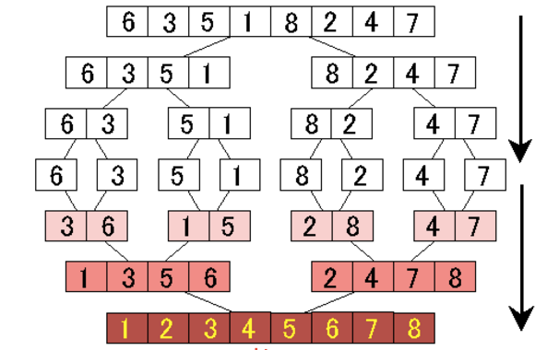
Merge Sort
Divide-and-conquer
Recursively sort ½ the set
Then merge them together: O(n)
O(n lg n) for both best, average, and worst cases
Can be made to be in-place
1/6/16

Slide 27
Codes: Merge Sort
function mergesort(data[], first, last)
if last > first:
mid = (first+last)/2 ;
mergesort(data[], first, mid );
mergesort(data[], mid+1,last);
merge ( data, first, last );
1/6/16

Slide 28
Key subroutine: MERGE O(n)
function mergesort(data[], first, last)
if last > first:
mid = (first+last)/2 ;
mergesort(data[], first, mid );
mergesort(data[], mid+1,last);
merge ( data, first, last );
1/6/16

Slide 29
Merging two sorted arrays
20
13
7
2
12
11
9
1
Array 1
Array 2
k numbers
m numbers
Time: O(k + m).
1/6/16

Slide 30
Merging two sorted arrays
20
13
7
2
12
11
9
1
1/6/16

Slide 31
Merging two sorted arrays
20
13
7
2
12
11
9
1
1/6/16

Slide 32
Merging two sorted arrays
20
13
7
2
12
11
9
1
1
1/6/16

Slide 33
Merging two sorted arrays
20
13
7
2
12
11
9
1
20
13
7
2
12
11
9
1
1/6/16

Slide 34
Merging two sorted arrays
20
13
7
2
12
11
9
1
20
13
7
2
12
11
9
1
2
1/6/16

Slide 35
Merging two sorted arrays
20
13
7
2
12
11
9
1
20
13
7
2
12
11
9
20
13
7
12
11
9
1
2
1/6/16

Slide 36
Merging two sorted arrays
20
13
7
2
12
11
9
1
20
13
7
2
12
11
9
20
13
7
12
11
9
1
2
7
1/6/16

Slide 37
Merging two sorted arrays
20
13
7
2
12
11
9
1
20
13
7
2
12
11
9
20
13
7
12
11
9
20
13
12
11
9
1
2
7
1/6/16

Slide 38
Merging two sorted arrays
20
13
7
2
12
11
9
1
20
13
7
2
12
11
9
20
13
7
12
11
9
20
13
12
11
9
1
2
7
9
1/6/16

Slide 39
Merging two sorted arrays
20
13
7
2
12
11
9
1
20
13
7
2
12
11
9
20
13
7
12
11
9
20
13
12
11
9
20
13
12
11
1
2
7
9
1/6/16

Slide 40
Merging two sorted arrays
20
13
7
2
12
11
9
1
20
13
7
2
12
11
9
20
13
7
12
11
9
20
13
12
11
9
20
13
12
11
1
2
7
9
11
1/6/16

Slide 41
Merging two sorted arrays
20
13
7
2
12
11
9
1
20
13
7
2
12
11
9
20
13
7
12
11
9
20
13
12
11
9
20
13
12
11
20
13
12
1
2
7
9
11
1/6/16

Slide 42
Merging two sorted arrays
20
13
7
2
12
11
9
1
20
13
7
2
12
11
9
20
13
7
12
11
9
20
13
12
11
9
20
13
12
11
20
13
12
1
2
7
9
11
12
1/6/16

Slide 43
Analyzing merge sort
Def mergesort(data, first, last):
if last > first:
mid = (first+last)/2 ;
mergesort(data, first, mid );
mergesort(data[], mid+1,last);
merge ( data, first, last );
Θ(1) if n = 1;
T(n) =
2T(n/2) + Θ(n) if n > 1.
1/6/16

Slide 44
Recurrence for merge sort
Θ(1) if n = 1;
T(n) =
2T(n/2) + Θ(n) if n > 1.
T(n)
= 2 T(n/2)+ n
= 2(2T(n/4)+n/2)+n = 4 T(n/4)+ 2*n
= 4 (2T(n/8)+n/4)+2*n = 8 T(n/8)+ 3*n
= … = 2^{k} T(n/2^{k})+ k*n =
= … = n* T(1) +k*n, where k = log n
= n+ (log2 n) *n = O (n log n)
1/6/16

Slide 45
Quicksort
Another divide and conquer sorting algorithm
like merge sort
The worst-case and average-case running time
Learn new algorithm analysis tricks
1/7/16

Slide 46
Quicksort (Divide & Conquer)
Pick a pivot element
Partition items to 2 groups
Items < pivot on the left
Items > pivot on the right
Sort the left and the right partitions recursively
…
Done when problem trivial
Time complexity: O(n lg n)
6
10
5
8
11
3
2
13
3
2
5
6
11
8
10
13
O(lg n)
2
3
5
6
10
8
11
13
2
3
5
6
8
10
11
13
O(n)

Slide 47
Pseudocode for quicksort
QUICKSORT(A, p, r)
if p < r
then q ← PARTITION(A, p, r) QUICKSORT(A, p, q–1)
QUICKSORT(A, q+1, r)
Initial call: QUICKSORT(A, 1, n)
1/7/16

Slide 48
Key Step of Quick Sort: Partitioning O(n)
6
10
5
8
13
3
2
11
6
2
5
8
13
3
10
11
6
2
5
3
13
8
10
11
Cross Over
r
3
2
5
6
13
8
10
11

Slide 49
Idea of partition
If we are allowed to use a second array, it would be easy
6
10
5
8
13
3
2
11
6
10

Slide 50
Idea of partition
If we are allowed to use a second array, it would be easy
6
10
5
8
13
3
2
11
6
5
10

Slide 51
Idea of partition
If we are allowed to use a second array, it would be easy
6
10
5
8
13
3
2
11
6
5
8
10

Slide 52
Idea of partition
If we are allowed to use a second array, it would be easy
6
10
5
8
13
3
2
11
6
5
13
8
10

Slide 53
Idea of partition
If we are allowed to use a second array, it would be easy
6
10
5
8
13
3
2
11
6
5
3
13
8
10

Slide 54
Idea of partition
If we are allowed to use a second array, it would be easy
6
10
5
8
13
3
2
11
2
6
5
3
2
13
8
10

Slide 55
Idea of partition
If we are allowed to use a second array, it would be easy
6
10
5
8
13
3
2
11
6
5
3
2
11
13
8
10

Slide 56
Idea of partition
If we are allowed to use a second array, it would be easy
6
10
5
8
13
3
2
11
6
5
3
2
11
13
8
10

Slide 57
Idea of partition
If we are allowed to use a second array, it would be easy
6
10
5
8
13
3
2
11
2
5
3
6
11
13
8
10

Slide 58
Idea of in-place partition
6
10
5
8
13
3
2
11
Keep two iterators: one from head, one from tail
Blue pointer stops at a number > 6(pivot)
Red pointer stops at a number < 6 (pivot)
Swap both numubers
Stop when BLUE and RED pointers cross over

Slide 59
Idea of in-place partition
6
2
5
8
13
3
10
11
Keep two iterators: one from head, one from tail
Stop when they cross over

Slide 60
Idea of in-place partition
6
2
5
8
13
3
10
11
Keep two iterators: one from head, one from tail
Stop when they cross over

Slide 61
Idea of in-place partition
6
2
5
8
13
3
10
11
Keep two iterators: one from head, one from tail
Stop when they cross over

Slide 62
Idea of in-place partition
6
2
5
8
13
3
10
11
Keep two iterators: one from head, one from tail
Stop when they cross over

Slide 63
Idea of in-place partition
6
2
5
3
13
8
10
11
Keep two iterators: one from head, one from tail
Stop when they cross over

Slide 64
Idea of in-place partition
6
2
5
3
13
8
10
11
Keep two iterators: one from head, one from tail
Stop when they cross over

Slide 65
Idea of in-place partition
6
2
5
3
13
8
10
11
Keep two iterators: one from head, one from tail
Stop when they cross over

Slide 66
Idea of in-place partition
3
2
5
6
13
8
10
11
Keep two iterators: one from head, one from tail
Stop when they cross over

Slide 67
Partition In Words
Partition(A, p, r):
Select an element to act as the “pivot” (which?)
Grow two regions, A[p..i] and A[j..r]
All elements in A[p..i] <= pivot
All elements in A[j..r] >= pivot
Increment i until A[i] > pivot
Decrement j until A[j] < pivot
Swap A[i] and A[j]
Repeat until i >= j
Swap A[j] and A[p]
Return j
Note: different from book’s partition(), which uses two iterators that both move forward.
1/7/16

Slide 68
Partition Code
Partition(A, p, r)
x = A[p]; // use the first element as PIVOT
i = p;
j = r + 1;
while (TRUE) {
repeat
i++; // move right
until A[i] > x or i >= j;
repeat
j—; // move left
until A[j] < x or j < i;
if (i < j)
Swap (A[i], A[j]);
else
break; // stop when iterators cross over
}
swap (A[p], A[j]);
return j;
Running time: Θ(n) time
1/7/16

Slide 69
p
r
x = 6
6
10
5
8
13
3
2
11
i
j
6
10
5
8
13
3
2
11
scan
i
j
6
2
5
8
13
3
10
11
swap
i
j
Partition
example
6
2
5
8
13
3
10
11
scan
i
j
6
2
5
3
13
8
10
11
swap
j
i
6
2
5
3
13
8
10
11
scan
p
q
r
3
2
5
6
13
8
10
11
final swap
1/7/16

Slide 70
Quick sort example
6
10
5
8
11
3
2
13
3
2
5
6
11
8
10
13
2
3
5
6
10
8
11
13
2
3
5
6
8
10
11
13

Slide 71
Quicksort Runtimes
Best-case runtime T_{best}(n) ∈ Θ(n log n)
Worst-case runtime T_{worst}(n) ∈ Θ(n²)
Worse than mergesort? Why is it called quicksort then?
Its average runtime T_{avg}(n) ∈ Θ(n log n )
That is, the expected runtime of randomized quicksort is Θ(n log n)
1/7/16

Slide 72
Time Complexity
Ratio
n | log₂n
10¹ | 3.3
10² | 6.6
10³ | 10
10⁴ | 13
10⁵ | 17
10⁶ | 20
10⁷ | 23
10⁸ | 26
10⁹ | 30
10¹⁰ | 33
Selection Sort | O(n²)
Insertion Sort | O(n²)
Quick Sort | O(n log₂ n)
For 10 billion random numbers (10¹⁰),
Quick Sort is about 300,000,000 times faster!!!

Slide 73
Time Complexity
 | Best-Case | Average-Case | Worst-Case
Selection Sort | O(n²) | O(n²) | O(n²)
Insertion Sort | O(n) | O(n²) | O(n²)
Quick Sort | O(n log₂ n) | O(n log₂ n) | O(n²)

Slide 74
Other Issues
 | Space Complexity | Stable
Selection Sort | O(1) | NO
Insertion Sort | O(1) | YES
Quick Sort | O(1) | NO
Stable: the relative order of elements with the same value is maintained.

Slide 75

Quiz
Which algorithm is the best for sorting data files frequently in the flash memory?
(Hints: Flash memory has limitation on the number of writes to it.)

Slide 76
Homework
Which algorithm is the best for sorting a big data file where most of data are in the sorted order already? (Hint: Best Case)
How do we avoid the worst-case behavior of the Quicksort? (Hints: selection of keys for partitioning.)
How many sorting algorithms are out there? (Hints: Google Search)

Slide 77
Unstable Sorting Algorithms
Please give a counter-example to show that they are not stable sorting algorithms.
Heap Sort
Selection sort
Quick Sort
Heap Sort: Consider array 20a 20b 19 (already in max-heap format) ➔ 19 20b 20a.
Selection sort: 4a 2 3 4b 1 ➔ 1 2 3 4b 4a
Quick Sort: 4a 2 3 4b 1 (use 3 as pivot) ➔ 1 2 3 4b 4a

Slide 78
In place algorithm
Which of the following sorting algorithms is NOT in-place?
Quick sort
Merge Sort
Insertion Sort
Selection Sort
Heap sort

Slide 79
Bonus Slides
1/6/16

Slide 80
Number of Inversion Pairs
Given an array of size N (1≤N≤2,000), count the number of inversions in the array, where an inversion is a pair of indexes (i, j) such that i < j and ar[i] > ar[j].
Brute-force solution ?
Faster solution?
3
7
10
14
18
19
2
11
16
17
23
25
6
3
2
2
0
0

Slide 81
Merge and Count
Merge and count step.
Given two sorted halves, count number of inversions where a_{i} and a_{j} are in different halves.
Combine two sorted halves into sorted whole.
i = 6
3
7
10
14
18
19
2
11
16
17
23
25
two sorted halves
auxiliary array
Total:

Slide 82
Merge and Count
Merge and count step.
Given two sorted halves, count number of inversions where a_{i} and a_{j} are in different halves.
Combine two sorted halves into sorted whole.
i = 6
3
7
10
14
18
19
2
11
16
17
23
25
two sorted halves
6
2
auxiliary array
Total: 6

Slide 83
Merge and Count
Merge and count step.
Given two sorted halves, count number of inversions where a_{i} and a_{j} are in different halves.
Combine two sorted halves into sorted whole.
i = 6
3
7
10
14
18
19
2
11
16
17
23
25
two sorted halves
6
2
auxiliary array
Total: 6

Slide 84
Merge and Count
Merge and count step.
Given two sorted halves, count number of inversions where a_{i} and a_{j} are in different halves.
Combine two sorted halves into sorted whole.
i = 6
3
7
10
14
18
19
2
11
16
17
23
25
two sorted halves
6
2
3
auxiliary array
Total: 6

Slide 85
Merge and Count
Merge and count step.
Given two sorted halves, count number of inversions where a_{i} and a_{j} are in different halves.
Combine two sorted halves into sorted whole.
i = 5
3
7
10
14
18
19
2
11
16
17
23
25
two sorted halves
6
2
3
auxiliary array
Total: 6

Slide 86
Merge and Count
Merge and count step.
Given two sorted halves, count number of inversions where a_{i} and a_{j} are in different halves.
Combine two sorted halves into sorted whole.
i = 5
3
7
10
14
18
19
2
11
16
17
23
25
two sorted halves
6
2
3
7
auxiliary array
Total: 6

Slide 87
Merge and Count
Merge and count step.
Given two sorted halves, count number of inversions where a_{i} and a_{j} are in different halves.
Combine two sorted halves into sorted whole.
i = 4
3
7
10
14
18
19
2
11
16
17
23
25
two sorted halves
6
2
3
7
auxiliary array
Total: 6

Slide 88
Merge and Count
Merge and count step.
Given two sorted halves, count number of inversions where a_{i} and a_{j} are in different halves.
Combine two sorted halves into sorted whole.
i = 4
3
7
10
14
18
19
2
11
16
17
23
25
two sorted halves
6
2
3
7
10
auxiliary array
Total: 6

Slide 89
Merge and Count
Merge and count step.
Given two sorted halves, count number of inversions where a_{i} and a_{j} are in different halves.
Combine two sorted halves into sorted whole.
i = 3
3
7
10
14
18
19
2
11
16
17
23
25
two sorted halves
6
2
3
7
10
auxiliary array
Total: 6

Slide 90
Merge and Count
Merge and count step.
Given two sorted halves, count number of inversions where a_{i} and a_{j} are in different halves.
Combine two sorted halves into sorted whole.
i = 3
3
7
10
14
18
19
2
11
16
17
23
25
two sorted halves
6
3
2
3
7
10
11
auxiliary array
Total: 6 + 3

Slide 91
Merge and Count
Merge and count step.
Given two sorted halves, count number of inversions where a_{i} and a_{j} are in different halves.
Combine two sorted halves into sorted whole.
i = 3
3
7
10
14
18
19
2
11
16
17
23
25
two sorted halves
6
3
2
3
7
10
11
auxiliary array
Total: 6 + 3

Slide 92
Merge and Count
Merge and count step.
Given two sorted halves, count number of inversions where a_{i} and a_{j} are in different halves.
Combine two sorted halves into sorted whole.
i = 3
3
7
10
14
18
19
2
11
16
17
23
25
two sorted halves
6
3
2
3
7
10
11
14
auxiliary array
Total: 6 + 3

Slide 93
Merge and Count
Merge and count step.
Given two sorted halves, count number of inversions where a_{i} and a_{j} are in different halves.
Combine two sorted halves into sorted whole.
i = 2
3
7
10
14
18
19
2
11
16
17
23
25
two sorted halves
6
3
2
3
7
10
11
14
auxiliary array
Total: 6 + 3

Slide 94
Merge and Count
Merge and count step.
Given two sorted halves, count number of inversions where a_{i} and a_{j} are in different halves.
Combine two sorted halves into sorted whole.
i = 2
3
7
10
14
18
19
2
11
16
17
23
25
two sorted halves
6
3
2
2
3
7
10
11
14
16
auxiliary array
Total: 6 + 3 + 2

Slide 95
Merge and Count
Merge and count step.
Given two sorted halves, count number of inversions where a_{i} and a_{j} are in different halves.
Combine two sorted halves into sorted whole.
i = 2
3
7
10
14
18
19
2
11
16
17
23
25
two sorted halves
6
3
2
2
3
7
10
11
14
16
auxiliary array
Total: 6 + 3 + 2

Slide 96
Merge and Count
Merge and count step.
Given two sorted halves, count number of inversions where a_{i} and a_{j} are in different halves.
Combine two sorted halves into sorted whole.
i = 2
3
7
10
14
18
19
2
11
16
17
23
25
two sorted halves
6
3
2
2
2
3
7
10
11
14
16
17
auxiliary array
Total: 6 + 3 + 2 + 2

Slide 97
Merge and Count
Merge and count step.
Given two sorted halves, count number of inversions where a_{i} and a_{j} are in different halves.
Combine two sorted halves into sorted whole.
i = 2
3
7
10
14
18
19
2
11
16
17
23
25
two sorted halves
6
3
2
2
2
3
7
10
11
14
16
17
auxiliary array
Total: 6 + 3 + 2 + 2

Slide 98
Merge and Count
Merge and count step.
Given two sorted halves, count number of inversions where a_{i} and a_{j} are in different halves.
Combine two sorted halves into sorted whole.
i = 2
3
7
10
14
18
19
2
11
16
17
23
25
two sorted halves
6
3
2
2
2
3
7
10
11
14
16
17
18
auxiliary array
Total: 6 + 3 + 2 + 2

Slide 99
Merge and Count
Merge and count step.
Given two sorted halves, count number of inversions where a_{i} and a_{j} are in different halves.
Combine two sorted halves into sorted whole.
i = 1
3
7
10
14
18
19
2
11
16
17
23
25
two sorted halves
6
3
2
2
2
3
7
10
11
14
16
17
18
auxiliary array
Total: 6 + 3 + 2 + 2

Slide 100
Merge and Count
Merge and count step.
Given two sorted halves, count number of inversions where a_{i} and a_{j} are in different halves.
Combine two sorted halves into sorted whole.
i = 1
3
7
10
14
18
19
2
11
16
17
23
25
two sorted halves
6
3
2
2
2
3
7
10
11
14
16
17
18
19
auxiliary array
Total: 6 + 3 + 2 + 2

Slide 101
Merge and Count
Merge and count step.
Given two sorted halves, count number of inversions where a_{i} and a_{j} are in different halves.
Combine two sorted halves into sorted whole.
first half exhausted
i = 0
3
7
10
14
18
19
2
11
16
17
23
25
two sorted halves
6
3
2
2
2
3
7
10
11
14
16
17
18
19
auxiliary array
Total: 6 + 3 + 2 + 2

Slide 102
Merge and Count
Merge and count step.
Given two sorted halves, count number of inversions where a_{i} and a_{j} are in different halves.
Combine two sorted halves into sorted whole.
i = 0
3
7
10
14
18
19
2
11
16
17
23
25
two sorted halves
6
3
2
2
0
2
3
7
10
11
14
16
17
18
19
23
auxiliary array
Total: 6 + 3 + 2 + 2 + 0

Slide 103
Merge and Count
Merge and count step.
Given two sorted halves, count number of inversions where a_{i} and a_{j} are in different halves.
Combine two sorted halves into sorted whole.
i = 0
3
7
10
14
18
19
2
11
16
17
23
25
two sorted halves
6
3
2
2
0
2
3
7
10
11
14
16
17
18
19
23
auxiliary array
Total: 6 + 3 + 2 + 2 + 0

Slide 104
Merge and Count
Merge and count step.
Given two sorted halves, count number of inversions where a_{i} and a_{j} are in different halves.
Combine two sorted halves into sorted whole.
i = 0
3
7
10
14
18
19
2
11
16
17
23
25
two sorted halves
6
3
2
2
0
0
2
3
7
10
11
14
16
17
18
19
23
25
auxiliary array
Total: 6 + 3 + 2 + 2 + 0 + 0

Slide 105
Merge and Count
Merge and count step.
Given two sorted halves, count number of inversions where a_{i} and a_{j} are in different halves.
Combine two sorted halves into sorted whole.
i = 0
3
7
10
14
18
19
2
11
16
17
23
25
two sorted halves
6
3
2
2
0
0
2
3
7
10
11
14
16
17
18
19
23
25
auxiliary array
Total: 6 + 3 + 2 + 2 + 0 + 0 = 13

