Slide 1
Recursion
Reduce and Conquer
Divide (Evenly) and Conquer
1/6/16

Slide 2
Recursive algorithms - Divide and Conquer
General idea:
Divide a large problem into smaller ones
Solve each smaller one recursively
Combine the solutions of smaller ones to form a solution for the original problem
Examples:
Tower of Hanoi (Reduced and Conquer)
Fibonacci sequence (Reduced and Conquer, Dynamic Programming)
Euclidean’s Algorithm (GCD) (Reduced and Conquer)
Merge Sort, Quick Sort (Divide and Conquer)
1/6/16

Slide 3
The Recursive Factorial Function
The factorial function:
n! = n*(n-1)*(n-2)*...*3*2*1 if n > 0
n! = 1 if n = 0
Can compute factorial of n if the factorial of (n-1) is known:
n! = n * (n-1)!
n = 0 is the base case

Slide 4
The Recursive Factorial Function
int factorial (int num)
{
if (num > 0)
return num * factorial(num - 1);
else
return 1;
}

Slide 5
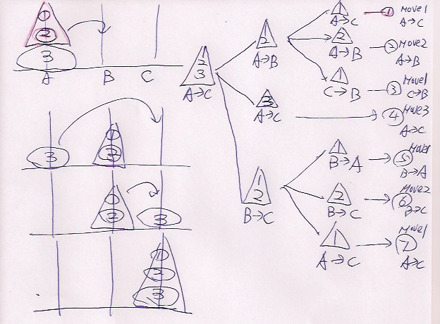
1/6/16

Slide 6
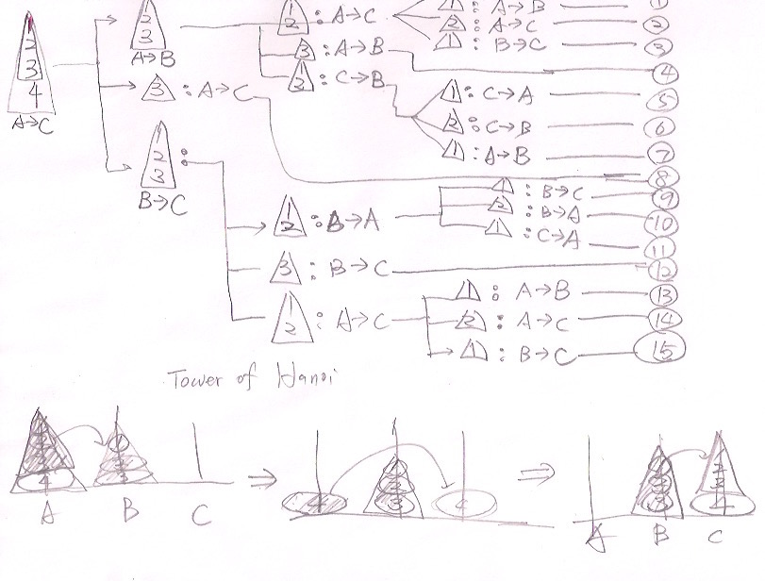
4
0 if n = 0;
T(n) =
2T(n-1) + 1 if n > 1.

Slide 7
To move n discs from peg A to peg C:
move n−1 discs from A to B. This leaves disc n alone on peg A
move disc n from A to C
move n−1 discs from B to C so they sit on disc n
0 if n = 0;
T(n) =
2T(n-1) + 1 if n > 1.
n
n-1
…
2
1
n-1
…
2
1
4
3
2
1
n
n
n-1
…
2
1
4
3
2
1
n

Slide 8
Recursive Algorithms for Tower of Hanoi
import java.util.*;
public class tower {
static int steps = 1 ;
final static char pegs[] = { 'A','B', 'C' } ;
public static void tower (int n, int A,int B, int C ) {
if ( n<=0) return; // terminating condition
tower (n-1,A,C,B);
System.out.printf ("%d: move %d from %c to %c.\n", steps, n, pegs[A],pegs[C]);
steps++;
tower (n-1,B,A,C);
}
public static void main(String[] args) throws Exception
{
int n=3;
int A=0;
int B = 1;
int C = 2;
tower ( n,A,B,C);
}
}
0 if n = 0;
T(n) =
2T(n-1) + 1 if n > 1.

Slide 9
Recurrence Function
0 if n = 0;
T(n) =
2T(n-1) + 1 if n > 1.
T(n) = 2* T(n-1) +1
= 2* (2*T(n-2)+1) + 1 = 4*T(n-2) + 3 = 2²*T(n-2) + 2² - 1
= 4* (2*T(n-3)+1) + 3 = 8*T(n-3) + 7 = 2³*T(n-3) + 2³ - 1
= 8* (2*T(n-4)+1) + 7 = 16*T(n-4) + 15 = 2⁴*T(n-4) + 2⁴ - 1
… = … = …
= = 2^{n}*T(0) + 2^{n} - 1
= 2^{n}-1

Slide 10
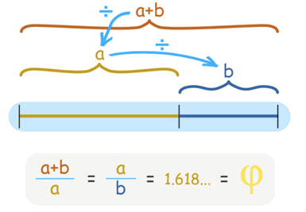
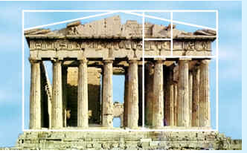
Fibonacci numbers
(Textbook Problem 4-4 page 108)
https://www.google.com/search?q=golden+ratio+in+nature&biw=1024&bih=448&source=lnms&tbm=isch&sa=X&ved=0ahUKEwjovNGBpcTKAhVH6WMKHcppCIMQ_AUIBigB&dpr=1#tbm=isch&q=golden+ratio+in+nature+shell
Golden Ratio

Slide 11
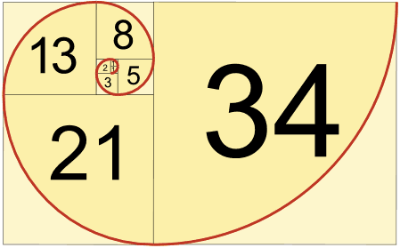





Fibonacci numbers
(Textbook Problem 4-4 page 108)
0,1, 1, 2, 3, 5, 8, 13, 21, 34, 55, 89, …
f(0) = 0;
f(1) = 1;
f(n) = f(n-1) + f(n-2)
Golden Ratio: lim f(n) / f(n-1)
n→∞
1/7/16

Slide 12

Fibonacci numbers
An recursive algorithm
fib(n) // recursive
if (n == 0 or n == 1)
return n;
else
return fib(n-1) + fib(n-2);
T(n) = T(n-1)+T(n-2) + 1
T(n) = Θ(Fn) = Θ(⏀^{n})
F(9)
F(8)
F(7)
F(7)
F(6)
F(6)
F(5)
F(6)
F(5)
F(5)
F(4)
F(5)
F(4)
F(4)
F(3)
1/7/16

Slide 13
Fibonacci numbers
An iterative algorithm
fib(n): // iterative
F[0] = 0; F[1] = 1;
for i = 2 to n
F[i] = F[i-1] + F[i-2]; // F[2]=1, F[3]= 2, F[4]=3, ….
Return F[n];
Time complexity?
T(n)
1/7/16

Slide 14
The Recursive gcd Function
Greatest common divisor (gcd) is the largest factor that two integers have in common
Computed using Euclid's algorithm:
gcd(x, y) = y if y divides x evenly
gcd(x, y) = gcd(y, x % y) otherwise
gcd(x, y) = y is the base case
def gcd_recursive(a, b):
if b == 0:
return a
else:
return gcd_recursive(b, a % b)

Slide 15
Iteration vs. Recursion
def gcd(x, y):
while y != 0:
(x, y) = (y, x % y)
return x
def gcd_recursive(a, b):
if b == 0:
return a
else:
return gcd_recursive(b, a % b)

Slide 16
Recursion vs. Iteration
Benefits (+), disadvantages(-) for recursion:
Models certain algorithms most accurately
Results in shorter, simpler functions
May not execute very efficiently
Benefits (+), disadvantages(-) for iteration:
Executes more efficiently than recursion
Often is harder to code or understand

Slide 17
Binary Search
To find an element in a sorted array, we
Check the middle element
If ==, we’ve found it
else if less than wanted, search right half
else search left half
Example: Find 9
3
5
7
8
9
12
15
1/6/16

Slide 18
Binary Search
To find an element in a sorted array, we
Check the middle element
If ==, we’ve found it
else if less than wanted, search right half
else search left half
Example: Find 9
3
5
7
8
9
12
15
1/6/16

Slide 19
Binary Search
To find an element in a sorted array, we
Check the middle element
If ==, we’ve found it
else if less than wanted, search right half
else search left half
Example: Find 9
3
5
7
8
9
12
15
1/6/16

Slide 20
Binary Search
To find an element in a sorted array, we
Check the middle element
If ==, we’ve found it
else if less than wanted, search right half
else search left half
Example: Find 9
3
5
7
8
9
12
15
1/6/16

Slide 21
Binary Search
To find an element in a sorted array, we
Check the middle element
If ==, we’ve found it
else if less than wanted, search right half
else search left half
Example: Find 9
3
5
7
8
9
12
15
1/6/16

Slide 22
Binary Search
To find an element in a sorted array, we
Check the middle element
If ==, done!
else if less than wanted, search right half
else search left half
Example: Find 9
3
5
7
8
9
12
15
1/6/16

Slide 23
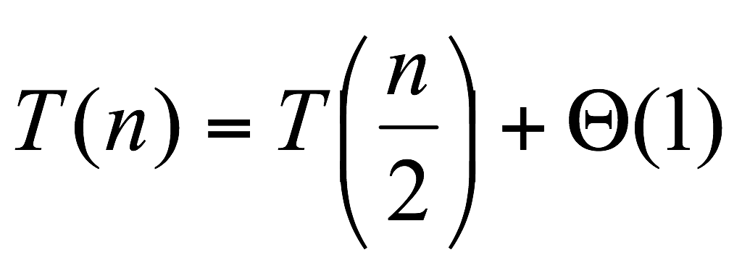
Binary Search
To find an element in a sorted array, we
Check the middle element
If ==, done!
else if less than wanted, search right half
else search left half
1/6/16

