Slide 1
CS295CA Data Structures and Algorithms
Lecture-1: Introduction
Dr. Chung-Wen Albert Tsao
1/15/2018

Slide 2
Agenda
Review algorithms we learned so far
Naïve (Brute-Force)
Incremental
Divide and Conquer

Slide 3
Naïve (Brute Force) Algorithms
Enumberate all the possible cases
Compare the solution quality in each case
Select the best (or the correct) one
Examples:
Profit of a stock transaction
Maximum-subarray problem
5 wolves and 3 sheep (http://jrmf.org/problems/WolvesAndSheep.pdf)
Three jugs problem (http://jrmf.org/problems/ThreeJugs.pdf)
The jumping frog puzzle (https://primefactorisation.com/frogpuzzle/)

Slide 4
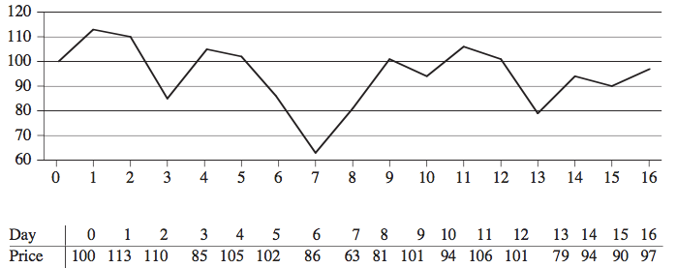
Profit of a Stock Transaction
Data Structure: array A where A[i] is the stock price on day i.
Algorithm: find maximum profit of a single transaction (buy & sell) permitted.

Slide 5
Naive Algorithm for Profit of a Stock Transaction
Naive Algorithm: O(N²)
Enumerate all the possible combinations of purchasing and selling dates.
Constraint: cannot sell before purchase
Compare all the pairs of (buying, selling) days, and pick up the best transaction
How many transactions enumberated?
Can we do better?
Reduced to Dynamic Programming

Slide 6
Naive Algorithm for Profit of a Stock Transaction
Naive Algorithm: O(N²)
Int A[N] = { …};
Int maxProfit = 0 ;
for (int I = 0; I < N; ++I ) { //i: purchase day
for (int j = i+1; j < N ; ++j ) { // j: sale day
int p = A[j] - A[i] ; // profit from buying at day I ad selling at day j
if (p > maxProfit) {
maxProfit = p
}
}
}

Slide 7
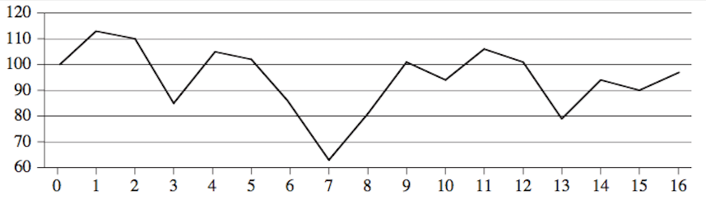
A Faster Algorithm: Enumerate all subcases
Define array B, such that B[i]= min {A[k], k ≤ i } = lowest price so far (upto day i)
B[i] = min { A[i],B[i-1] }
C[i]= A[i]-B[i] will be the best profit of transaction ending on day i
 | 0 | 1 | 2 | 3 | 4 | 5 | 6 | 7 | 8 | 9 | 10 | 11 | 12 | 13 | 14 | 15 | 16
A | 100 | 113 | 110 | 85 | 105 | 102 | 86 | 63 | 81 | 101 | 94 | 106 | 101 | 79 | 94 | 90 | 97
B | 100 | 100 | 100 | 85 | 85 | 85 | 85 | 63 | 63 | 63 | 63 | 63 | 63 | 63 | 63 | 63 | 63
C | 0 | 13 | 10 | 0 | 20 | 17 | 1 | 0 | 18 | 38 | 31 | 43 | 38 | 16 | 31 | 27 | 34

Slide 8
A Faster Algorithm: Enumerate all subcases
Faster Algorithm: O(N)
Int A[N] = { …}; int B[N]; int C[N];
B[0] = A[0];
For (int i=1; I <N; ++I ) { B[i] = min (B[i-1], A[i] } ;
For (int i=0; I <N; ++I ) { C[i] = A[i] – B[i] } ;
Int maxProfit = 0 ;
for (int I = 0; I < N; ++I ) { //i: purchase day
maxProfit = max (maxProfit, C[i] );
}

Slide 9
Example: The Three-Jug Problem
5
8
Given an empty 3-, 5-, and a full 8-liter water jug.
Use the three jugs to measure out exactly 4 liters of water with the “least number of steps”.
Solution: How to enumerate all the possible schemes? (Not that obvious)
Define State (a b c): the amounts of water in each of 3-,5- and 8-liter jugs
From the initial state, enumerate all possible states at each step
Caveat: avoid repeated states
3
1/12/16
SVU CS502

Slide 10
Solution: Enumerate All Possibilities
State (a b c): the amounts of water in each of jugs of 3-,5- and 8-liter
From the initial state, enumerate all possible states step by step (Avoid repeated states)
----------------------------------------------------------------
step 1: 0 0 8 <--- initial state 8 <--- newly measured amount of water
----------------------------------------------------------------
step 2: 3 0 5 0 5 3 3,5
----------------------------------------------------------------
step 3: 3 5 0 0 3 5 3 2 3 2
----------------------------------------------------------------
step 4: 3 3 2 0 2 6 6
----------------------------------------------------------------
step 5: 2 0 6
----------------------------------------------------------------
step 6: 2 5 1 1
----------------------------------------------------------------
step 7: 3 4 1 4
----------------------------------------------------------------
step 8: 0 4 4
----------------------------------------------------------------
step 0: 3 1 4 3 4 1
----------------------------------------------------------------
step 10:0 1 7 7
----------------------------------------------------------------
Data Structure:
Queue,
HashTable
1/12/16
SVU CS502

Slide 11
Exercises:
Consider the problem for jugs of different sizes.
Suppose the empty jugs are 2-liter and 6-liter, and the full jug is 8-liter?
What amounts can you measure out in this scenario?
What about if the jugs are 4, 6, and 10 gallons respectively?
What about 5, 6, and 11?

Slide 12

The Jumping Frog Puzzle
https://primefactorisation.com/frogpuzzle/
Z
Z
Z
A
A
A
Rules:
The left set of frogs can only move right, the right set only moves left.
Frogs can move forward 1 space, or move 2 spaces by jumping over another frog.
The puzzle is solved when the two sets of frogs have switched positions.

Slide 13
Example: 2 frogs at each side
Brute-Force Solution: (Enumerate all possibilities)
Define “state” as the positions of frogs.
Starting from the initial state (ZZ-AA)
Enumerate all Unique states from each state at current step.
Repeat the above step until the target state (AA-ZZ) is reached.
0: ZZ-AA <—— Initial state
1: -ZZAA Z-ZAA ZZA-A ZZAA- <—- New states reached in 1 step
2: ZAZ-A Z-AZA <—- New states reached in 2 steps
3: ZA-ZA ZAZA- -ZAZA <—- New states reached in 3 steps
4: -AZZA ZAAZ- ZA-AZ AZ-ZA <—- New states reached in 4 steps
5: A-ZZA ZAA-Z -AZAZ AZAZ- <—- New states reached in 5 steps
6: A-ZAZ AZA-Z <—- New states reached in 6 steps
7: AAZ-Z A-AZZ <—- New states reached in 7 steps
8: AA-ZZ <—- The target states reached in 8 steps
Data Structure:
Queue,
HashTable

Slide 14
Example: 3 frogs at each side
How many moves to get the frogs interchanged?
0: ZZZ-AAA <—— Initial state
1: Z-ZZAAA ZZ-ZAAA ZZZA-AA ZZZAA-A <—- new states reached in 1 step
2: -ZZZAAA ZZAZ-AA ZZ-AZAA ZZZAAA- <—- new states reached in 2 steps
3: ZZA-ZAA ZZAZA-A ZZAZAA- -ZZAZAA Z-ZAZAA
4: Z-AZZAA ZZAAZ-A ZZA-AZA ZAZ-ZAA
5: -ZAZZAA ZA-ZZAA ZZAA-ZA ZZAAZA- Z-AZAZA ZAZAZ-A
6: AZ-ZZAA -AZZZAA ZZAAAZ- ZZAA-AZ -ZAZAZA ZA-ZAZA ZAZA-ZA ZAZAZA-
7: A-ZZZAA ZZAAA-Z AZ-ZAZA -AZZAZA ZAAZ-ZA ZA-AZZA ZAZAAZ- ZAZA-AZ
8: A-ZZAZA AZAZ-ZA ZAA-ZZA ZAAZAZ- -AZAZZA ZAZAA-Z ZA-AZAZ
9: AZA-ZZA AZAZAZ- ZAAZA-Z A-ZAZZA -AZAZAZ ZAA-ZAZ
10: A-AZZZA AZAZA-Z ZAA-AZZ AAZ-ZZA A-ZAZAZ ZAAAZ-Z
11: AA-ZZZA AZA-AZZ ZAAA-ZZ AAZ-ZAZ <—- new states reached in 11 steps
12: A-AZAZZ AZAA-ZZ AA-ZZAZ AAZAZ-Z <—- new states reached in 12 steps
13: AA-ZAZZ AAZA-ZZ <—- new states reached in 13 steps
14: AAAZ-ZZ AA-AZZZ <—- new states reached in 14 steps
15: AAA-ZZZ <—- Target state reached in 15 steps

Slide 15
Conjecture: # Moves in Frog Puzzles
Conjecture: The least number of moves is expected as shown below
number of frogs a side N: 1 2 3 4 5 6 7 8 … N
number of moves F(N): 3 8 15 24 35 ? ? ? … ?
F(N) = (N+1)²⁻ 1
Mathematical Proof?

Slide 16
Iterative Algorithm
Incrementally (or iteratively) construct the solution.
Usually use an iterative for-loop
Example:
Selection Sort
http://cs.armstrong.edu/liang/animation/web/SelectionSortNew.html
http://www.algomation.com/
https://www.geeksforgeeks.org/selection-sort/
Insertion Sort
http://cs.armstrong.edu/liang/animation/web/InsertionSortNew.html
http://www.algomation.com/
https://www.geeksforgeeks.org/insertion-sort/

Slide 17
Selection Sort
Number of
Comparisons
6
5
4
3
2
1
6 | 10 | 5 | 8 | 11 | 3
Find smallest item, move to 1st location (n comparisons). ➔ (1 sorted item)
Find next smallest item, move to 2nd location (n-1 comparisons). ➔ (2 sorted items)
…
Repeat until the final location is reached. ➔ (n sorted item)
3 | 10 | 5 | 8 | 11 | 6
3 | 5 | 10 | 8 | 11 | 6
3 | 5 | 6 | 8 | 11 | 10
3 | 5 | 6 | 8 | 11 | 10
Time complexity: n+(n-1)+(n-2)+…+1 = (n²+n)/2 = O(n²)
3 | 5 | 6 | 8 | 10 | 11
Data Structure: Array or List
In-Place: No extra memory spaces needed
1/6/16

Slide 18
Can Sorting be done faster?
Yes, with the paradigm of Divie and Conquer
Merge sort, quick sort, …

