Slide 1
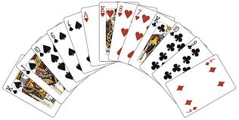
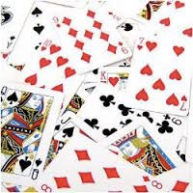
Introduction to Sorting Algorithms
Dr. Chung-Wen Albert Tsao

Slide 2
Outline
Sorting algorithm
Programmable procedure to place numbers in a descending (or ascending) order
Introduction to 3 sorting algorithms
Selection and Insertion Sort:
Incremental approach (Reduced and Conquer)
Simple but slow
Quick Sort
Divide and Conquer
Quickest
Animations: http://cs.armstrong.edu/liang/animation/animation.html

Slide 3
Selection Sort (Incremental)
Number of
Comparisons
6
5
4
3
2
1
6 | 10 | 5 | 8 | 11 | 3
Find smallest item, move to 1st location (n comparisons).
Find next smallest item, move to 2nd location (n-1 comparisons).
…
Repeat until the final location is reached.
Time complexity: n+(n-1)+(n-2)+…+1 = (n²+n)/2 = O(n²)
3 | 10 | 5 | 8 | 11 | 6
3 | 5 | 10 | 8 | 11 | 6
3 | 5 | 6 | 8 | 11 | 10
3 | 5 | 6 | 8 | 11 | 10
3 | 5 | 6 | 8 | 10 | 11
Data Structure: Array or List
In-Place: No extra memory spaces needed
1/6/16

Slide 4
Insertion Sort (Incremental)
Number of
Comparisons
1
2
3
4
5
1
6 | 10 | 5 | 8 | 11 | 3
Begin with 1 sorted item.
Insert 2nd item properly onto the sorted list
2 sorted items
Insert 3rd item properly ontothe sorted list
3 sorted item
…
Repeat util we have all (n) sorted iterms.
Time complexity: 1+2+…+(n-1) = (n²-n)/2 =O(n²)
6 | 10 | 5 | 8 | 11 | 3
5 | 6 | 10 | 8 | 11 | 3
5 | 6 | 8 | 10 | 11 | 3
5 | 6 | 8 | 10 | 11 | 3
3 | 5 | 6 | 8 | 10 | 11
Data Structure: Array or List
In-Place: No extra memory spaces needed
1/6/16

Slide 5
Can Sorting be done faster?
Yes. Dived-And-Conquer

Slide 6
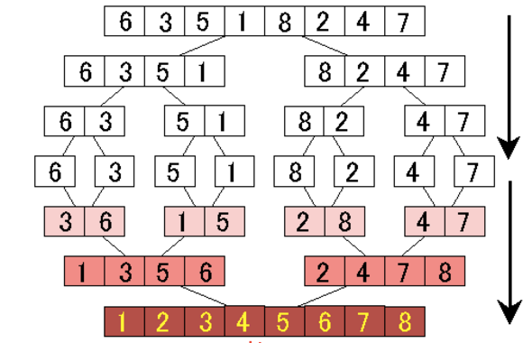
Merge Sort
Divide-and-conquer
Recursively sort ½ the set
Then merge them together: O(n)
O(n lg n) for both best, average, and worst cases
Can be made to be in-place
Data Structure: Array or List
In-Place: if using List
1/6/16

Slide 7
function mergesort(data[], first, last)
if last > first:
mid = (first+last)/2 ;
mergesort(data[], first, mid );
mergesort(data[], mid+1,last);
merge ( data, first, last );
Key subroutine: MERGE
1/6/16

Slide 8
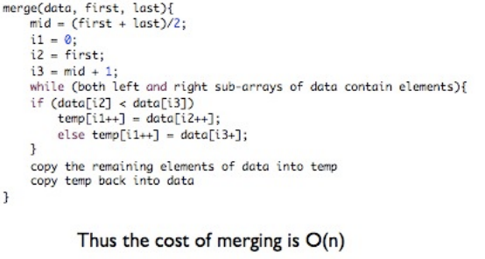

Slide 9
Merging two sorted arrays
20
13
7
2
12
11
9
1
Array 1
Array 2
k numbers
m numbers
Time: O(k + m).
1/6/16

Slide 10
Merging two sorted arrays
Array 1
Array 2
k numbers
m numbers
20
13
7
2
12
11
9
1
Time: O( n), where n is the total array size k+m.
1/6/16

Slide 11
Merging two sorted arrays
20
13
7
2
12
11
9
1
1/6/16

Slide 12
Merging two sorted arrays
20
13
7
2
12
11
9
1
1
1/6/16

Slide 13
Merging two sorted arrays
20
13
7
2
12
11
9
1
20
13
7
2
12
11
9
1
1/6/16

Slide 14
Merging two sorted arrays
20
13
7
2
12
11
9
1
20
13
7
2
12
11
9
1
2
1/6/16

Slide 15
Merging two sorted arrays
20
13
7
2
12
11
9
1
20
13
7
2
12
11
9
20
13
7
12
11
9
1
2
1/6/16

Slide 16
Merging two sorted arrays
20
13
7
2
12
11
9
1
20
13
7
2
12
11
9
20
13
7
12
11
9
1
2
7
1/6/16

Slide 17
Merging two sorted arrays
20
13
7
2
12
11
9
1
20
13
7
2
12
11
9
20
13
7
12
11
9
20
13
12
11
9
1
2
7
1/6/16

Slide 18
Merging two sorted arrays
20
13
7
2
12
11
9
1
20
13
7
2
12
11
9
20
13
7
12
11
9
20
13
12
11
9
1
2
7
9
1/6/16

Slide 19
Merging two sorted arrays
20
13
7
2
12
11
9
1
20
13
7
2
12
11
9
20
13
7
12
11
9
20
13
12
11
9
20
13
12
11
1
2
7
9
1/6/16

Slide 20
Merging two sorted arrays
20
13
7
2
12
11
9
1
20
13
7
2
12
11
9
20
13
7
12
11
9
20
13
12
11
9
20
13
12
11
1
2
7
9
11
1/6/16

Slide 21
Merging two sorted arrays
20
13
7
2
12
11
9
1
20
13
7
2
12
11
9
20
13
7
12
11
9
20
13
12
11
9
20
13
12
11
20
13
12
1
2
7
9
11
1/6/16

Slide 22
Merging two sorted arrays
20
13
7
2
12
11
9
1
20
13
7
2
12
11
9
20
13
7
12
11
9
20
13
12
11
9
20
13
12
11
20
13
12
1
2
7
9
11
12
1/6/16

Slide 23
Analyzing merge sort
function mergesort(data[], first, last)
if last > first:
mid = (first+last)/2 ;
mergesort(data[], first, mid );
mergesort(data[], mid+1,last);
merge ( data, first, last );
Θ(1) if n = 1;
T(n) =
2T(n/2) + Θ(n) if n > 1.
1/6/16

Slide 24
Recurrence for merge sort
Θ(1) if n = 1;
T(n) =
2T(n/2) + Θ(n) if n > 1.
T(n)
= 2 T(n/2)+ n
= 2(2T(n/4)+n/2)+n = 4 T(n/4)+ 2*n
= 4 (2T(n/8)+n/4)+2*n = 8 T(n/8)+ 3*n
= … = 2^{k} T(n/2^{k})+ k*n =
= … = n* T(1) +k*n, where k = log n
= n+ (log2 n) *n = O (n log n)
1/6/16

Slide 25
Quicksort
Another divide and conquer sorting algorithm
like merge sort
The worst-case and average-case running time
Learn new algorithm analysis tricks
Data Structure: Array or List
In-Place: No Extra Memory Needed
1/7/16

Slide 26
Quicksort (Divide & Conquer)
Pick a pivot element
Partition items to 2 groups
Items < pivot on the left
Items > pivot on the right
Sort the left and the right partitions recursively
…
Done when problem trivial
Time complexity: O(n lg n)
6
10
5
8
11
3
2
13
3
2
5
6
11
8
10
13
O(lg n)
2
3
5
6
10
8
11
13
2
3
5
6
8
10
11
13
O(n)

Slide 27
Pseudocode for quicksort
QUICKSORT(A, p, r)
if p < r
then q ← PARTITION(A, p, r) QUICKSORT(A, p, q–1)
QUICKSORT(A, q+1, r)
Initial call: QUICKSORT(A, 1, n)
1/7/16

Slide 28
Key Step of Quick Sort: Partitioning O(n)
6
10
5
8
13
3
2
11
6
2
5
8
13
3
10
11
6
2
5
3
13
8
10
11
Cross Over
r
3
2
5
6
13
8
10
11

Slide 29
Idea of partition
If we are allowed to use a second array, it would be easy
6
10
5
8
13
3
2
11
6
10

Slide 30
Idea of partition
If we are allowed to use a second array, it would be easy
6
10
5
8
13
3
2
11
6
5
10

Slide 31
Idea of partition
If we are allowed to use a second array, it would be easy
6
10
5
8
13
3
2
11
6
5
8
10

Slide 32
Idea of partition
If we are allowed to use a second array, it would be easy
6
10
5
8
13
3
2
11
6
5
13
8
10

Slide 33
Idea of partition
If we are allowed to use a second array, it would be easy
6
10
5
8
13
3
2
11
6
5
3
13
8
10

Slide 34
Idea of partition
If we are allowed to use a second array, it would be easy
6
10
5
8
13
3
2
11
2
6
5
3
2
13
8
10

Slide 35
Idea of partition
If we are allowed to use a second array, it would be easy
6
10
5
8
13
3
2
11
6
5
3
2
11
13
8
10

Slide 36
Idea of partition
If we are allowed to use a second array, it would be easy
6
10
5
8
13
3
2
11
6
5
3
2
11
13
8
10

Slide 37
Idea of partition
If we are allowed to use a second array, it would be easy
6
10
5
8
13
3
2
11
2
5
3
6
11
13
8
10

Slide 38
Idea of in-place partition
6
10
5
8
13
3
2
11
Keep two iterators: one from head, one from tail
Blue pointer stops at a number > 6(pivot)
Red pointer stops at a number < 6 (pivot)
Swap both numubers
Stop when BLUE and RED pointers cross over

Slide 39
Idea of in-place partition
6
2
5
8
13
3
10
11
Keep two iterators: one from head, one from tail
Stop when they cross over

Slide 40
Idea of in-place partition
6
2
5
8
13
3
10
11
Keep two iterators: one from head, one from tail
Stop when they cross over

Slide 41
Idea of in-place partition
6
2
5
8
13
3
10
11
Keep two iterators: one from head, one from tail
Stop when they cross over

Slide 42
Idea of in-place partition
6
2
5
8
13
3
10
11
Keep two iterators: one from head, one from tail
Stop when they cross over

Slide 43
Idea of in-place partition
6
2
5
3
13
8
10
11
Keep two iterators: one from head, one from tail
Stop when they cross over

Slide 44
Idea of in-place partition
6
2
5
3
13
8
10
11
Keep two iterators: one from head, one from tail
Stop when they cross over

Slide 45
Idea of in-place partition
6
2
5
3
13
8
10
11
Keep two iterators: one from head, one from tail
Stop when they cross over

Slide 46
Idea of in-place partition
3
2
5
6
13
8
10
11
Keep two iterators: one from head, one from tail
Stop when they cross over

Slide 47
Partition In Words
Partition(A, p, r):
Select an element to act as the “pivot” (which?)
Grow two regions, A[p..i] and A[j..r]
All elements in A[p..i] <= pivot
All elements in A[j..r] >= pivot
Increment i until A[i] > pivot
Decrement j until A[j] < pivot
Swap A[i] and A[j]
Repeat until i >= j
Swap A[j] and A[p]
Return j
Note: different from book’s partition(), which uses two iterators that both move forward.
1/7/16

Slide 48
Partition Code
Partition(A, p, r)
x = A[p]; // use the first element as PIVOT
i = p;
j = r + 1;
while (TRUE) {
repeat
i++; // move right
until A[i] > x or i >= j;
repeat
j—; // move left
until A[j] < x or j < i;
if (i < j)
Swap (A[i], A[j]);
else
break; // stop when iterators cross over
}
swap (A[p], A[j]);
return j;
Running time: Θ(n) time
1/7/16

Slide 49
p
r
x = 6
6
10
5
8
13
3
2
11
i
j
6
10
5
8
13
3
2
11
scan
i
j
6
2
5
8
13
3
10
11
swap
i
j
Partition
example
6
2
5
8
13
3
10
11
scan
i
j
6
2
5
3
13
8
10
11
swap
j
i
6
2
5
3
13
8
10
11
scan
p
q
r
3
2
5
6
13
8
10
11
final swap
1/7/16

Slide 50
Quick sort example
6
10
5
8
11
3
2
13
3
2
5
6
11
8
10
13
2
3
5
6
10
8
11
13
2
3
5
6
8
10
11
13

Slide 51
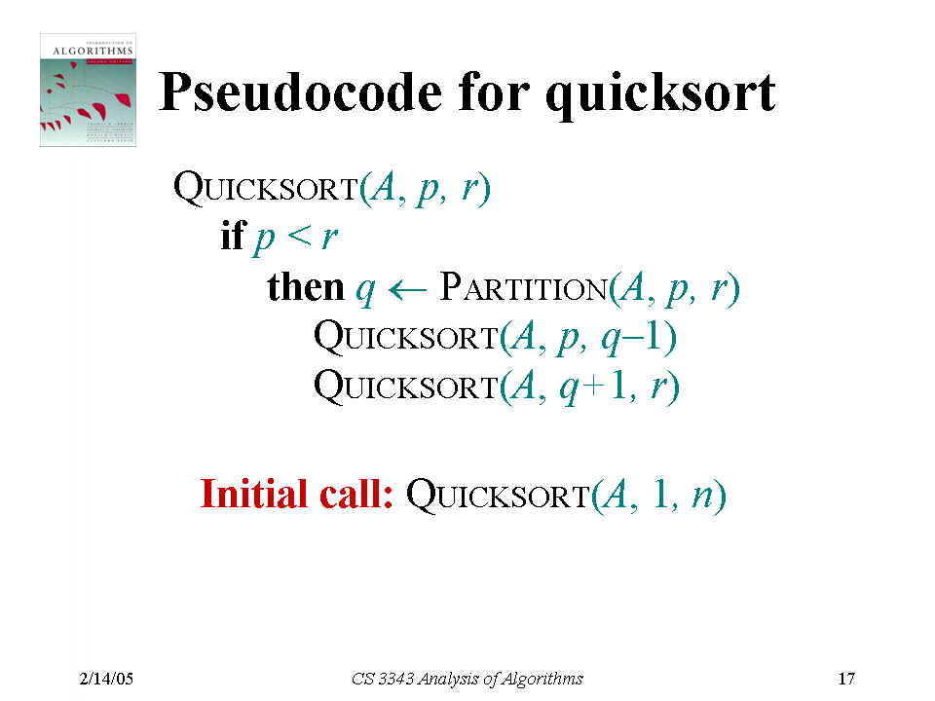

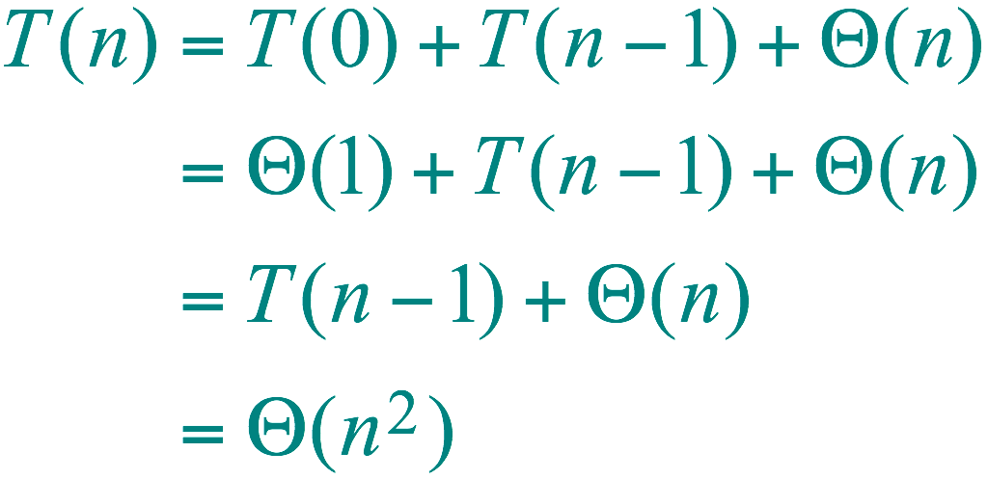
Worst-case of quicksort
Input sorted or reverse sorted.
Partition around min or max element.
One side of partition always has no elements.
1
(arithmetic series)
1/7/16

Slide 52
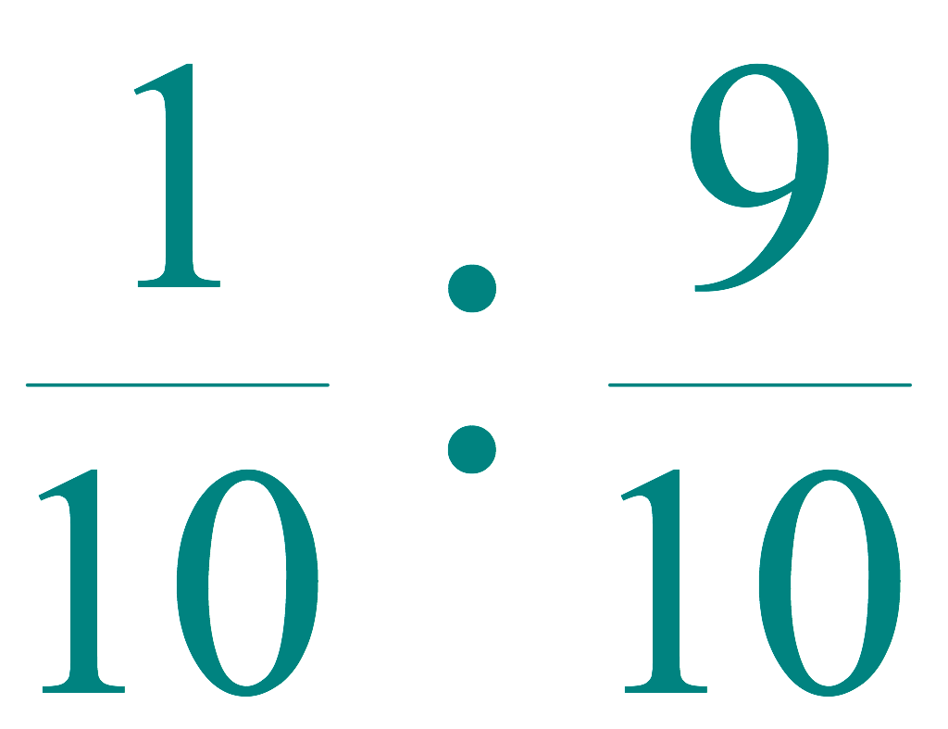

Best-case analysis
(For intuition only!)
If we’re lucky, PARTITION splits the array evenly:
T(n) = 2T(n/2) + Θ(n)
= Θ(n log n)
(same as merge sort)
What if the split is always
?
What is the solution to this recurrence?
1/7/16

Slide 53
Quicksort Runtimes
Best-case runtime T_{best}(n) ∈ Θ(n log n)
Worst-case runtime T_{worst}(n) ∈ Θ(n²)
Worse than mergesort? Why is it called quicksort then?
Its average runtime T_{avg}(n) ∈ Θ(n log n )
That is, the expected runtime of randomized quicksort is Θ(n log n)
1/7/16

Slide 54
Time Complexity
Ratio
n | log₂n
10¹ | 3.3
10² | 6.6
10³ | 10
10⁴ | 13
10⁵ | 17
10⁶ | 20
10⁷ | 23
10⁸ | 26
10⁹ | 30
10¹⁰ | 33
Selection Sort | O(n²)
Insertion Sort | O(n²)
Quick Sort | O(n log₂ n)
For 10 billion random numbers (10¹⁰),
Quick Sort is about 300,000,000 times faster!!!

Slide 55
Time Complexity
 | Best-Case | Average-Case | Worst-Case
Selection Sort | O(n²) | O(n²) | O(n²)
Insertion Sort | O(n) | O(n²) | O(n²)
Quick Sort | O(n log₂ n) | O(n log₂ n) | O(n²)

Slide 56
Other Issues
 | Space Complexity | Stable
Selection Sort | O(1) | NO
Insertion Sort | O(1) | YES
Quick Sort | O(1) | NO
Stable: the relative order of elements with the same value is maintained.

Slide 57

Quiz
Which algorithm is the best for sorting data files frequently in the flash memory?
(Hints: Flash memory has limitation on the number of writes to it.)

Slide 58
Homework
Which algorithm is the best for sorting a big data file where most of data are in the sorted order already? (Hint: Best Case)
How do we avoid the worst-case behavior of the Quicksort? (Hints: selection of keys for partitioning.)
How many sorting algorithms are out there? (Hints: Google Search)

Slide 59
Bonus Slides

Slide 60
More about sorting
Theoretical lower-bound
Linear-time sorting algorithms
Stability of sorting
1/7/16

Slide 61
Unstable Sorting Algorithms
Please give a counter-example to show that they are not stable sorting algorithms.
Heap Sort
Selection sort
Quick Sort
Heap Sort: Consider array 20a 20b 19 (already in max-heap format) ➔ 19 20b 20a.
Selection sort: 4a 2 3 4b 1 ➔ 1 2 3 4b 4a
Quick Sort: 4a 2 3 4b 1 (use 3 as pivot) ➔ 1 2 3 4b 4a

Slide 62
In place algorithm
Which of the following sorting algorithms is NOT in-place?
Quick sort
Merge Sort
Insertion Sort
Selection Sort
Heap sort

Slide 63
More about sorting
How many sorting algorithms do you know?
https://en.wikipedia.org/wiki/Sorting_algorithm#Inefficient_sorts
What are their time complexity?
What’s common about them?
Can we do better than Θ(n log n)?
Yes and no
1/7/16

Slide 64
Theoretical lower-bound
Comparison sort: determines the relative order of two elements only by comparison
What else can you do …
Text book Ch8.1 shows that the theoretical lower-bound for any comparison-based sorting algorithm is Θ(n log n)
1/7/16

Slide 65
Lower-bound of comparison-based sort
Assume an array A with 3 distinct elements, a₁, a₂, and a₃
Comparison-Based Sorting
# comparisons?
A = [9 6 5]
A = [5 6 9]
A = …
a1 < a2?
yes
no
a2 < a3?
a1 < a3 ?
yes
no
yes
no
(a1, a2, a3)
a1 < a3?
(a2, a1, a3)
a2 < a3?
yes
no
yes
no
(a1, a3, a2)
(a3, a1, a2)
(a2, a3, a1)
(a3, a2, a1)
1/7/16

Slide 66
Lower-bound of comparison-based sort
Assume all elements are distinct, each comparison has two possible outcomes: a_{i} < a_{j} or a_{i} > a_{j}
Based on the outcome, change the relative order of some elements
Output is a permutation of the input
A correct sorting algorithm can handle any arbitrary input
n! possible permutations
Therefore, at least log(n!) = Θ(n log n) comparisons in the worst case.
A
a_{i} < a_{j}
a_{i} > a_{j}
A’
A’’
log(n!)
Θ(n!)
1/7/16

Slide 67
Sorting in linear time
Is there a problem with the theory?
No. We are going to sort without doing comparison
How is that possible?
Key: Some Special Properties about the data
Example: Almost sorted? All distinct? Many identical ones? Uniformly distributed?
The more you know about your data, the more likely you can have a better algorithm
1/7/16

Slide 68
Counting sort
Knowledge: the numbers fall in a small range
Example 1: sort the final exam score of a large class
1000 students
Maximum score: 100
Minimum score: 0
Scores are integers
Example 2: sort students according to the first letter of their last name
Number of students: many
Number of letters: 26
1/7/16

Slide 69
Counting sort
Input: A[1 . . n], where A[ j] ∈ {1, 2, …, k} .
Output: B[1 . . n], sorted.
Auxiliary storage: C[1 . . k] . // for counting
Not an in-place, but stable sorting algorithm
Requires Θ (n+k) additional storage besides the original array
1/7/16

Slide 70
Intuition: Counting and Running Sum
S1: 100
S2: 90
S3: 85
S4: 100
S5: 90
S6: 75
S7: 75
50 students with score < 75
0
75
85
90
100
2
1
2
2
S6
S3
S2
S1
S7
S5
S4
… S3 … S2, S5, …, S1, S4
1/7/16

Slide 71
Intuition: Counting and Running Sum
75
85
90
100
50
2
1
2
2
(52)
(53)
(55)
(57)
50 students with score < 75
What is the rank (lowest to highest) for a student with score = 75?
52, 51, …
53 students with score ≤ 85
What is the rank for a student with score = 85?
53
55 students with score ≤ 90
What is the rank for a student with score = 90?
55, 54
1/7/16

Slide 72
Counting sort
for i ← 1 to k
do C[i] ← 0
for j ← 1 to n
do C[A[ j]] ← C[A[ j]] + 1 ⊳ C[i] = |{key = i}|
for i ← 2 to k
do C[i] ← C[i] + C[i–1] ⊳ C[i] = |{key ≤ i}|
for j ← n downto 1
do B[C[A[ j]]] ← A[ j]
C[A[ j]] ← C[A[ j]] – 1
1.
Initialize
2.
Count
3.
Compute running sum
4.
Re-arrange
1/7/16

Slide 73
Counting-sort example
1
2
3
4
5
1
2
3
4
A:
4
1
3
4
3
C:
B:
1/7/16

Slide 74
Loop 1: initialization
1
2
3
4
5
1
2
3
4
A:
4
1
3
4
3
C:
0
0
0
0
B:
for i ← 1 to k
do C[i] ← 0
1.
1/7/16

Slide 75
Loop 2: count
1
2
3
4
5
1
2
3
4
A:
4
1
3
4
3
C:
0
0
0
1
C[i] = |{key = i}|
B:
for j ← 1 to n
do C[A[ j]] ← C[A[ j]] + 1 ⊳ C[i] = |{key = i}|
2.
1/7/16

Slide 76
Loop 2: count
1
2
3
4
A:
4
1
3
4
3
C:
1
0
0
1
C[i] = |{key = i}|
B:
for j ← 1 to n
do C[A[ j]] ← C[A[ j]] + 1 ⊳ C[i] = |{key = i}|
2.
1/7/16

Slide 77
Loop 2: count
1
2
3
4
5
1
2
3
4
A:
4
1
3
4
3
C:
1
0
1
1
C[i] = |{key = i}|
B:
for j ← 1 to n
do C[A[ j]] ← C[A[ j]] + 1 ⊳ C[i] = |{key = i}|
2.
1/7/16

Slide 78
Loop 2: count
1
2
3
4
5
1
2
3
4
A:
4
1
3
4
3
C:
1
0
1
2
C[i] = |{key = i}|
B:
for j ← 1 to n
do C[A[ j]] ← C[A[ j]] + 1 ⊳ C[i] = |{key = i}|
2.
1/7/16

Slide 79
Loop 2: count
1
2
3
4
5
1
2
3
4
A:
4
1
3
4
3
C:
1
0
2
2
C[i] = |{key = i}|
B:
for j ← 1 to n
do C[A[ j]] ← C[A[ j]] + 1 ⊳ C[i] = |{key = i}|
2.
1/7/16

Slide 80
Loop 3: compute running sum
1
2
3
4
5
1
2
3
4
A:
4
1
3
4
3
C:
1
0
2
2
1
2
3
4
B:
C':
1
1
2
2
C’[i] = |{key ≤ i}|
for i ← 2 to k
do C’[i] ← C’[i] + C’[i–1]
3.
1/7/16

Slide 81
Loop 3: compute running sum
1
2
3
4
5
1
2
3
4
A:
4
1
3
4
3
C:
1
0
2
2
1
2
3
4
B:
C':
1
1
3
2
C’[i] = |{key ≤ i}|
for i ← 2 to k
do C’[i] ← C’[i] + C’[i–1]
3.
1/7/16

Slide 82
Loop 3: compute running sum
1
2
3
4
5
1
2
3
4
A:
4
1
3
4
3
C:
1
0
2
2
Given unsorted list
1
2
3
4
B:
C':
1
1
3
5
Sorted list
C’[i] = |{key ≤ i}|
for i ← 2 to k
do C’[i] ← C’[i] + C’[i–1]
3.
1/7/16

Slide 83
Loop 4: re-arrange
1
2
3
4
5
1
2
3
4
A:
4
1
3
4
3
C:
1
0
2
2
1
2
3
4
B:
3
C':
1
1
3
5
for j ← n downto 1
do B[C[A[ j]]] ← A[ j]
C[A[ j]] ← C[A[ j]] – 1
4.
1/7/16

Slide 84
Loop 4: re-arrange
1
2
3
4
5
1
2
3
4
A:
4
1
3
4
3
C:
1
0
2
2
1
2
3
4
B:
3
C':
1
1
2
5
decrease
for j ← n downto 1
do B[C[A[ j]]] ← A[ j]
C[A[ j]] ← C[A[ j]] – 1
4.
1/7/16

Slide 85
Loop 4: re-arrange
1
2
3
4
5
1
2
3
4
A:
4
1
3
4
3
C:
1
0
2
2
1
2
3
4
B:
3
4
C':
1
1
2
5
for j ← n downto 1
do B[C[A[ j]]] ← A[ j]
C[A[ j]] ← C[A[ j]] – 1
4.
1/7/16

Slide 86
Loop 4: re-arrange
1
2
3
4
5
1
2
3
4
A:
4
1
3
4
3
C:
1
0
2
2
1
2
3
4
B:
3
4
C':
1
1
2
4
decrease
for j ← n downto 1
do B[C[A[ j]]] ← A[ j]
C[A[ j]] ← C[A[ j]] – 1
4.
1/7/16

Slide 87
Loop 4: re-arrange
1
2
3
4
5
1
2
3
4
A:
4
1
3
4
3
C:
1
0
2
2
1
2
3
4
B:
3
3
4
C':
1
1
2
4
for j ← n downto 1
do B[C[A[ j]]] ← A[ j]
C[A[ j]] ← C[A[ j]] – 1
4.
1/7/16

Slide 88
Loop 4: re-arrange
1
2
3
4
5
1
2
3
4
A:
4
1
3
4
3
C:
1
0
2
2
1
2
3
4
B:
3
3
4
C':
1
1
1
4
decrease
for j ← n downto 1
do B[C[A[ j]]] ← A[ j]
C[A[ j]] ← C[A[ j]] – 1
4.
1/7/16

Slide 89
Loop 4: re-arrange
1
2
3
4
5
1
2
3
4
A:
4
1
3
4
3
C:
1
0
2
2
1
2
3
4
B:
1
3
3
4
C':
1
1
1
4
for j ← n downto 1
do B[C[A[ j]]] ← A[ j]
C[A[ j]] ← C[A[ j]] – 1
4.
1/7/16

Slide 90
Loop 4: re-arrange
1
2
3
4
5
1
2
3
4
A:
4
1
3
4
3
C:
1
0
2
2
1
2
3
4
B:
1
3
3
4
C':
0
1
1
4
decrease
for j ← n downto 1
do B[C[A[ j]]] ← A[ j]
C[A[ j]] ← C[A[ j]] – 1
4.
1/7/16

Slide 91
Loop 4: re-arrange
1
2
3
4
5
1
2
3
4
A:
4
1
3
4
3
C:
1
0
2
2
1
2
3
4
B:
1
3
3
4
4
C':
0
1
1
4
for j ← n downto 1
do B[C[A[ j]]] ← A[ j]
C[A[ j]] ← C[A[ j]] – 1
4.
1/7/16

Slide 92
Loop 4: re-arrange
1
2
3
4
5
1
2
3
4
A:
4
1
3
4
3
C:
1
0
2
2
1
2
3
4
B:
1
3
3
4
4
C':
0
1
1
3
decrease
for j ← n downto 1
do B[C[A[ j]]] ← A[ j]
C[A[ j]] ← C[A[ j]] – 1
4.
1/7/16

Slide 93
Analysis
1.
for i ← 1 to k
do C[i] ← 0
Θ(k)
for j ← 1 to n
do C[A[ j]] ← C[A[ j]] + 1
2.
Θ(n)
for i ← 2 to k
do C[i] ← C[i] + C[i–1]
3.
Θ(k)
for j ← n downto 1
do B[C[A[ j]]] ← A[ j]
C[A[ j]] ← C[A[ j]] – 1
4.
Θ(n)
Θ(n + k)
1/7/16

Slide 94
Running time
k = O(n), so counting sort takes Θ(n) time.
But, theoretical lower-bound sorting takes Ω(n log n) time!
Problem with the theory?
Answer:
Comparison sorting takes Ω(n log n) time.
Counting sort is not a comparison sort.
In fact, not a single comparison between elements occurs!
1/7/16

Slide 95
Stable sorting
Counting sort is a stable sort: it preserves the input order among equal elements.
A:
4
1
3
4
3
B:
1
3
3
4
4
Why this is important?
What other algorithms have this property?
1/7/16

Slide 96
How to sort very large numbers?
198099109123518183599
340199540380128115295
384700101594539614696
382408360201039258538
614386507628681328936
738148652090990369197
987084087096653020299
185664124421234516454
785392075747859131885
530995223593137397354
267057490443618111767
795293581914837377527
815501764221221110674
142522204403312937607
718098797338329180836
856504702326654684056
982119770959427525245
528076153239047050820
305445639847201611168
478334240651199238019
Those numbers are too large for the int type.
They are represented as strings.
One method: Use comparison-based sorting, but compare strings character by character.
What’s the cost to compare two strings, each with d characters?
Total cost: d*Θ(n log n)
Θ(d)
1/7/16

Slide 97
Radix sort
Similar to sorting address books
Treat each digit as a key
Start from the least significant bit
Most significant
Least significant
198099109123518183599
340199540380128115295
384700101594539614696
382408360201039258538
614386507628681328936
1/7/16

Slide 98
Radix sort illustration
Use simpler examples:
7 4 2
7 4 8
0 5 4
6 8 8
4 1 2
2 3 0
9 3 5
1 1 6
1 6 1
4 3 4
3 8 5
6 6 6
0 3 1
0 1 3
3 6 5
1 7 3
0 1 6
1/7/16

Slide 99
Radix sort illustration
Counting sort the last (3rd) digit
2 3 0
1 6 1
0 3 1
7 4 2
4 1 2
0 1 3
1 7 3
0 5 4
4 3 4
9 3 5
3 8 5
3 6 5
1 1 6
6 6 6
0 1 6
7 4 8
6 8 8
1/7/16

Slide 100
Radix sort illustration
Counting sort the 2nd digit
As counting sort is stable, the sorted order of the last digit remains the same for those numbers with ties at the 2nd digit.
4 1 2
0 1 3
1 1 6
0 1 6
2 3 0
0 3 1
4 3 4
9 3 5
7 4 2
7 4 8
0 5 4
1 6 1
3 6 5
6 6 6
1 7 3
3 8 5
6 8 8
Relative order of last digit remains
the same
1/7/16

Slide 101
Radix sort illustration
Counting sort the 1st digit
As counting sort is stable, the sorted order of the 2nd digit remains the same for those numbers with ties at the 1st digit.
Relative order of 2nd digit remains
the same
0 1 3
0 1 6
0 3 1
0 5 4
1 1 6
1 6 1
1 7 3
2 3 0
3 6 5
3 8 5
4 1 2
4 3 4
6 6 6
6 8 8
7 4 2
7 4 8
9 3 5
1/7/16

Slide 102
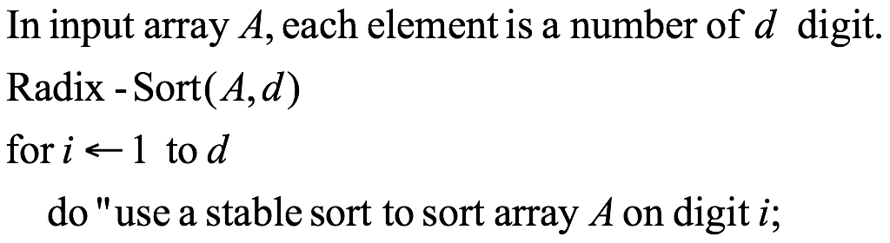
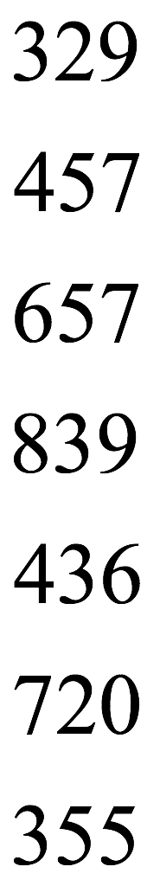
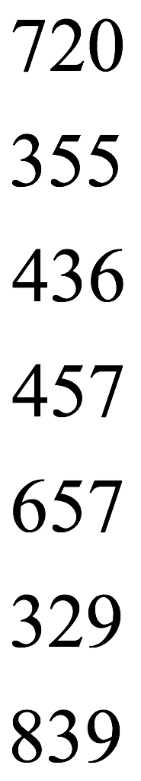
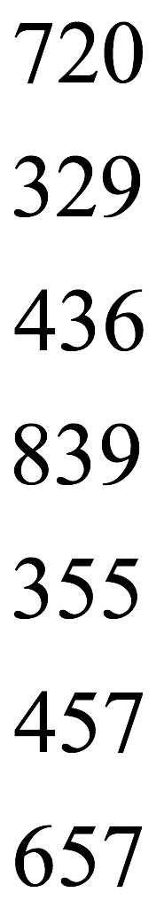
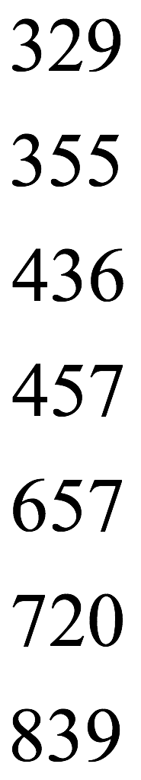
Radix Sort

Slide 103
Time complexity of Radix Sort
Sort each of the d digits by counting sort
T(n)=d*(n + k)
k = 10
T(n)= Θ(d*n) < comparison-based sorting cost d*(n log n)
Partition the d digits into groups of r
T(n)= (n+10^{r})(d/r)
T(n)=d*(2n/log10 n) when n=10^{r} , (r = log10 n)
When using binary systems rather than decimals
Partition d bits into groups of r bits
T(n) = d*(2n/log2 n) when r=log2 n
1/7/16

Slide 104
Space complexity
Calls counting sort
Therefore additional storage is needed
Θ(n)
1/7/16

Slide 106




Counting-sort example
1
2
3
4
5
6
7
8
A:
5
3
0
2
3
0
3
0
1
2
3
4
5
C:
1
2
3
4
5
6
7
8
B:

Slide 107

Executing Loop 1
1
2
3
4
5
6
7
8
A:
5
3
0
2
3
0
3
0
1
2
3
4
5
C:
0
0
0
0
0
0
1
2
3
4
5
6
7
8
B:

Slide 108

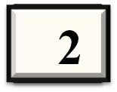

Executing Loop 2
1
2
3
4
5
6
7
8
A:
5
3
0
2
3
0
3
0
1
2
3
4
5
C:
0
0
1
0
0
0
1
2
3
4
5
6
7
8
B:

Slide 109

Executing Loop 2
1
2
3
4
5
6
7
8
A:
5
3
0
2
3
0
3
0
1
2
3
4
5
C:
0
0
1
0
0
1
1
2
3
4
5
6
7
8
B:

Slide 110

Executing Loop 2
1
2
3
4
5
6
7
8
A:
5
3
0
2
3
0
3
0
1
2
3
4
5
C:
0
0
1
1
0
1
1
2
3
4
5
6
7
8
B:

Slide 111
Executing Loop 2
1
2
3
4
5
6
7
8
A:
5
3
0
2
3
0
3
0
1
2
3
4
5
C:
1
0
1
1
0
1
1
2
3
4
5
6
7
8
B:

Slide 112
Executing Loop 2
1
2
3
4
5
6
7
8
A:
5
3
0
2
3
0
3
0
1
2
3
4
5
C:
1
0
2
1
0
1
1
2
3
4
5
6
7
8
B:

Slide 113
Executing Loop 2
1
2
3
4
5
6
7
8
A:
5
3
0
2
3
0
3
0
1
2
3
4
5
C:
1
0
2
2
0
1
1
2
3
4
5
6
7
8
B:

Slide 114
Executing Loop 2
1
2
3
4
5
6
7
8
A:
5
3
0
2
3
0
3
0
1
2
3
4
5
C:
2
0
2
2
0
1
1
2
3
4
5
6
7
8
B:

Slide 115
Executing Loop 2
1
2
3
4
5
6
7
8
A:
5
3
0
2
3
0
3
0
1
2
3
4
5
C:
2
0
2
3
0
1
1
2
3
4
5
6
7
8
B:

Slide 116
End of Loop 2
1
2
3
4
5
6
7
8
A:
5
3
0
2
3
0
3
0
1
2
3
4
5
C:
2
0
2
3
0
1
1
2
3
4
5
6
7
8
B:

Slide 117

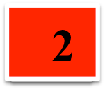




Executing Loop 3
1
2
3
4
5
6
7
8
A:
5
3
0
2
3
0
3
0
1
2
3
4
5
C:
2
0
2
3
0
1
0
1
2
3
4
5
C:
2
2
2
3
0
1
1
2
3
4
5
6
7
8
B:

Slide 118

Executing Loop 3
1
2
3
4
5
6
7
8
A:
5
3
0
2
3
0
3
0
1
2
3
4
5
C:
2
2
2
3
0
1
0
1
2
3
4
5
C:
2
2
4
3
0
1
1
2
3
4
5
6
7
8
B:

Slide 119
Executing Loop 3
1
2
3
4
5
6
7
8
A:
5
3
0
2
3
0
3
0
1
2
3
4
5
C:
2
2
4
3
0
1
0
1
2
3
4
5
C:
2
2
4
7
0
1
1
2
3
4
5
6
7
8
B:

Slide 120
Executing Loop 3
1
2
3
4
5
6
7
8
A:
5
3
0
2
3
0
3
0
1
2
3
4
5
C:
2
2
4
7
0
1
0
1
2
3
4
5
C:
2
2
4
7
7
1
1
2
3
4
5
6
7
8
B:

Slide 121
Executing Loop 3
1
2
3
4
5
6
7
8
A:
5
3
0
2
3
0
3
0
1
2
3
4
5
C:
2
2
4
7
7
1
0
1
2
3
4
5
C:
2
2
4
7
7
8
1
2
3
4
5
6
7
8
B:

Slide 122
End of Loop 3
1
2
3
4
5
6
7
8
A:
5
3
0
2
3
0
3
0
1
2
3
4
5
C:
2
2
4
7
7
8
1
2
3
4
5
6
7
8
B:

Slide 123

Executing Loop 4
1
2
3
4
5
6
7
8
A:
5
3
0
2
3
0
3
0
1
2
3
4
5
C:
2
2
4
7
7
8
1
2
3
4
5
6
7
8
B:

Slide 124
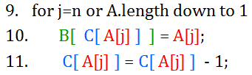

Executing Loop 4
1
2
3
4
5
6
7
8
A:
5
3
0
2
3
0
3
J=8, then A[ j ]=A[8]=3
And B[ C[ A[j] ] ]
=B[ C[ 3 ] ]
=B[ 7]
So B[ C[ A[j] ] ] ←A[ j ]
=B[7]←3
0
1
2
3
4
5
C:
2
2
4
7
7
8
1
2
3
4
5
6
7
8
B:

Slide 125


Executing Loop 4
1
2
3
4
5
6
7
8
A:
5
3
0
2
3
0
3
J=8, then A[ j ]=A[8]=3
Then C[ A[j] ]
= C[ 3 ]
=7
So C[ A[j] ] = C[ A[j] ] -1
=7-1=6
0
1
2
3
4
5
C:
2
2
4
6
7
8
1
2
3
4
5
6
7
8
B:
3

Slide 126


Executing Loop 4
1
2
3
4
5
6
7
8
A:
5
3
0
2
3
0
3
0
1
2
3
4
5
C:
1
2
4
6
7
8
1
2
3
4
5
6
7
8
B:
0
3

Slide 127


Executing Loop 4
1
2
3
4
5
6
7
8
A:
5
3
0
2
3
0
3
0
1
2
3
4
5
C:
1
2
4
5
7
8
1
2
3
4
5
6
7
8
B:
0
3
3

Slide 128

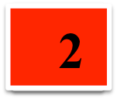

Executing Loop 4
1
2
3
4
5
6
7
8
A:
5
3
0
3
0
3
0
1
2
3
4
5
C:
1
2
3
5
7
8
1
2
3
4
5
6
7
8
B:
0
2
3
3

Slide 129



Executing Loop 4
1
2
3
4
5
6
7
8
A:
5
3
0
3
0
3
0
1
2
3
4
5
C:
0
2
3
5
7
8
1
2
3
4
5
6
7
8
B:
0
0
2
3
3

Slide 130

Executing Loop 4
1
2
3
4
5
6
7
8
A:
5
3
0
3
0
3
0
1
2
3
4
5
C:
0
2
3
4
7
8
1
2
3
4
5
6
7
8
B:
0
0
2
3
3
3

Slide 131

Executing Loop 4
1
2
3
4
5
6
7
8
A:
2
5
3
0
3
0
3
0
1
2
3
4
5
C:
0
2
3
4
7
7
1
2
3
4
5
6
7
8
B:
0
0
2
3
3
3
5

Slide 132
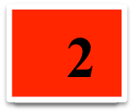
End of Loop 4
1
2
3
4
5
6
7
8
A:
5
3
0
3
0
3
0
1
2
3
4
5
C:
0
2
2
4
7
7
1
2
3
4
5
6
7
8
B:
0
0
2
2
3
3
3
5
Sorted data in Array B

Slide 133
For simplicity, consider the data in the range 0 to 9.
Input data: 1, 4, 1, 2, 7, 5, 2
1) Take a count array to store the count of each unique object.
Index: 0 1 2 3 4 5 6 7 8 9
Count: 0 2 2 0 1 1 0 1 0 0
2) Modify the count array such that each element at each index
stores the sum of previous counts.
Index: 0 1 2 3 4 5 6 7 8 9
Count: 0 2 4 4 5 6 6 7 7 7
The modified count array indicates the position of each object in the output sequence.
3) Output each object from the input sequence followed by decreasing its count by 1.
Process the input data: 1, 4, 1, 2, 7, 5, 2.
Position of 1 is 2, Put data 1 at index 2 in output. Decrease count by 1 to place
next data 1 at an index 1 smaller than this index.

