Slide 1
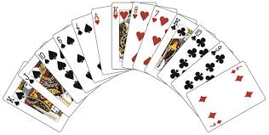
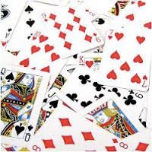
Introduction to Sorting Algorithms
Dr. Chung-Wen Albert Tsao

Slide 2
Outline
Sorting algorithm
Selection and Insertion Sort:
Incremental approach (Reduced and Conquer)
Simple but slow
Merge/Quick Sort
Divide and Conquer
Much

Slide 3
Selection Sort (Incremental)
Number of
Comparisons
6
5
4
3
2
1
6 | 10 | 5 | 8 | 11 | 3
Find smallest item, move to 1st location (n comparisons).
Find next smallest item, move to 2nd location (n-1 comparisons).
…
Repeat until the final location is reached.
Time complexity: n+(n-1)+(n-2)+…+1 = (n²+n)/2 = O(n²)
3 | 10 | 5 | 8 | 11 | 6
3 | 5 | 10 | 8 | 11 | 6
3 | 5 | 6 | 8 | 11 | 10
3 | 5 | 6 | 8 | 11 | 10
3 | 5 | 6 | 8 | 10 | 11
1/6/16

Slide 4
Insertion Sort (Incremental)
Number of
Comparisons
1
2
3
4
5
1
6 | 10 | 5 | 8 | 11 | 3
Begin with 1 sorted item.
Insert 2nd item properly onto the sorted list
2 sorted items
Insert 3rd item properly ontothe sorted list
3 sorted item
…
Repeat util we have all (n) sorted iterms.
Time complexity: 1+2+…+(n-1) = (n²-n)/2 =O(n²)
6 | 10 | 5 | 8 | 11 | 3
5 | 6 | 10 | 8 | 11 | 3
5 | 6 | 8 | 10 | 11 | 3
5 | 6 | 8 | 10 | 11 | 3
3 | 5 | 6 | 8 | 10 | 11
1/6/16

Slide 5
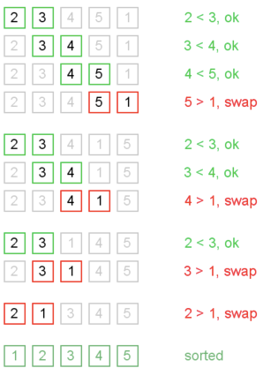
Bubble (Sinking, Ripple) Sort
Main idea: Go through each element, and if it’s out of order with its neighbor, swap them.
If you can go through entire array with no swaps, you’re done
After i^{th} pass, at least last i positions are sorted and in final correct order.
Worst case: O(n²)
has a big constant
Best case: O(n)
if already sorted

Slide 6
Merge Sort (Divide & Conquer)
Recursively partition the set
Then merge them together: O(n)
O(n lg n) for both best, average, and worst cases
O(lg n)
Merge can be made to be in-place
O(n)
1/6/16

Slide 7
Merge Sort
Key subroutine: MERGE
def mergeSort(alist):
if len(alist)>1:
mid = len(alist)//2
lefthalf = alist[:mid]
righthalf = alist[mid:]
mergeSort(lefthalf)
mergeSort(righthalf)
merge (alist, lefthalf, righthalf )
def merge ( alist, lefthalf, righthalf):
i=j=k=0
while i<len(lefthalf) and j<len(righthalf):
if lefthalf[i]<righthalf[j]:
alist[k]=lefthalf[i]; i=i+1
else:
alist[k]=righthalf[j]; j=j+1
k=k+1
while i<len(lefthalf):
alist[k]=lefthalf[i]; i=i+1; k=k+1
while j<len(righthalf):
alist[k]=righthalf[j]; j=j+1; k=k+1
O (N log N)
O (N)
1/6/16

Slide 8
Merging two sorted arrays: O(m+n)
20
13
7
2
12
11
9
1
1/6/16

Slide 9
Merging two sorted arrays
20
13
7
2
12
11
9
1
1/6/16

Slide 10
Merging two sorted arrays
20
13
7
2
12
11
9
1
1
1/6/16

Slide 11
Merging two sorted arrays
20
13
7
2
12
11
9
1
20
13
7
2
12
11
9
1
1/6/16

Slide 12
Merging two sorted arrays
20
13
7
2
12
11
9
1
20
13
7
2
12
11
9
1
2
1/6/16

Slide 13
Merging two sorted arrays
20
13
7
2
12
11
9
1
20
13
7
2
12
11
9
20
13
7
12
11
9
1
2
1/6/16

Slide 14
Merging two sorted arrays
20
13
7
2
12
11
9
1
20
13
7
2
12
11
9
20
13
7
12
11
9
1
2
7
1/6/16

Slide 15
Merging two sorted arrays
20
13
7
2
12
11
9
1
20
13
7
2
12
11
9
20
13
7
12
11
9
20
13
12
11
9
1
2
7
1/6/16

Slide 16
Merging two sorted arrays
20
13
7
2
12
11
9
1
20
13
7
2
12
11
9
20
13
7
12
11
9
20
13
12
11
9
1
2
7
9
1/6/16

Slide 17
Merging two sorted arrays
20
13
7
2
12
11
9
1
20
13
7
2
12
11
9
20
13
7
12
11
9
20
13
12
11
9
20
13
12
11
1
2
7
9
1/6/16

Slide 18
Merging two sorted arrays
20
13
7
2
12
11
9
1
20
13
7
2
12
11
9
20
13
7
12
11
9
20
13
12
11
9
20
13
12
11
1
2
7
9
11
1/6/16

Slide 19
Merging two sorted arrays
20
13
7
2
12
11
9
1
20
13
7
2
12
11
9
20
13
7
12
11
9
20
13
12
11
9
20
13
12
11
20
13
12
1
2
7
9
11
1/6/16

Slide 20
Merging two sorted arrays
20
13
7
2
12
11
9
1
20
13
7
2
12
11
9
20
13
7
12
11
9
20
13
12
11
9
20
13
12
11
20
13
12
1
2
7
9
11
12
1/6/16

Slide 21
Analyzing merge sort
def mergeSort(alist):
if len(alist)>1:
mid = len(alist)//2
lefthalf = alist[:mid]
righthalf = alist[mid:]
mergeSort(lefthalf)
mergeSort(righthalf)
merge (alist, lefthalf, righthalf )
Θ(1) if n = 1;
T(n) =
2T(n/2) + Θ(n) if n > 1.
T(n) = 2 T(n/2) + n
= 2(2T(n/4)+n/2)+n = 4 T(n/4) + 2*n
= 4 (2T(n/8)+n/4)+2*n = 8 T(n/8) + 3*n
= … = 2^{k} T(n/2^{k}) + k*n =
= … = n* T(1) + k*n, where k = log n
= n+ (log2 n) *n = O (n log n)
1/6/16

Slide 22
Quicksort
Another divide and conquer sorting algorithm
like merge sort
Learn new algorithm analysis tricks
1/7/16

Slide 23
Quicksort (Divide & Conquer)
Pick a pivot element
Partition items to 2 groups
Items < pivot on the left
Items > pivot on the right
Sort the left and the right partitions recursively
…
Done when problem trivial
Time complexity: O(n lg n)
6
10
5
8
11
3
2
13
3
2
5
6
11
8
10
13
O(lg n)
2
3
5
6
10
8
11
13
2
3
5
6
8
10
11
13
O(n)

Slide 24
Pseudocode for quicksort
QUICKSORT(A, p, r)
if p < r
then q ← PARTITION(A, p, r) QUICKSORT(A, p, q–1)
QUICKSORT(A, q+1, r)
Initial call: QUICKSORT(A, 1, n)
1/7/16

Slide 25
Key Step of Quick Sort: Partitioning O(n)
6
10
5
8
13
3
2
11
6
2
5
8
13
3
10
11
6
2
5
3
13
8
10
11
Cross Over
r
3
2
5
6
13
8
10
11

Slide 26
Idea of partition
If we are allowed to use a second array, it would be easy
6
10
5
8
13
3
2
11
6
10

Slide 27
Idea of partition
If we are allowed to use a second array, it would be easy
6
10
5
8
13
3
2
11
6
5
10

Slide 28
Idea of partition
If we are allowed to use a second array, it would be easy
6
10
5
8
13
3
2
11
6
5
8
10

Slide 29
Idea of partition
If we are allowed to use a second array, it would be easy
6
10
5
8
13
3
2
11
6
5
13
8
10

Slide 30
Idea of partition
If we are allowed to use a second array, it would be easy
6
10
5
8
13
3
2
11
6
5
3
13
8
10

Slide 31
Idea of partition
If we are allowed to use a second array, it would be easy
6
10
5
8
13
3
2
11
2
6
5
3
2
13
8
10

Slide 32
Idea of partition
If we are allowed to use a second array, it would be easy
6
10
5
8
13
3
2
11
6
5
3
2
11
13
8
10

Slide 33
Idea of partition
If we are allowed to use a second array, it would be easy
6
10
5
8
13
3
2
11
6
5
3
2
11
13
8
10

Slide 34
Idea of partition
If we are allowed to use a second array, it would be easy
6
10
5
8
13
3
2
11
2
5
3
6
11
13
8
10

Slide 35
Idea of in-place partition
6
10
5
8
13
3
2
11
Keep two iterators: one from head, one from tail
Blue pointer stops at a number > 6(pivot)
Red pointer stops at a number < 6 (pivot)
Swap both numubers
Stop when BLUE and RED pointers cross over

Slide 36
Idea of in-place partition
6
2
5
8
13
3
10
11
Keep two iterators: one from head, one from tail
Stop when they cross over

Slide 37
Idea of in-place partition
6
2
5
8
13
3
10
11
Keep two iterators: one from head, one from tail
Stop when they cross over

Slide 38
Idea of in-place partition
6
2
5
8
13
3
10
11
Keep two iterators: one from head, one from tail
Stop when they cross over

Slide 39
Idea of in-place partition
6
2
5
8
13
3
10
11
Keep two iterators: one from head, one from tail
Stop when they cross over

Slide 40
Idea of in-place partition
6
2
5
3
13
8
10
11
Keep two iterators: one from head, one from tail
Stop when they cross over

Slide 41
Idea of in-place partition
6
2
5
3
13
8
10
11
Keep two iterators: one from head, one from tail
Stop when they cross over

Slide 42
Idea of in-place partition
6
2
5
3
13
8
10
11
Keep two iterators: one from head, one from tail
Stop when they cross over

Slide 43
Idea of in-place partition
3
2
5
6
13
8
10
11
Keep two iterators: one from head, one from tail
Stop when they cross over

Slide 44
Partition Code
def partition(alist,first,last):
pivotvalue = alist[first]
leftmark = first+1; rightmark = last
done = False
while not done:
while leftmark <= rightmark and alist[leftmark] <= pivotvalue:
leftmark = leftmark + 1
while alist[rightmark] >= pivotvalue and rightmark >= leftmark:
rightmark = rightmark -1
if rightmark < leftmark:
done = True
else:
alist[leftmark], alist[rightmark] = alist[rightmark] , alist[leftmark]
alist[first], alist[rightmark] = alist[rightmark] , alist[first]
return rightmark
Running time: Θ(n) time
1/7/16

Slide 45
p
r
x = 6
6
10
5
8
13
3
2
11
i
j
6
10
5
8
13
3
2
11
scan
i
j
6
2
5
8
13
3
10
11
swap
i
j
Partition
example
6
2
5
8
13
3
10
11
scan
i
j
6
2
5
3
13
8
10
11
swap
j
i
6
2
5
3
13
8
10
11
scan
p
q
r
3
2
5
6
13
8
10
11
final swap
1/7/16

Slide 46
Quick sort example
6
10
5
8
11
3
2
13
3
2
5
6
11
8
10
13
2
3
5
6
10
8
11
13
2
3
5
6
8
10
11
13

Slide 47

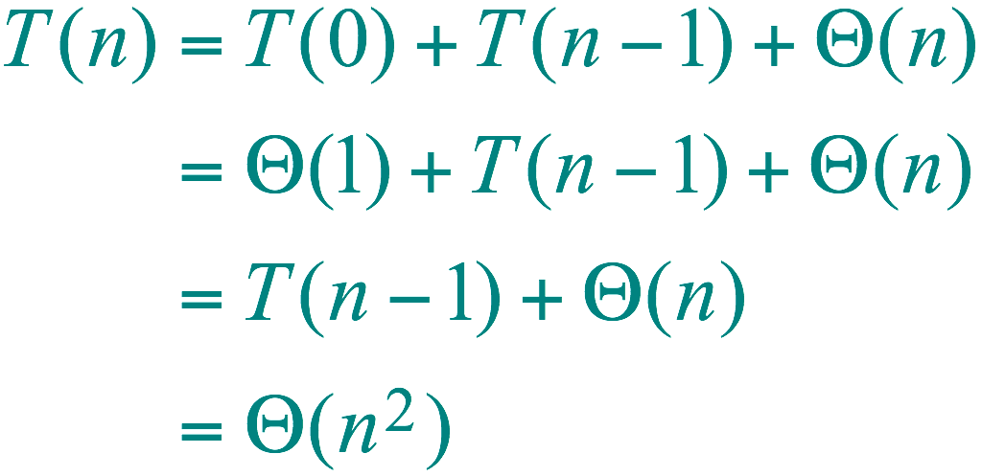
Worst-case of quicksort
Input sorted or reverse sorted.
Partition around min or max element.
One side of partition always has no elements.
1
1/7/16

Slide 48
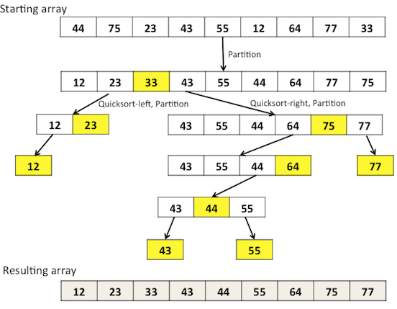

Slide 49
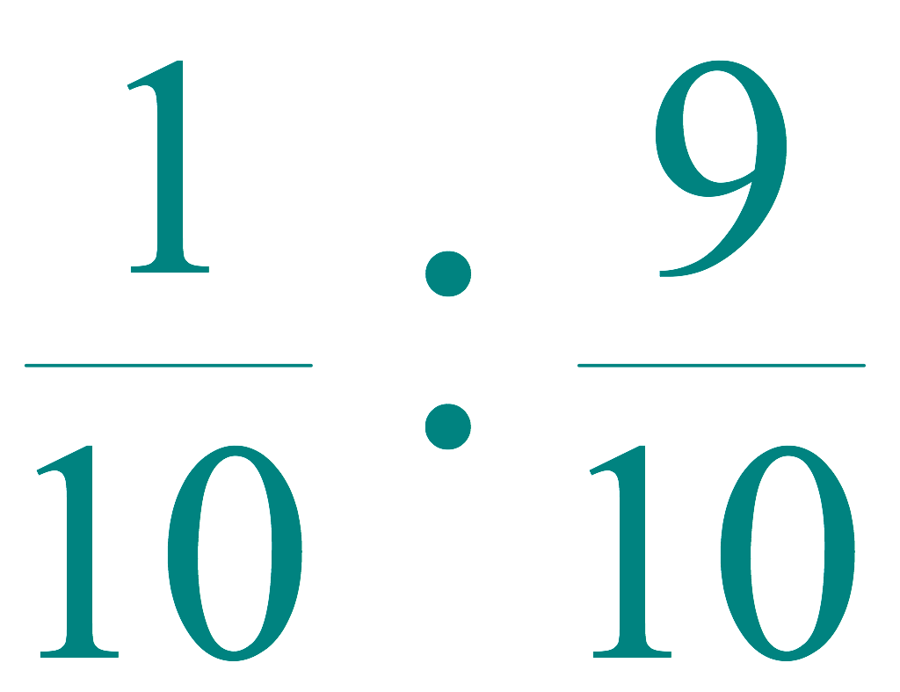
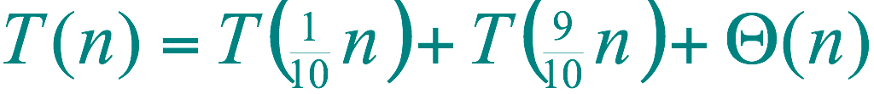
Best-case analysis
(For intuition only!)
If we’re lucky, PARTITION splits the array evenly:
T(n) = 2T(n/2) + Θ(n)
= Θ(n log n)
(same as merge sort)
What if the split is always
?
1/7/16

Slide 50
Quicksort Runtimes
Best-case runtime T_{best}(n) ∈ Θ(n log n)
Worst-case runtime T_{worst}(n) ∈ Θ(n²)
Worse than mergesort? Why is it called quicksort then?
Its average runtime T_{avg}(n) ∈ Θ(n log n )
1/7/16

Slide 51
Time Complexity
Ratio
n | log₂n
10¹ | 3.3
10² | 6.6
10³ | 10
10⁴ | 13
10⁵ | 17
10⁶ | 20
10⁷ | 23
10⁸ | 26
10⁹ | 30
10¹⁰ | 33
Selection Sort | O(n²)
Insertion Sort | O(n²)
Quick Sort | O(n log₂ n)
For 10 billion random numbers (10¹⁰),
Quick Sort is about 300,000,000 times faster!!!

Slide 52
Time Complexity
 | Best-Case | Average-Case | Worst-Case
Selection Sort | O(n²) | O(n²) | O(n²)
Insertion Sort | O(n) | O(n²) | O(n²)
Quick Sort | O(n log₂ n) | O(n log₂ n) | O(n²)

Slide 53
Other Issues
 | Space Complexity | Stable
Selection Sort | O(1) | NO
Insertion Sort | O(1) | YES
Quick Sort | O(1) | NO
Stable: the relative order of elements with the same value is maintained.

Slide 54

Quiz
Which algorithm is the best for sorting data files frequently in the flash memory?
(Hints: Flash memory has limitation on the number of writes to it.)

Slide 55
Homework
Which algorithm is the best for sorting a big data file where most of data are in the sorted order already? (Hint: Best Case)
How do we avoid the worst-case behavior of the Quicksort? (Hints: selection of keys for partitioning.)
How many sorting algorithms are out there? (Hints: Google Search)

Slide 56
Unstable Sorting Algorithms
Please give a counter-example to show that they are not stable sorting algorithms.
Heap Sort
Selection sort
Quick Sort
Heap Sort: Consider array 20a 20b 19 (already in max-heap format) ➔ 19 20b 20a.
Selection sort: 4a 2 3 4b 1 ➔ 1 2 3 4b 4a
Quick Sort: 4a 2 3 4b 1 (use 3 as pivot) ➔ 1 2 3 4b 4a

Slide 57
In place algorithm
Which of the following sorting algorithms is NOT in-place?
Quick sort
Merge Sort
Insertion Sort
Selection Sort
Heap sort

