Slide 1
Asymptotic Analysis
1/7/16

Slide 2
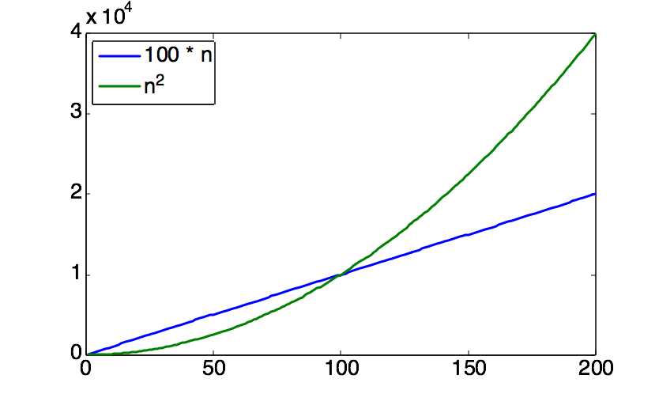
Asymptotic Analysis
Run time: # simple steps that are executed
Depends on the size of the input (n)
Size of input, n, is generally defined as the number of input elements
Larger array takes more time to sort
T(n): run time for input with size n
Look at growth of T(n) as n→∞.
High order term dominates
1/12/16

Slide 3
Comparison of Time Complexity Functions
 | log₂n | n | nlog₂n | n² | n³ | 2^{n} | n!
n=10 | 3.3 | 10 | 33 | 10² | 10³ | 10³ | 10⁶
n=10² | 6.6 | 10² | 660 | 10⁴ | 10⁶ | 10³⁰ | 10¹⁵⁸
n=10³ | 10 | 10³ | 10⁴ | 10⁶ | 10⁹
n=10⁴ | 13 | 10⁴ | 10⁵ | 10⁸ | 10¹²
n=10⁵ | 17 | 10⁵ | 10⁶ | 10¹⁰ | 10¹⁵
n=10⁶ | 20 | 10⁶ | 10⁷ | 10¹² | 10¹⁸
For a super computer that does 1 trillion operations per second, it will be longer than 1 billion years
1/12/16

Slide 4
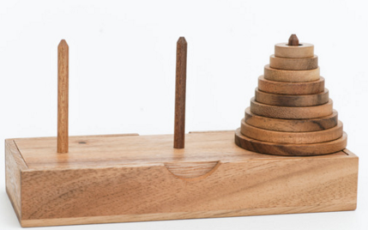
Comparison of Time Complexity Functions
Tower of Hanoi
http://www.dynamicdrive.com/dynamicindex12/towerhanoi.htm
Time Complexity T(n)= 2^{n}-1
Suppose each move take you 1 second.
How soon can you finish the game with n=30 discs?
Hours?days?week? Month?years?
How about n=40?
1/12/16

Slide 5
Exact analysis is hard!
easier to talk about upper and lower bounds of the function.
T(n)
problem size(n)

Slide 6
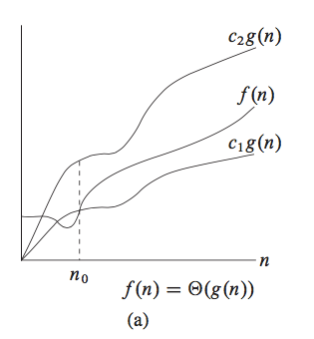
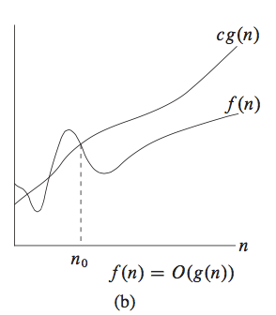
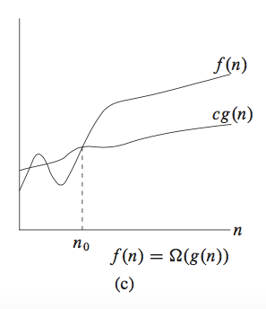
O, Ω, and Θ
The definitions imply a constant n₀ beyond which they are
satisfied. (We do not care about small values of n.)
1/7/16

Slide 7
Asymptotic notations
O: Big-Oh
Ω: Big-Omega
Θ: Theta
o: Small-oh
ω: Small-omeg
f(n) = O(g(n)) ➔ f(n) ≤ c*g(n)
f(n) = Ω(g(n)) ➔ f(n) ≥ c*g(n)
f(n) = Θ(g(n)) ➔ f(n) = c*g(n)
f(n) = o(g(n)) ➔ f(n) < c*g(n)
f(n) = ω(g(n)) ➔ f(n) > c*g(n)
1/7/16

Slide 8
Example: Repeated Elements
repeated_Element (A, n)
{
// determines whether all elements in a given // array are distinct
for i = 1 to n-1 {
for j = i+1 to n {
if (A[i] == A[j]) return true;
}
}
return false;
}
1/7/16

Slide 9
Run Time Complexity
Best case
A[1] = A[2]
T(n) = Θ (1)
Worst-case
No repeated elements
T(n) = (n-1) + (n-2) + … + 1 = n (n-1) / 2 = Θ (n²)
Average case?
What do you mean by “average”?
Need more assumptions about data distribution.
How many possible repeats are in the data?
Average-case analysis often involves probability.
1/7/16

Slide 10
Q#3. Which of the following is false?
2^{2n} ∈ O(2^{n})
log(n!) ∈ O(n log n)
2^{n+1} ∈ Θ(2^{n})
2^{2n} ∈ ω(2^{n})
9n³+ 12n ∈ o(2^{n})
Q#4 Which of the following is true?
a) 10n² + 50 ∈ O(n log n)
b) 3n² + 12n + 2 ∈ Ω(n³)
c) If f(n) ∈ ω(g(n)), then g(n) ∈ o(f(n)).
Q#5. Which of the following is true?
If f(n) = O(g(n)), then f(n) = ο(g(n)).
If f(n) = Θ(g(n)), then f(n) = ω(g(n)).
If f(n) = Ο(g(n)), then g(n) = ω(f(n)).
If f(n) = Θ(g(n)), then g(n) = Ω(f(n)).

Slide 11
Q#1. Prove n ∈ O(n²) by choosing some c>0 and n0 such that n ≤ c•n² for n≥ n0. Which of the following is NOT the correct choice of c and n0?
a) c=1, n0=2
b) c= 1/2, n0= 1
c) c= 10, n0= 2
d) c= 1/20, n0= 20
e) c=1, n0=1
Q#2. Prove 1000*n ∈ O(n²) by choosing some c>0 and n0 such that 1000*n ≤ c * n² for n ≥ n0. Which of the following is NOT the correct choice of c and n0?
c=1, n0=1000
c=1000, n0=1
c=1000, n0=1000
c=1, n0=1

Slide 12
Q#1. Prove n ∈ O(n²) by choosing some c>0 and n0 such that n ≤ c•n² for n≥ n0. Which of the following is NOT the correct choice of c and n0?
a) c=1, n0=2
b) c= 1/2, n0= 1
c) c= 10, n0= 2
d) c= 1/20, n0= 20
e) c=1, n0=1
Q#2. Prove 1000*n ∈ O(n²) by choosing some c>0 and n0 such that 1000*n ≤ c * n² for n ≥ n0. Which of the following is NOT the correct choice of c and n0?
c=1, n0=1000
c=1000, n0=1
c=1000, n0=1000
c=1, n0=1

Slide 13
Student ID:________________________
Q#3. Which of the following is false?
2^{2n} ∈ O(2^{n})
log(n!) ∈ O(n log n)
2^{n+1} ∈ Θ(2^{n})
2^{2n} ∈ ω(2^{n})
9n³+ 12n ∈ o(2^{n})
Q#4 Which of the following is true?
a) 10n² + 50 ∈ O(n log n)
b) 3n² + 12n + 2 ∈ Ω(n³)
c) If f(n) ∈ ω(g(n)), then g(n) ∈ o(f(n)).
Q#5. Which of the following is true?
If f(n) = O(g(n)), then f(n) = ο(g(n)).
If f(n) = Θ(g(n)), then f(n) = ω(g(n)).
If f(n) = Ο(g(n)), then g(n) = ω(f(n)).
If f(n) = Θ(g(n)), then g(n) = Ω(f(n)).

Slide 14
Student ID:________________________
Q#3. Which of the following is false?
2^{2n} ∈ O(2^{n})
log(n!) ∈ O(n log n)
2^{n+1} ∈ Θ(2^{n})
2^{2n} ∈ ω(2^{n})
9n³+ 12n ∈ o(2^{n})
Q#4 Which of the following is true?
10n² + 50 ∈ O(n log n)
3n² + 12n + 2 ∈ Ω(n³)
If f(n) ∈ ω(g(n)), then g(n) ∈ o(f(n)).
Q#5. Which of the following is true?
If f(n) = O(g(n)), then f(n) = ο(g(n)).
If f(n) = Θ(g(n)), then f(n) = ω(g(n)).
If f(n) = Ο(g(n)), then g(n) = ω(f(n)).
If f(n) = Θ(g(n)), then g(n) = Ω(f(n)).

Slide 15
Run Time Complexity:
for(int i=0; i<N; i++) cout<<i<<endl;
for(int i=0; i*i<N; i++) cout<<i<<endl;
for(int i=0; i<W; i++) { for(int j=0; j<H; j++) cout<<i*j<<endl; }
for(int sum=0, i=0; i<N; i++, sum += i) { for(int j=0; j<sum; j++) cout<<j<<endl; }
set<int> bst; for(int i=0; i<N; i++) bst.insert(i);
vector<int> v; for(int i=0; i<N; i++) v.push_back(i); for(int i=0; i<N; i++) v.erase(v.begin());

Slide 16
Run Time Complexity:
Find the element x in an unsorted array of size N (N ≤ 1,000,000).
In a grid of size N x M (1<=N, M<=1,000), find the shortest path between 2 points marked S and E.
Given a number A and a number B (1≤A, B≤10,000,000), find A to the power of B. As this number can be quite large, find it modulo 1,000,007.
Given a number P (1≤P≤10,000,000), determine if P is prime.
Given an array of size N (1<=N<=100,000, N odd), find the median of the array.
Given an array of size N (1≤N≤2,000), count the number of inversions in the array, where an inversion is a pair of indexes (i, j) such that i < j and ar[i] > ar[j].

