Slide 1
Introduction to Graphs
Dr. Chung-Wen Albert Tsao
1/7/16

Slide 2
Graphs and Trees
A path that begins and ends at the same node is called a cycle. Example:
Two nodes are connected if there is a path between them.
A graph is connected if every pair of its nodes is connected.
A graph is acyclic if it doesn’t have any cycle.
tree is connected, acyclic graph. |E| = |V| -1
1/7/16

Slide 3
Rooted Trees
Definition: A rooted tree is a tree in which one vertex is distinguished from the others and is called the root.
The level of a vertex is the number of edges along the unique path between it and the root.
The height of a rooted tree is the maximum level to any vertex of the tree.
The children of a vertex v are those vertices that are adjacent to v and one level farther away from the root than v.
r
a
b
c
d
1/7/16

Slide 4
Binary Tree
Tree with at most 2 children for each node
Usually draw root at the top
Can be complete, or full
1/7/16

Slide 5
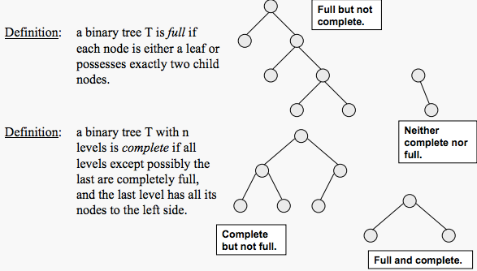
Binary Tree
http://courses.cs.vt.edu/~cs3114/Fall09/wmcquain/Notes/T03a.BinaryTreeTheorems.pdf

Slide 6
Outline
Graph definition
Graph representations
Adjacency matrix
Adjacency list
Graph search
Breadth first search (BFS)
Depth first search (DFS)
Topological sort
Part of the slides are based on material from Prof. Jianhua Ruan, The University of Texas at San Antonio
1/7/16

Slide 7
Graph
A graph is a structure that consists of a set of vertices and a set of edges between pairs of vertices
A graph is a pair (V, E), where
V is a set of vertices
E is a set of pairs of vertices, called edges
Example:
V = {A, B, C, D, E, F}
E = {(A,B), (A,C), (A,D), (C,D), (C,E), (D, F)}
F
E
D
C
B
A
1/7/16

Slide 8
Graphs
We will typically express running times in terms of |E| and |V| (often dropping the |’s)
If |E| ≈ |V|² the graph is dense
If |E| ≈ |V| the graph is sparse
If you know you are dealing with dense or sparse graphs, different data structures may make sense
1/7/16

Slide 9
Graph Variations
A connected graph has a path from every vertex to every other
In an undirected graph:
Edge (u,v) = edge (v,u)
No self-loops
In a directed graph:
Edge (u,v) goes from vertex u to vertex v, notated u→v
A weighted graph associates weights with either the edges or the vertices
E.g., a road map: edges might be weighted w/ distance
A multigraph allows multiple edges between the same vertices
E.g., the call graph in a program (a function can get called from multiple points in another function)
1/7/16

Slide 10
Directed graph (digraph)
Directed edge
ordered pair of vertices (u,v)
Undirected edge
unordered pair of vertices (u,v)
A graph with directed edges is called a directed graph or digraph
A graph with undirected edges is an undirected graph or simply a graph
1/7/16

Slide 11
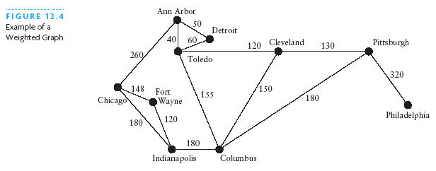
Weighted Graphs
The edges in a graph may have values associated with them known as their weights
A graph with weighted edges is known as a weighted graph
1/7/16

Slide 12
Terminology
End vertices (or endpoints) of an edge
U and V are the endpoints of a
Edges incident on a vertex
a, d, and b are incident on V
Adjacent vertices
U and V are adjacent
Degree of a vertex
X has degree 5
Parallel edges
h and i are parallel edges
Self-loop
j is a self-loop
V
a
b
h
j
U
d
X
Z
c
e
i
W
g
f
Y
1/7/16

Slide 13
DAG
A Directed Acyclic Graph (DAG) is a digraph that has no directed cycles
D
E
B
C
A
DAG G
1/7/16

Slide 14
Spanning Trees and Forests
A spanning tree of a connected graph is a spanning subgraph that is a tree
A spanning tree is not unique unless the graph is a tree
A spanning forest of a graph is a spanning subgraph that is a forest
Graph
Spanning tree
1/7/16

Slide 15
Representing Graphs
Assume V = {1, 2, …, n}
An adjacency matrix represents the graph as a n x n matrix A:
A[i, j] = 1 if edge (i, j) ∈ E = 0 if edge (i, j) ∉ E
For weighted graph
A[i, j] = w_{ij} if edge (i, j) ∈ E
= 0 if edge (i, j) ∉ E
For undirected graph
Matrix is symmetric: A[i, j] = A[j, i]
1/7/16

Slide 16
Directed Graphs: Adjacency Matrix
Example:
A | 1 | 2 | 3 | 4
1
2
3 |  |  | ??
4
1
2
4
3
1/7/16

Slide 17
Directed Graphs: Adjacency Matrix
Example:
A | 1 | 2 | 3 | 4
1 | 0 | 1 | 1 | 0
2 | 0 | 0 | 1 | 0
3 | 0 | 0 | 0 | 0
4 | 0 | 0 | 1 | 0
1
2
4
3
How much storage does the adjacency matrix require?
A: O(V²)
1/7/16

Slide 18
(Undirected) Graphs: Adjacency Matrix
Example:
A
1
2
3
4
1
1
0
1
1
0
2
4
2
1
0
1
0
3
1
1
0
1
3
4
0
0
1
0
Undirected graph → matrix is symmetric
No self-loops → don’t need diagonal
1/7/16

Slide 19
(Undirected) Graphs: Adjacency Matrix
Example:
A
1
2
3
4
1
1
0
5
6
0
5
2
6
4
2
5
0
9
0
9
4
3
6
9
0
4
3
4
0
0
4
0
Weighted graph
1/7/16

Slide 20
Graphs: Adjacency Matrix
Time to answer if there is an edge between vertex u and v: Θ(1)
Memory required: Θ(n²) regardless of |E|
Usually too much storage for large graphs
But can be very efficient for small graphs
Most large interesting graphs are sparse
E.g., road networks (due to limit on junctions)
For this reason the adjacency list is often a more appropriate representation
1/7/16

Slide 21
Graphs: Adjacency Matrix
The adjacency matrix is a dense representation
Usually too much storage for large graphs
But can be very efficient for small graphs
Most large interesting graphs are sparse
E.g., planar graphs, in which no edges cross, have |E| = O(|V|) by Euler’s formula
For this reason the adjacency list is often a more appropriate representation
1/7/16

Slide 22
Graphs: Adjacency List
Adjacency list: for each vertex v ∈ V, store a list of vertices adjacent to v
Example:
Adj[1] = {2,3}
Adj[2] = {3}
Adj[3] = {}
Adj[4] = {3}
Variation: can also keep a list of edges coming into vertex
1
2
4
3
1/7/16

Slide 23
Graph representations
Adjacency list
1
1
2
3
2
3
2
4
3
4
3
3
How much storage does the adjacency list require?
A: O(V+E)
1/7/16

Slide 24
Graph representations
Undirected graph
1
A
1
2
3
4
1
0
1
1
0
2
4
2
1
0
1
0
3
1
1
0
1
3
4
0
0
1
0
2
3
1
3
1
2
4
1/7/16
3

Slide 25
Graph representations
Weighted graph
A
1
2
3
4
1
1
0
5
6
0
5
2
5
0
9
0
2
6
4
3
6
9
0
4
9
4
4
0
0
4
0
3
2,5
3,6
1,5
3,9
1,6
2,9
4,4
1/7/16
3,4

Slide 26
Graphs: Adjacency List
How much storage is required?
For directed graphs
|adj[v]| = out-degree(v)
Total # of items in adjacency lists is Σ out-degree(v) = |E|
For undirected graphs
|adj[v]| = degree(v)
# items in adjacency lists is Σ degree(v) = 2 |E|
So: Adjacency lists take Θ(V+E) storage
Time needed to test if edge (u, v) ∈ E is O(n)
1/7/16

Slide 27
Tradeoffs between the two representations
|V| = n, |E| = m
 | Adj Matrix | Adj List
test (u, v) ∈ E | Θ(1) | O(n)
Degree(u) | Θ(n) | O(n)
Memory | Θ(n²) | Θ(n+m)
Edge insertion | Θ(1) | Θ(1)
Edge deletion | Θ(1) | O(n)
Graph traversal | Θ(n²) | Θ(n+m)
Both representations are very useful and have different properties.
1/7/16

Slide 28
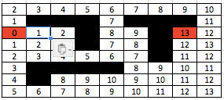
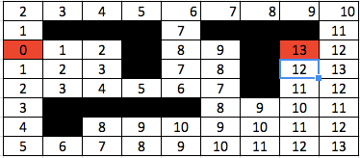
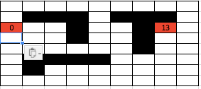
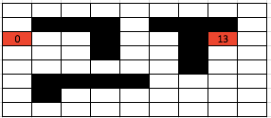
Breadth-First Search (BFS)
“Explore” a graph, turning it into a tree
One vertex at a time
Expand frontier of explored vertices across the breadth of the frontier
Builds a (shortest-Path) tree over the graph
Pick a source vertex to be the root
Find (“discover”) its children, then their children, etc.
1/7/16

Slide 29
Breadth-First Search (BFS)
“Explore” a graph, turning it into a tree
One vertex at a time
Expand frontier of explored vertices across the breadth of the frontier
Builds a (shortest-Path) tree over the graph
Pick a source vertex to be the root
Find (“discover”) its children, then their children, etc.
1/7/16

Slide 30
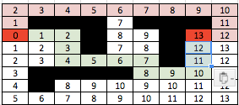
Breadth-First Search (BFS)
“Explore” a graph, turning it into a tree
One vertex at a time
Expand frontier of explored vertices across the breadth of the frontier
Builds a (shortest-Path) tree over the graph
Find out the shortest path by back tracking
1/7/16

Slide 31
Breadth-First Search
Associate vertex “colors” to guide the algorithm
White vertices have not been discovered
All vertices start out white
Gray vertices are discovered but not fully explored
They may be adjacent to white vertices
Yellow vertices are discovered and fully explored
They are adjacent only to black and gray vertices
Explore vertices by scanning adjacency list of gray vertices
1/7/16

Slide 32
Breadth-First Search
BFS(G, s) {
initialize vertices;
Q = {s}; // Q is a queue, initialize to s
while (Q not empty) {
u = RemoveTop(Q);
for each v ∈ u->adj {
if (v->color == WHITE)
v->color = GREY;
v->d = u->d + 1;
v->p = u;
Enqueue(Q, v);
}
u->color = BLACK;
}
}
What does v->d represent? (distance, #steps)
What does v->p represent? (preceding or parent node)
1/7/16

Slide 33
Breadth-First Search: Example
(Starting node)
a
r
s
t
∞
∞
∞
∞
b
∞
∞
∞
∞
∞
v
w
x
y
1/7/16

Slide 34
Breadth-First Search: Example
a
r
s
t
∞
∞
0
∞
∞
b
∞
∞
∞
∞
∞
v
w
x
y
Q:
s
Queue
(FIFO)
s
1/7/16

Slide 35
Breadth-First Search: Example
(Starting node)
a
r
s
t
∞
1
0
∞
∞
b
∞
∞
1
∞
∞
v
w
x
y
Q:
w
r
Queue
(FIFO)
s
w
r
1/7/16

Slide 36
Breadth-First Search: Example
a
r
s
t
u
∞
1
0
2
∞
b
∞
∞
1
2
∞
v
w
x
y
Q:
r
t
x
Queue
(FIFO)
s
w
r
t
x
1/7/16

Slide 37
Breadth-First Search: Example
a
r
s
t
u
∞
1
0
2
∞
b
∞
2
1
2
∞
v
w
x
y
Q:
t
x
v
Queue
(FIFO)
s
w
r
t
x
v
1/7/16

Slide 38
Breadth-First Search: Example
a
r
s
t
u
∞
1
0
2
3
b
∞
2
1
2
∞
v
w
x
y
Q:
x
v
u
s
w
r
t
x
v
u
Queue (FIFO)
1/7/16

Slide 39
Breadth-First Search: Example
a
r
s
t
u
∞
1
0
2
3
b
∞
2
1
2
3
v
w
x
y
Q:
Queue
(FIFO)
s
w
r
t
x
v
u
y
v
u
y
Queue (FIFO)

Slide 40
Breadth-First Search: Example
a
r
s
t
u
∞
1
0
2
3
b
∞
2
1
2
3
v
w
x
y
Q:
Queue
(FIFO)
s
w
r
t
x
v
u
y
u
y
1/7/16

Slide 41
Breadth-First Search: Example
a
r
s
t
u
∞
1
0
2
3
b
∞
2
1
2
3
v
w
x
y
Q:
y
Queue
(FIFO)
s
w
r
t
x
v
u
y

Slide 42
Breadth-First Search: Example
a
r
s
t
u
∞
1
0
2
3
b
∞
2
1
2
3
v
w
x
y
Q:
Ø
Queue
(FIFO)
s
w
r
t
x
v
u
y

Slide 43
Breadth-First Search: Example
a
r
s
t
1
0
∞
0
2
3
0
∞
∞
b
2
1
2
3
∞
∞
∞
∞
∞
v
w
x
y
Q:
a
Queue
(FIFO)
a
b
1/7/16

Slide 44
Breadth-First Search: Example
(Starting node)
a
r
r
s
s
t
t
1
0
∞
0
2
3
0
∞
∞
b
2
1
2
3
1
∞
∞
∞
∞
v
w
x
y
v
w
x
y
Queue
(FIFO)
Q:
a
b
Queue
(FIFO)
a
b
a
1/7/16

Slide 45
Breadth-First Search: Properties
Total running time: O(V+E)
BFS calculates the shortest-path distance from source to each node
Edge weight is assume to be identical
Shortest-path distance δ(s,v) = minimum number of edges from s to v, or ∞ if v not reachable from s
Proof given in the book (p. 472-5)
BFS builds breadth-first tree, in which paths to root represent shortest paths in G
Thus can use BFS to calculate shortest path from one vertex to another in O(V+E) time
1/7/16

Slide 46
Breadth-First Search (BFS)
“Explore” a graph, turning it into a tree
One vertex at a time
Expand frontier of explored vertices across the breadth of the frontier
Builds a (shortest-Path) tree over the graph
Find out the shortest path by back tracking
1/7/16

Slide 47
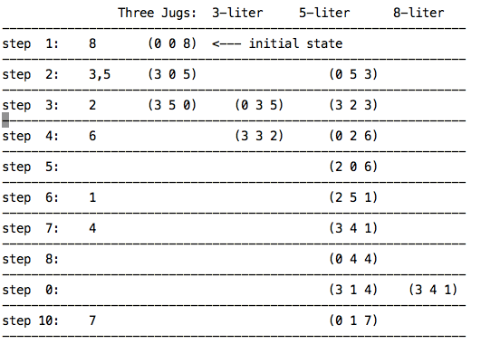
1/12/16

Slide 48
The Frog Puzzle
http://britton.disted.camosun.bc.ca/frog_puzzle.htm
----------------------------------------------------------------
Frog A moves to left only. Frog Z moves to right only.
----------------------------------------------------------------
0: ZZZ-AAA
1: Z-ZZAAA ZZ-ZAAA ZZZA-AA ZZZAA-A
2: -ZZZAAA ZZAZ-AA ZZ-AZAA ZZZAAA-
3: ZZA-ZAA ZZAZA-A ZZAZAA- -ZZAZAA Z-ZAZAA
4: Z-AZZAA ZZAAZ-A ZZA-AZA ZAZ-ZAA
5: -ZAZZAA ZA-ZZAA ZZAA-ZA ZZAAZA- Z-AZAZA ZAZAZ-A
6: AZ-ZZAA -AZZZAA ZZAAAZ- ZZAA-AZ -ZAZAZA ZA-ZAZA ZAZA-ZA ZAZAZA-
7: A-ZZZAA ZZAAA-Z AZ-ZAZA -AZZAZA ZAAZ-ZA ZA-AZZA ZAZAAZ- ZAZA-AZ
8: A-ZZAZA AZAZ-ZA ZAA-ZZA ZAAZAZ- -AZAZZA ZAZAA-Z ZA-AZAZ
9: AZA-ZZA AZAZAZ- ZAAZA-Z A-ZAZZA -AZAZAZ ZAA-ZAZ
10: A-AZZZA AZAZA-Z ZAA-AZZ AAZ-ZZA A-ZAZAZ ZAAAZ-Z
11: AA-ZZZA AZA-AZZ ZAAA-ZZ AAZ-ZAZ
12: A-AZAZZ AZAA-ZZ AA-ZZAZ AAZAZ-Z
13: AA-ZAZZ AAZA-ZZ
14: AAAZ-ZZ AA-AZZZ
15: AAA-ZZZ

Slide 49

How Google's AlphaGo Beat a Go World Champion
(BFS or DFS?)

Slide 51
Depth-First Search: Example
a
z
r
s
t
∞
∞
0
∞
∞
b
∞
∞
∞
∞
∞
v
w
x
y
Stack
(LIFO)
s
1/7/16

Slide 52
Depth-First Search: Example
(Starting node)
a
z
r
s
t
0
∞
∞
0
∞
∞
b
1
∞
∞
1
∞
∞
v
w
x
y
Stack
(LIFO)
s
w
1/7/16

Slide 53
Depth-First Search: Example
(Starting node)
a
z
r
s
t
0
0
0
2
2
∞
∞
∞
∞
b
1
∞
∞
1
∞
∞
v
w
x
y
Stack
(LIFO)
s
w
t
1/7/16

Slide 54
Depth-First Search: Example
(Starting node)
a
z
r
s
t
1
0
2
0
2
∞
∞
∞
∞
b
1
1
3
∞
3
∞
∞
∞
v
w
x
y
Stack
(LIFO)
s
w
t
x
1/7/16

Slide 55
Depth-First Search: Example
(Starting node)
a
z
r
s
t
0
2
0
2
∞
∞
∞
∞
b
1
4
1
3
4
∞
3
∞
∞
∞
v
w
x
y
Stack
(LIFO)
s
w
t
x
y
1/7/16

Slide 56
Depth-First Search: Example
(Starting node)
a
z
r
s
t
0
2
5
0
2
∞
∞
∞
∞
b
1
3
1
3
4
∞
∞
4
∞
∞
v
w
x
y
Stack
(LIFO)
s
w
t
x
y
z
1/7/16

Slide 57
Depth-First Search: Example
(Starting node)
a
z
r
s
t
0
2
5
0
2
∞
∞
∞
∞
b
1
3
∞
1
3
4
∞
∞
∞
v
w
x
y
Stack
(LIFO)
s
w
t
x
y
1/7/16

Slide 58
Depth-First Search: Example
(Starting node)
a
z
r
s
t
0
2
5
0
2
∞
∞
∞
∞
b
1
∞
1
3
4
∞
∞
∞
v
w
x
y
Stack
(LIFO)
s
w
t
x
1/7/16

Slide 59
Depth-First Search: Example
(Starting node)
a
z
r
s
t
0
5
0
2
∞
∞
∞
∞
b
1
∞
1
3
4
∞
∞
∞
v
w
x
y
Stack
(LIFO)
s
w
t
1/7/16

Slide 60
Depth-First Search: Example
(Starting node)
a
z
r
s
t
0
5
0
2
∞
∞
∞
∞
b
∞
1
3
4
∞
∞
∞
v
w
x
y
Stack
(LIFO)
s
w
1/7/16

Slide 61
Depth-First Search: Example
(Starting node)
a
z
r
s
t
0
5
0
2
∞
∞
∞
∞
b
∞
1
3
4
∞
∞
∞
v
w
x
y
Stack
(LIFO)
s
1/7/16

Slide 62
Depth-First Search: Example
(Starting node)
a
z
r
s
t
1
5
1
0
0
2
∞
∞
∞
∞
b
∞
1
3
4
∞
∞
∞
v
w
x
y
Stack
(LIFO)
s
r
1/7/16

Slide 63
Depth-First Search: Example
(Starting node)
a
z
r
s
t
1
5
1
0
1
0
2
1
∞
∞
∞
∞
b
2
1
3
4
2
∞
∞
∞
∞
v
w
x
y
Stack
(LIFO)
s
r
v
1/7/16

Slide 64
Depth-First Search: Example
(Starting node)
a
z
r
s
t
1
1
1
0
5
0
2
∞
∞
∞
∞
b
2
1
3
4
∞
∞
∞
∞
v
w
x
y
Stack
(LIFO)
s
r
1/7/16

Slide 65
Depth-First Search: Example
(Starting node)
a
z
r
s
t
1
0
2
5
∞
∞
∞
∞
b
2
1
3
4
∞
∞
∞
∞
v
w
x
y
Stack
(LIFO)
s
1/7/16

Slide 66
Depth-First Search: Example
(Starting node)
a
z
r
s
t
1
0
2
5
∞
∞
∞
∞
b
2
1
3
4
∞
∞
∞
∞
v
w
x
y
Stack
(LIFO)
1/7/16

Slide 67
Depth-First Search: Example
(Starting node)
a
z
r
s
t
0
1
0
2
5
∞
∞
∞
∞
b
2
1
3
4
∞
∞
∞
∞
v
w
x
y
Stack
(LIFO)
a
1/7/16

Slide 68
Depth-First Search: Example
(Starting node)
a
z
r
s
t
0
1
0
2
5
∞
∞
∞
∞
b
1
2
1
3
4
∞
∞
∞
∞
v
w
x
y
Stack
(LIFO)
a
b
1/7/16

Slide 69
Depth-First Search: Example
(Starting node)
a
z
r
s
t
0
1
0
2
5
∞
∞
∞
∞
b
1
2
1
3
4
∞
∞
∞
∞
v
w
x
y
Stack
(LIFO)
a
1/7/16

Slide 70
Depth-First Search: Example
(Starting node)
a
z
r
s
t
0
1
0
2
5
∞
∞
∞
∞
b
1
2
1
3
4
∞
∞
∞
∞
v
w
x
y
Stack
(LIFO)
1/7/16

Slide 71
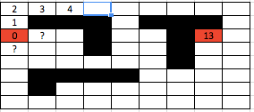
Depth-First Search
Depth-first search is another strategy for exploring a graph
Explore “deeper” in the graph whenever possible
Edges are explored out of the most recently discovered vertex v that still has unexplored edges
When all of v’s edges have been explored, backtrack to the vertex from which v was discovered
Which direction to go first?
1/7/16

Slide 72
DFS Example
Vertices initially colored white
Then colored gray when discovered
Then yellow when finished
source vertex
Stack (FILO)
1/7/16

Slide 73
DFS Example
d: discovered time
f: finished time
Vertices initially colored white
Then colored gray when discovered
Then yellow when finished
source vertex
d f
1 |
1 |
1 |
|
|
|
|
|
|
|
Stack (FILO)
1|
1/7/16

Slide 74
DFS Example
Vertices initially colored white
Then colored gray when discovered
Then yellow when finished
source vertex
d f
1 |
|
|
2 |
|
|
|
|
Stack (FILO)
1|
2|

Slide 75
DFS Example
Vertices initially colored white
Then colored gray when discovered
Then yellow when finished
source vertex
d f
1 |
|
|
2 |
|
3 |
|
|
Stack (FILO)
1|
2|
3|
1/7/16

Slide 76
DFS Example
Vertices initially colored white
Then colored gray when discovered
Then yellow when finished
source vertex
d f
1 |
|
|
2 |
|
3 |
|
|
Stack (FILO)
1|
2|
3|
1/7/16

Slide 77
DFS Example
Vertices initially colored white
Then colored gray when discovered
Then yellow when finished
source vertex
d f
1 |
|
|
2 |
|
3 | 4
|
|
Stack (FILO)
1|
2|
3|4
1/7/16

Slide 78
DFS Example
Vertices initially colored white
Then colored gray when discovered
Then yellow when finished
Vertices initially colored white
Then colored gray when discovered
Then yellow when finished
source vertex
d f
1 |
|
|
2 |
|
3 | 4
|
|
Stack (FILO)
1|
2|
1/7/16

Slide 79
DFS Example
Vertices initially colored white
Then colored gray when discovered
Then yellow when finished
source vertex
d f
1 |
|
|
2 |
|
3 | 4
5 |
|
Stack (FILO)
1|
2|
5|
1/7/16

Slide 80
DFS Example
Vertices initially colored white
Then colored gray when discovered
Then yellow when finished
source vertex
d f
1 |
|
|
2 |
|
3 | 4
5 |
|
Stack (FILO)
1|
2|
5|
1/7/16

Slide 81
DFS Example
Vertices initially colored white
Then colored gray when discovered
Then yellow when finished
source vertex
d f
1 |
|
|
2 |
|
3 | 4
5 | 6
|
Stack (FILO)
1|
2|
5|6
1/7/16

Slide 82
DFS Example
Vertices initially colored white
Then colored gray when discovered
Then yellow when finished
source vertex
d f
1 |
|
|
|
2 | 7
|
3 | 4
5 | 6
|
Stack (FILO)
1|
2|7
1/7/16

Slide 83
DFS Example
Vertices initially colored white
Then colored gray when discovered
Then yellow when finished
source vertex
d f
1 |
|
|
|
2 | 7
|
3 | 4
5 | 6
|
Stack (FILO)
1|
1/7/16

Slide 84
DFS Example
Vertices initially colored white
Then colored gray when discovered
Then yellow when finished
source vertex
d f
1 |
8 |
|
2 | 7
|
3 | 4
5 | 6
|
Stack (FILO)
1|
8|
1/7/16

Slide 85
DFS Example
Vertices initially colored white
Then colored gray when discovered
Then yellow when finished
source vertex
d f
1 |
8 |
|
2 | 7
|
3 | 4
5 | 6
|
Stack (FILO)
1|
8|
1/7/16

Slide 86
DFS Example
Vertices initially colored white
Then colored gray when discovered
Then yellow when finished
source vertex
d f
1 |
8 |
|
2 | 7
9 |
3 | 4
5 | 6
|
Stack (FILO)
1|
8|
9|
≈

Slide 87
DFS Example
Vertices initially colored white
Then colored gray when discovered
Then yellow when finished
source vertex
d f
1 |
8 |
|
2 | 7
9 |
3 | 4
5 | 6
|
Stack (FILO)
1|
8|
9|
≈

Slide 88
DFS Example
Vertices initially colored white
Then colored gray when discovered
Then yellow when finished
source vertex
d f
1 |
8 |
|
2 | 7
9 |10
3 | 4
5 | 6
|
Stack (FILO)
1|
8|
9|10
1/7/16

Slide 89
DFS Example
Vertices initially colored white
Then colored gray when discovered
Then yellow when finished
source vertex
d f
1 |
8 |11
|
2 | 7
9 |10
3 | 4
5 | 6
|
Stack (FILO)
1|
8|11
1/7/16

Slide 90
DFS Example
Vertices initially colored white
Then colored gray when discovered
Then yellow when finished
source vertex
d f
1 |12
8 |11
|
2 | 7
9 |10
3 | 4
5 | 6
|
Stack (FILO)
1|12
1/7/16

Slide 91
DFS Example
Vertices initially colored white
Then colored gray when discovered
Then yellow when finished
source vertex
d f
1 |12
8 |11
13|
2 | 7
9 |10
3 | 4
5 | 6
|
Stack (FILO)
13|
1/7/16

Slide 92
DFS Example
Vertices initially colored white
Then colored gray when discovered
Then yellow when finished
source vertex
d f
1 |12
8 |11
13|
2 | 7
9 |10
3 | 4
5 | 6
14|
Stack (FILO)
13|
14|
1/7/16

Slide 93
DFS Example
Vertices initially colored white
Then colored gray when discovered
Then yellow when finished
source vertex
d f
1 |12
8 |11
13|
2 | 7
9 |10
3 | 4
5 | 6
14|
Stack (FILO)
13|
14|
1/7/16

Slide 94
DFS Example
Vertices initially colored white
Then colored gray when discovered
Then yellow when finished
source vertex
d f
1 |12
8 |11
13|
2 | 7
9 |10
3 | 4
5 | 6
14|15
Stack (FILO)
13|
14|15
1/7/16

Slide 95
DFS Example
Vertices initially colored white
Then colored gray when discovered
Then yellow when finished
source vertex
d f
1 |12
8 |11
13|
2 | 7
9 |10
3 | 4
5 | 6
14|15
Stack (FILO)
13|16
1/7/16

Slide 96
DFS Example
Vertices initially colored white
Then colored gray when discovered
Then yellow when finished
source vertex
d f
1 |12
8 |11
13|16
13|16
2 | 7
9 |10
3 | 4
5 | 6
14|15
Stack (FILO)
13|16
1/7/16

Slide 97
DFS Example
Vertices initially colored white
Then colored gray when discovered
Then yellow when finished
source vertex
d f
1 |12
8 |11
13|16
2 | 7
9 |10
3 | 4
5 | 6
14|15
Stack (FILO)
13|16
1/7/16

Slide 98
DFS: 4 Kinds of edges
A graph G is acyclic iff a DFS of G yields no back edges
Topological ordering = the inverse order of the 2nd numbers
A>B>C>D>E>F>G>H
C
D
A
Tree edges
source vertex
1|12
8|11
13|16
F
E
2|7
Back edges
9|10
G
B
H
3|4
5| 6
14|15

Slide 99
DFS: 4 Kinds of edges
A graph G is acyclic iff a DFS of G yields no back edges
Topological ordering = the inverse order of the 2nd numbers
A>B>C>D>E>F>G>H
C
D
A
source vertex
1|12
8|11
13|16
F
E
2|7
9|10
G
B
H
3|4
5| 6
14|15

Slide 100
Topological Sort
Topological sort of a DAG:
Linear ordering of all vertices in graph G such that vertex u comes before vertex v if edge (u, v) ∈ G
Underwear
Socks
Watch
Pants
Shoes
Shirt
Belt
Tie
Jacket

Slide 101
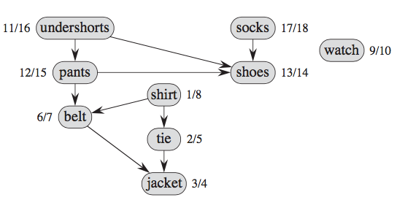
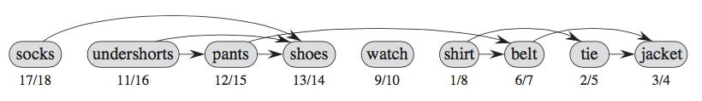
Getting Dressed
D
Start
Topological ordering = the inverse order of the 2nd numbers

Slide 102
Topological Sort Algorithm
Topological-Sort()
{ // condition: the graph is a DAG
Run DFS
When a vertex is finished, output it
Vertices are output in reverse topological order
}
Time: O(V+E)
Correctness: Want to prove that (u,v) ∈ G ⇒ u→f > v→f

Slide 103
LeetCode 210. Course Schedule II
Total n courses to take, labeled from 0 to n - 1.
Courses have prerequisites:
[0,1] means course 1 is the prerequisite of course 0
Compute the ordering of courses to satisfy all the prerequisite pairs.
There may be multiple or no answer.
For example: 4, [[1,0],[2,0],[3,1],[3,2]]
Total 4 courses to take.
courses 1 and 2 are prerequisites of course 3.
Course 0 is the prerequisite of course 1 and 2.
Answers: [0,1,2,3] or [0,2,1,3].

Slide 104
Topological Sort Runtime
Runtime:
O(|V|) to build heap + O(|E|) DECREASE-KEY ops
O(|V| + |E| log |V|) with a binary heap
O(|V|²) with an array
Compare to DFS:
O(|V|+|E|)

Slide 105
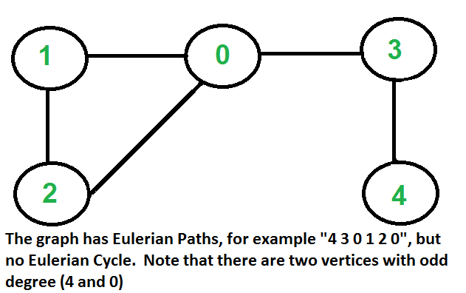
DFS Application:
Eulerian Path & Fleury's Algorithm
http://www.geeksforgeeks.org/eulerian-path-and-circuit/
Can we trace the graph without lifting pencil from the paper and without tracing any of the edges more than once?
How many nodes have odd-number degree?

Slide 106
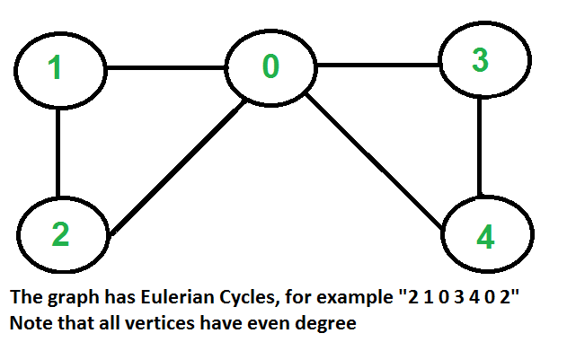
DFS Application:
Eulerian Path & Fleury's Algorithm
http://www.geeksforgeeks.org/eulerian-path-and-circuit/
Can we trace the graph without lifting pencil from the paper and without tracing any of the edges more than once?
How many nodes have odd-number degree?

Slide 107
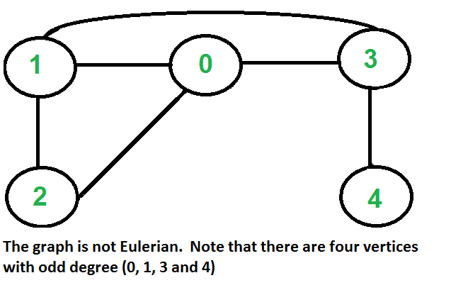
DFS Application:
Eulerian Path & Fleury's Algorithm
http://www.geeksforgeeks.org/eulerian-path-and-circuit/
Can we trace the graph without lifting pencil from the paper and without tracing any of the edges more than once?
How many nodes have odd-number degree?

Slide 108
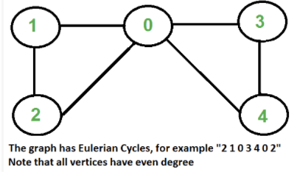
DFS Application:
Eulerian Path & Fleury's Algorithm
http://www.geeksforgeeks.org/fleurys-algorithm-for-printing-eulerian-path/
Make sure the graph has either 0 or 2 odd vertices.
If there are 0 odd vertices, start anywhere. If there are 2 odd vertices, start at one of them.
Follow edges one at a time.
Do not burn the bridge: ff you have a choice between a bridge and a non-bridge, always choose the non-bridge
Stop when you run out of edges.

Slide 109
Strongly Connected Components
Every pair of vertices are reachable from each other
Graph G is strongly connected if, for every u and v in V, there is some path from u to v and some path from v to u.
Strongly Connected
Not Strongly Connected
Data Structure and Algorithm

Slide 110
Finding Strongly Connected Components
Input: A directed graph G = (V,E)
Output: a partition of V into disjoint sets so that each set defines a strongly connected component (SCC) of G
a
{ a , c , g }
g
c
a
{ f , d , e , b }
d
e
f
b

Slide 111
Strongly-Connected-Components(G)
Call DFS(G) to compute finishing times f[u] for each vertex u.
Cost: O(E+V)
Compute G^{T} (transpose of G, all edges are revered.)
Cost: O(E+V)
Call DFS(G^{T}), but in the main loop of DFS, consider the vertices in order of decreasing f[u]
Cost: O(E+V)
Each tree output at step 3 is a SCC of G
Data Structure and Algorithm

Slide 112
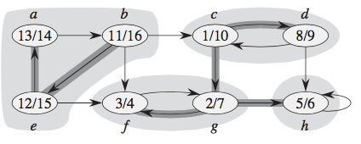
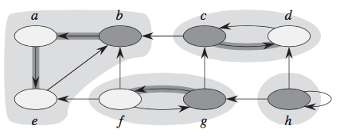
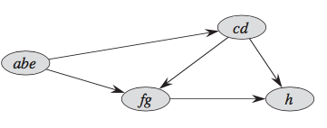
1. Call DFS(G) to compute finishing times f[u] for each vertex u. Cost: O(E+V)
DFS(G^{T})
2. Compute GT (transpose of G, all edges are revered.) :Cost: O(E+V)
2
1
2
1
4
3
3
4
3. Call DFS(GT), but in the main loop of DFS, consider the vertices in order of decreasing f[u]
Cost: O(E+V)
4. Each tree output at step 3 is a SCC of G

Slide 113
Programming Exercise
Do the programming exercise at http://www.geeksforgeeks.org/strongly-connected-components/

Slide 114
Example
Question: Consider the example below. What are the discovered and finished times for each node, and the topological order? (Note that the answers can be not unique. To make the answer unique, we assume that lower-numbered edges are explored first.)
start
A
e2
B
e1
0|?
?|?
e5
C
e4
e3
D
1|?
?|?
e6
E
?|?

Slide 115
Example
Question: Consider the example below. What are the discovered and finished times for each node, and the topological order? (Note that the answers can be not unique. To make the answer unique, we assume that lower-numbered edges are explored first.)
start
A
e2
B
e1
0|?
2|?
e5
C
e4
e3
D
1|?
?|?
e6
E
?|?

Slide 116
Example
Question: Consider the example below. What are the discovered and finished times for each node, and the topological order? (Note that the answers can be not unique. To make the answer unique, we assume that lower-numbered edges are explored first.)
start
A
e2
B
e1
0|?
2|?
e5
C
e4
e3
D
1|?
3|?
e6
E
?|?

Slide 117
Example
Question: Consider the example below. What are the discovered and finished times for each node, and the topological order? (Note that the answers can be not unique. To make the answer unique, we assume that lower-numbered edges are explored first.)
start
A
e2
B
e1
0|?
2|?
e5
C
e4
e3
D
1|?
3|4
e6
E
?|?

Slide 118
Example
Question: Consider the example below. What are the discovered and finished times for each node, and the topological order? (Note that the answers can be not unique. To make the answer unique, we assume that lower-numbered edges are explored first.)
start
A
e2
B
e1
0|?
2|5
e5
C
e4
e3
D
1|?
3|4
e6
E
?|?

Slide 119
Example
Question: Consider the example below. What are the discovered and finished times for each node, and the topological order? (Note that the answers can be not unique. To make the answer unique, we assume that lower-numbered edges are explored first.)
start
A
e2
B
e1
0|?
2|5
e5
C
e4
e3
D
1|?
3|4
e6
E
6|?

Slide 120
Example
Question: Consider the example below. What are the discovered and finished times for each node, and the topological order? (Note that the answers can be not unique. To make the answer unique, we assume that lower-numbered edges are explored first.)
start
A
e2
B
e1
0|?
2|5
e5
C
e4
e3
D
1|?
3|4
e6
E
6|7

Slide 121
Example
Question: Consider the example below. What are the discovered and finished times for each node, and the topological order? (Note that the answers can be not unique. To make the answer unique, we assume that lower-numbered edges are explored first.)
start
A
e2
B
e1
0|?
2|5
e5
C
e4
e3
D
1|8
3|4
e6
E
6|7

Slide 122
Example
Question: Consider the example below. What are the discovered and finished times for each node, and the topological order? (Note that the answers can be not unique. To make the answer unique, we assume that lower-numbered edges are explored first.)
start
1) Node A? Answer(1pt): 0 | 9
2) Node B? Answer(1pt): 2 | 5
3) Node C? Answer(1pt): 1 | 8
4) Node D? Answer(1pt): 3 | 4
5) Node E? Answer(1pt): 6 | 7
6) What is the topological order?
Answer(1pt):
A
e2
B
e1
0|9
2|5
e5
C
e4
e3
D
1|8
3|4
e6
Topological ordering = the inverse order of the 2nd numbers
E
6|7

Slide 124
Example 2
start
A
B
Consider the example on the right.
What are the the discovered and finished
time for each node, and the topological order?
Note that the answers can be not unique.
To make the answer unique, we assume that
lower-numbered edges are explored first.
3
0| 11
7| 10
1
4
C
2
D
1| 6
8 |9
6
5
F
What are the the discovered and finished time for each node?
Node A (1pt) ___0___ | ____11_____
Node B (1pt) ___7___ | ____10_____
Node C (1pt) ___1___ | _____6____
Node D (1pt) ___8___ | _____9____
Node E (1pt) ___2___ | _____3____
Node F (1pt) ___4___ | _____5____
What is the topological oder? ABDCFE
E
2| 3
4| 5

