Slide 1
Binary Heap
Dr. Chung-Wen Albert Tsao
1/6/16

Slide 2
Overview
Sorting overview
Heaps
Heapify
BuildHeap
Heapsort
Priority Queues
1/6/16

Slide 3
Analyzing sorts
Running time?
O(n²), O(nlogn), O(n)?
Space – is it in-place?
Using a small, constant amount of extra storage space.
Stable?
the initial order of equal items is preserved
1/6/16

Slide 4
Analyzing sorts
Running time?
O(n²), O(nlogn), O(n)?
Space – is it in-place?
Using a small, constant amount of extra storage space.
Stable?
the initial order of equal items is preserved
1/6/16

Slide 5
Insertion Sort
k= 1 2 3 4 5 6
5 | 2 | 4 | 6 | 1 | 3
Worst case O(n²)
elements in reverse sorted order
Best case O(n)
Already sorted order
Stable
At iteration k, first k elements are sorted, and they are the same first k elements from the unsorted set.
2 | 5 | 4 | 6 | 1 | 3
2 | 4 | 5 | 6 | 1 | 3
2 | 4 | 5 | 6 | 1 | 3
1 | 2 | 4 | 5 | 6 | 3
1 | 2 | 3 | 4 | 5 | 6
1/6/16

Slide 6
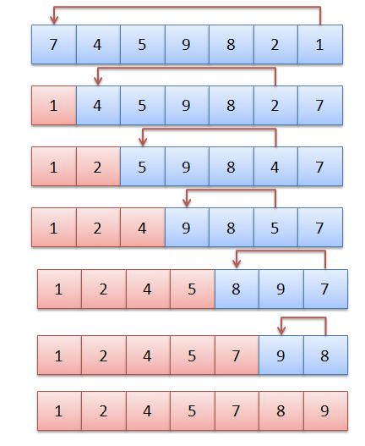
Selection Sort
O(n²)
Not Stable
Does it perform better/worse for already sorted input? Reverse-sorted input?
At iteration k, first k elements are sorted, and they are the same first k elements from the unsorted set.
1/6/16

Slide 7
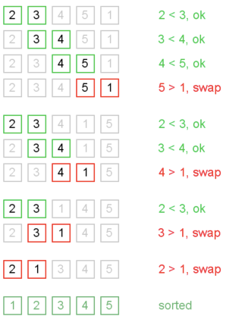
Bubble (Sinking, Ripple) Sort
Main idea: Go through each element, and if it’s out of order with its neighbor, swap them.
If you can go through entire array with no swaps, you’re done
After i^{th} pass, at least last i positions are sorted and in final correct order.
Worst case: O(n²)
has a big constant
Best case: O(n)
if already sorted

Slide 8
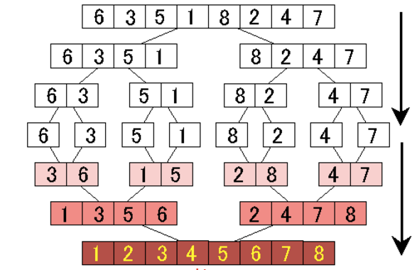
Merge Sort
Divide-and-conquer
Recursively sort ½ the set
Then merge them together: O(n)
O(n lg n)
No real best or worst case
Can be made to be in-place
1/6/16

Slide 9
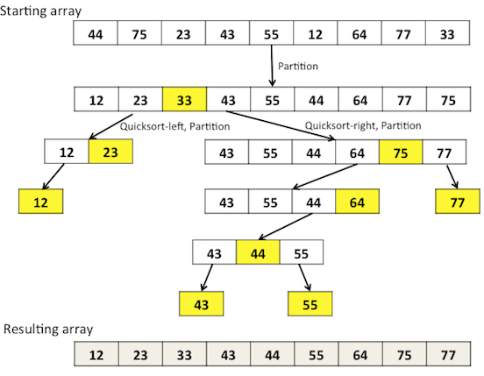
Quicksort
1. Pick a pivot element
2. Put elements <pivot on the left
3. Put elements> pivot on right.
3. Sort the left and right

Slide 10
Heaps
A heap is a complete binary tree:
A complete binary tree is a binary tree in which every level, except possibly the last, is completely filled, and all nodes are as far left as possible
Perfect binary tree
16
14
10
8
7
9
3
2
4
1
1/6/16

Slide 11
(Max) Heap Property
Parent bigger than its children (and all of its descendants)
Implemented as arrays:
Root=A[1]
Node i = A[i]
Parent = A[i/2]
Left child = A[2i]
Right child = A[2i + 1]
16
14
10
8
7
9
3
2
4
1
A =
16
14
10
8
7
9
3
2
4
1
1
2
3
4
5
6
7
8
9
10
Is {23, 17, 14, 6, 13, 10, 1, 5, 7, 12} a heap?
1
2
3
4
5
6
7
8
9
10
1/6/16

Slide 12
Heap Property
Parent bigger than its children (and all of its descendants)
Implemented as arrays:
Root=A[1]
Node i = A[i]
Parent = A[i/2]
Left child = A[2i]
Right child = A[2i + 1]
16
14
10
8
7
9
3
2
4
1
A =
16
14
10
8
7
9
3
2
4
1
1
2
3
4
5
6
7
8
9
10
Leaves are indexed by ⎣n/2⎦+1,⎣n/2⎦+2,…, n

Slide 13
Heap Height
height of an n-element heap = log₂n. Why?
heap operations take log₂(n)
height
#nodes
16
h=0
2⁰
h=1
2¹
14
10
8
7
9
3
h=2
2²
2
4
1
h=3
2³
What are the max and min number of elements in a heap of height h?
between (2^{h} ) and (2^{h+1} -1)
1/6/16

Slide 14
Are they heaps?
16
4
10
14
7
9
3
2
8
1
1
2
3
4
5
6
7
8
9
10
16
10
14
7
8
9
3
2
4
1
1
2
3
4
5
6
7
8
9
10

Slide 15
Are they heaps?
16
✗
4
10
16
4
10
14
7
9
3
2
8
1
14
7
9
3
1
2
3
4
5
6
7
8
9
10
2
8
1
16
✔︎
10
14
16
10
14
7
8
9
3
2
4
1
7
8
9
3
1
2
3
4
5
6
7
8
9
10
2
4
1
Violation to heap property: a node has value < one of its children
How to find that?
How to resolve that?
1/6/16

Slide 16
Heap Operations: Heapify()
Heapify(): maintain the heap property
Given: a node i in the heap with children l and r
Given: two subtrees rooted at l and r, assumed to be heaps
Problem: The subtree rooted at i may violate the heap property
Action: let the value of the parent node “sift down” so subtree at i satisfies the heap property
Fix up the relationship between i, l, and r recursively
1/6/16

Slide 17
Heap Operations: Heapify()
Heapify(A, i)
{ // precondition: subtrees rooted at l and r are heaps
l = Left(i); r = Right(i);
if (l <= A.heap_size && A[l] > A[i])
largest = l;
else
largest = i;
if (r <= A.heap_size && A[r] > A[largest])
largest = r;
if (largest != i) {
Swap(A, i, largest);
Heapify(A, largest);
}
} // postcondition: subtree rooted at i is a heap
Among A[l], A[i], A[r],
which one is largest?
If violation, fix it.
1/6/16

Slide 18
Heapify() Example
16
4
10
14
7
9
3
2
8
1
A =
16
4
10
14
7
9
3
2
8
1
1
2
3
4
5
6
7
8
9
10
1/6/16

Slide 19
Heapify() Example
16
sift down
4
10
14
7
9
3
2
8
1
A =
16
4
10
14
7
9
3
2
8
1
1
2
3
4
5
6
7
8
9
10
1/6/16

Slide 20
Heapify() Example
16
sift down
14
10
4
7
9
3
2
8
1
A =
16
14
10
4
7
9
3
2
8
1
1
2
3
4
5
6
7
8
9
10
1/6/16

Slide 21
Heapify() Example
16
14
10
4
4
sift down
7
9
3
2
8
1
A =
16
14
10
4
7
9
3
2
8
1
1
2
3
4
5
6
7
8
9
10
1/6/16

Slide 22
Heapify() Example
16
14
10
8
7
9
3
✔︎
2
4
1
✔︎
A =
16
14
10
8
7
9
3
2
4
1
1/6/16

Slide 23
Analyzing Heapify(): Sift (Percolating) down
The running time of Heapify()?
Fixing up relationships between i, l, and r takes Θ(1) time
How many times can Heapify() recursively call itself?
T(n) = O(lg n), which is height of a complete binary tree with n leaves
1/6/16

Slide 24
Heap Operations: BuildHeap()
We can build a heap in a bottom-up manner by running Heapify() on successive subarrays
The nodes after n/2 are all leaves, which are single-node heap
Iterate array from n/2 to 1, calling Heapify() on each node.
Order of processing guarantees that the children of node i are heaps when i is processed
BuildHeap(A){ // A is an unsorted array
A.heap_size = length(A);
for (i = Α.length/2 downto 1)
Heapify(A, i); // make A a heap
}
1/6/16

Slide 25
BuildHeap() Example
Work through example A = {4, 1, 3, 2, 16, 9, 10, 14, 8, 7}
4
1
3
✔︎
✔︎
2
16
9
10
✔︎
✔︎
✔︎
14
8
7
A =
4
1
3
2
16
9
10
14
8
7
1/6/16

Slide 26
BuildHeap() Example
4
1
3
✔︎
2
16
9
10
14
8
7
A =
4
1
3
2
16
9
10
14
8
7
1/6/16

Slide 27
BuildHeap() Example
Heapfify(A,4)
4
1
3
2
16
9
10
14
8
7
A =
4
1
3
2
16
9
10
14
8
7
1/6/16

Slide 28
BuildHeap() Example
4
1
3
14
16
9
10
8
7
2
A =
4
1
3
14
16
9
10
2
8
7
1/6/16

Slide 29
BuildHeap() Example
Heapfify(A,3)
4
1
3
14
16
9
10
2
8
7
A =
4
1
3
14
16
9
10
2
8
7
1/6/16

Slide 30
BuildHeap() Example
4
1
10
14
16
9
3
2
8
7
A =
4
1
10
14
16
9
3
2
8
7
1/6/16

Slide 31
BuildHeap() Example
Heapfify(A,2)
4
1
10
14
16
9
3
2
8
7
A =
4
1
10
14
16
9
3
2
8
7
1/6/16

Slide 32
BuildHeap() Example
Heapfify(A,2)
4
16
10
14
1
9
3
2
8
7
A =
4
1
10
14
16
9
3
2
8
7
1/6/16

Slide 33
BuildHeap() Example
Heapfify(A,2)
4
16
10
14
7
9
3
2
8
1
1
A =
4
16
10
14
7
9
3
2
8
1
1/6/16

Slide 34
BuildHeap() Example
Heapfify(A,1)
4
4
Shift Down
16
10
14
7
9
3
2
8
1
A =
4
16
10
14
7
9
3
2
8
1
1/6/16

Slide 35
BuildHeap() Example
Heapfify(A,1)
Sift Down
16
4
10
14
7
9
3
2
8
1
A =
16
4
10
14
7
9
3
2
8
1
1/6/16

Slide 36
BuildHeap() Example
Heapfify(A,1)
Shift Down
16
14
10
4
7
9
3
2
8
1
A =
16
14
10
4
7
9
3
2
8
1
1/6/16

Slide 37
BuildHeap() Example
Heapfify(A,1)
16
14
10
8
Shift Down
7
9
3
2
4
1
A =
16
14
10
8
7
9
3
2
4
1
1/6/16

Slide 38
Analyzing BuildHeap()
Each call to Heapify() takes O(lg n) time
There are O(n) such calls (specifically, ⎣n/2⎦)
Thus the running time is O(n lg n)
A tighter bound is O(n)
How can this be? Is there a flaw in the above reasoning?
1/6/16

Slide 39
height
#nodes
16
h=3
2⁰
h=2
2¹
14
10
8
7
9
3
h=1
2²
2
4
1
h=0
2³
A complete binary of n nodes has
At most n/2 leaves (height h=0)
At most n/4 nodes of height h=1
At most n/8 nodes of height h=2
At most n/16 nodes of height h=3
…
At most n/2^{h+1} nodes of height h
1/6/16

Slide 40
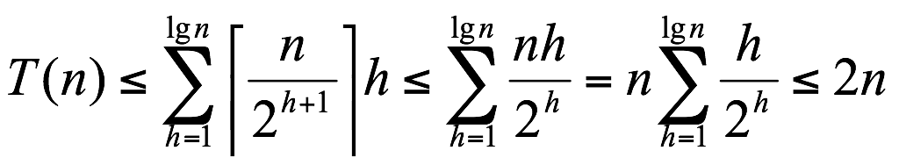
height
#nodes
16
h=3
2⁰
h=2
2¹
14
10
8
7
9
3
h=1
2²
2
4
1
h=0
2³
Therefore T(n) = O(n)
1/6/16

Slide 41
Idea of heap sort
HeapSort(A[1..n])
Build a heap from A // O(n)
For i = n down to 1
Retrieve largest element from heap // O(log n)
Put element at end of A
Reduce heap size by one
end
1/6/16

Slide 42
Heapsort
Given BuildHeap(), an in-place sorting algorithm is easily constructed:
Maximum element is at A[1]
Discard by swapping with element at A[n]
Decrement heap_size[A]
A[n] now contains correct value
Restore heap property at A[1] by calling Heapify()
Repeat, always swapping A[1] for A[A.heap_size]
1/6/16

Slide 43
Heapsort
Heapsort(A)
{
BuildHeap(A);
for (i = length(A) downto 2)
{
Swap(A[1], A[i]);
A.heap_size -= 1;
Heapify(A, 1);
}
}
1/6/16

Slide 44
Heapsort
Heapsort(A):
BuildHeap(A);
for (i = length(A) downto 2):
Swap(A[1], A[i]);
A.heap_size -= 1;
Heapify(A, 1);
First: build a heap in O(n)
16
14
10
8
7
9
3
2
4
1
A =
16
14
10
8
7
9
3
2
4
1
1/6/16

Slide 45
Heapsort
Heapsort(A):
BuildHeap(A);
for (i = length(A) downto 2):
Swap(A[1], A[i]);
A.heap_size -= 1;
Heapify(A, 1);
Swap last and first
1
14
10
8
7
9
3
2
4
16
A =
1
14
10
8
7
9
3
2
4
16
1/6/16

Slide 46
Heapsort Example
Last element sorted
Heapify(A,1)
14
1
10
8
7
9
3
2
4
16
A =
1
14
10
8
7
9
3
2
4
16
1/6/16

Slide 47
Heapsort Example
Last element sorted
Heapify(A,1)
14
8
10
1
7
9
3
2
4
16
A =
1
14
10
8
7
9
3
2
4
16
1/6/16

Slide 48
Heapsort Example
Last element sorted
Heapify(A,1)
14
8
10
1
7
9
3
2
4
16
A =
1
14
10
8
7
9
3
2
4
16
1/6/16

Slide 49
Heapsort Example
Restore heap on remaining unsorted elements
14
8
10
4
7
9
3
2
1
16
Heapify
A =
14
8
10
4
7
9
3
2
1
16
1/6/16

Slide 50
Heapsort Example
Repeat: swap new last and first
1
14
8
10
4
7
9
3
2
14
1
16
A =
1
8
10
4
7
9
3
2
14
16
1/6/16

Slide 51
Heapsort Example
Repeat: swap new last and first
Heapify(A,1)
1
8
10
4
7
9
3
2
14
16
A =
1
8
10
4
7
9
3
2
14
16
1/6/16

Slide 52
Heapsort Example
Repeat: swap new last and first
Heapify(A,1)
1
8
10
4
7
9
3
2
14
16
A =
1
8
10
4
7
9
3
2
14
16
1/6/16

Slide 53
Heapsort Example
Repeat: swap new last and first
Heapify(A,1)
10
8
1
4
7
9
3
2
14
16
A =
1
8
10
4
7
9
3
2
14
16
1/6/16

Slide 54
Heapsort Example
Restore heap
10
10
8
9
4
7
1
3
2
14
16
A =
10
8
9
4
7
1
3
2
14
16
1/6/16

Slide 55
Heapsort Example
Restore heap
Heapify(A,1)
2
8
9
4
7
1
3
10
10
14
16
A =
2
8
9
4
7
1
3
10
10
14
16
1/6/16

Slide 56
Heapsort Example
Restore heap
Heapify(A,1)
9
8
2
4
7
1
3
10
10
14
16
A =
2
8
9
4
7
1
3
10
10
14
16
1/6/16

Slide 57
Heapsort Example
Repeat
9
8
3
4
7
1
2
10
14
16
A =
9
8
3
4
7
1
2
10
14
16
1/6/16

Slide 58
Heapsort Example
Repeat
9
8
3
4
7
1
2
10
14
16
A =
9
8
3
4
7
1
2
10
14
16
1/6/16

Slide 59
Heapsort Example
Repeat
Heapify(A,1)
2
9
8
3
4
7
1
2
9
10
14
16
A =
2
8
3
4
7
1
9
9
10
14
16
1/6/16

Slide 60
Heapsort Example
Repeat
Heapify(A,1)
8
9
2
3
4
7
1
2
9
10
14
16
A =
2
8
3
4
7
1
9
9
10
14
16
1/6/16

Slide 61
Heapsort Example
Repeat
Heapify(A,1)
8
9
2
3
4
7
1
2
9
10
14
16
A =
2
8
3
4
7
1
9
9
10
14
16
1/6/16

Slide 62
Heapsort Example
Repeat
8
7
3
4
2
1
9
10
14
16
A =
8
7
3
4
2
1
9
10
14
16
1/6/16

Slide 63
Heapsort Example
Repeat
8
1
7
3
4
2
1
8
9
10
14
16
A =
1
7
3
4
2
8
9
10
14
16

Slide 64
Heapsort Example
Repeat
8
1
7
7
4
3
4
1
2
1
8
9
10
14
16
A =
7
4
3
1
2
1
8
9
10
14
16
1/6/16

Slide 65
Heapsort Example
Repeat
8
1
7
7
4
3
4
1
2
1
8
9
10
14
16
A =
7
4
3
1
2
1
8
9
10
14
16
1/6/16

Slide 66
Heapsort Example
Repeat
8
1
7
2
7
4
3
4
1
2
1
7
8
9
10
14
16
A =
2
4
3
1
2
7
1
8
9
9
10
14
16
1/6/16

Slide 67
Heapsort Example
Repeat
Heapify(A,1)
8
1
7
2
7
4
3
4
1
2
1
7
8
9
10
14
16
A =
2
4
3
1
2
7
1
8
9
10
14
16
1/6/16

Slide 68
Heapsort Example
Repeat
4
4
7
4
3
2
4
1
2
1
7
8
9
10
14
16
A =
4
2
3
1
2
7
1
8
9
10
14
16
1/6/16

Slide 69
Heapsort Example
Repeat
Heapify(A,1)
1
7
4
3
2
4
2
1
7
8
9
10
14
16
A =
1
2
3
4
4
2
7
1
8
9
10
14
16
1/6/16

Slide 70
Heapsort Example
Repeat
3
7
4
3
2
1
4
2
1
7
8
9
10
14
16
A =
3
2
1
4
4
2
7
1
8
9
10
14
16
1/6/16

Slide 71
Heapsort Example
Repeat
Heapify(A,1)
1
7
4
3
2
3
4
2
1
7
8
9
10
14
16
A =
1
2
3
3
4
4
2
7
1
8
9
10
14
16
1/6/16

Slide 72
Heapsort Example
Repeat
Heapify(A,1)
1
7
4
3
2
3
4
2
1
7
8
9
10
14
16
A =
1
1
2
3
3
4
4
2
7
1
8
9
10
14
16
1/6/16

Slide 73
Heapsort Example
Repeat
2
7
4
1
3
2
3
4
2
1
7
8
9
10
14
16
A =
1
2
3
3
4
4
2
7
1
8
9
10
14
16
1/6/16

Slide 74
Heapsort Example
Repeat
1
7
4
1
2
3
2
3
4
2
1
7
8
9
10
14
16
A =
1
7
2
3
3
4
4
2
7
1
8
9
10
14
16
1/6/16

Slide 75
Heapsort Example
Repeat
1
2
3
4
7
8
9
10
14
16
A =
1
2
3
4
7
8
9
10
14
16
1/6/16

Slide 76
Analyzing Heapsort
The call to BuildHeap() takes O(n) time
Each of the n - 1 calls to Heapify() takes O(lg n) time
Thus the total time taken by HeapSort() = O(n) + (n - 1) O(lg n) = O(n) + O(n lg n) = O(n lg n)
1/6/16

Slide 77
Comparison
 | Time complexity | Stable? | In-place?
Merge sort
Quick sort
Heap sort
1/6/16

Slide 78
Comparison
 | Time complexity | Stable? | In-place?
Merge sort | Θ (n log n) | Yes | No (or Yes)
Quick sort | (n log n) expected. (n²) worst case | No | Yes
Heap sort | Θ (n log n) | No | Yes
1/6/16

Slide 79
Priority Queues
Heapsort is a nice algorithm, but in practice Quicksort usually wins
The heap data structure is incredibly useful for implementing priority queues
A data structure for maintaining a set S of elements, each with an associated value or key
Supports the operations Insert(), Maximum(), ExtractMax(), changeKey()
What might a priority queue be useful for?
1/6/16

Slide 80
Priority Queue Operations
Insert(S, x)
insert element x into set S
Maximum(S)
returns the element of S with the maximum key
ExtractMax(S)
removes and returns the element of S with the maximum key
ChangeKey(S, i, k)
Change the key for element i to k
How could we implement these operations using a heap?
1/6/16

Slide 81








Your personal travel destination list
A list of places, S, that you want to visit, each with a preference score
Always visit the place with highest score, Maximum(S)
Remove a place after visiting it, ExtractMax(S)
You frequently add more destinations, Insert(S, x)
You may change score for a place when you have more information, ChangeKey(S, i, k)
What’s the best data structure?
1/6/16
Notes:
----- Meeting Notes (1/24/18 18:21) -----

Slide 82
Heap vs Array
Heap
Sorted Array
HeapSort: Θ(n log n)
Maximum: Θ(1)
ExtractMax: Θ(log n)
ChangeKey: Θ(log n)
Insert: Θ(log n)
Sort: Θ(n log n)
Maximum: Θ(1)
ExtractMax: Θ(n) or Θ(1)
ChangeKey: Θ(n)
Insert: Θ(n)
Heapify: Θ(log n)
BuildHeap: Θ(n)
1/6/16

Slide 83
Heap: Maximum
HeapMaximum(A)
{
return A[1];
}
1/6/16

Slide 84
Heap: Extract Max
HeapExtractMax(A)
{
if (heap_size[A] < 1) { error; }
max = A[1];
A[1] = A[heap_size[A]]
heap_size[A] --;
Heapify(A, 1);
return max;
}
1/6/16

Slide 85
Heap: Extract Max
16
14
10
8
7
9
3
2
4
1
A =
16
14
10
8
7
9
3
2
4
1
1/6/16

Slide 86
Heap: Extract Max
Swap first and last, then remove last
1
14
10
8
7
9
3
2
4
16
A =
1
14
10
8
7
9
3
2
4
16
1/6/16

Slide 87
Heap: Extract Max
Heapify
14
8
10
4
7
9
3
2
1
16
A =
14
8
10
4
7
9
3
2
1
16
1/6/16

Slide 88
Heap Change Key
HeapChangeKey(A, i, key){
if (key <= A[i]){ // decrease key
A[i] = key;
heapify(A, i);
} else { // increase key
A[i] = key;
while (i>1 & A[parent(i)]<A[i])
swap(A[i], A[parent(i)];
}
}
Sift (Percolating) down
Bubble (percolating) up
1/6/16

Slide 89
Heap Change Key
HeapChangeKey(A, 4, 15)
Change key value to 15
4th element
16
14
10
8
15
7
9
3
2
4
1
15
A =
16
14
10
8
7
9
3
2
4
1
1/6/16

Slide 90
Heap Change Key
HeapChangeKey(A, 4, 15)
Change key value to 15
4th element
16
14
10
15
7
9
3
2
4
1
15
A =
16
14
10
8
7
9
3
2
4
1
1/6/16

Slide 91
Heap Change Key
HeapChangeKey(A, 4, 15)
16
15
10
14
7
9
3
2
4
1
A =
16
15
10
14
7
9
3
2
4
1
1/6/16

Slide 92
Heap Insert
HeapInsert(A, key) {
heap_size[A] ++;
i = heap_size[A];
A[i] = -∞;
HeapChangeKey(A, i, key);
}
1/6/16

Slide 93
Heap Insert
HeapInsert(A, 17)
16
14
10
8
7
9
3
2
4
1
A =
16
14
10
8
7
9
3
2
4
1
1/6/16

Slide 94
Heap Insert
HeapInsert(A, 17)
16
14
10
8
7
9
3
2
4
1
-∞
-∞ makes it a valid heap
A =
16
14
10
8
7
9
3
2
4
1
-∞
1/6/16

Slide 95
Heap Insert
HeapInsert(A, 17)
16
14
10
8
7
9
3
2
4
1
17
Now call HeapChangeKey
A =
16
14
10
8
7
9
3
2
4
1
17
1/6/16

Slide 96
Heap Insert
HeapInsert(A, 17)
17
16
10
8
14
9
3
2
4
1
7
A =
17
16
10
8
14
9
3
2
4
1
7
1/6/16

Slide 97
Heap vs Array
Heap
Sorted Array
HeapSort: Θ(n log n)
Maximum: Θ(1)
ExtractMax: Θ(log n)
ChangeKey: Θ(log n)
Insert/Delete: Θ(log n)
Sort: Θ(n log n)
Maximum: Θ(1)
ExtractMax: Θ(n) or Θ(1)
ChangeKey: Θ(n)
Insert/delete: Θ(n)
Heapify: Θ(log n)
BuildHeap: Θ(n)
1/6/16

Slide 98
Quiz Preview
Q#1: For an array A of N numbers, with index starting with 1 (That is, the first number is A[1] ). Assume N is an even number. Which of the following is NOT correct?
An inversely sorted array of numbers is always a heap. for example: A={9,8,7,6, ..., 1 }
All the numbers after A[N/2] must satisfy the heap property.
All the numbers after A[N/2] have no children.
All the numbers before A[N/2] have two children.

Slide 99
Quiz Preview
Q#2: Heapsort: Consider the following example.
5
|-----|-----|
3 4
|--|--|
1 2 6 7
Array: 7 5 6 1 3 2 4
index: A[1] A[2] A[3] A[4] A[5] A[6] A[7]
Step 1. Swap root A[1] with the last node A[7].
Decrease heap size by one.
Heapfiy the new root node.
What will the array look like at step 1? Answer: _____________ (1pt)
Step 2.Swap the new root node with the last node A[6]=2.
Decrease heap size by one.
Heapfiy the new root node.
What will the array look like at step 2? Answer: _____________ (1pt)

Slide 100
Quiz Preview
Q#4: Show the result of the following example where the key of root node A[0] is decreased to 1 from 10.
8 ----------> changed to 1
|-----|-----|
7 6
|--|--| |--|--|
3 5 4 1
A[1] A[2] A[3] A[4] A[5] A[6] A[7]
10 7 8 3 5 4 6
What will the resulting array look like?
Answer: _____________ (1pt)

Slide 101
Quiz Preview
Q#5: In the following example of a heap, the key of node A[5] is increased from 3 to 10. The violation of the heap property caused by this key change can be fixed by swapping nodes in a manner of bubble up.
What will the new array A for this new heap look like?
Answer: _____________ (1pt)
A[1] A[2] A[3] A[4] A[5] A[6] A[7]
Array: 7 5 6 1 3 2 4
10
|-----|-----|
7 6
|--|--| |--|--|
1 5 2 4
(Node A[5])
^
|_________ change key of node A[5] from 3 to 10

Slide 102
Quiz Preview
Q#1: For an array A of N numbers, with index starting with 1 (That is, the first number is A[1] ). Assume N is an even number. Which of the following is NOT correct?
An inversely sorted array of numbers is always a heap. for example: A={9,8,7,6, ..., 1 }
All the numbers after A[N/2] must satisfy the heap property.
All the numbers after A[N/2] have no children.
All the numbers before A[N/2] have two children. Answer: ? (1pt)

Slide 103
Quiz Preview
Q#2: Heapsort: Consider the following example.
7
|-----|-----|
5 6
|--|--| |--|--|
1 3 2 4
Array: 7 5 6 1 3 2 4
index: A[1] A[2] A[3] A[4] A[5] A[6] A[7]
Step 1. Swap root A[1] with the last node A[7]. Decrease heap size by one. Heapfiy the new root node.
Step 2. Swap the new root node with the last node A[6]=2. Decrease heap size by one. Heapfiy the new root node.
What will the array look like at step 1?
A[1] A[2] A[3] A[4] A[5] A[6] A[7]
a) 6 5 4 1 3 2 (7)
b) 4 5 6 1 3 2 (7)
c) 5 4 6 1 3 2 (7)
d) 7 5 6 1 3 2 (7) Answer: ? (1pt)
Q#3 What will the array look like at step 2?
A[1] A[2] A[3] A[4] A[5] A[6] A[7]
a) 5 3 4 1 2 6 7
b) 4 5 2 1 3 6 7
c) 5 4 2 1 3 6 7
d) 4 5 2 1 3 7 6
e) None of the above is correct Answer: ? (1pt)

Slide 104
Q#4: Show the result of the following example where the key of root node A[0] is decreased to 1 from 10.
10 ----------> changed to 1
|-----|-----|
7 8
|--|--| |--|--|
3 5 4 6
A[1] A[2] A[3] A[4] A[5] A[6] A[7]
10 7 8 3 5 4 6
What will the resulting array look like?
A[1] A[2] A[3] A[4] A[5] A[6] A[7]
a) 8 7 1 3 5 4 6
b) 8 7 6 3 5 1 4
c) 8 7 6 3 5 4 1
Answer: ? (1pt)

Slide 105
Q#5: In the following example of a heap, the key of node A[5] is increased from 3 to 10. The violation of the heap property caused by this key change can be fixed by swapping nodes in a manner of bubble up. What will the new array A for this new heap look like?
A[1] A[2] A[3] A[4] A[5] A[6] A[7]
Array: 7 5 6 1 3 2 4
7
|-----|-----|
5 6
|--|--| |--|--|
1 3 2 4
(Node A)
^
|_________ change key of node A[5] from 3 to 10
A[1] A[2] A[3] A[4] A[5] A[6] A[7]
a) Array: 10 7 6 1 5 2 4
b) Array: 7 5 6 1 10 2 4
c) Array: 7 10 6 1 5 2 4
d) Array: 10 7 6 5 1 2 4 Answer: ? (1pt)

