Slide 1

Binary Classification of Fake News and Real News
Hui Zhang
Mar.14 2024

Slide 2

Introduction
This project aims to develop a robust binary classification model to distinguish between fake news and real news articles.
Using traditional machine learning method and NLP method and compare these two methods

Slide 3

Audience
Journalists, editors, and media analysts who are interested in understanding and combating the spread of fake news.
General Public: People interested in understanding how fake news is detected and differentiated from real news, as well as those concerned about the impact of misinformation on society.
Researchers, scholars, and students interested in machine learning, natural language processing, or media studies.

Slide 4
Data
Labeled Fake News and Real News
Train Dataset: 2 csv files from Kaggle
fake news:
23481 rows and 5 columns, including information about title, text, subject, date and label.
real news:
21417 rows and 5 columns, including information about title, text, subject, date and label.
https://www.kaggle.com/datasets/bhavikjikadara/fake-news-detection
Real_world unseen test set, 1 csv files
Collect 25 pieces of news from internet.
the 13 real news comes from reuters (7 news), cnn (2 news) and npr(4 news),
the 12 real news comes from breitbart (5 news) and thegatewaypundit (7 news).

Slide 5
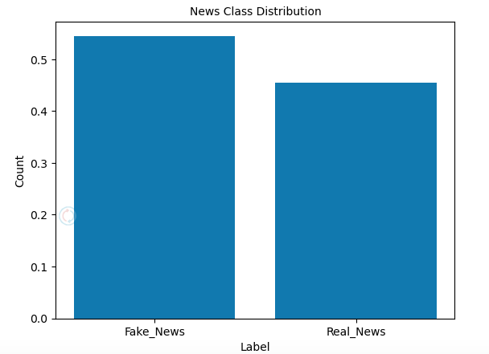
Fake news 54.5%
Real news 45.5%

Slide 6
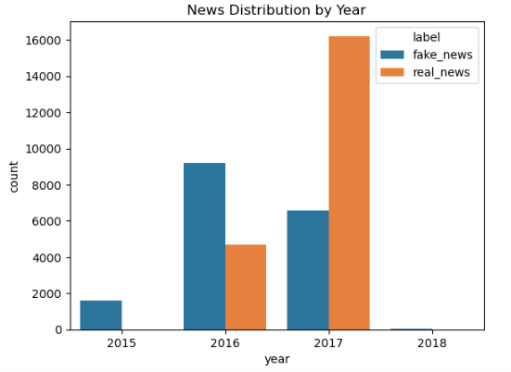
News distribution by year is biased. 2015 and 2018 only fake news.

Slide 7
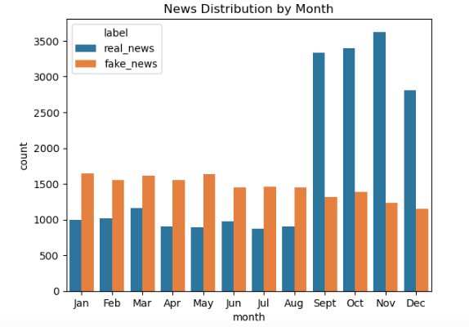
Patterns of news distribution by months: more real news from Sept. to Dec.

Slide 8
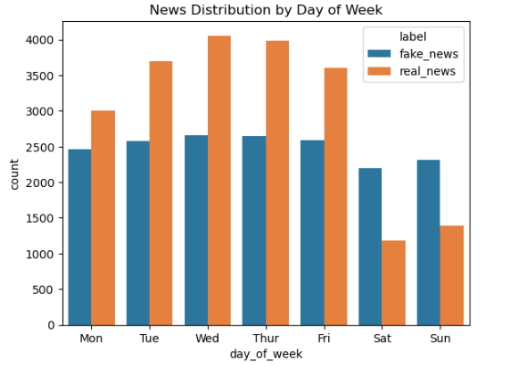
Patterns of news distribution by day: more fake news at weekends

Slide 9
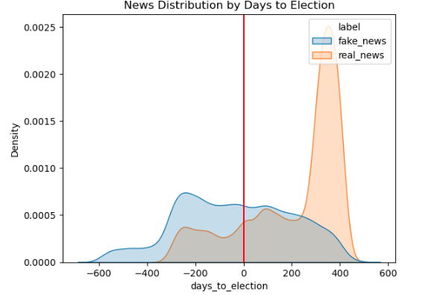
Distribution of news by day to election: more fake news before election

Slide 10
Hyperparameter Table_Method_1
Exp | Model_Name | Train_Accuracy | Val_Accuracy | Val_Recall | Val_Precision | Test_Accuracy | Test_Recall | Test_Precision | Test_f1
1 | Logistic Regression | 0.89 | 0.897 | 0.93 | 0.888 | 0.6 | 0.308 | 0.8 | 0.444
2 | RandomForest Classifier | 0.919 | 0.922 | 0.95 | 0.913 | 0.68 | 0.462 | 0.857 | 0.6
3 | GradientBoost Classifier | 0.919 | 0.921 | 0.956 | 0.907 | 0.68 | 0.462 | 0.857 | 0.6
4 | XGBoost Classifier | 0.918 | 0.924 | 0.947 | 0.918 | 0.76 | 0.615 | 0.889 | 0.727
Winner: XGBoost Classifier, but obvious overfitting.

Slide 11
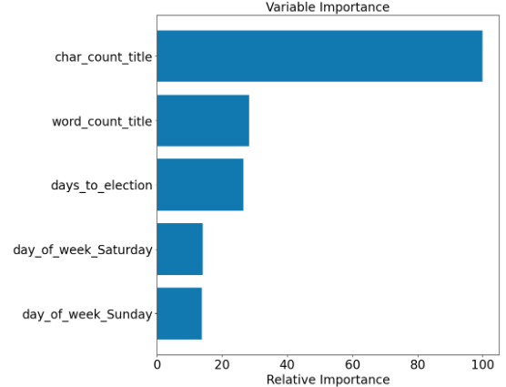
Features Importance
Top 3 features in XGBoost Classifier: character count of title, word count of title and days to election

Slide 12
Hyperparameter Table_Method_2
Ex | Model | Tr_Ac | Val_Ac | Val_Re | Val_Pr | Te_Ac | Te_Re | Test_Pr | Te_f1 | Nlp_En | n_Vec | ngram | Del_H | max | min
5 | Logistic R | 0.995 | 0.993 | 0.996 | 0.992 | 0.88 | 0.769 | 1 | 0.87 | CV | 115418 | (1, 1)
6 | Logistic R | 0.974 | 0.973 | 0.981 | 0.971 | 0.88 | 0.769 | 1 | 0.87 | CV | 109545 | (1, 1) | Yes
7 | Logistic R | 0.972 | 0.97 | 0.976 | 0.97 | 0.92 | 0.846 | 1 | 0.917 | CV | 109537 | (1, 1) | Yes | 0.8
8 | Logistic R | 0.952 | 0.953 | 0.966 | 0.95 | 0.88 | 0.923 | 0.857 | 0.889 | CV | 300 | (1, 1) | Yes |  | 0.1
9 | Logistic R | 0.947 | 0.944 | 0.962 | 0.938 | 0.92 | 1 | 0.867 | 0.929 | CV | 292 | (1, 1) | Yes | 0.8 | 0.1
10 | Logistic R | 0.901 | 0.895 | 0.901 | 0.908 | 0.6 | 0.692 | 0.6 | 0.643 | CV | 91 | (2, 2) | Yes | 0.8 | 0.1
11 | Logistic R | 0.96 | 0.958 | 0.967 | 0.957 | 0.84 | 0.846 | 0.846 | 0.846 | CV | 383 | (1, 2) | Yes | 0.8 | 0.1
12 | Logistic R | 0.932 | 0.932 | 0.954 | 0.925 | 0.8 | 0.769 | 0.833 | 0.8 | CV | 143 | (1, 2) | Yes | 0.8 | 0.2
13 | Logistic R | 0.96 | 0.958 | 0.968 | 0.956 | 0.84 | 0.846 | 0.846 | 0.846 | TV | 383 | (1, 2) | Yes | 0.8 | 0.1
14 | Logistic R | 0.951 | 0.944 | 0.961 | 0.939 | 0.92 | 0.923 | 0.923 | 0.923 | TV | 292 | (1, 1) | Yes | 0.8 | 0.1
15 | Logistic R | 0.956 | 0.952 | 0.964 | 0.95 | 0.88 | 0.846 | 0.917 | 0.88 | TV | 300 | (1, 1) | Yes |  | 0.1
16 | Logistic R | 0.972 | 0.971 | 0.979 | 0.968 | 0.92 | 0.846 | 1 | 0.917 | TV | 109537 | (1, 1) | Yes | 0.8
17 | Logistic R | 0.973 | 0.971 | 0.977 | 0.97 | 0.92 | 0.846 | 1 | 0.917 | TV | 109545 | (1, 1) | Yes
Note: CV: CountVectorizer(), TV:TfidfVectorizer()
Notes:
red:1st, purple:2nd, yellow: 3rd, organe 4th.

Slide 13
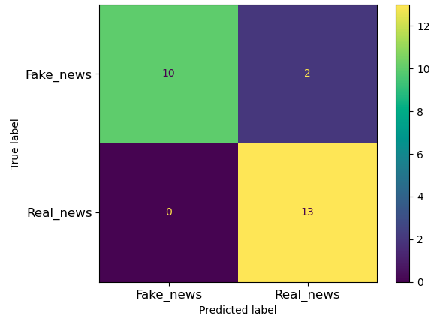
Best Model Confusion Matrix on Test Set

Slide 14
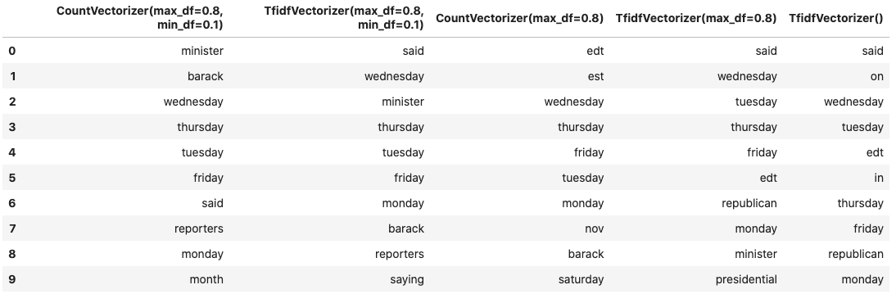
High Coefficients Vectors for Real News Classification

Slide 15
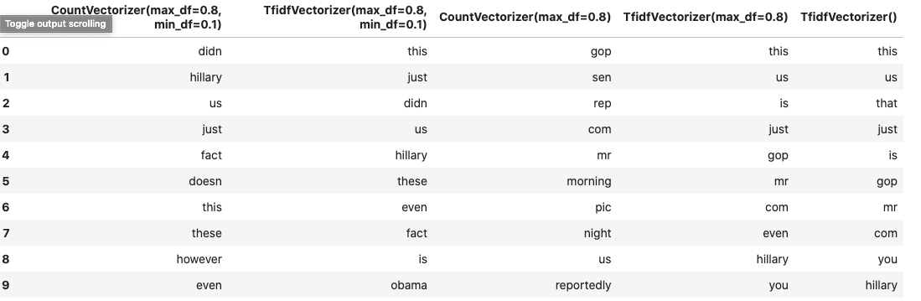
High Coefficients Vectors for Fake News Classification

Slide 16
Conclusion
Two modeling methods were used for this project. Method_2 performs better than Method_1 overall, which makes sense, means natural language processing method can be generalized better.
It is very difficult to decide better one from CountVectorizer and TfidfVectorizer.
The top 6 vectors for determining real news are: Wednesday, Thursday, Tuesday, Friday, Monday, said.
The top 6 vectors for determining fake news are: just, this, these, even, Hillary, us.
Using CountVectorizer and TfidfVectorizer with different parameters didn’t change these high coefficient vectors much.

Slide 17
Future Work
Try other vectorize methods using packages like spacy, genism, sentence_transformer etc.
spacy vector, word2vec, doc2vec and sentence_transformer.
All these four methods work differently as CountVectorizer and TfidfVectorizer. In CountVectorizer and TfidfVectorizer, each vector corresponds to a unique word in the vocabulary. Therefore, interpreting the logistic regression coefficients is straightforward. However, with spacy, word2vec, doc2vec and BERT embeddings, each vector captures complex relationships and context-dependent information from the text. Interpreting the coefficients becomes more challenging because each dimension does not directly correspond to a word.

