Slide 1

Binary Classification of Fake News and Real News
Hui Zhang
Mar.14 2024

Slide 2

Introduction
This project aims to develop a robust binary classification model to distinguish between fake news and real news articles.
Using traditional machine learning method and NLP method and compare these two methods

Slide 3

Audience
Journalists, editors, and media analysts who are interested in understanding and combating the spread of fake news.
General Public: People interested in understanding how fake news is detected and differentiated from real news, as well as those concerned about the impact of misinformation on society.
Researchers, scholars, and students interested in machine learning, natural language processing, or media studies.

Slide 4
Data
Labeled Fake News and Real News
Train Dataset: 2 csv files from Kaggle
fake news:
23481 rows and 5 columns, including information about title, text, subject, date and label.
real news:
21417 rows and 5 columns, including information about title, text, subject, date and label.
https://www.kaggle.com/datasets/bhavikjikadara/fake-news-detection
Real_world unseen test set, 1 csv files
Collect 25 pieces of news from internet.
the 13 real news comes from reuters (7 news), cnn (2 news) and npr(4 news),
the 12 real news comes from breitbart (5 news) and thegatewaypundit (7 news).

Slide 5
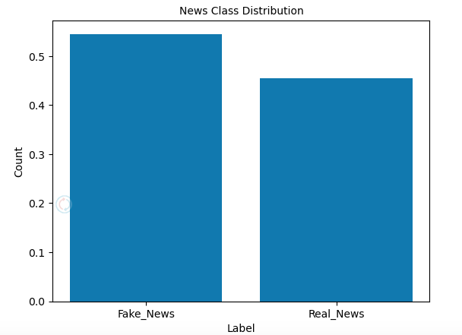
Fake news 54.5%
Real news 45.5%

Slide 6
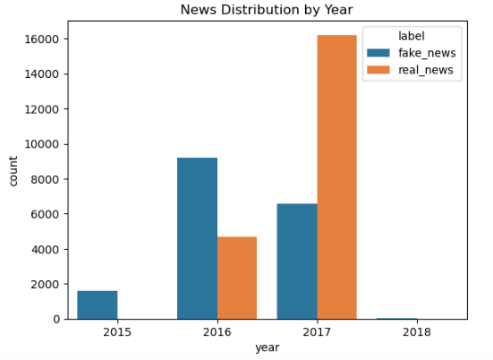
News distribution by year is biased. 2015 and 2018 only fake news.

Slide 7
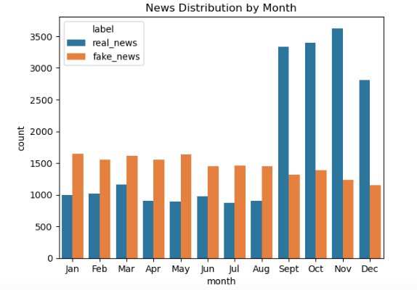
Patterns of news distribution by months: more real news from Sept. to Dec.

Slide 8
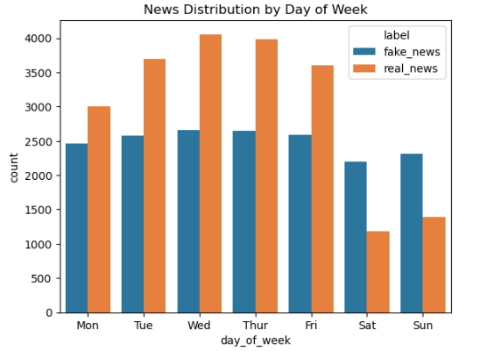
Patterns of news distribution by day: more fake news at weekends

Slide 9
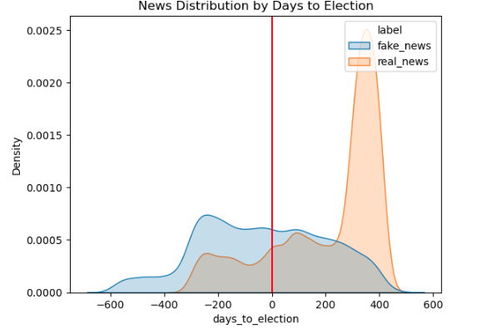
Distribution of news by day to election: more fake news before election

Slide 10
Result
Exp | Model_Name | Features | Scale | Vectorizer | Train_Accuracy | Val_Accuracy | Val_Recall | Val_Precision | Val_F1
1_Hybrid | Logistic Regression (Pipeline) | Text+Meta | StandardScaler | CountVectorizer | 0.999 | 0.981 | 0.976 | 0.982 | 0.979
2_Hybrid | Random Forest (Pipeline) | Text+Meta | StandardScaler | CountVectorizer | 1 | 0.972 | 0.957 | 0.98 | 0.968
3_Hybrid | Gradient Boost (Pipeline) | Text+Meta | StandardScaler | CountVectorizer | 0.976 | 0.971 | 0.957 | 0.978 | 0.967
4_Hybrid | XGboost (Pipeline) | Text+Meta | StandardScaler | CountVectorizer | 0.999 | 0.987 | 0.983 | 0.989 | 0.986
Winner: XGBoost Classifier

Slide 11
Test Set Result
Exp | Model_Name | Features | Scale | Vectorizer | Test_Accuracy | Test_Recall | Test_Precision | Test_F1 | Vectorizer_Params
4_Hybrid | XGboost (Pipeline) | Text+Meta | StandardScaler | CountVectorizer | 0.84 | 0.917 | 0.786 | 0.846 | max_features=None, ngram_range=(1,1), max_df=1, min_df=1
5_Hybrid | XGboost (Pipeline) | Text+Meta | StandardScaler | CountVectorizer | 0.84 | 0.917 | 0.786 | 0.846 | max_features=2000, ngram_range=(1,3), max_df=0.8, min_df=5

Slide 12
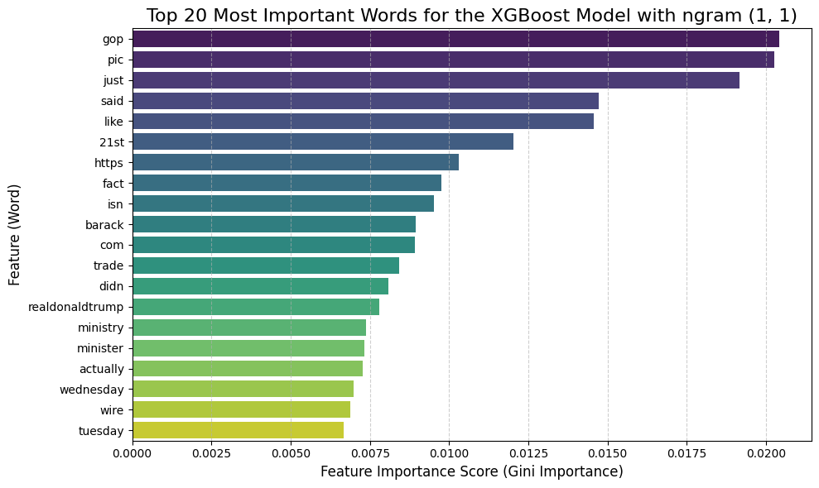
Feature Importance for Fake News Detection (ngram=(1, 1))

Slide 13
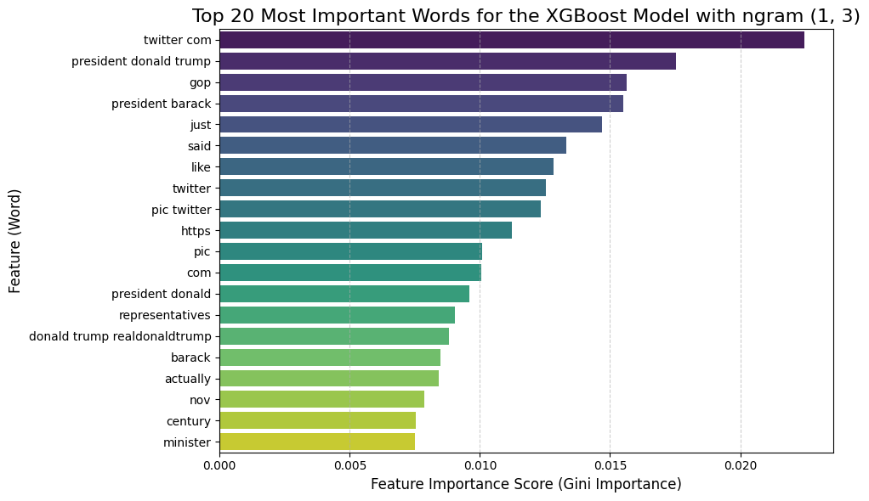
Feature Importance for Fake News Detection (ngram=(1, 3))

Slide 14
Conclusion
Best Model: The XGBoost Classifier using a hybrid of text and metadata features was the top performer, achieving a Test F1-Score of 0.846.
Critical Insight: The model succeeds by acting as a "Format Detector," not a "Content Analyzer." It identifies stylistic and structural shortcuts rather than understanding the narrative.
Key Predictive Patterns Identified:
Social Media: Presence of embedded tweets (twitter com, pic)
Political Polarization: Use of terms like gop, president donald trump
Informal Tone: Frequent use of words like just, said, like
Main Limitation: The model is highly effective on this dataset but is likely overfit to a specific style of fake news, posing a risk to its ability to generalize to different types of misinformation.

