Slide 1

Fox Hunting & ARDF — M&K 2026 Program
Mike & Key Amateur Radio Club (K7LED)
Tom KE4HET | June 20, 2026
Notes:
Talking point: welcome the club, introduce yourself, and frame this as a 2026 program preview.

Slide 2
Today's Agenda
• What is fox hunting / ARDF?
• Our equipment — foxes, antennas, and a budget radio tip
• Radio Camp build event — Thu Jun 26 at Fort Flagler
• ARDF demonstration at Field Day — Jun 28–29
• 2026 hunt season — July · August · September
• How to get involved
• Q&A
Notes:
Talking point: read the roadmap so the audience knows where the program is headed.
Read the agenda aloud. Flag: RT-910B rec is coming in §2, hunt dates are tentative, questions welcome throughout.

Slide 3
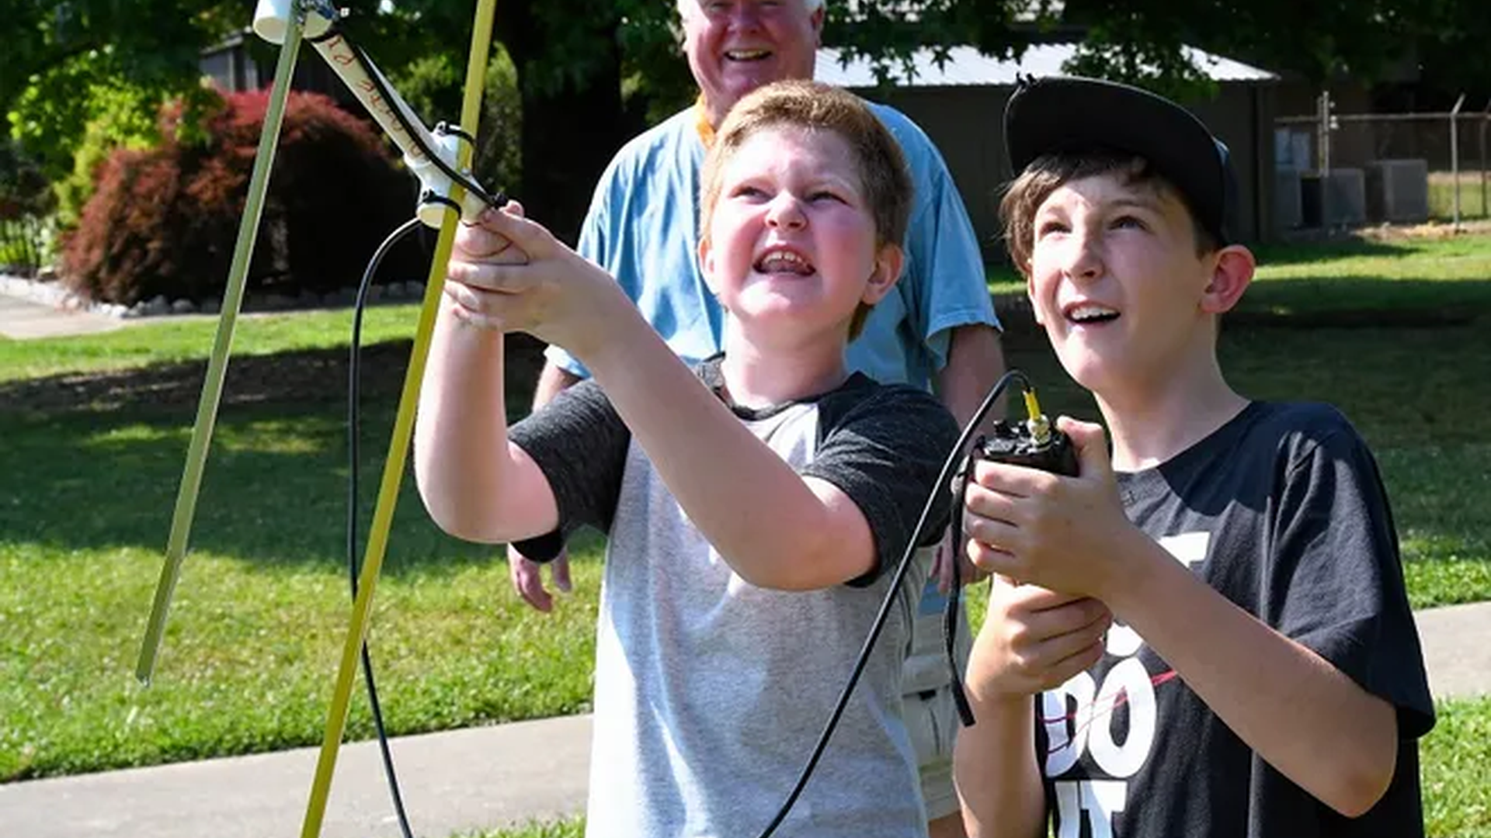
1
What Is Fox Hunting / ARDF?
Notes:
Talking point: open section one by showing fox hunting as hands-on, approachable, and family friendly.

Slide 4
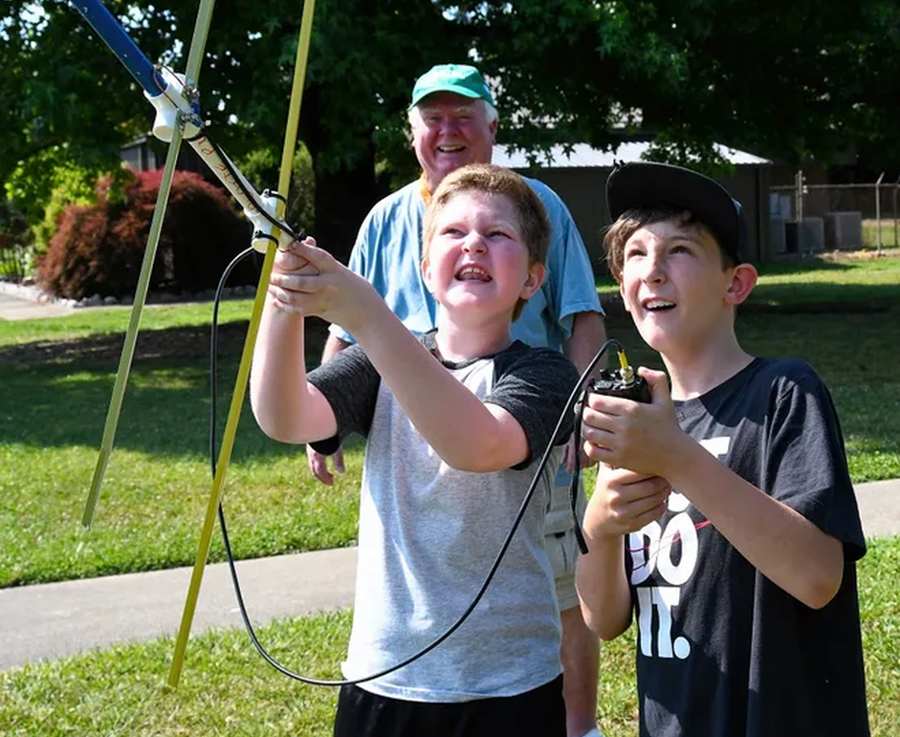
The Concept
• A hidden transmitter — the "fox" — is placed in the field
• Participants find it using Radio Direction Finding (RDF)
• Used worldwide for sport, training, and fun
• Any license class can participate
Notes:
Talking point: define the fox, RDF, and the basic activity in one clear example.

Slide 5
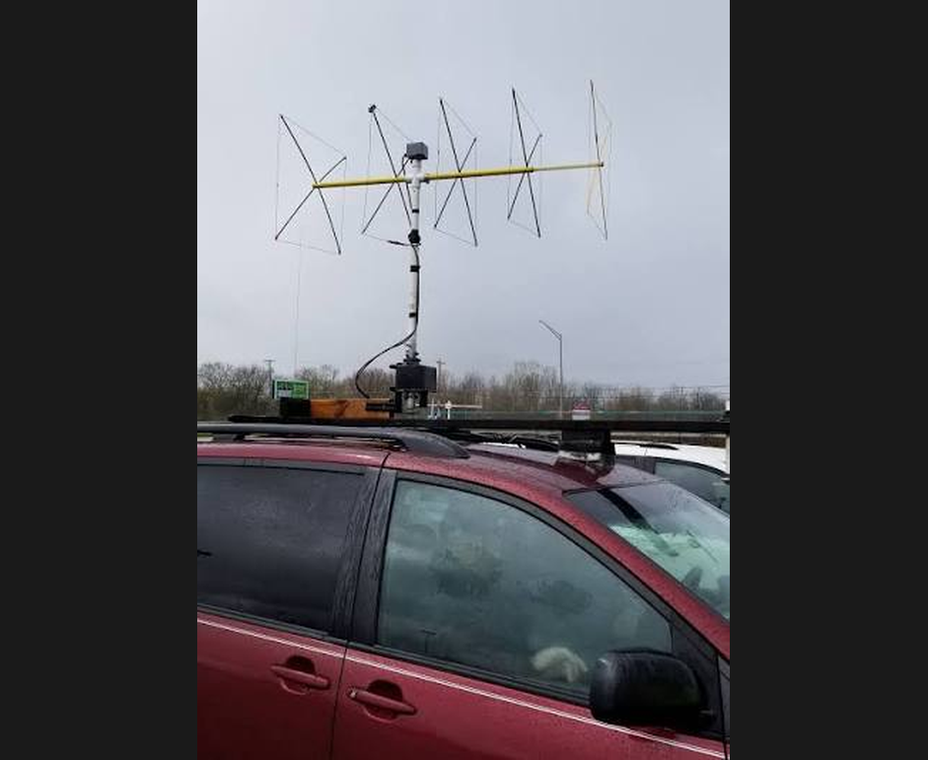
Two Flavors of Fox Hunting
• On-foot (ARDF): walk/run with a directional antenna
• Mobile (T-hunt): car-based, hunting from the road
• Both use the same core RDF skills
• Today's program covers both
Notes:
Talking point: distinguish on-foot and mobile hunting while showing the shared skills behind both.

Slide 6
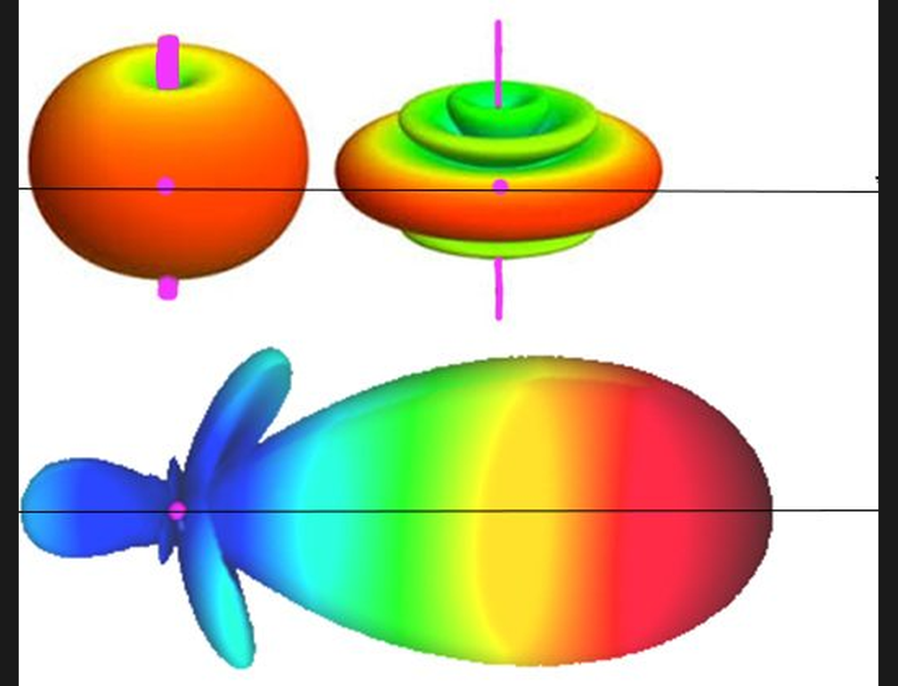
How Direction Finding Works
• A Yagi antenna has a sharp directional pattern
• Rotate until signal is strongest → that's the bearing
• Take multiple bearings → triangulate the fox
• Step attenuator reduces signal when you're close
Notes:
Talking point: explain the bearing-taking loop and why attenuation matters near the fox.

Slide 7
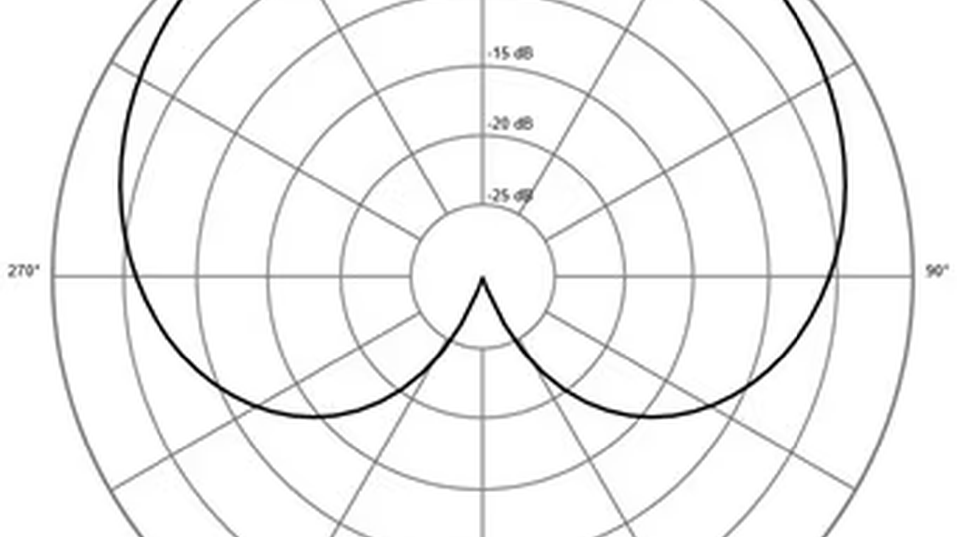
Antenna Pattern
Yagi polar pattern — signal strongest in the forward direction
Notes:
Talking point: reinforce that the forward lobe is the key clue the hunter uses in the field.

Slide 8
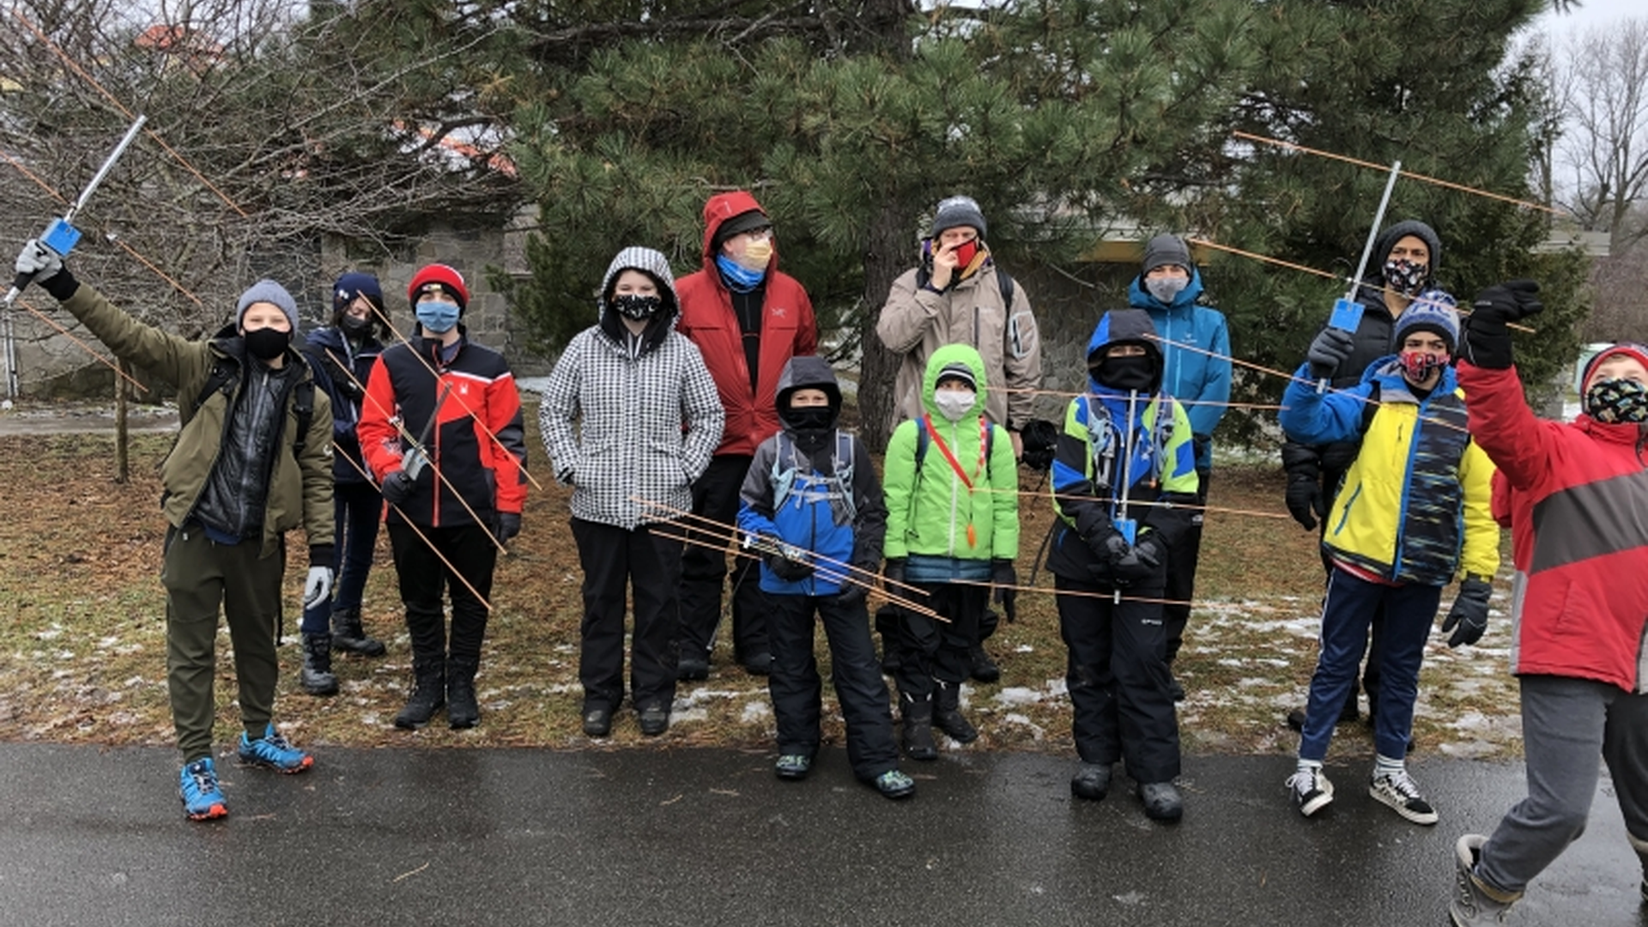
This Is What It Looks Like
Fox hunters at a club event — Yagis up, bearings taken
Notes:
Talking point: show the audience a real hunt moment so the gear and posture feel concrete.

Slide 9
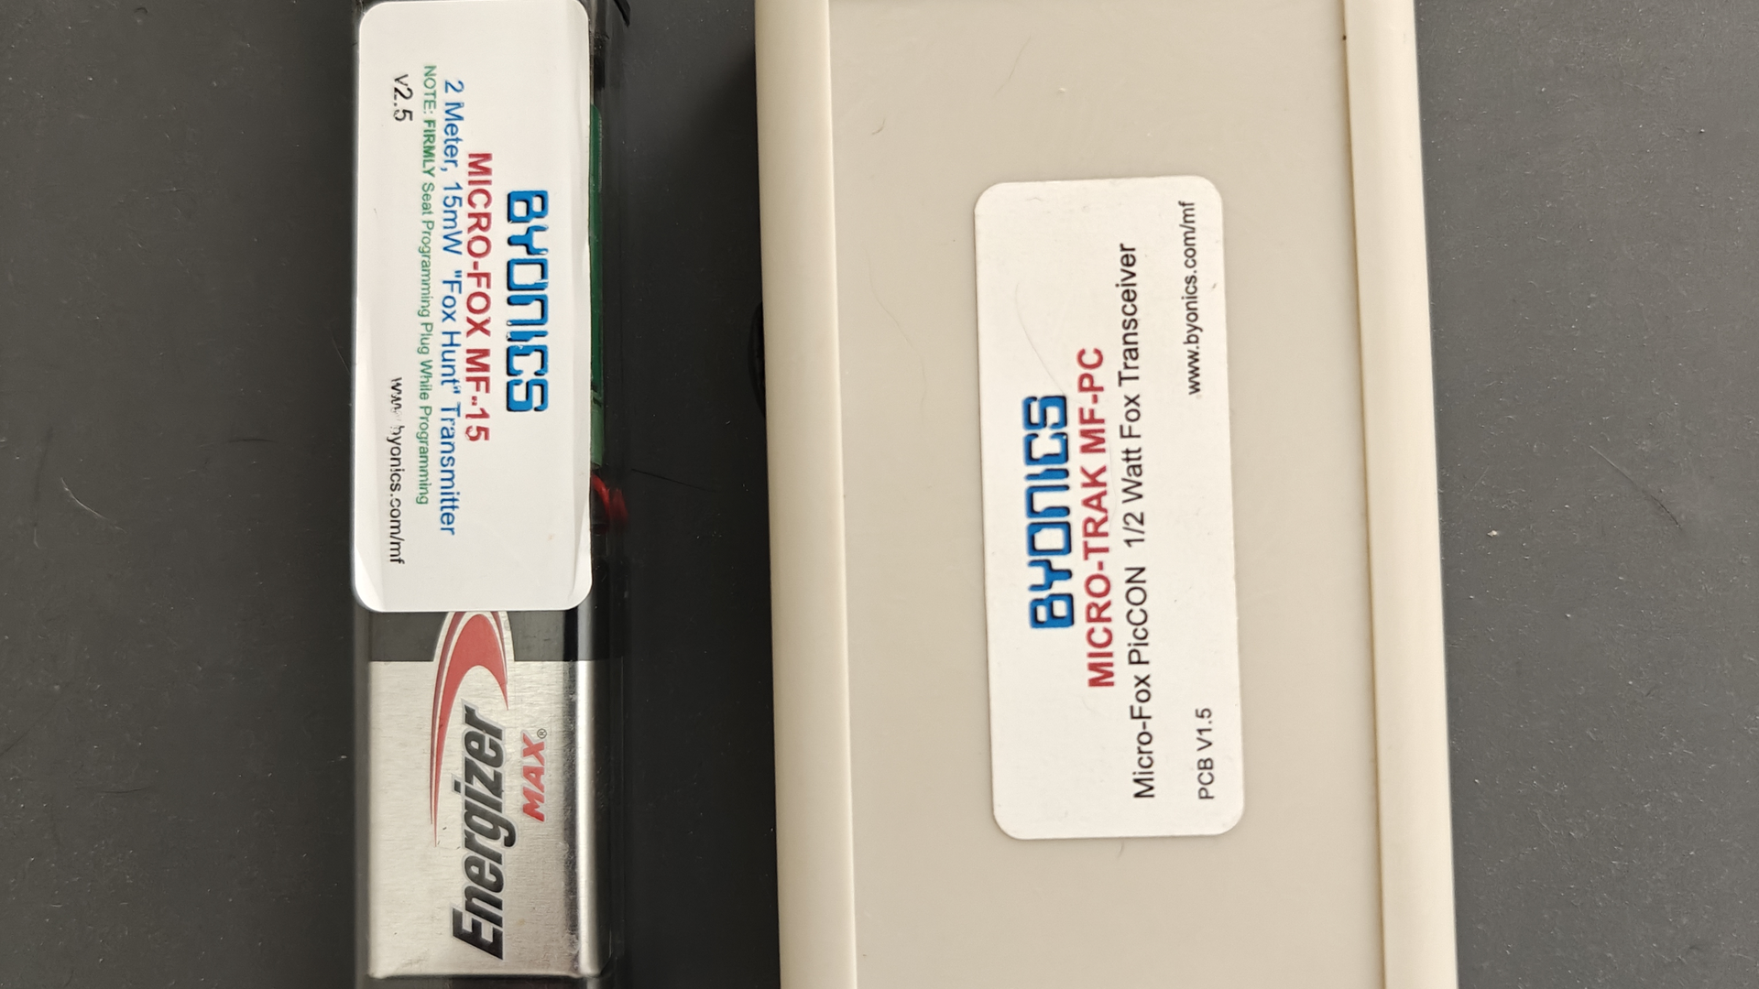
2
Our Equipment
Notes:
Talking point: transition from the concept to the specific club gear and entry path.

Slide 10
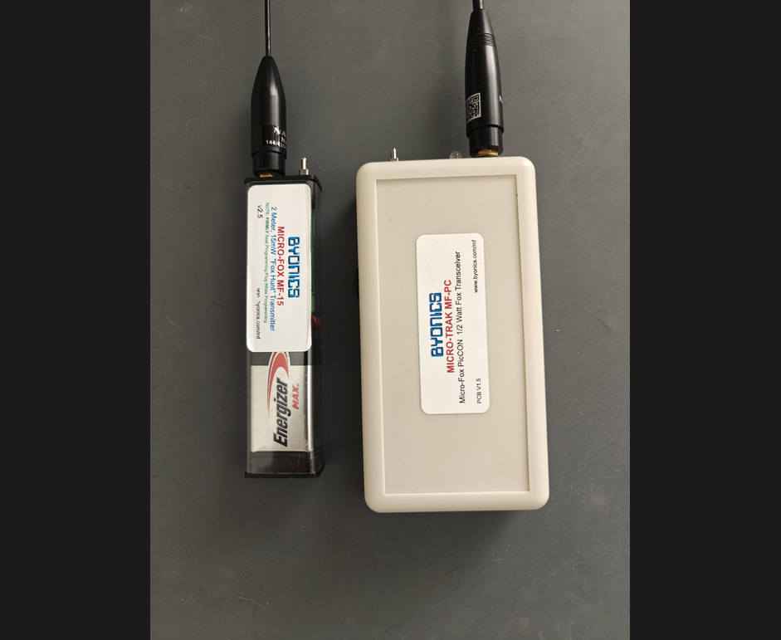
The Fox — Byonics MicroFox
• MF-15 and MF-PC — both programmed and tested
• Frequency: 147.42 MHz simplex, callsign K7LED
• Cycle: 15 s on / 15 s off with CW ID
• WWARA coordination in progress (Steve N9VW)
• Deploy one at a time (currently identical config)
Notes:
Talking point: describe the current beacon inventory and how each fox is configured for the program.

Slide 11
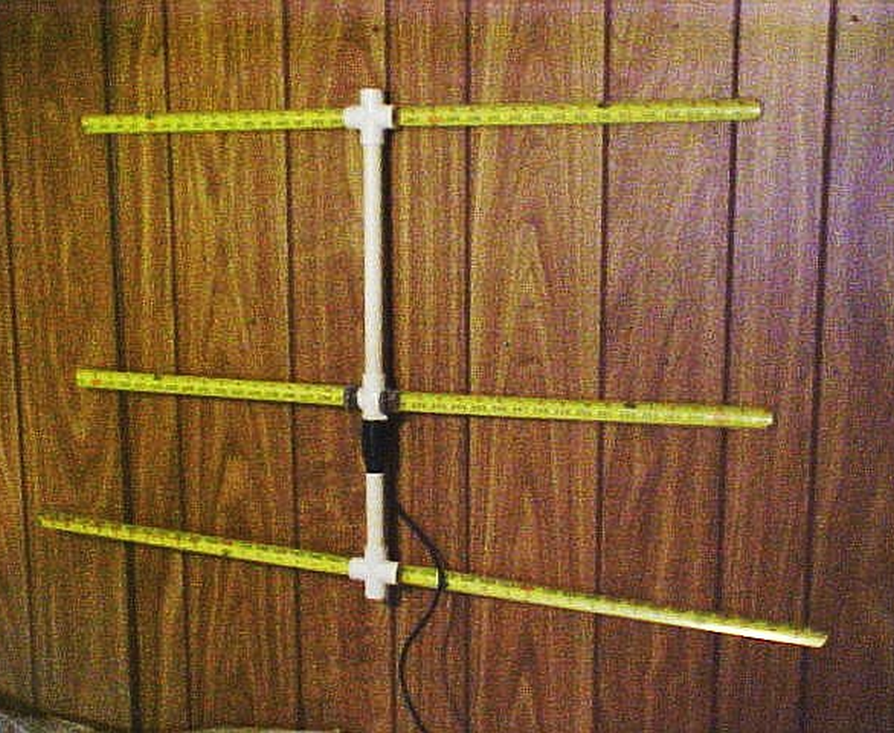
The Hunter's Antenna — Tape Measure Yagi
• 3-element tape-measure Yagi — 2 m band
• Lightweight, collapsible, inexpensive to build
• Connects to any HT with a BNC connector
• We'll build these at Radio Camp on Thu Jun 26
Notes:
Talking point: position the tape-measure Yagi as the practical, low-cost hunter antenna.

Slide 12
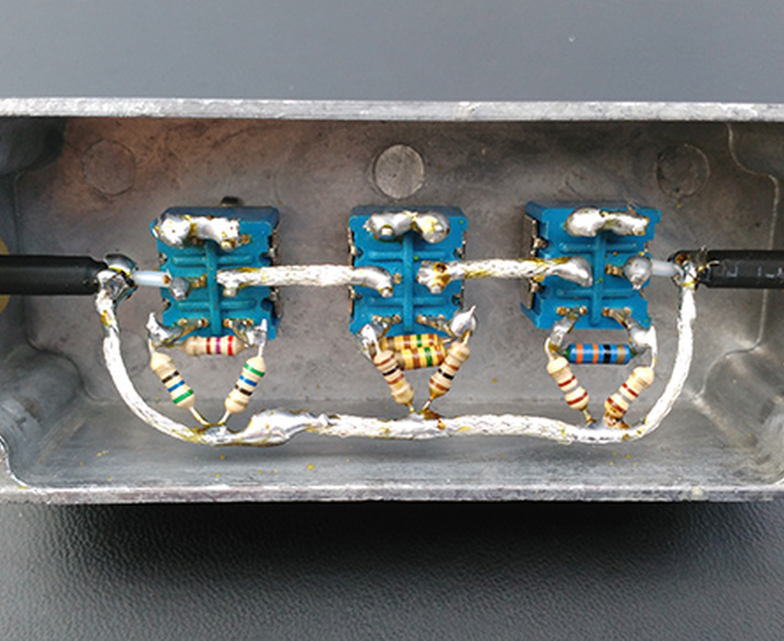
The Close-In Tool — Step Attenuator
• Inserted between HT and antenna
• Reduces signal strength in steps as you approach
• Prevents "spinning S-meter" confusion near the fox
• Also built at Radio Camp — Project 2
Notes:
Talking point: explain how attenuation keeps close-in hunting readable and less frustrating.

Slide 13
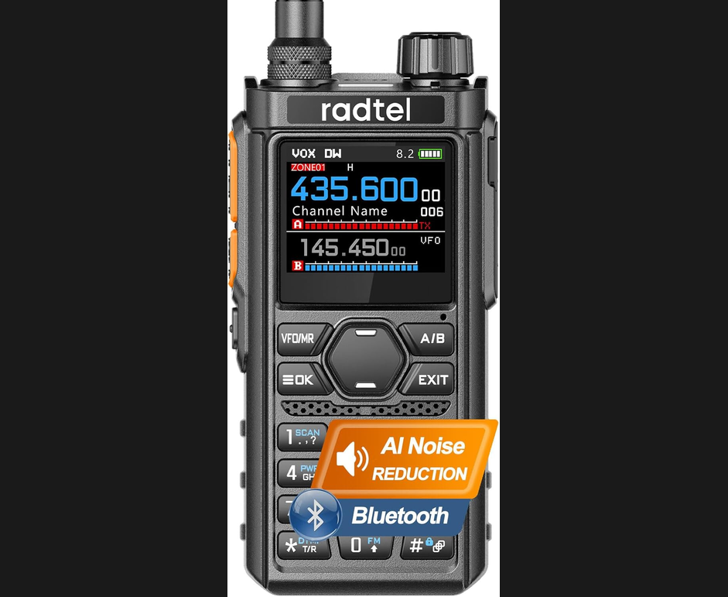
Entry-Level Radio — Radtel RT-910B
• ~$30 on Amazon — lowest barrier to entry
• Large S-meter display — great visual RDF aid
• TX lockout — safe for loaner / demo use
• BNC-to-SMA adapter required (~$5, 2-pack)
• ⚠️ Conditional rec — not yet hands-on tested
Notes:
Talking point: share the lowest-cost HT path while keeping the recommendation clearly provisional.
Emphasize this is conditional — we haven't put one in our hands yet.

Slide 14
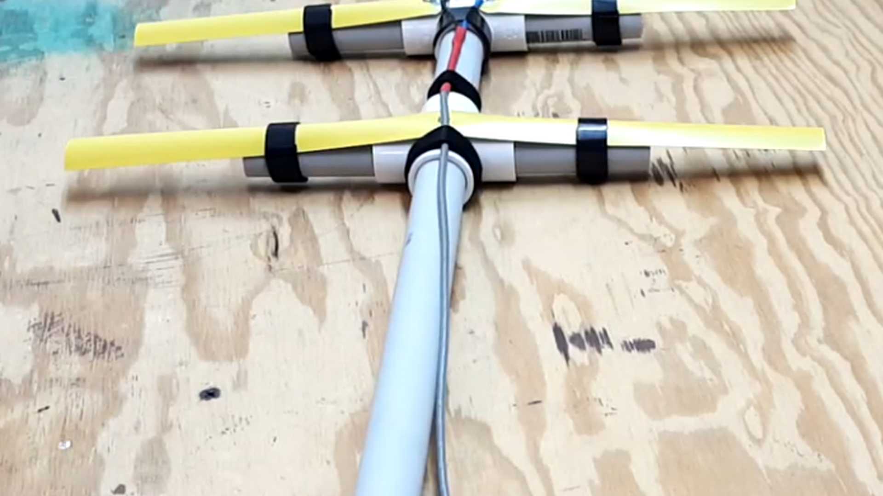
3
Radio Camp Build Event
Notes:
Talking point: open the build-event section with a strong maker image and clear date anchor.

Slide 15
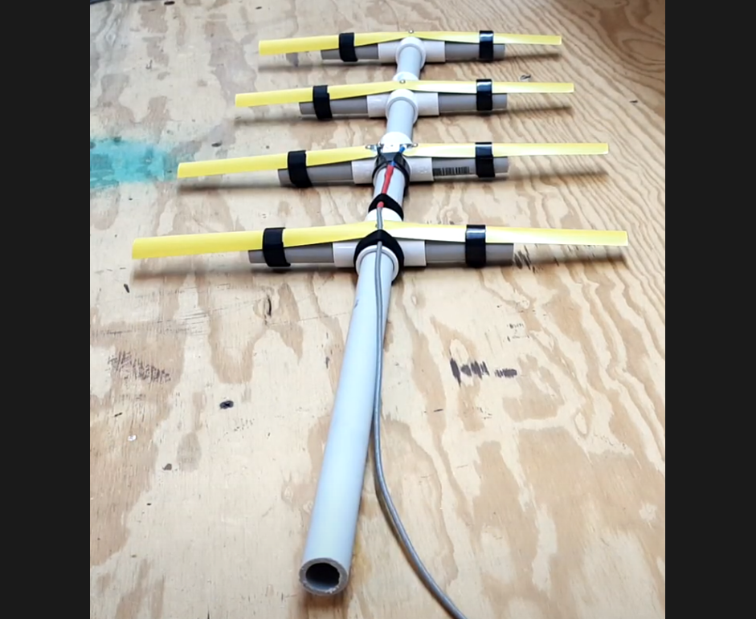
Thu Jun 26 — Fort Flagler, Wagon Wheel
• Radio Camp: Mon Jun 22 – Mon Jun 29 at Fort Flagler State Park
• Build session Thursday afternoon (~5 hours, time TBD on site)
• Project 1: 3-element 2 m tape-measure Yagi (required)
• Project 2: Step attenuator (if time allows)
• Project 3: Dual-band 2m/70cm Yagi (optional, advanced)
Notes:
Talking point: outline the camp timing, venue, and three project tracks for the Thursday build.

Slide 16
Who, What, How
• Licensed amateurs at camp — 1–10 participants
• Hands-on from minute one — no whiteboard lectures
• Tom KE4HET brings materials for at least 5 sets
• Materials mostly on hand; everything expected by Thursday
🙋 Volunteers needed — build assistants & tool wranglers
Notes:
Talking point: make the build feel approachable and end with a specific volunteer ask.

Slide 17
4
ARDF Demonstration at Field Day
Notes:
Talking point: shift from club-internal building to the public-facing Field Day demonstration.

Slide 18
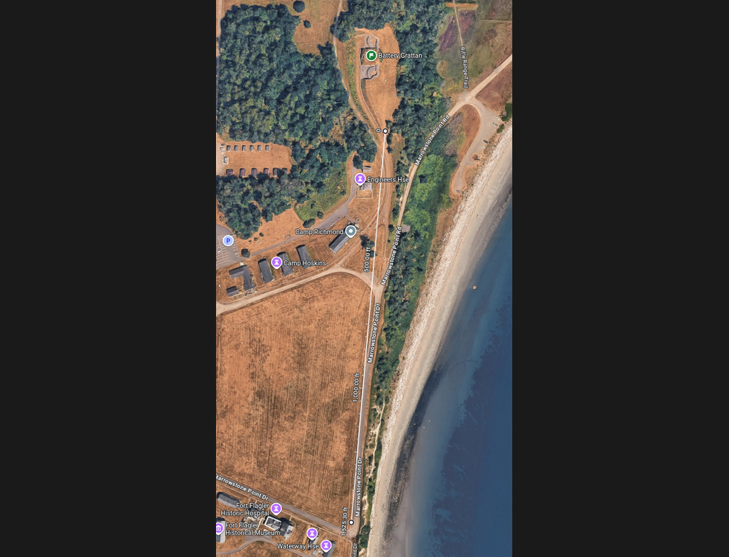
Sat–Sun Jun 28–29 — Fort Flagler
• Visitor tent: Battery Grattan (start point)
• Fox: hidden south side of Parade Grounds
• Fox location unstaffed — visible from tent
• Frequency: 147.42 MHz (WWARA pending)
Notes:
Talking point: orient the audience to the demo geography and the simple start-to-finish hunt path.

Slide 19
How the Demo Works
• Visitor arrives at Battery Grattan tent
• 2-minute intro — no ham license required
• Borrow HT + Yagi → hunt the fox → return gear
• Format: guided or self-guided based on experience
• Fox re-hidden between groups
Notes:
Talking point: walk through the visitor experience so club members can picture the staffing model.

Slide 20
We Need Your Help
• 🙋 Demo hosts — explain fox hunting to the public
• 🦊 Fox wranglers — re-hide the transmitter between hunts
• 📻 Loaner gear — HTs and Yagis for visitors
Talk to Tom KE4HET to sign up
Notes:
Talking point: make the staffing and loaner-equipment asks explicit for Field Day.

Slide 21
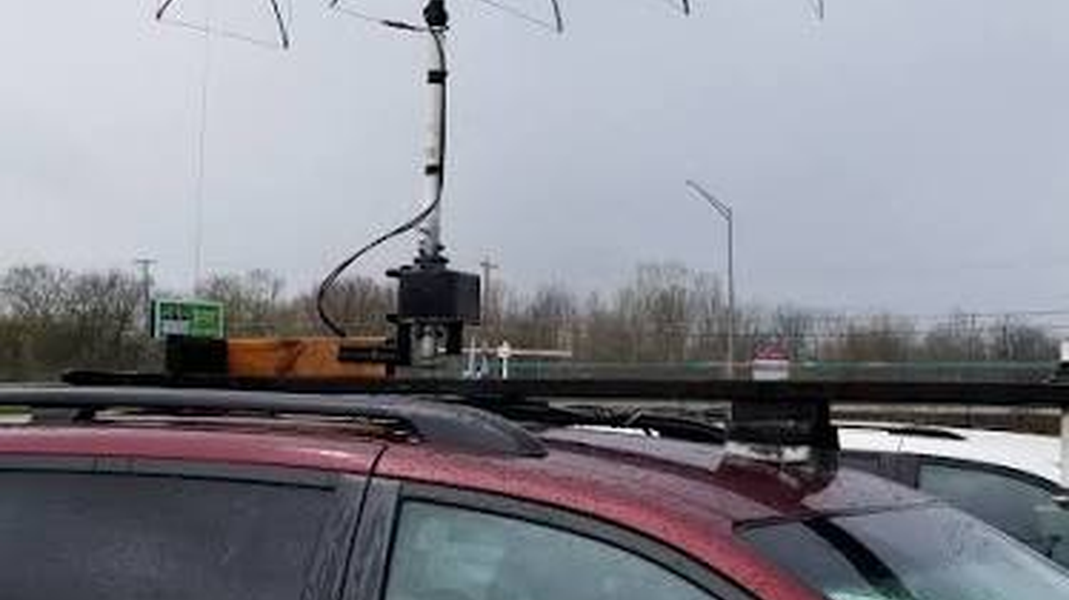
5
2026 Hunt Season
Notes:
Talking point: introduce the summer schedule as a tentative three-event progression.

Slide 22
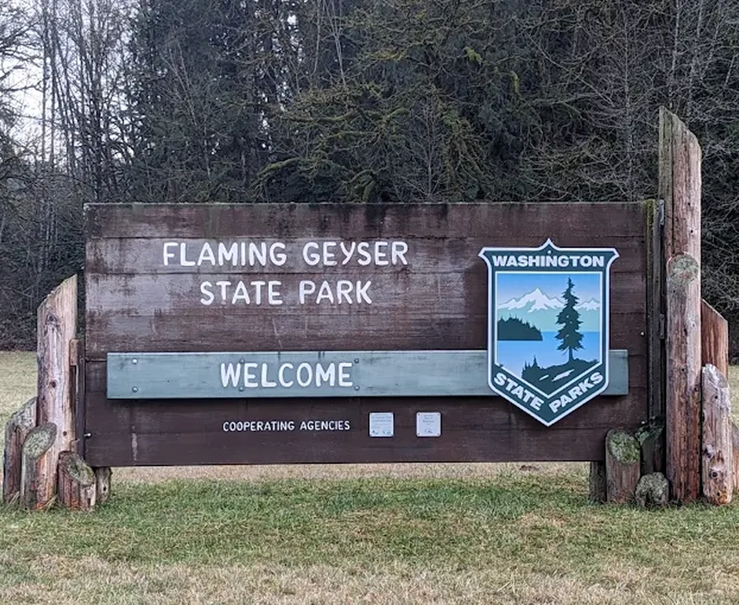
July — Practice Hunt (tentative)
• Sun Jul 19 — Flaming Geyser State Park, Auburn
• On-foot, single fox, noon – 2:30 PM (2.5 hrs)
• 480+ acres, Green River valley, wooded trails
• Discover Pass required per vehicle; carpools encouraged
• Good intro event — multipath adds realistic challenge
Notes:
Talking point: present July as the entry-friendly practice hunt with realistic terrain and manageable logistics.

Slide 23
August — On-Foot Hunt (tentative)
Photo coming
• Sat Aug 22 — Marymoor Park, Redmond
• On-foot, single fox, noon – 2:30 PM
• 640 acres — wooded Sammamish River corridor + open fields
• Light-rail accessible (2 Line)
• Note: wrap by 2:30 PM — Marymoor Live concert that evening
Notes:
Talking point: describe Marymoor as the main on-foot hunt, noting transit access and the strict afternoon wrap time.

Slide 24
September — Mobile T-Hunt (tentative)
• Sun Sep 20 — Finish at Howarth Park, Everett
• Hunt from your vehicle — take bearings while driving
• Final leg: short on-foot walk on forested hillside
• Puget Sound views; social wrap-up at finish
• ⚠️ Stay clear of BNSF railroad tracks at finish
Notes:
Talking point: position September as the mobile hunt, with a scenic finish and a clear safety reminder.

Slide 25
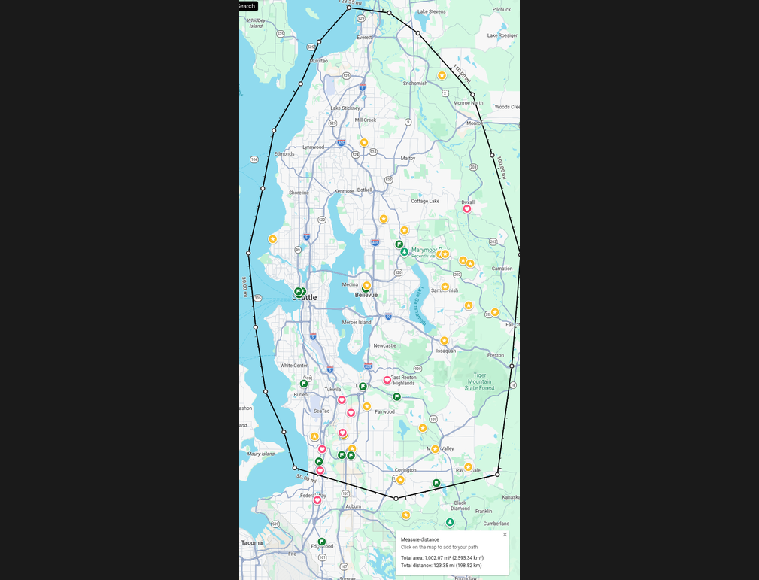
The Region We'll Hunt
• Three events across the greater Puget Sound area
• July: Auburn (Flaming Geyser)
• August: Redmond (Marymoor)
• September: Everett (Howarth) — mobile finish
Notes:
Talking point: zoom out and show the three hunt areas as a regional program, not isolated events.

Slide 26
How to Get Involved
Notes:
Talking point: pivot from the event calendar to the specific ways members can jump in right away.

Slide 27
Join the Program
• Radio Camp (Jun 22–29): attend and/or volunteer Thu build
• Field Day demo (Jun 28–29): host visitors or hide the fox
• Hunts: show up and hunt — all levels welcome, mentors present
• Mailing list: groups.io/g/mikeandkey-foxhunt (ask Scott KC7SAG)
• Questions: Tom KE4HET
Notes:
Talking point: finish the call to action with the top entry points, contact path, and mailing list.

Slide 28
Questions?
Tom KE4HET | groups.io/g/mikeandkey-foxhunt
Notes:
Talking point: invite questions and leave the audience with a clear follow-up contact path.

