Slide 1
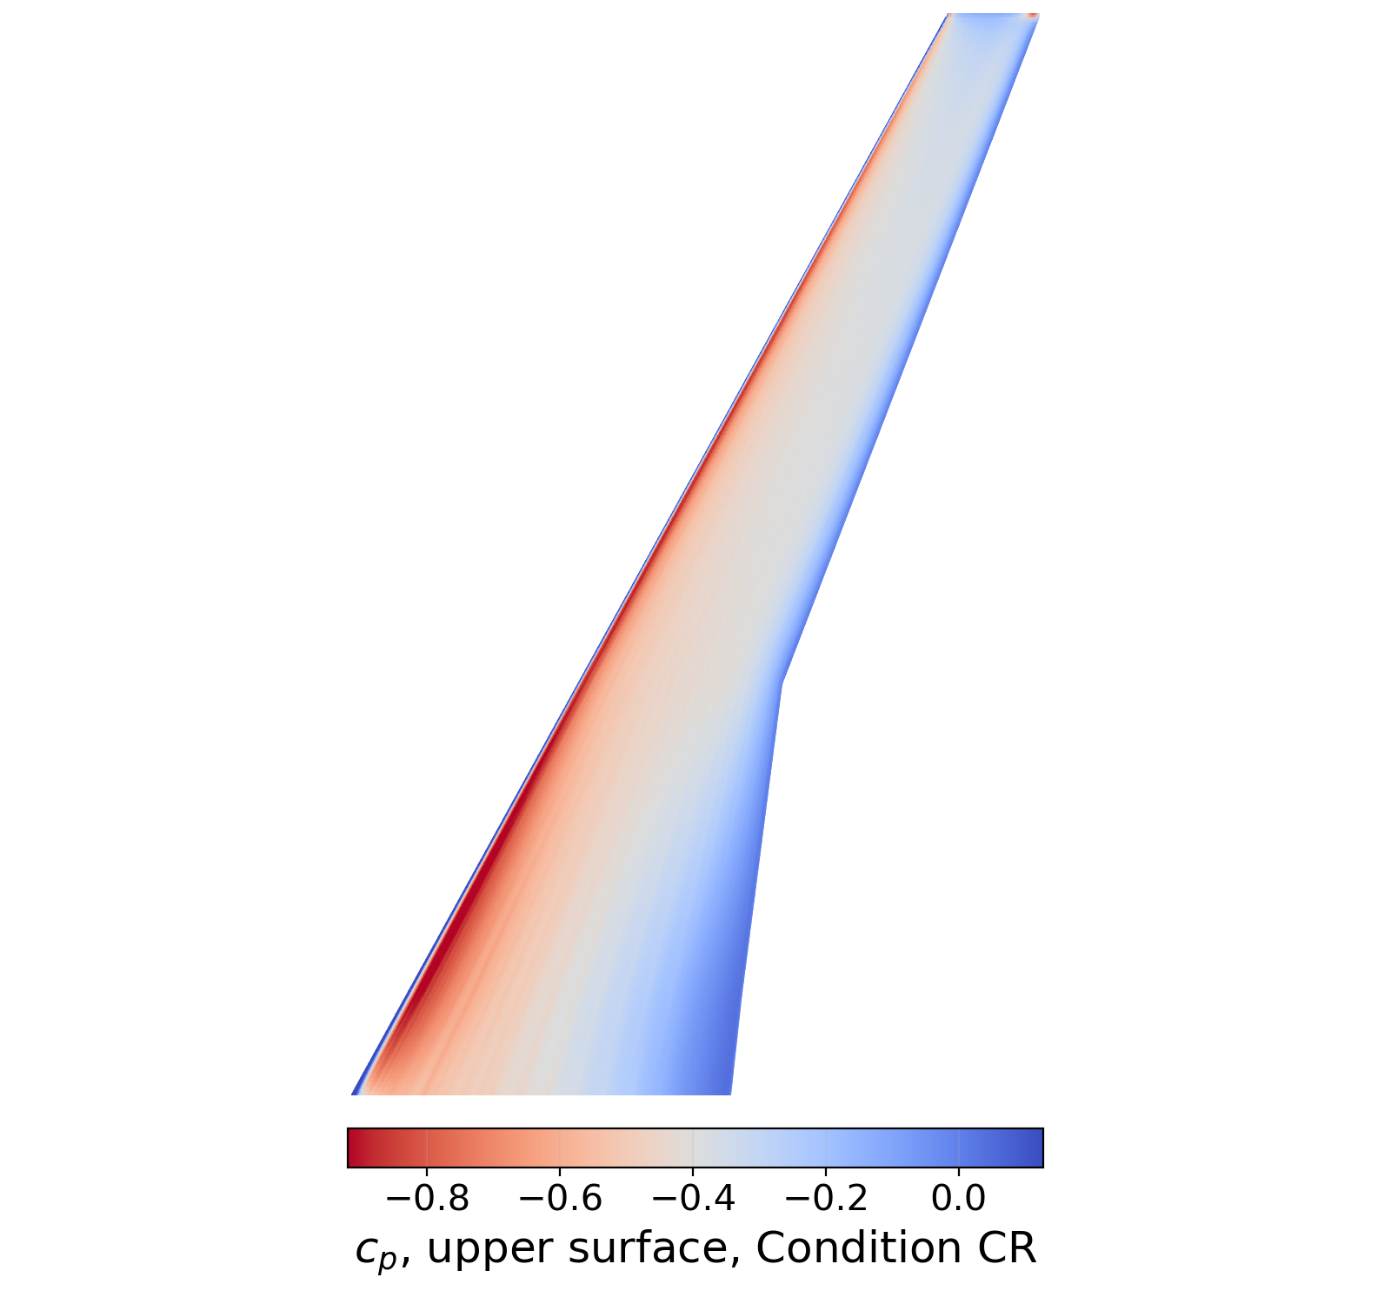
ARGUS morphing wing: RANS validation of the VLM design study
Tyler Buchanan | ARGUS group | 9 October 2026
Notes:
Twenty minutes, three parts: what was done and how, what every quantity came out as with the VLM beside it wherever a VLM value exists, and whether the VLM can be trusted to drive the design study. The short answer is that it orders the candidates on one of its two induced-drag columns, gets their differences right up to one common offset, and cannot see the cruise shock that makes two of them costly. The wing on the right is the baseline's upper-surface pressure at Condition CR.

Slide 2
My job on ARGUS, and the three questions
Validate the VLM candidate selection against viscous RANS on six wings.
Six geometries, three operating points, 90 converged cases, 18 matched-lift trims.
Questions: what was done, what every quantity gives, is the VLM trustworthy.
Early and late cruise on top, which the VLM does not have.
Notes:
The design study ran a vortex-lattice method; my job was to put a higher-order method on the same six wings and see whether its selection survives. 90 converged cases in total, of which 18 are trim cases at the target lift. Three questions in order: the method so the numbers have a provenance, every quantity rather than a summary of three, then the verdict on the low-order tool, where order and magnitude are separate questions. The cruise points are extra: the VLM has no cruise decks for these geometries.

Slide 3
Operating points and OpenFOAM setup
Reference area S_{ref} 1.24092 m² and chord C_{ref} 0.39396 m, full wing.
RANS solves the half wing on S_{ref}/2; one drag count is 10⁻⁴.
 | Condition CR | Early cruise | Late cruise | VLM, Condition CR
Mach | 0.10 | 0.78 | 0.78 | 0.10
Target C_{L} | 0.428277635108 | 0.529297087450 | 0.544114800210 | 0.428277635108
U∞ (m/s) | 34.0 | 233.9 | 230.5 | n/a
Re on C_{ref} | 0.92×10⁶ | 2.1176454×10⁷ | 1.6107442×10⁷ | 1.0×10⁷ (deck)
Solver | incompressible, incompressibleFluid | compressible, fluid transonic | compressible, fluid transonic | vortex lattice
Turbulence model | kOmegaSST | Spalart-Allmaras | Spalart-Allmaras | none
Wall treatment | resolved, nutLowReWallFunction | modelled, nutUSpaldingWallFunction | modelled, nutUSpaldingWallFunction | none
First-cell y⁺, top / centre | 0.541 / 0.270 | 80.3 / 40.1 | 80.3 / 40.1 | n/a
Prism layers | 11, first 4.5 µm, r 1.450 | 5, first 43.7 µm, r 1.300 | 5, first 43.7 µm, r 1.300 | n/a
Surface cell | level 11, 0.488 mm | level 11, 0.488 mm | level 11, 0.488 mm | n/a
Notes:
Condition CR is the design study's low-speed point, Mach 0.10 at a fixed lift coefficient of 0.4283; the two cruise points are Mach 0.78 at 0.5293 and 0.5441. Every difference in this talk is formed inside one of these points, never across them. The VLM column is the deck the design study ran: same Mach and target lift as Condition CR, but its flat-plate friction term is evaluated at a Reynolds number of ten million against our 0.92×10⁶, which is one reason its total drag is never set beside ours. Condition CR is wall resolved with kOmegaSST; cruise is wall modelled with Spalart-Allmaras, chosen because skin friction cancels within a morph pair and the drag rise is what matters there. One mesh recipe serves both conditions and only the prism stack differs, from a 4.5 micron first cell wall resolved to 43.7 microns wall modelled.

Slide 4
The six geometries
Three mechanisms, five candidates, one rigid baseline B.
Trailing edge moves 3 to 7 mm over the outer 39% span.
ID | DSO case | Concept | What moves | Span, η | Peak TE (mm)
C | cte_i002_c04 | trailing-edge camber | aft chord from x/c 0.62 | 0.6125 to tip | 6.89
F | cfft_b02_c01 | trailing-edge camber | aft chord from x/c 0.62 | 0.6125 to tip | 3.45
H | chc_g02_c06 | hinged flap | flap aft of x/c 0.70 | 0.710 to 0.970 | 3.15
M | mcv2_i002_c01 | trailing-edge camber | aft chord from x/c 0.62 | 0.6125 to tip | 7.29
W | cffw_b01_c01 | distributed twist | whole section, about x/c 0.25 | 0.6125 to tip | 5.72
Notes:
Five candidates from three mechanisms: continuous trailing-edge camber on C, F and M, distributed twist on W, a conventional hinged flap on H. All were selected by the design study at Condition CR. The displacements are millimetres, 3.1 to 7.3 mm at the trailing edge, over the outer part of the span from eta 0.61. If asked why they look alike: the morphing signal at low speed is a count or less, which is the whole reason a matched-lift comparison is needed.

Slide 5
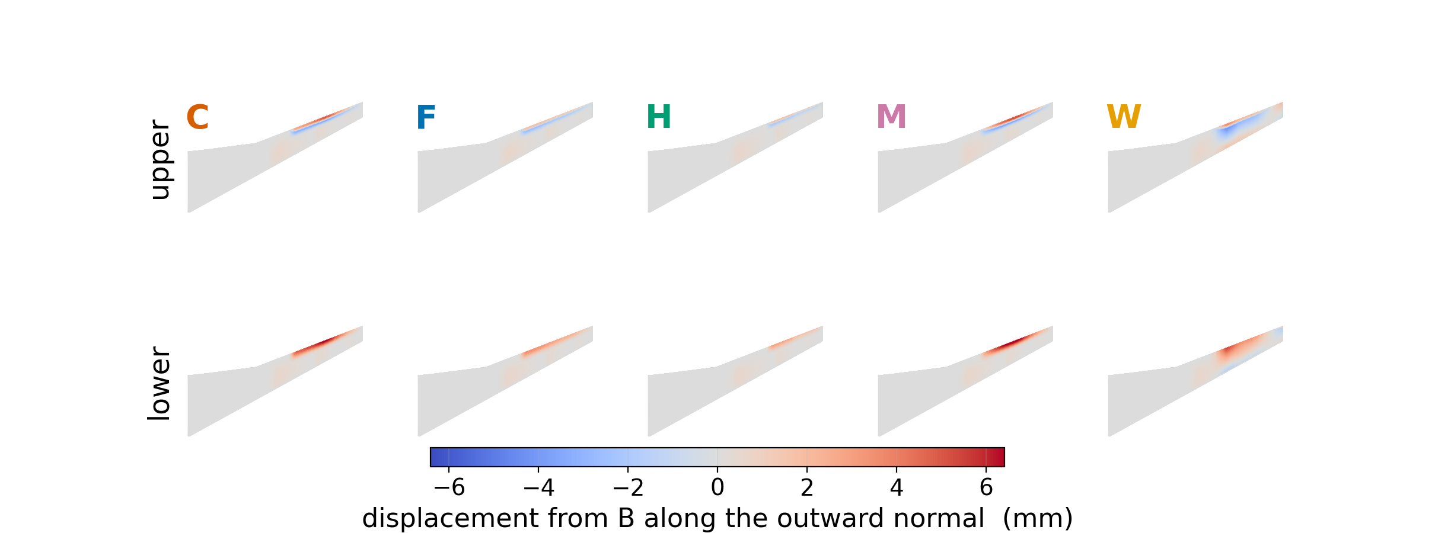
Where each concept moves the surface
Notes:
Each candidate's surface against the baseline, seen from above and from below, signed along the baseline's outward normal so the same colour means the same physical direction on both surfaces. Red is outward. Span runs left to right, root at the left, and the chord runs up the page. One colour scale across every panel, so the panels are comparable by eye. C and M move most, F and H least, and W is the only one that moves the leading edge.

Slide 6
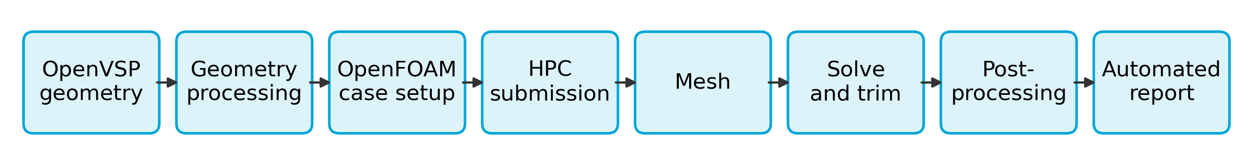
The pipeline, end to end
Geometry: scale feet to metres, strip non-wing solids, close the cap.
Every case: mesh, three-angle bracket, trim, gate, run card.
Every table and figure regenerates by script from one harvested file.
Notes:
Eight stages from an OpenVSP export to the report, all scripted. The geometry step scales the export from feet to metres, strips the non-wing solids and closes the end cap so the surface is watertight before it is meshed. Case setup, submission, meshing, solving and the trim loop run on the cluster from one template. Post-processing writes a run card per case and harvests one force file, and every table and figure in the report and in this deck regenerates from it. The next slide opens the middle stages.

Slide 7
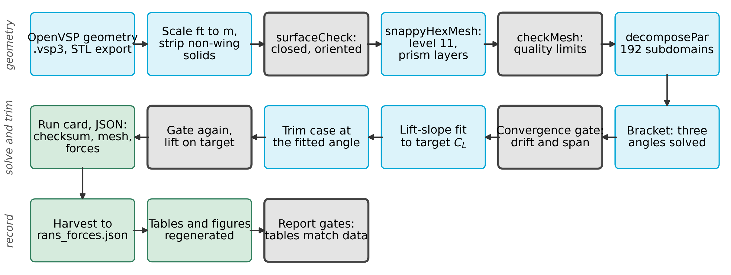
The automated pipeline in detail
Every geometry flies at one lift; drag at different lift compares nothing.
Notes:
One case from geometry to a quotable number, with four gates. The surface is checked closed before meshing; the mesh is checked; three angles are solved to a convergence gate; the lift slope is fitted and the trim case solved at the interpolated angle and gated again. Every case then writes a run card with its geometry checksum, mesh statistics, forces and core-hours, and every table and figure regenerates from the harvested file. If asked what the gate is: two hundred samples, drift and span thresholds on drag and lift, and a lift residual below one count.

Slide 8
Quantities of interest: the contents of the results
Quantity | Definition | VLM (slide) | RANS (slide) | Baseline, VLM | Baseline, RANS
Trimmed drag, each point | candidate minus B at fixed C_{L} | induced only (22) | yes, 3 points (9, 10)
Trim angle | incidence at the target C_{L} | yes (12) | yes (12) | 2.000° | 1.748°
Spanwise load | c_{l} c / C_{ref} per strip | yes (13) | yes (13)
Induced drag, span efficiency | Trefftz integral and e | near and far (14) | yes (14) | 57.65 ct far, 91.68 near | 55.98 ct
Hinge moment | moment about x/c 0.62, η ≥ 0.60; H, W own lines | no | yes (15, 16)
Root bending | solver moment at the root | yes (17) | yes (17) | 137.8 N m | 137.1 N m
Surface c_{p} and c_{f} | sections and surface maps | no | yes (11, 18, 19)
Notes:
This is the contents of the results part: every quantity, what it is, and where each method's result sits in the deck. The VLM gives induced drag only, a trim angle, a spanwise load and a root bending moment; it has no hinge moment and no surface pressure. Where the baseline is a single number both methods' values are in the last two columns, so the level is visible before the differences are. If asked about the two VLM induced-drag numbers: the deck writes a surface integration and a wake integral, and I will keep both in view.

Slide 9
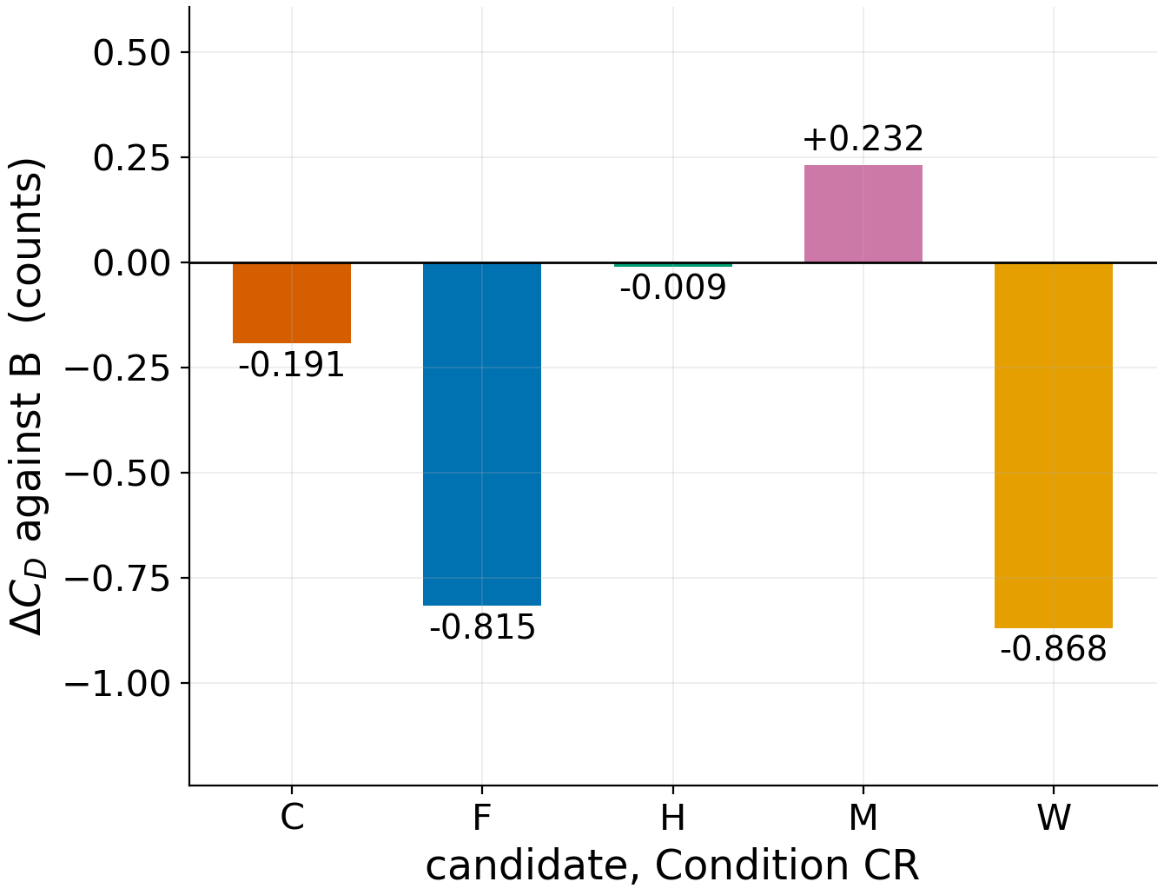
Trimmed drag, Condition CR
The whole field spans 1.1 counts around the baseline.
Four of five candidates sit below the baseline drag.
Read the low-speed sequence as a group, not a ranking.
Every candidate trims at lower incidence than the baseline.
ID | C_{D} (ct) | ΔC_{D} (ct) | L/D
B | 188.031 | +0.000 | 22.78
C | 187.840 | -0.191 | 22.80
F | 187.216 | -0.815 | 22.88
H | 188.022 | -0.009 | 22.78
M | 188.263 | +0.232 | 22.75
W | 187.163 | -0.868 | 22.88
Notes:
At Condition CR the baseline sits at 188.031 counts and the five candidates within 1.1 counts of it, 4 of them below. Two groups are visible, W and F near a count of saving and C, H and M near zero, but the neighbours inside a group are separated by less than the gate resolves. So this is a grouping, not a ranking. If asked whether one count matters: it is the size of the effect the design study was optimising, and the point of the next slides is that cruise dwarfs it.

Slide 10
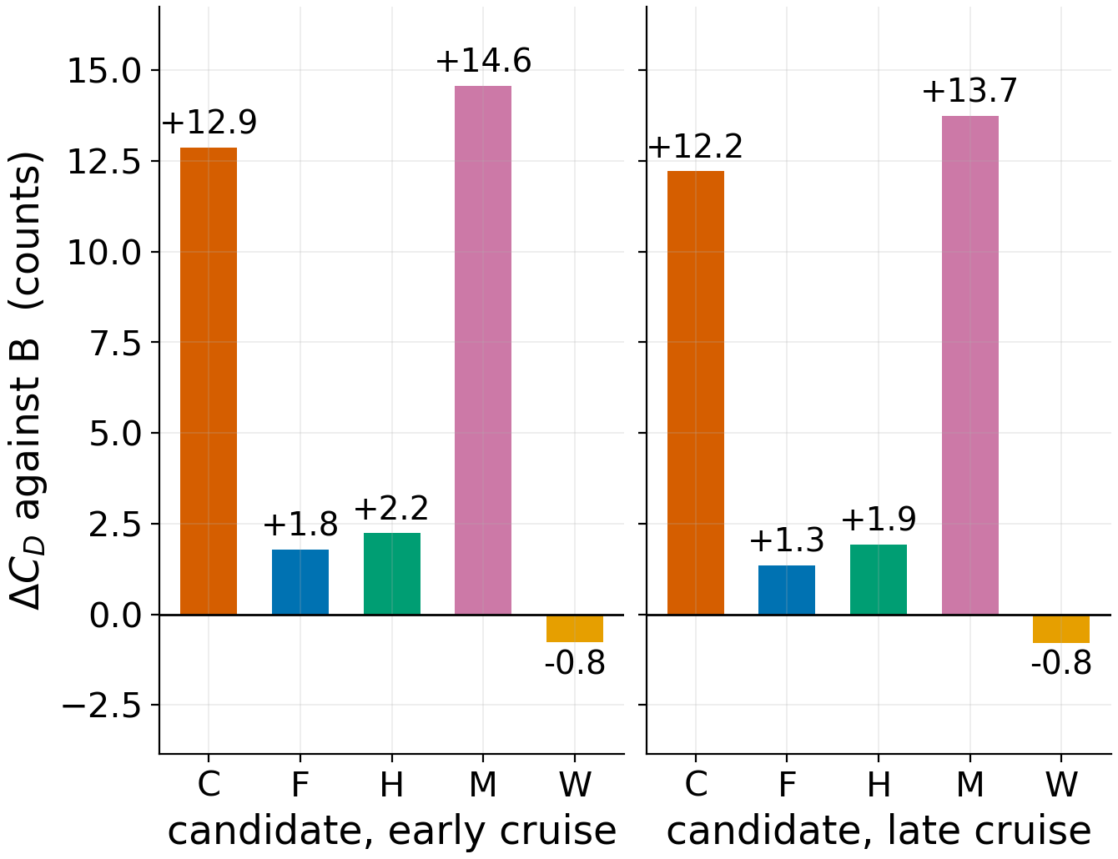
Trimmed drag, early and late cruise
W saves drag at both cruise points, 0.77 and 0.78 counts.
Both cruise points give the same order: W, F, H, C, M.
C, M cost 12 to 15 counts; F, H about 2.
Low-speed order differs only in the H and C pair.
ID | ΔC_{D} early (ct) | ΔC_{D} late (ct)
B | +0.000 | +0.000
C | +12.871 | +12.214
F | +1.796 | +1.348
H | +2.244 | +1.927
M | +14.554 | +13.728
W | -0.769 | -0.781
Notes:
At Mach 0.78 W is the only candidate that beats the baseline, by 0.77 counts at early cruise and 0.78 at late cruise, and it is the cheapest geometry at all three operating points. F and H cost about two counts, C and M twelve to fifteen. The two cruise points were solved independently and give the same order, W, F, H, C, M, which is the strongest evidence I have that the order belongs to the wings and not to one operating point. It is also the low-speed order except for H and C, which are 0.18 counts apart at Condition CR, inside what the low-speed field resolves. If asked why C and M are expensive here: next slide, a strong shock and separation behind it, which is wave and profile drag, not induced.

Slide 11
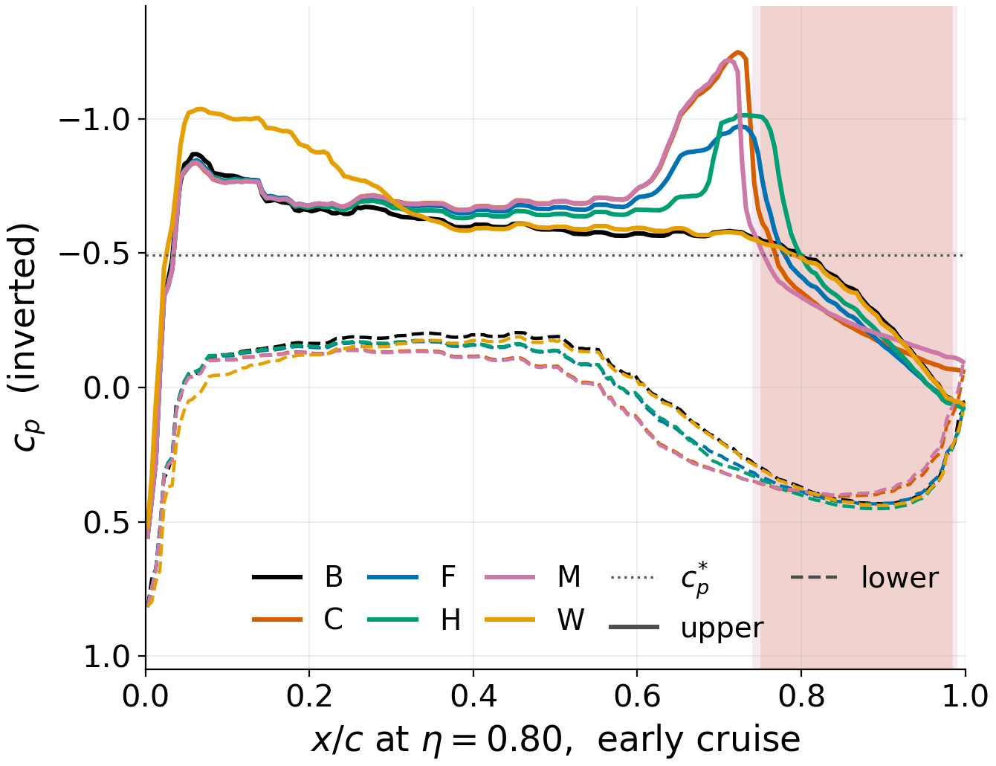
Cruise drag follows the aft shock
B and W: the supersonic region ends without a shock.
F and H: a moderate shock, flow stays attached.
C and M: a strong shock and separation behind it.
Drag follows shock strength; late cruise repeats it.
ID | Shock x/c | Peak dc_{p}/d(x/c) | Reversed run, x/c
B | none |  | attached
C | 0.738 | 46 | 0.75 to 0.98
F | 0.752 | 17 | attached
H | 0.772 | 19 | attached
M | 0.728 | 51 | 0.74 to 0.99
W | none |  | attached
Notes:
This is the mechanism at eta 0.80, the peak of the commanded camber, where the upper surface is supersonic over most of the chord on every geometry. On B and W it recompresses gradually with no shock, F and H end it in a moderate shock and stay attached, and C and M end it in a strong shock, peak gradient 46 and above against 19 at most for the moderate ones, and separate behind it. The drag order is exactly that grouping, and late cruise repeats it station by station. If asked whether the separation extent is trustworthy: the sign is robust, the extent is a wall-modelled reconstruction and I would re-measure it before publication.

Slide 12
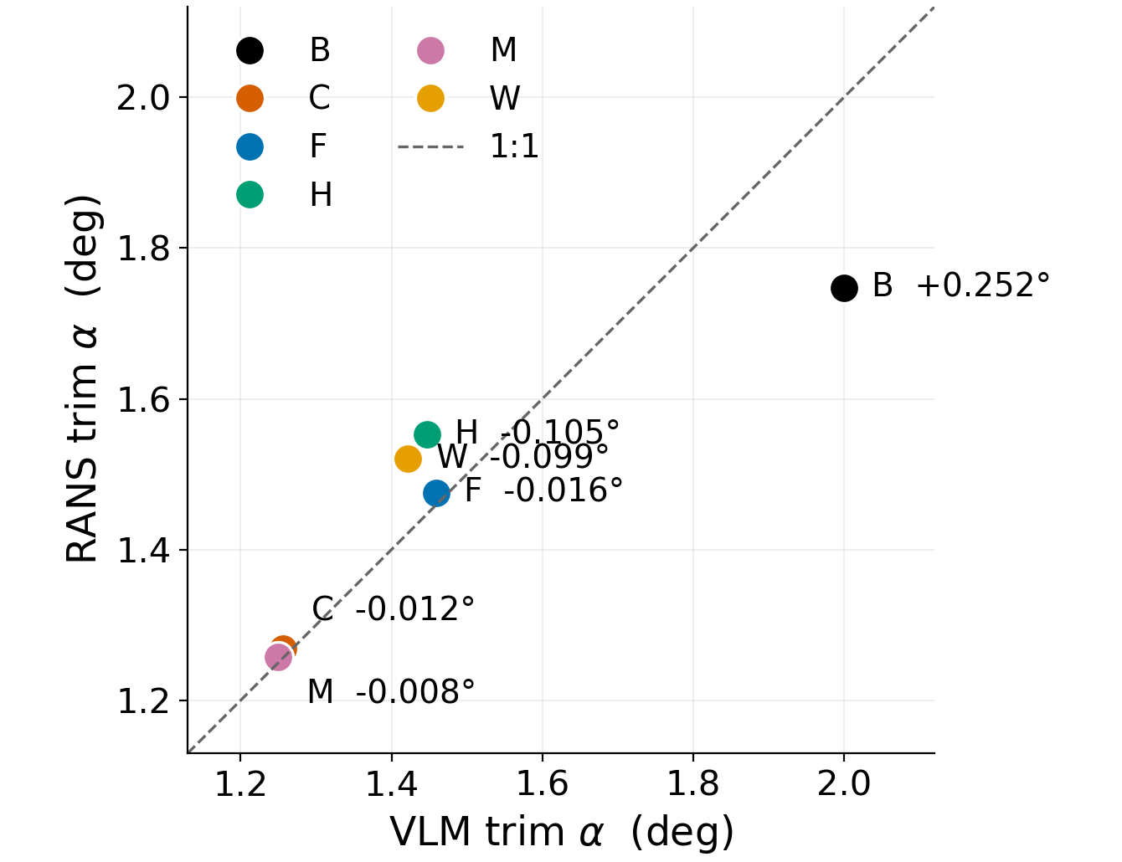
Trim angle at the Condition CR target lift
VLM matches the RANS trim angle within 0.11 degrees on every candidate.
The baseline deck is the outlier, +0.25 degrees from the RANS.
Same target lift on both sides, so no conversion enters.
ID | α RANS (deg) | α VLM (deg) | Δα (deg)
B | 1.7476 | 1.9998 | +0.2522
C | 1.2683 | 1.2565 | -0.0118
F | 1.4755 | 1.4594 | -0.0161
H | 1.5523 | 1.4470 | -0.1053
M | 1.2574 | 1.2497 | -0.0077
W | 1.5205 | 1.4219 | -0.0986
Notes:
Trim angle is the closest agreement in the whole comparison: on the five candidates the VLM lands within 0.11 degrees of the RANS incidence at the same target lift. The baseline deck is the outlier at +0.25 degrees, and that is the one deck whose aerofoil lineage differs from the candidates', so the candidates agree with each other better than the baseline agrees with itself across methods. Through the fitted RANS lift slope, 0.11 degrees is about 2.1 per cent of the target lift. If asked why the baseline is the outlier: lineage of that one deck, not the method.

Slide 13
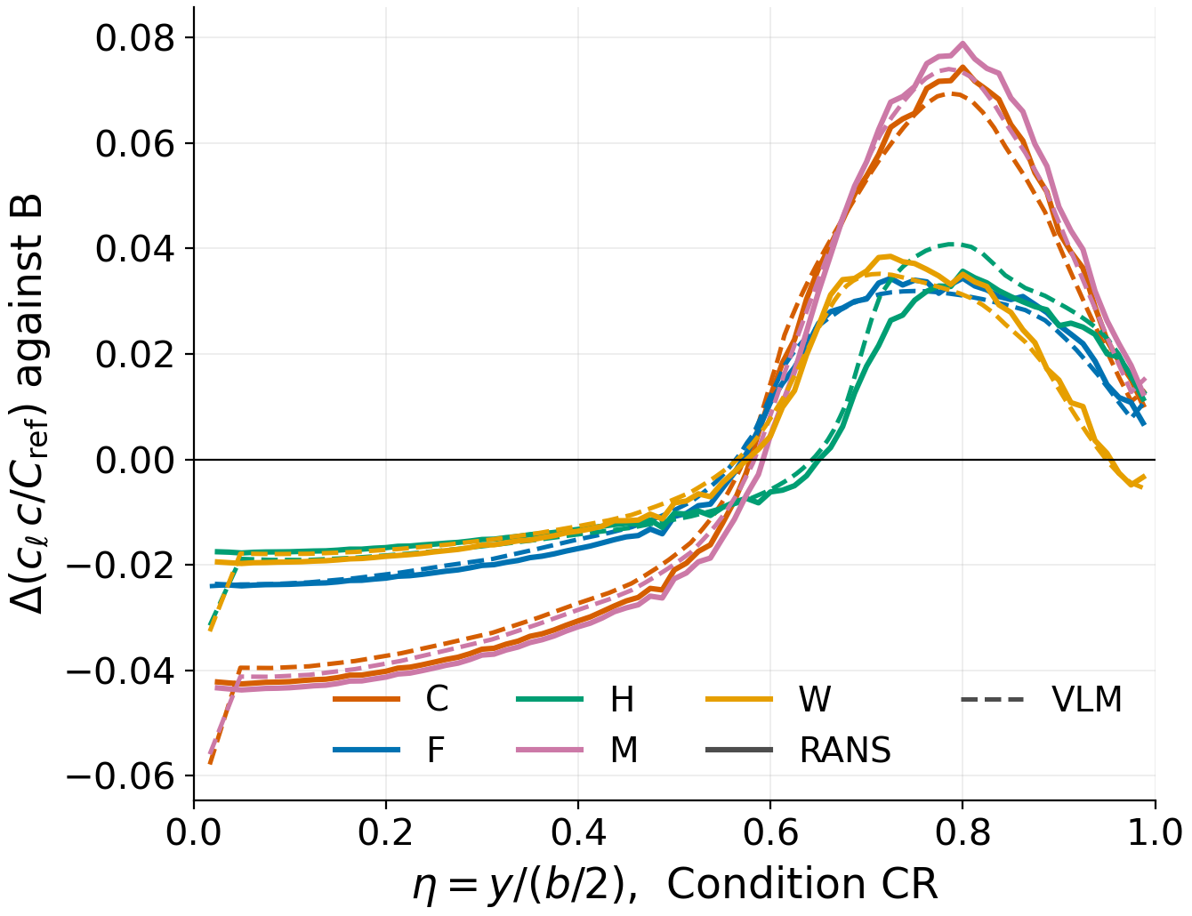
Spanwise load, Condition CR
The VLM puts the load change where the RANS puts it.
R.m.s. difference 4.3 to 9.5 per cent of the peak change.
The station of peak change agrees within 0.05 in η.
ID | RANS peak Δ at η | VLM peak Δ at η | r.m.s., % of peak
C | 0.074 at 0.80 | 0.069 at 0.79 | 4.6
F | 0.034 at 0.80 | 0.032 at 0.75 | 4.5
H | 0.036 at 0.80 | 0.041 at 0.79 | 9.5
M | 0.079 at 0.80 | 0.074 at 0.79 | 4.3
W | 0.039 at 0.72 | 0.035 at 0.71 | 5.5
Notes:
Candidate minus baseline, each method against its own baseline, so what is compared is the shape of the load change. The VLM puts it in the same place: the peak change sits at eta 0.80 in the RANS and within 0.05 of that in the VLM on every candidate, and the root-mean-square difference between the two curves is 4 to 9 per cent of the peak. The change is negative inboard and positive outboard, as an aft-loading morph over the outer span must be. If asked about the inboard end: both methods lose a strip at the root and the first point is not resolved.

Slide 14
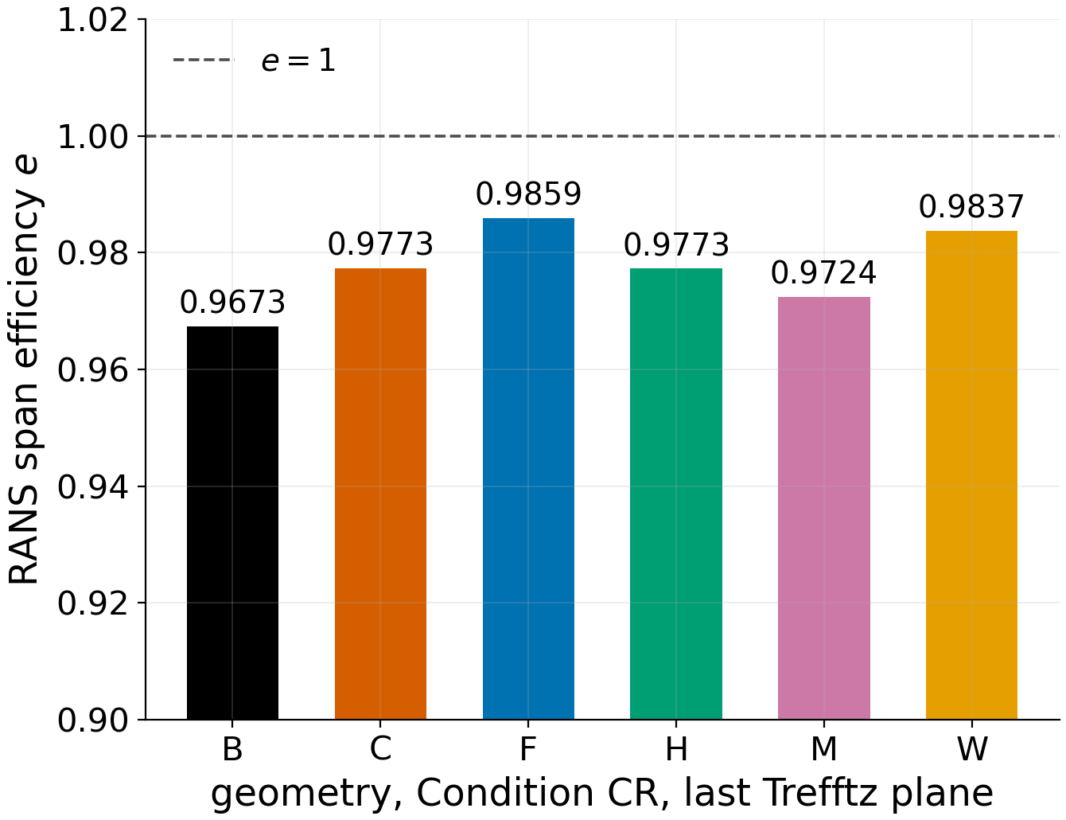
Induced drag and span efficiency, Condition CR
Far-field VLM and RANS agree on the level, 0.94 to 0.99.
Near-field VLM does not: 0.57 to 0.59 on the same runs.
RANS e spans 0.9673 to 0.9859, every one below 1.
ID | VLM E, near field (surface) | VLM E_{w}, far field (wake) | RANS e, last plane
B | 0.5907 | 0.9394 | 0.9673
C | 0.5865 | 0.9627 | 0.9773
F | 0.5733 | 0.9721 | 0.9859
H | 0.5679 | 0.9605 | 0.9773
M | 0.5847 | 0.9595 | 0.9724
W | 0.5699 | 0.9701 | 0.9837
Notes:
The VLM writes two induced drags: a near-field surface integration and a far-field wake integral, and they are the same physical quantity computed two ways. On the far-field column the VLM span efficiency is 0.94 to 0.97 and the RANS Trefftz value 0.97 to 0.99, the same level; on the near-field column the VLM reads 0.57 to 0.59, which is not a physical span efficiency for this planform. The RANS value is the wake integral at the last of four planes, and it decays downstream, so the spread across planes is its uncertainty. If asked which VLM column to believe: the far-field one, and the ordering slide shows why.

Slide 15
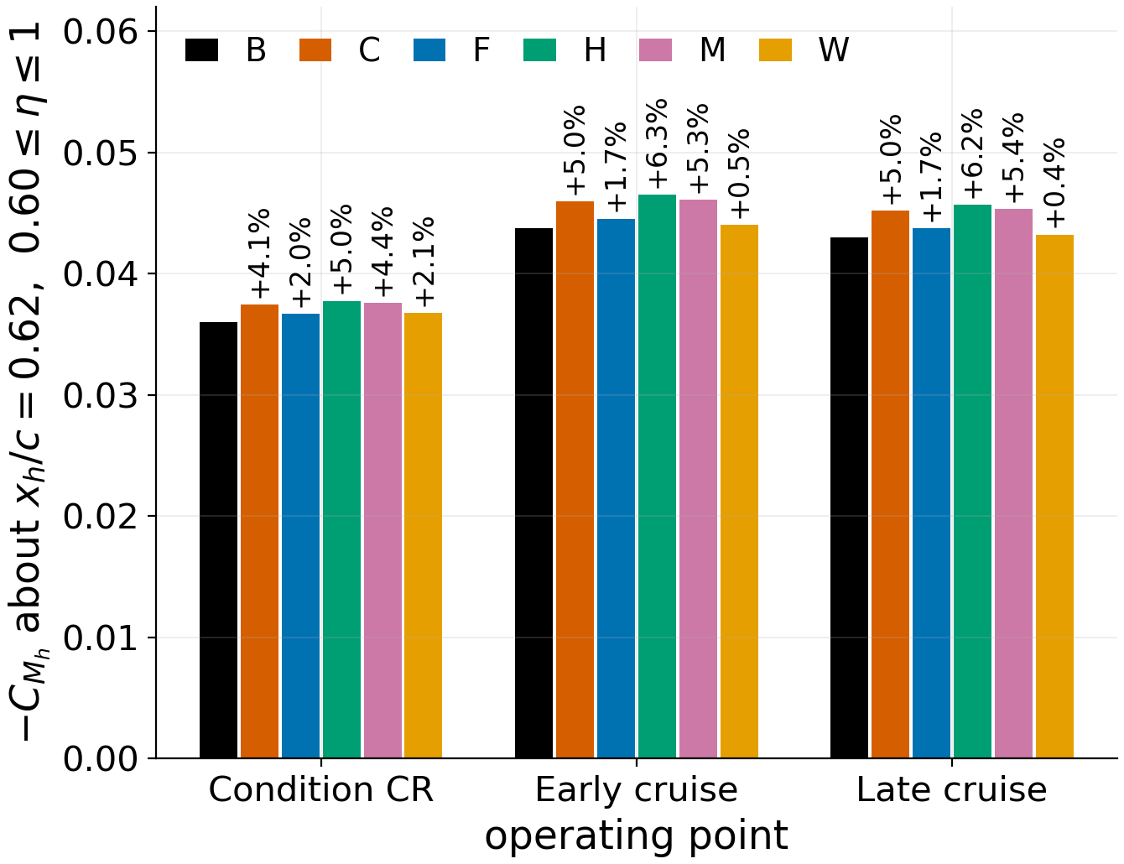
Hinge moment about x/c = 0.62, outer span
Every candidate raises the hinge moment, 0.4 to 6.3 per cent.
The VLM cannot produce this quantity at all.
H's and W's rows are comparisons, not their actuator loads.
ID | Δ % Condition CR | Δ % early cruise | Δ % late cruise | Actuator load?
C | +4.1 | +5.0 | +5.0 | yes
F | +2.0 | +1.7 | +1.7 | yes
H | +5.0 | +6.3 | +6.2 | no, hinge at 0.70
M | +4.4 | +5.3 | +5.4 | yes
W | +2.1 | +0.5 | +0.4 | no, twist about 0.25
Notes:
Hinge moment integrated about a common line at 62 per cent chord over the outer forty per cent of span, at every operating point. Every candidate raises it, by 0.4 to 6.3 per cent, and the VLM has no such quantity. The last column is load-bearing: C, F and M actuate on this line, so their rows are their actuator moments; H's hinge is at 70 per cent and W is not hinged at all, so their rows are valid comparisons on a shared line and nothing else. H's and W's own actuator loads, a hinge moment about 0.70 and a torsional moment about the quarter chord over the whole section, are on the next slide.

Slide 16
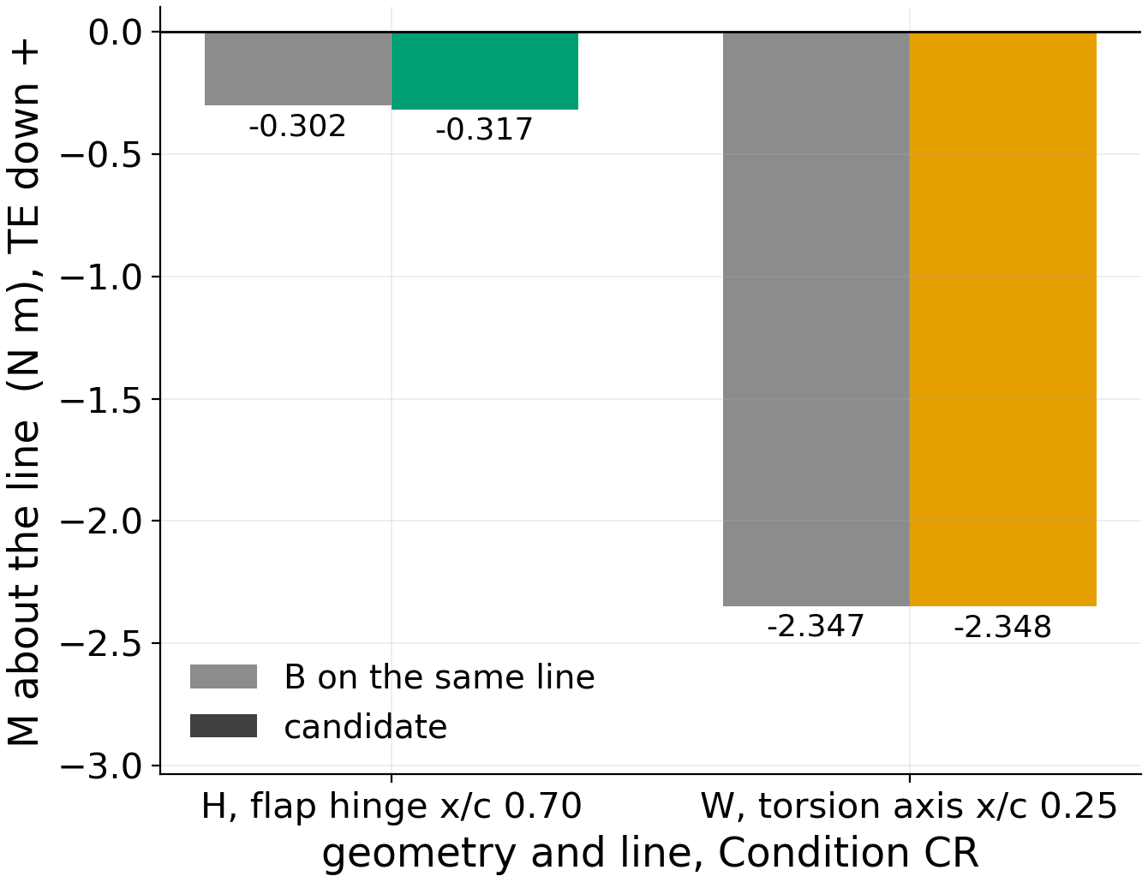
Actuator loads on their own lines: H and W
H's flap hinge at x/c 0.70: -0.317 N m, +5.1% against B.
W's torsion about x/c 0.25: -2.35 N m, +0.0% against B.
Current Condition CR evaluation, same gates and integrator as the common line.
Geometry, line | M (N m) | B on that line | Δ |M| %
H, flap 0.70, η 0.71 to 0.97 | -0.317 | -0.302 | +5.1
W, torsion 0.25, η 0.61 to 1 | -2.348 | -2.347 | +0.0
Notes:
These are the two loads the common-line table cannot give. H's flap hinges at 70 per cent chord over eta 0.71 to 0.97, so its actuator reacts -0.317 newton metres there, +5.1 per cent against the baseline integrated on the same line. W is not hinged: its twist mechanism rotates the whole section about the quarter chord over eta 0.61 to the tip, and the torsional moment it reacts is -2.35 newton metres, +0.0 per cent against the baseline. These sit on the current Condition CR evaluation, the one the drag and trim-angle slides use, with the same frame and orientation gates and the same integrator as the common line, generalised only to put the axis and the selected chord where each mechanism has them; the route reproduced each case's committed common-line value before either new line was evaluated. The sign convention is trailing-edge down positive throughout.

Slide 17
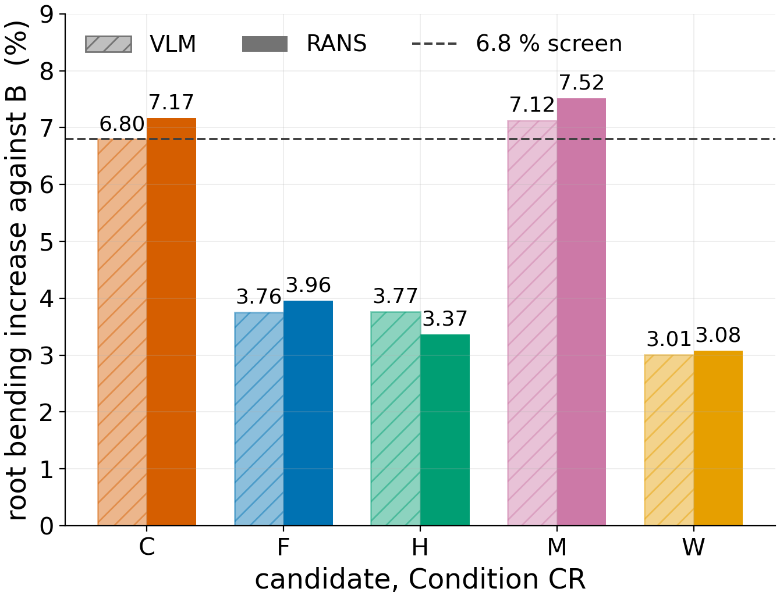
Root bending moment, Condition CR
VLM and RANS agree on root bending within 0.4 percentage points.
C passes the 6.8% screen in the VLM, fails it in RANS.
M exceeds the screen in both methods.
ID | VLM % | RANS % | Difference (pp)
C | +6.796 | +7.170 | +0.37
F | +3.755 | +3.960 | +0.20
H | +3.769 | +3.368 | -0.40
M | +7.124 | +7.519 | +0.40
W | +3.010 | +3.079 | +0.07
Notes:
Root bending is the constraint the June selection was screened on, at 6.8 per cent above the baseline. The two methods agree to 0.4 percentage points on every candidate, so what follows is a property of the shapes, not of the method. C sits at +6.796 per cent in the VLM, inside the screen by 0.004 points, and at +7.170 in the RANS, outside it; M is outside in both. If asked whether this changes the selection: it means the constraint that selected C is not satisfied viscously, and that is a finding, not a mesh question.

Slide 18
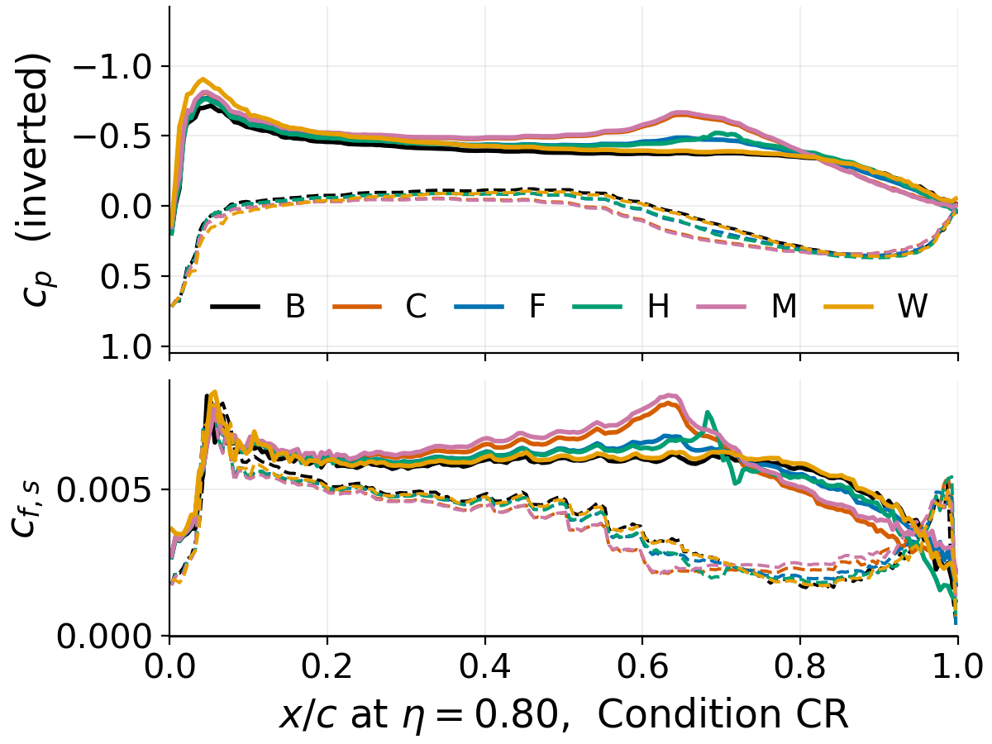
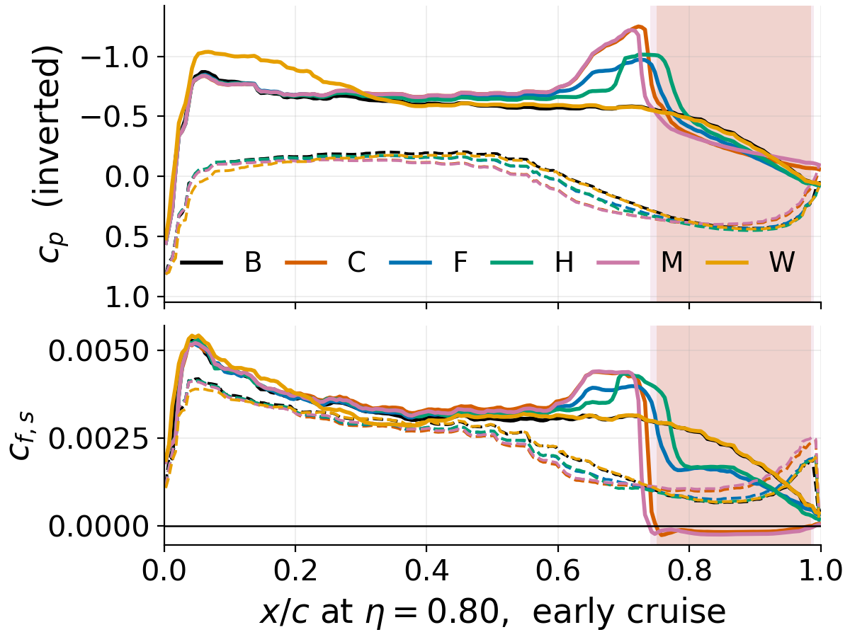
Surface pressure and skin friction at η = 0.80
Nothing separates at Condition CR: largest reversed upper fraction 0.02 per cent.
Cruise, η 0.80: C and M separate; F, H do not.
Notes:
The same station at both conditions, pressure above and signed skin friction below, upper surface solid and lower dashed. At Condition CR nothing separates anywhere: the largest reversed fraction on any upper surface is 0.02 per cent of faces and those sit at the blunt trailing edge. At early cruise, and again at late cruise, C and M go through zero behind the shock and stay there to the trailing edge. The sign of the skin friction is the useful part: it is the sign change that locates separation, never the magnitude, and the sign is calibrated per case.

Slide 19
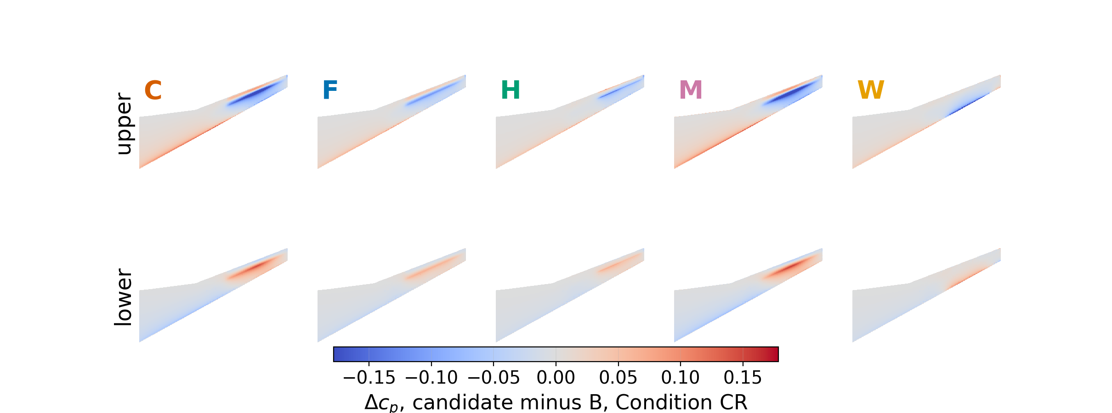
Surface Δc_{p} against the baseline, Condition CR
Candidate minus B on one shared scale, ±0.18 at the 99.5th percentile.
Suction gain above and pressure gain below over the morphed outer span.
Notes:
Each panel is candidate minus baseline on the wing itself, upper surface above and lower surface below, on one shared scale so the five are comparable by eye. The difference lives on a common span and chord-fraction grid, because two separately meshed wings share no cells, and is painted back onto the planform. Blue is a suction gain on the upper surface, red a pressure gain on the lower, and both sit exactly where the surfaces move: over the outer span, aft of the hinge. M is the largest change and H the smallest, measured by the RMS pressure change over the wing. If an experimentalist asks where to put taps: along the hinge line at eta 0.7 to 0.9, above and below.

Slide 20
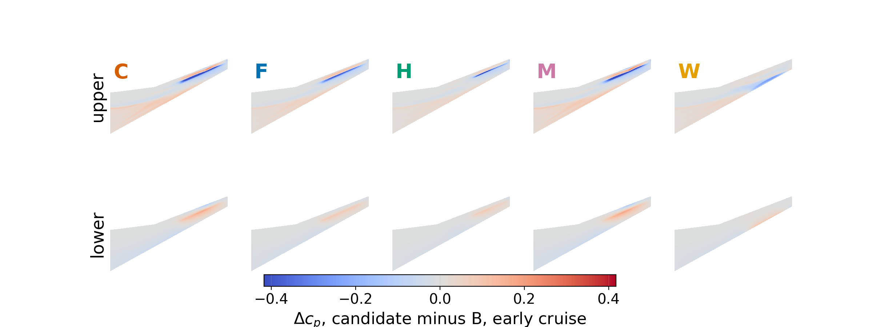
Surface Δc_{p} against the baseline, early cruise
Candidate minus B on one shared scale, ±0.42 at the 99.5th percentile.
Suction gain above and pressure gain below over the morphed outer span.
Notes:
Each panel is candidate minus baseline on the wing itself, upper surface above and lower surface below, on one shared scale so the five are comparable by eye. The difference lives on a common span and chord-fraction grid, because two separately meshed wings share no cells, and is painted back onto the planform. Blue is a suction gain on the upper surface, red a pressure gain on the lower, and both sit exactly where the surfaces move: over the outer span, aft of the hinge. C and M are the largest changes and W the smallest, measured by the RMS pressure change over the wing. If an experimentalist asks where to put taps: along the hinge line at eta 0.7 to 0.9, above and below.

Slide 21
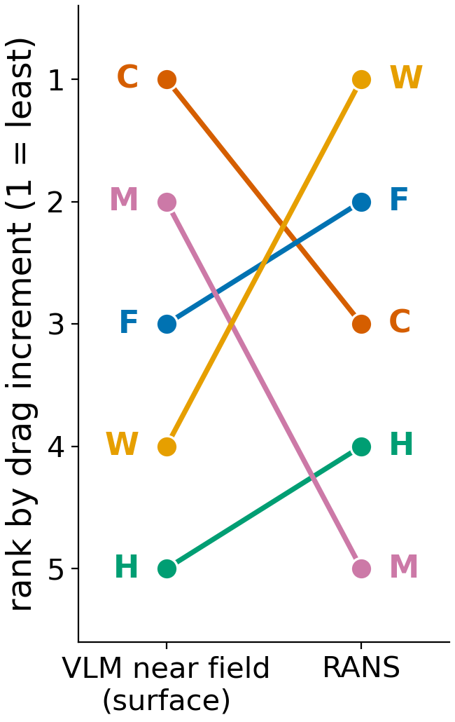
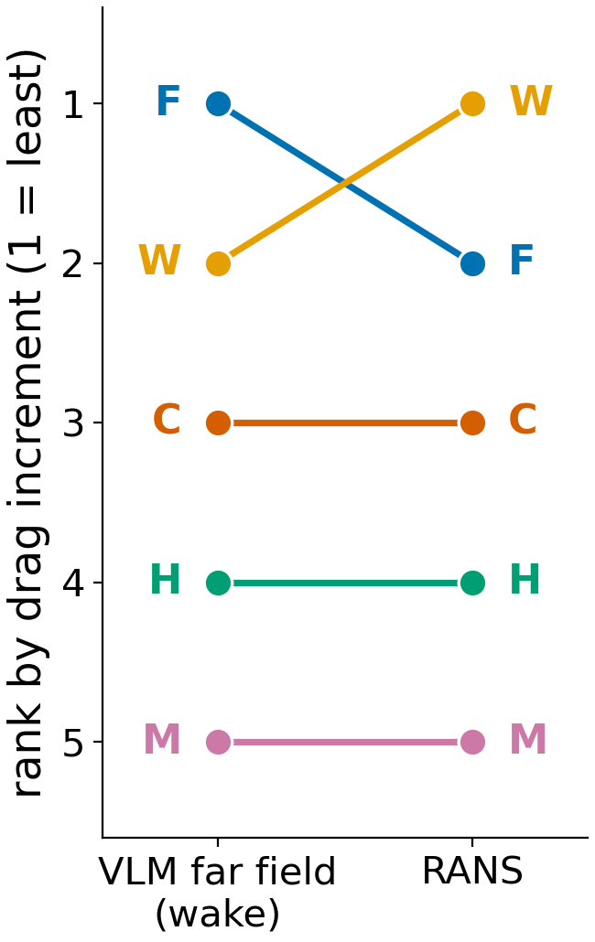
Ordering: does the VLM rank the candidates?
Far field reproduces the RANS order, 9 pairs of ten.
Near field does not, 4 pairs of ten concordant.
The one far-field error is the closest pair, 0.053 counts apart.
ID | RANS rank | Near field (surface) | Far field (wake)
C | 3 | 1 | 3
F | 2 | 3 | 1
H | 4 | 5 | 4
M | 5 | 2 | 5
W | 1 | 4 | 2
Kendall τ |  | -0.20 | +0.80
Notes:
Rank one is the least drag increment. On its far-field column the VLM reproduces the RANS order to 9 pairs of ten, Kendall tau +0.80, and its one error is F against W, which the RANS separates by 0.053 counts, the narrowest gap in the field and at the edge of what the convergence gate resolves. On the near-field column, the metric the June selection was made on, it gets 4 of ten and tau -0.20: it groups C and M as cheap and the rest as expensive, and the viscous answer is close to the reverse. If asked why one column ranks and the other does not: the far-field errors are all one sign and within a quarter count of each other, so they move the field together.

Slide 22
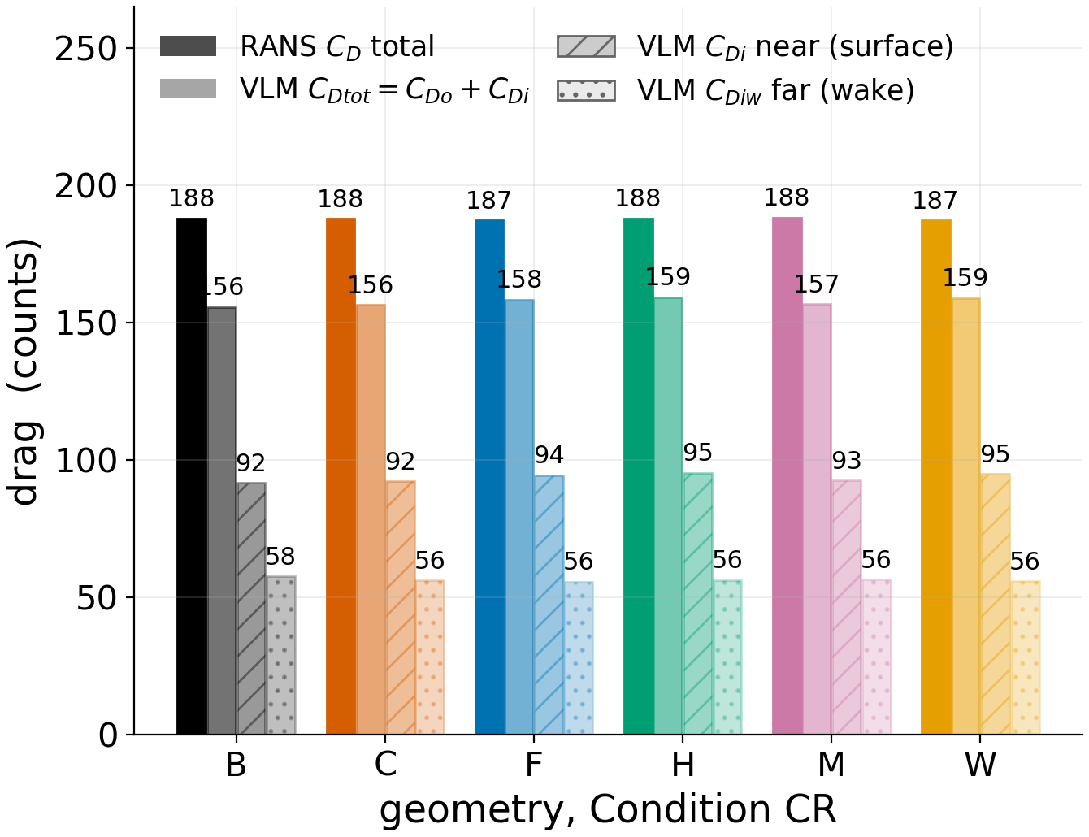
Magnitude: does the VLM price the candidates?
Far-field increments sit a near-constant 1.2 counts below the RANS increments.
Remove that one offset and the candidates agree within 0.25 counts.
Near-field errors span 0.7 to 4.2 counts, wrong sign on four.
Absolute pricing needs that offset, which only RANS supplies.
ID | RANS ΔC_{D} | Far ΔC_{Diw} | Far minus offset | Residual
C | -0.191 | -1.392 | -0.196 | -0.01
F | -0.815 | -1.938 | -0.743 | +0.07
H | -0.009 | -1.266 | -0.071 | -0.06
M | +0.232 | -1.209 | -0.014 | -0.25
W | -0.868 | -1.823 | -0.627 | +0.24
Notes:
The figure shows what each method contains: the RANS total beside the VLM's total, which is a flat-plate friction estimate plus induced drag, and beside its two induced-drag columns; the two bar heights are never differenced. The table is the increments. The far-field increments are all 0.95 to 1.44 counts below the RANS ones, a near-constant offset of 1.20, and once that one offset is removed the five candidates agree within 0.25 counts, so the far field gets the differences between candidates right and misses only the level. The near-field errors span a factor of six and get the sign wrong on 4 of five, so that column prices nothing. If asked where the offset comes from: it is the profile-drag increment the VLM has no mechanism to produce, which is why RANS supplies the level.

Slide 23
Verdict
The VLM orders candidates on its far-field column, 9 pairs of ten.
Far-field increments hold to 0.25 counts after one common 1.2-count offset.
At cruise W saves; C, M pay 12 to 15 counts.
Every candidate raises the hinge moment; C fails the root-bending screen viscously.
Notes:
Candidate search can stay with the VLM provided it selects on the far-field column, the one the design study adopted in August and not the one the June selection used. On that column the differences between candidates are right to a quarter count once a single offset of about 1.2 counts is applied, and that offset comes from RANS. At cruise the study's current selection holds: W, F and H are the three cheapest at both cruise points, W the only one below the baseline, and the two strong-camber shapes from the July selection pay twelve to fifteen counts for a shock no induced-drag column can see. On loads, every candidate raises the hinge moment and the root-bending constraint that selected C is not satisfied viscously. If asked what to do: carry W forward, and compute its torsional actuator moment before committing to it.

Slide 24
Thank you
Tyler Buchanan | questions
Notes:
Backup slides follow: cell counts, the convergence gate, trim residuals, the wall-modelled question and the skin-friction surface maps. The report behind every number is the all-geometry report of 15 September, regenerated by script. Every table and figure here reads the same files.

Slide 25
Backup: cell counts
Condition CR: 99.1 to 99.2 million cells; cruise: 73.6 to 73.8 million.
ID | Concept | Triangles | Condition CR (M) | Early cruise (M) | Late cruise (M) | Surface gate
B | rigid baseline | 192588 | 99.11 | 73.64 | 73.67 | pass
C | continuous TE camber | 192588 | 99.17 | 73.70 | 73.73 | pass
M | continuous TE camber | 192588 | 99.21 | 73.73 | 73.75 | pass
F | continuous TE camber | 195266 | 99.15 | 73.66 | 73.68 | pass
W | distributed twist | 195266 | 99.20 | 73.67 | 73.69 | pass
H | conventional hinged | 195266 | 99.12 | 73.67 | 73.69 | pass
Notes:
Cell counts per geometry. Within a condition the six meshes agree to a tenth of a per cent or two, so every candidate-minus-baseline difference is taken between meshes of one size. The gap between 99.1 to 99.2 million and 73.6 to 73.8 million is the prism stack. The surface gate is surfaceCheck on the case copy: zero open edges, one zone, one orientation, on every surface.

Slide 26
Backup: the convergence gate
Verdict: CONVERGED, 55 of 55.
Term | Threshold | Achieved over the 55 | Median
Window W | 200 samples | 200 on all 55 | 200
C_d drift | ≤ 0.05 ct | 0.0000 to 0.0130 | 0.0012
C_l drift | ≤ 1.0 ct | 0.0004 to 0.2590 | 0.0615
C_l span | ≤ 1.0 ct | 0.0008 to 0.5374 | 0.1068
Verdict | all three terms | CONVERGED, 55 of 55 | n/a
Notes:
The gate every case had to pass: a two-hundred-sample window, drag drift within ≤ 0.05 ct, lift drift and span within ≤ 1.0 ct. Drift is the difference of the two half-window means and span the first-to-last excursion. Residual targets are set below anything the solve reaches, so the run ends at endTime and this gate decides.

Slide 27
Backup: trim residuals
Every trim sits within 0.90 counts of C_{L} of its target.
ID | Condition CR | Early cruise | Late cruise
B | -0.094 | +0.194 | +0.537
C | -0.005 | -0.305 | +0.752
F | -0.039 | -0.017 | -0.220
H | -0.039 | +0.087 | -0.372
M | +0.001 | +0.380 | +0.545
W | -0.037 | -0.565 | -0.895
Notes:
Lift residual of every trim case in counts of lift coefficient, target minus achieved. The largest is 0.90 counts, and through each family's own drag slope the drag bias that implies is below a tenth of a count everywhere. The increments on the results slides are quoted at the achieved lift, not corrected, because the correction is smaller than the gate.

Slide 28
Backup: the wall-modelled question
Surface cell 0.488 mm at level 11, identical for both conditions.
Prism stack: 11 layers from 4.5 µm against 5 from 43.7 µm.
Design y⁺ at the cell centre: 0.270 wall resolved, 40.1 wall modelled.
That stack alone explains 99 to 99 versus 74 to 74 million.
Notes:
The surface cell is set by the 1.03 mm blunt trailing edge, level 11 at 0.488 mm, identically for both conditions. Only the prism stack differs: 11 layers at 4.5 microns wall resolved against 5 at 43.7 microns wall modelled, which is the whole of the 99 against 74 million difference. Cruise is wall modelled by design: skin friction cancels between the members of a morph pair, and Spalart-Allmaras is the stronger model on the drag rise. If asked whether the separation extent at cruise depends on that: the sign of the finding is robust and the extent is a Spalding-law reconstruction, and I would re-measure it with a narrower band before publication.

Slide 29
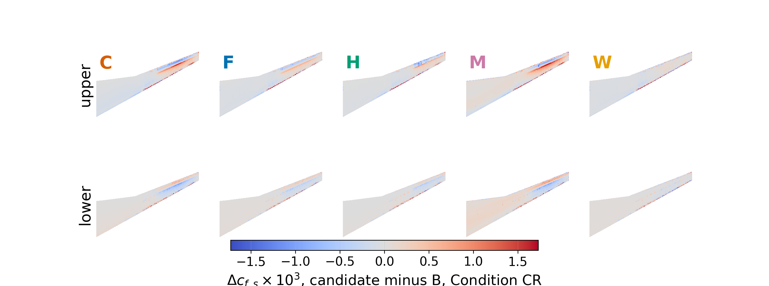
Backup: surface Δc_{f,s} against B, Condition CR
Candidate minus B, ±1.7 × 10⁻³ at the 99.5th percentile.
Notes:
Signed skin friction, candidate minus baseline, on the same grid and planform as the pressure maps. Negative is a loss of streamwise shear, which at cruise on C and M is the separated region behind the shock; at Condition CR nothing reverses and the map shows only the redistribution under the morph. The scale is small, a few parts in ten thousand, which is why it is a backup.

Slide 30
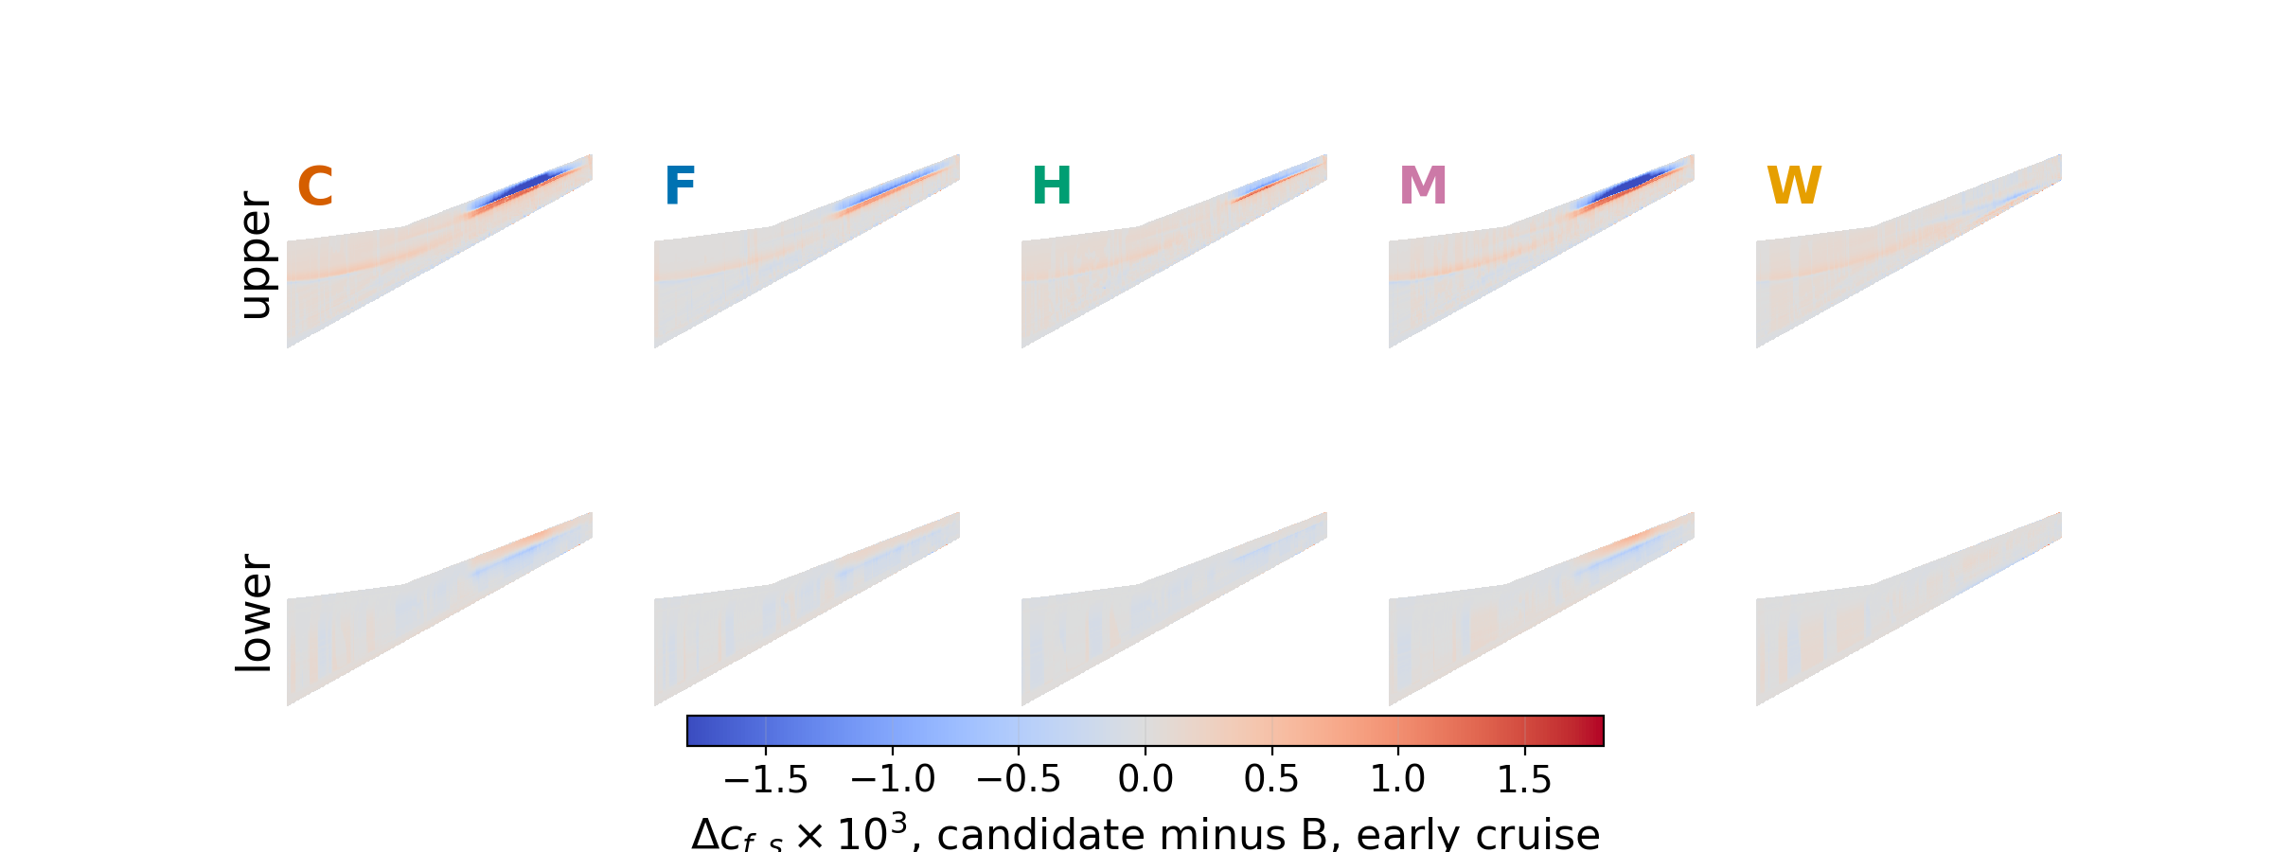
Backup: surface Δc_{f,s} against B, early cruise
Candidate minus B, ±1.8 × 10⁻³ at the 99.5th percentile.
Notes:
Signed skin friction, candidate minus baseline, on the same grid and planform as the pressure maps. Negative is a loss of streamwise shear, which at cruise on C and M is the separated region behind the shock; at Condition CR nothing reverses and the map shows only the redistribution under the morph. The scale is small, a few parts in ten thousand, which is why it is a backup.

