Slide 1
Server startup Log Monitoring system
Team Avengers
Nithyananda Kamath
Shambhu Kumar
Vanita Singh
Balaji Rajan

Slide 2
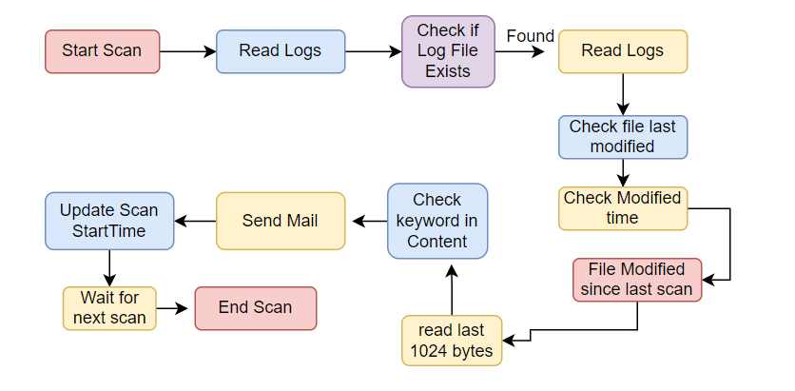
Solution Approach
1. Overall Idea:
- The LogScanner is a Java program designed to scan a log file for changes and notify recipients via email if specific messages like "fail" or "error" are found.
2. Solution Outline:
- The program continuously monitors the log file, checking for modifications at regular intervals.
- It reads the last portion of the log file to minimize processing time and avoid redundant checks.
- If the log file has been modified and contains the specified keyword, an email notification is sent.
3. Program Modularity:
- The LogScanner class is modular, allowing easy extension and integration into existing projects.
- It separates the logic for file scanning, keyword matching, and email sending into distinct methods.
4. Configurability and Parametric:
- The program offers configurability through constants like LOG_FILE_PATH, SCAN_INTERVAL_MS, MAX_SCAN_DURATION_MS, and SEARCH_KEYWORD.
- These constants can be adjusted to adapt the program to different log file locations, scan intervals, time limits, and keywords.
5. Output:
- The program outputs email notifications when the specified keyword is found in the log file.

Slide 3
LogScanner - Summary and Benefits
1. Mechanism:
- The LogScanner employs a continuous monitoring mechanism to scan log files for changes.
- It utilizes file size and modification time checks to identify recent updates efficiently.
- The program reads the last portion of the log file and checks for specific keywords.
2. Benefits:
- Automates log file monitoring, reducing the need for manual checks.
- Provides timely alerts by sending email notifications when errors or failures occur.
- Minimizes resource usage by reading only the necessary portion of the log file.
- Offers flexibility through configuration options to suit various environments.
- Enhances modularity, making it easy to integrate the LogScanner into existing systems.
3. Use Cases:
- Log file monitoring in production environments.
- Error tracking and notification in critical systems.
- Enhancing proactive system maintenance and debugging processes.
4. Conclusion:
- The LogScanner simplifies log file monitoring and enhances system monitoring capabilities.
- It enables prompt response to critical events, reducing downtime and enhancing system reliability.
5. Next Steps:
- Consider integrating the LogScanner into your existing systems.
- Customize the configuration parameters to meet your specific requirements.
- Explore further enhancements such as advanced keyword matching or integration with log analysis tools.- Enhances modularity, making it easy to integrate the

Slide 4
THANK YOU
Team Avengers

