Slide 1
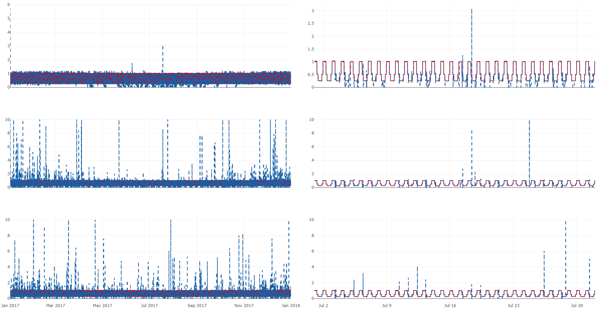
Use case 1- air infiltration
Ground truth
Inverse solution
Solved with temperature
Solved with humidity ratio
Solved with CO₂ concentration
Annual results
Monthly results

Slide 2
Air infiltration - use case 1
Ground truth
Inverse solution
Solved with temperature
Solved with humidity ratio
Solved with CO₂ concentration
Annual results
Monthly results

Slide 3
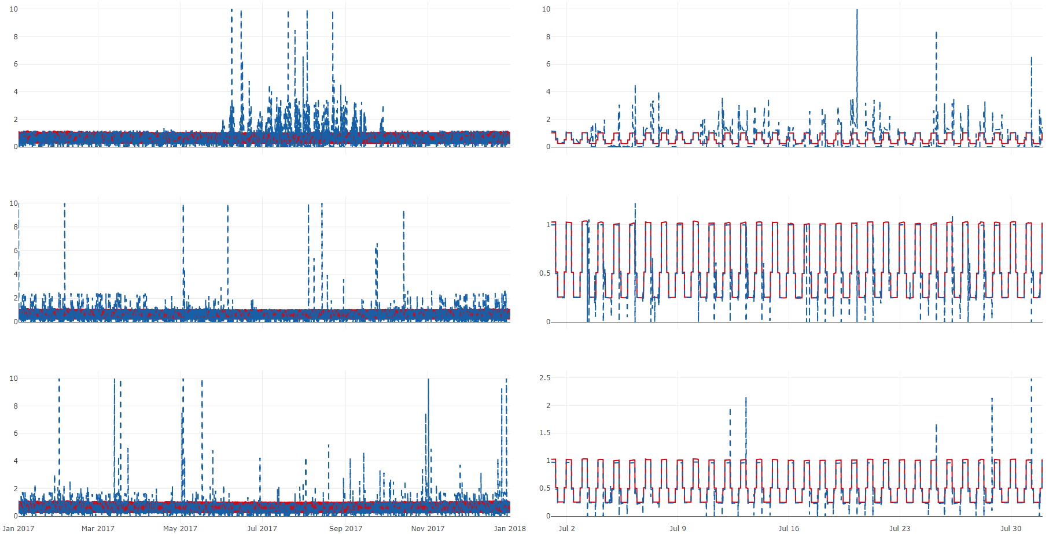
Air infiltration – use case 2
Ground truth
Inverse solution
Solved with temperature
Solved with humidity ratio
Solved with CO₂ concentration
Annual results
Monthly results

Slide 4
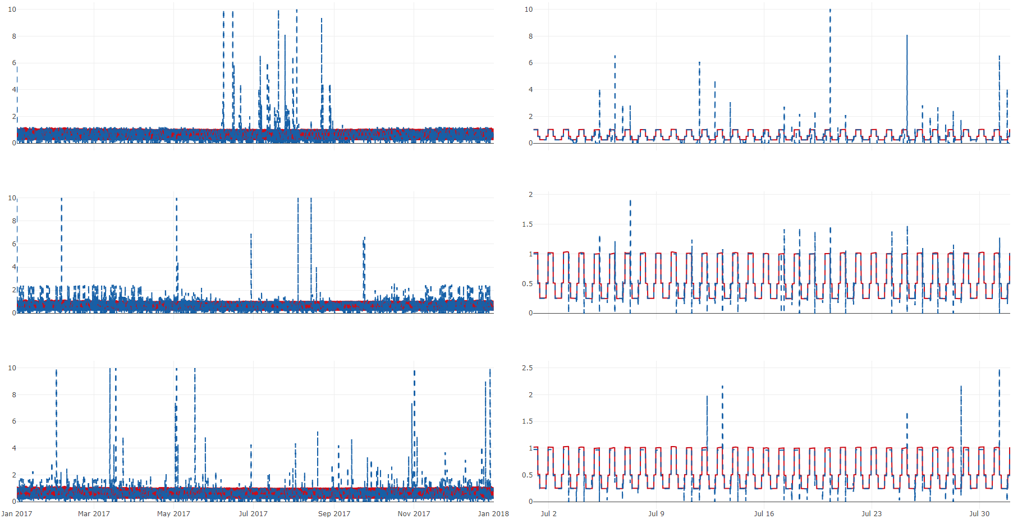
Air infiltration – use case 3
Ground truth
Inverse solution
Solved with temperature
Solved with humidity ratio
Solved with CO₂ concentration
Annual results
Monthly results

Slide 5
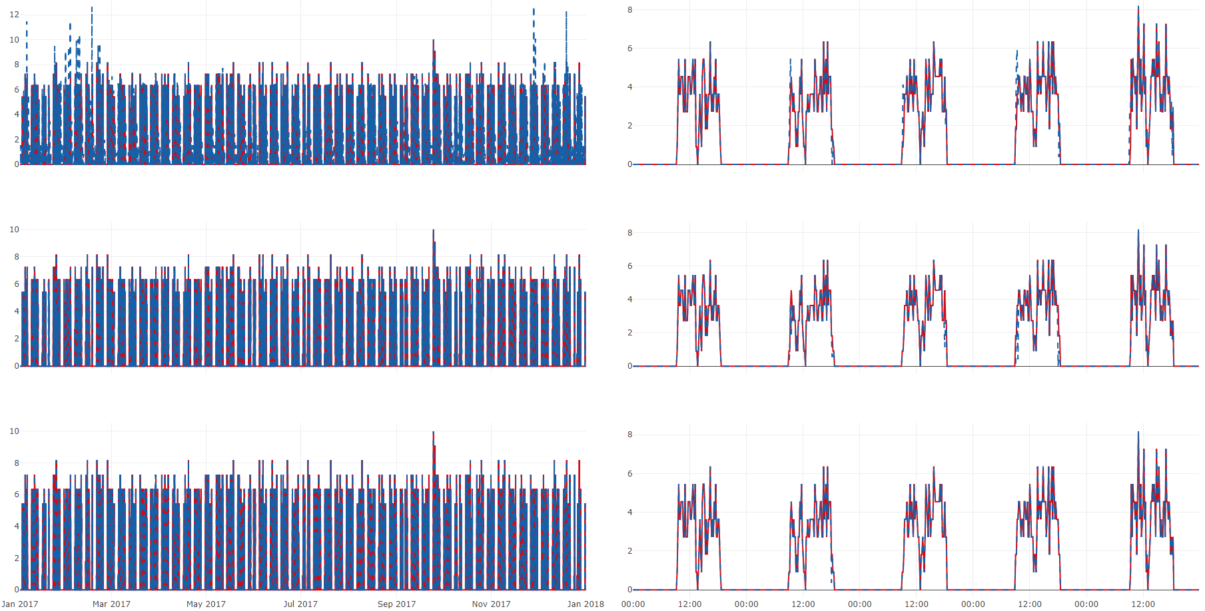
People count – use case 1
Ground truth
Inverse solution
Solved with temperature
Solved with humidity ratio
Solved with CO₂ concentration
Annual results
Weekly results

Slide 6
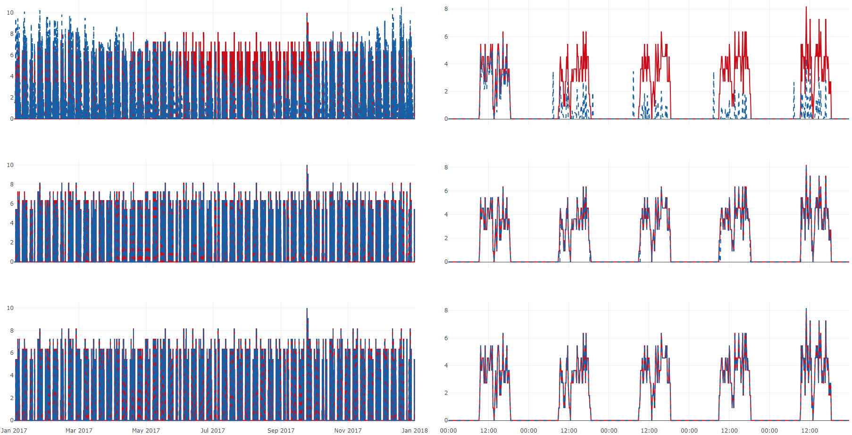
People count – use case 2
Ground truth
Inverse solution
Solved with temperature
Solved with humidity ratio
Solved with CO₂ concentration
Annual results
Weekly results

Slide 7
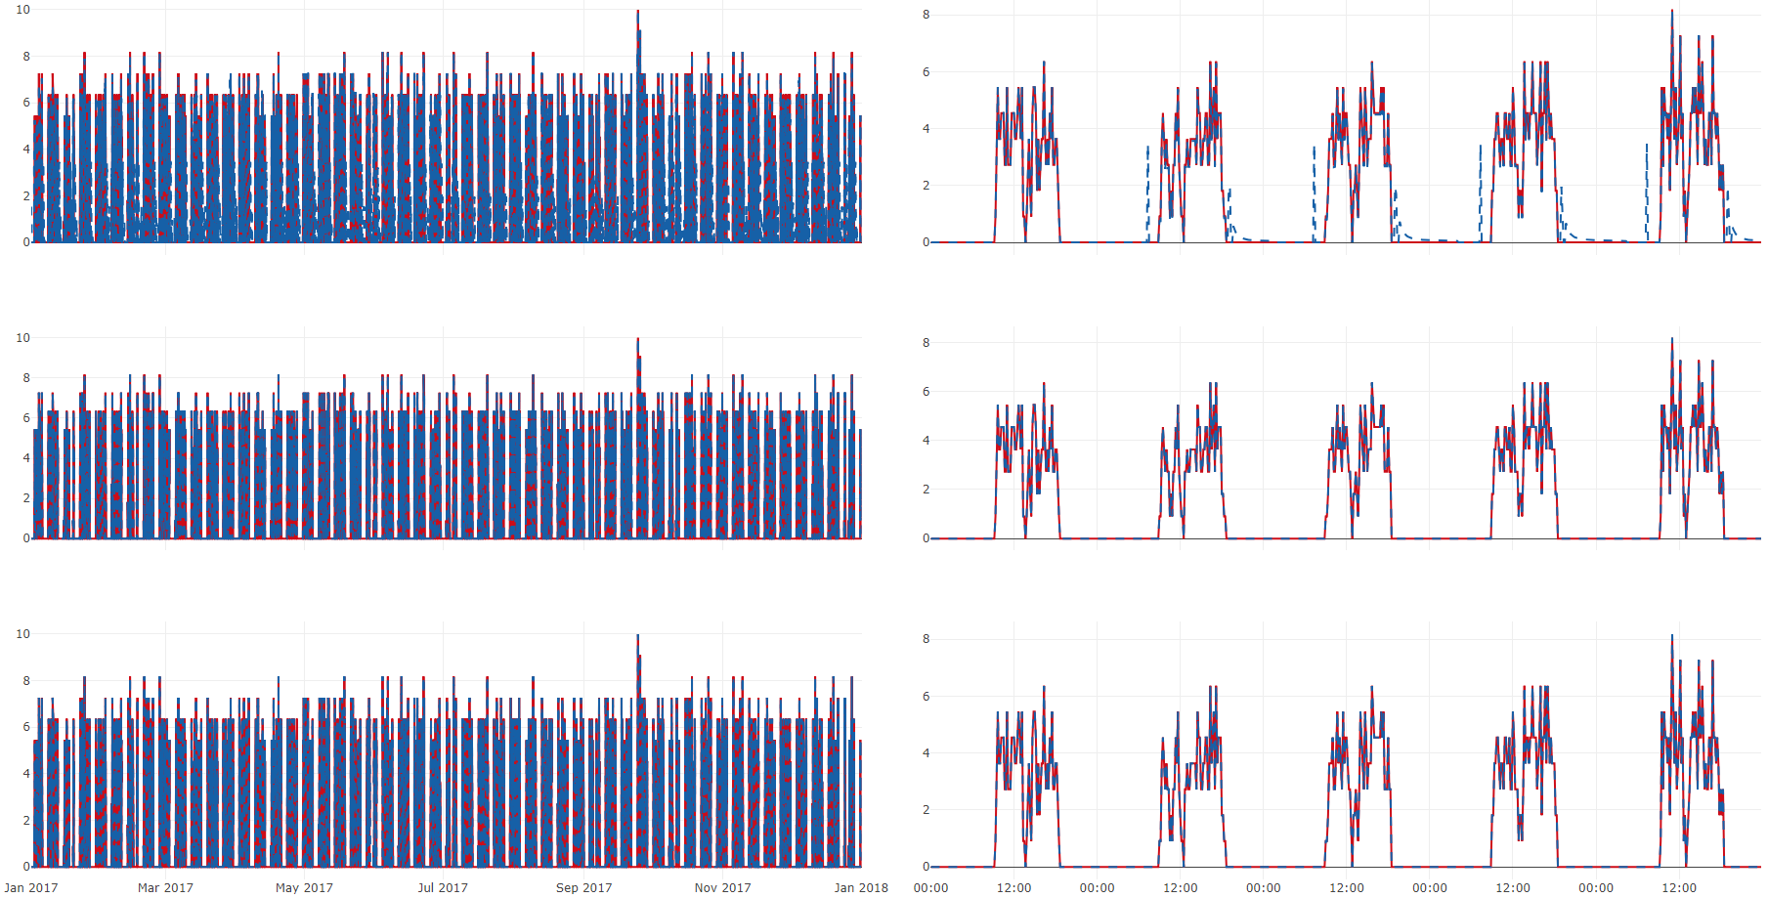
People count – use case 3
Ground truth
Inverse solution
Solved with temperature
Solved with humidity ratio
Solved with CO₂ concentration
Annual results
Weekly results

