Slide 1
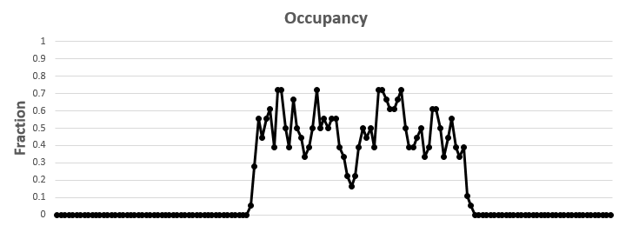
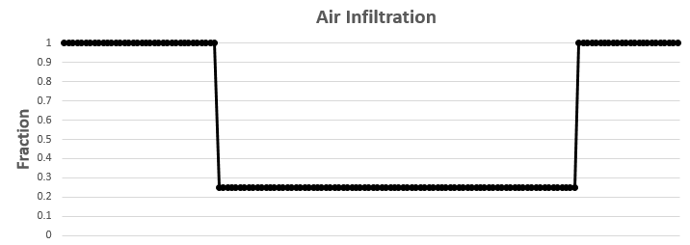
0
12
24
Hour of day
0
12
24
Hour of day

