Slide 1
Finance Tracker
Project By: Aryan, Darsh, Prakash

Slide 2
App.py
from flask import Flask, render_template, request, redirect, url_for, session, flash,jsonify
from datetime import datetime
import sqlite3
from collections import defaultdict
app = Flask(__name__)app.secret_key = 'your_secret_key'
# SQLite database setupDATABASE = 'finance_tracker.db'
def init_db(): conn = sqlite3.connect(DATABASE) c = conn.cursor() c.execute(''' CREATE TABLE IF NOT EXISTS users ( id INTEGER PRIMARY KEY AUTOINCREMENT, username TEXT NOT NULL, email TEXT NOT NULL, phone TEXT NOT NULL, password TEXT NOT NULL ) ''') c.execute(''' CREATE TABLE IF NOT EXISTS transactions ( id INTEGER PRIMARY KEY AUTOINCREMENT, user_id INTEGER NOT NULL, amount REAL NOT NULL, category TEXT NOT NULL, date TEXT NOT NULL, description TEXT, payment_method TEXT NOT NULL, FOREIGN KEY (user_id) REFERENCES users (id) ) ''') conn.commit() conn.close()
init_db()

Slide 3
Login
<form action="{{ url_for('login') }}" method="post">
<div class="mb-3">
<label for="username" class="form-label"> Username: </label>
<input type="text" id="username" name="username" class="form-control" required>
</div>
<div class="mb-3">
<label for="password" class="form-label">Password:</label>
<input type="password" id="password" name="password" class="form-control" required> </div>
<button type="submit" class="btn btn-primary">Login</button> </form> <p>Don't have an account? <a href="{{ url_for('register') }}">Register</a></p> </div> </div>
</body>
</html>
<!DOCTYPE html><html lang="en">
<head>
<meta charset="UTF-8">
<meta name="viewport" content="width=device-width, initial-scale=1.0">
<title>Login</title>
<link href="https://cdn.jsdelivr.net/npm/bootstrap@5.3.0-alpha1/dist/css/bootstrap.min.css" rel="stylesheet">
<style> .center-container { display: flex; justify-content: center; align-items: center; height: 100vh; } </style>
</head>
<body>
<div class="container center-container">
<div class="col-md-6"> <h1>Login</h1>
{% with messages = get_flashed_messages(with_categories=true) %} {% if messages %} {% for category, message in messages %}
<div class="alert alert-{{ category }}">{{ message }}
</div> {% endfor %} {% endif %} {% endwith %}

Slide 4
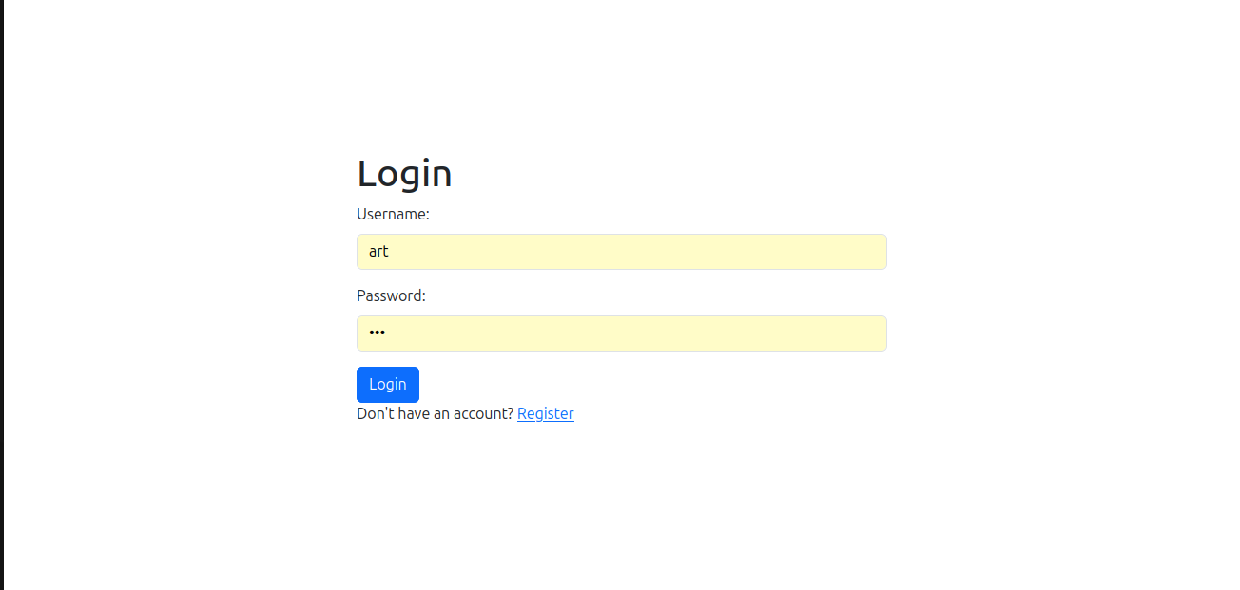

Slide 5
{{ message }}</div> {% endfor %} {% endif %} {% endwith %} <form action="{{ url_for('register') }}" method="post">
<div class="mb-3">
<label for="username" class="form-label">Username:</label> <input type="text" id="username" name="username" class="form-control" required>
</div> <div class="mb-3"> <label for="email" class="form-label">Email:</label>
<input type="email" id="email" name="email" class="form-control" required> </div> <div class="mb-3">
<label for="phone" class="form-label">Phone:</label>
<input type="tel" id="phone" name="phone" class="form-control" required> </div>
<div class="mb-3"> <label for="password" class="form-label">Password:</label>
<input type="password" id="password" name="password" class="form-control" required> </div> <button type="submit" class="btn btn-primary">Register</button> </form> <p>Already have an account? <a href="{{ url_for('login') }}">Login</a></p>
</div> </div></body></html>
<!DOCTYPE html>
<html lang="en">
<head>
<meta charset="UTF-8"> <meta name="viewport" content="width=device-width, initial-scale=1.0"> <title>Register</title>
<link href="https://cdn.jsdelivr.net/npm/bootstrap@5.3.0-alpha1/dist/css/bootstrap.min.css" rel="stylesheet">
<style>
.center-container { display: flex; justify-content: center; align-items: center; height: 100vh; }
</style>
</head>
<body>
<div class="container center-container">
<div class="col-md-6">
<h1>Register</h1>
{% with messages = get_flashed_messages(with_categories=true) %} {% if messages %} {% for category, message in messages %}
<div class="alert alert-{{ category }}">

Slide 6
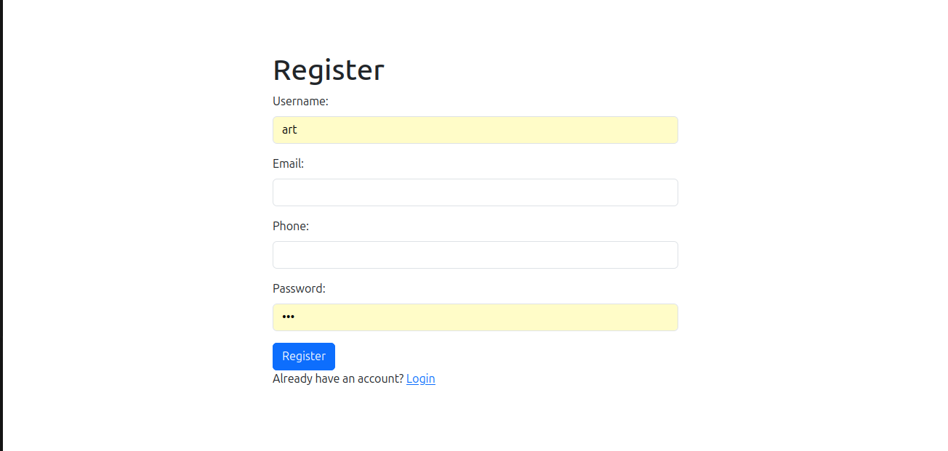

Slide 7
