Slide 1

Computational Methods for Quantum Many-Body Systems (CMQMB) -
from artificial atoms to high-temperature superconductors
Lecture 3 – Pictures of time evolution, linear response and Kubo formalism
Prof. Dr. Thomas Schäfer Università degli studi di Trieste (UNITS), Winter Semester 2025

Slide 2

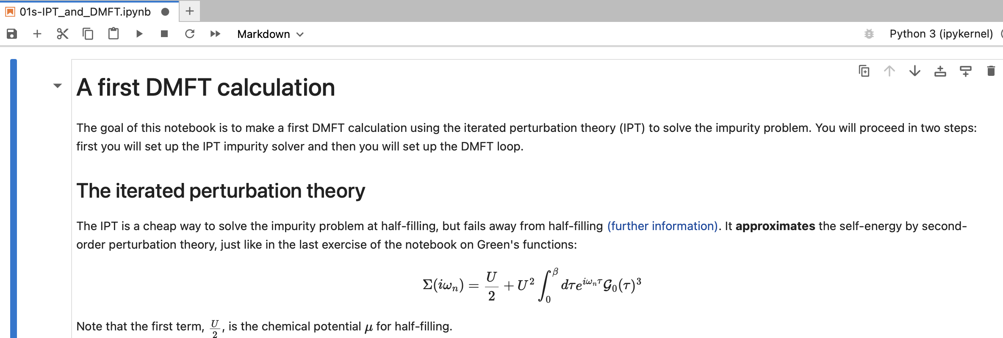
Tutorials
Please check, whether you can connect to:
sdsc-binder.flatironinstitute.org
Owner: ccq
Project: CMQMS
Toolbox for Research on Interacting Quantum Systems

Slide 3
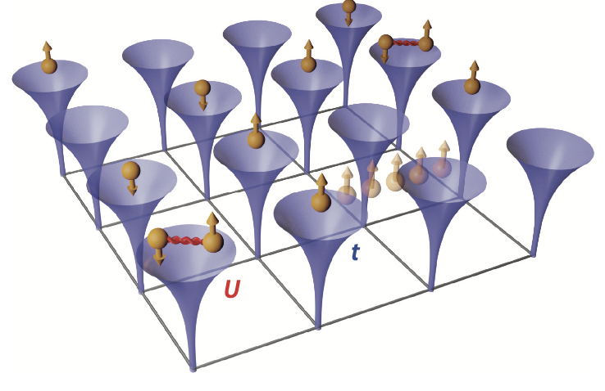
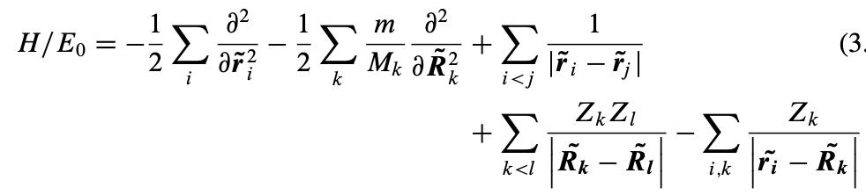
The full solid-state Hamiltonian
Many fascinating phenomena like magnetism, superconductivity, quantum criticality, metal-insulator transitions, …
However: advanced description necessary! One-particle picture does not hold!

Slide 4




Towards interacting systems…
How can we obtain information from an interacting system?
→ Scattering experiments (theory)
$$|f>$$
$$|i>$$
$$\left({\overset{⃑}{r}}^{′},t^{′}\right)$$
$$\left(\overset{⃑}{r},t\right)$$
Three ingredients necessary:
Many-body treatment → Second quantization ✔️
Time evolution → Pictures of time evolution
How does the system respond? → Linear response theory

Slide 5
Lecture 3
Content and goals
Pictures of time evolution in quantum mechanics
Schrödinger picture
Heisenberg picture
Dirac picture
Linear Response Theory
Kubo-Nakano formula
Examples

Slide 6
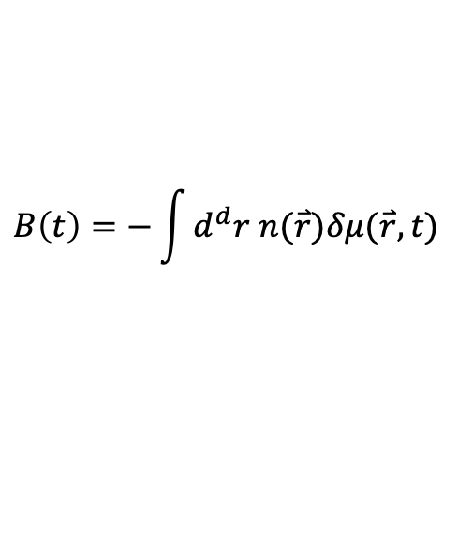
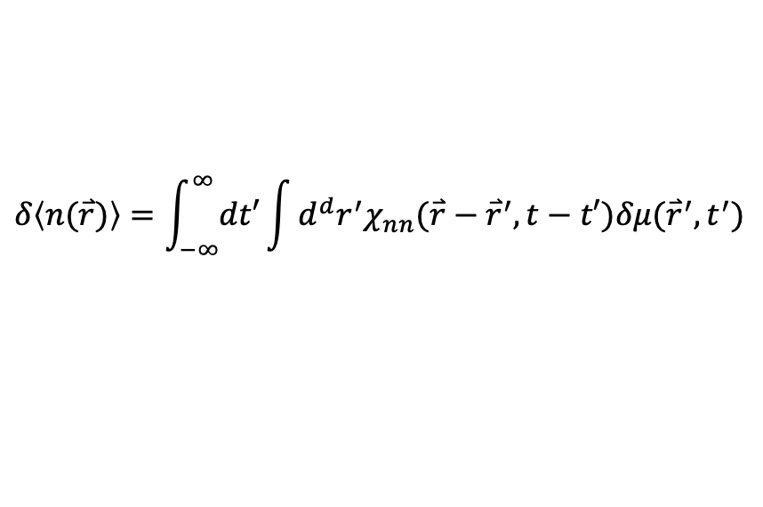
Lecture 3: Examples for correlation functions I
Density operator and variation of chemical potential
$$B\left(t\right)=−\int{d^{d}r n(\overset{⃑}{r})δμ(\overset{⃑}{r},t)}$$
We also measure density: A=B
$$δ\left\langle n(\overset{⃑}{r})\right\rangle =\int_{−∞}^{∞}{dt′}\int{d^{d}r^{′}χ_{nn}(\overset{⃑}{r}−{\overset{⃑}{r}}^{′},t−t′)δμ({\overset{⃑}{r}}^{′},t^{′})}$$
Density-density (or charge) response function “Polarizability”
$$χ_{nn}\left(\overset{⃑}{r}−{\overset{⃑}{r}}^{′},t−t^{′}\right)=−iθ(t−t^{′})\left\langle \left[n\left(\overset{⃑}{r},t\right),n\left(\overset{⃑}{r}′,t′\right)\right]\right\rangle$$

Slide 7
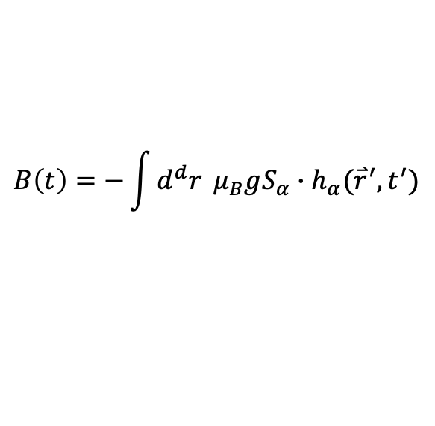
Lecture 3: Examples for correlation functions II
Magnetic moment and external magnetic field in direction ⍺
$$B\left(t\right)=−\int{d^{d}r }μ_{B}gS_{α}∙h_{α}({\overset{⃑}{r}}^{′},t^{′})$$
We also measure spin: A=B
Spin-spin (or magnetic) response function “spin susceptibility”
$$χ_{S_{α}S_{β}}\left(\overset{⃑}{r}−{\overset{⃑}{r}}^{′},t−t^{′}\right)=−iθ(t−t^{′})\left\langle \left[S_{α}\left(\overset{⃑}{r},t\right),S_{β}\left(\overset{⃑}{r}′,t′\right)\right]\right\rangle$$

