Slide 1

Computational Methods for Quantum Many-Body Systems (CMQMB) -
from artificial atoms to high-temperature superconductors
Lecture 5 – Spectral functions and tunneling experiments
Prof. Dr. Thomas Schäfer Università degli studi di Trieste (UNITS), Winter Semester 2025

Slide 2
Towards interacting systems…
How can we obtain information from an interacting system?
→ Scattering experiments (theory)
$$|GS>$$
$$|GS>$$
$$ψ$$
$${ψ }^{†}$$
$$\left({\overset{⃑}{r}}^{′},t^{′}\right)$$
$$\left(\overset{⃑}{r},t\right)$$
→ Green functions
Three ingredients necessary:
Many-body treatment → Second quantization ✔️
Time evolution → Pictures of time evolution ✔️
How does the system respond? → Linear response theory ✔️

Slide 3
Lecture 11
Content and goals
A closer look at the spectral function
Spectral function of the non-interacting system
Properties of the spectral function
A glimpse towards interactions
Example: Scanning tunnelling microscopy

Slide 4
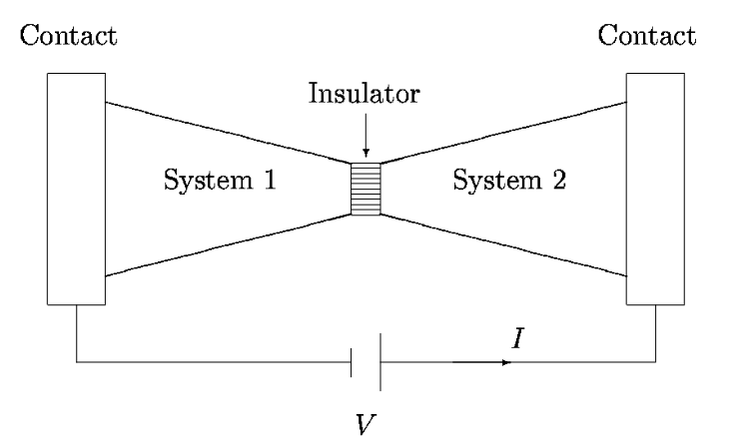
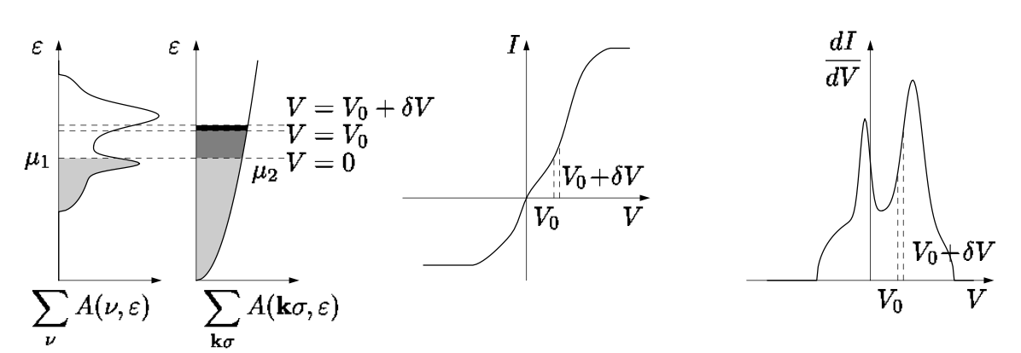
Lecture 11: Scanning tunnelling microscopy (STM)
Figures taken from H. Bruus and K. Flensberg, Introduction to many-body quantum theory in condensed matter physics

Slide 5

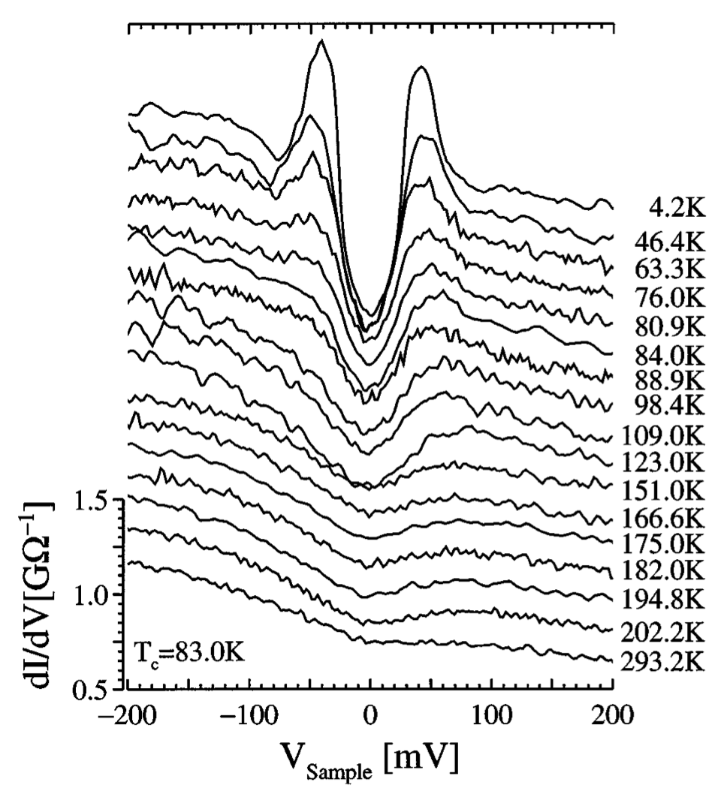
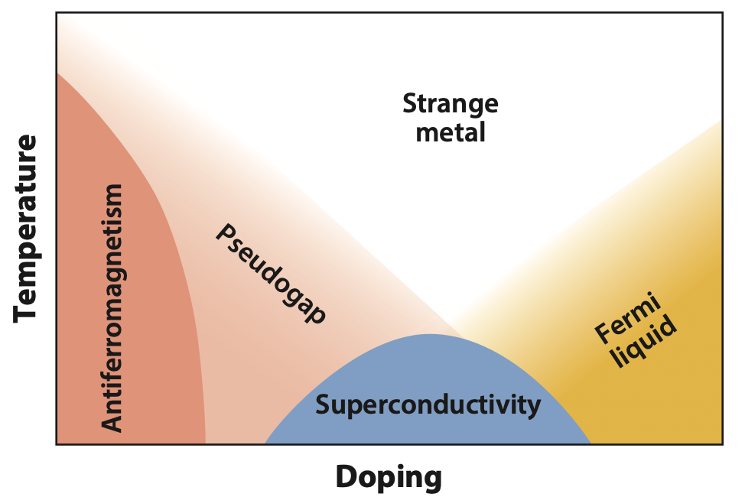
Lecture 11: Scanning tunnelling microscopy (STM)
M. Qin, T. Schäfer, et al., Annual Review of Condensed Matter Physics 13, 275-302 (2022)
C. Renner, et al., Phys. Rev. Lett. 80, 149 (1998)

