Slide 1

Computational Methods for Quantum Many-Body Systems (CMQMB) -
from artificial atoms to high-temperature superconductors
Electron gases in 3, 2, 1, and 0 (!) dimensions
Assistant-Prof. Dr. Thomas Schäfer Università degli studi di Trieste (UNITS), Winter Semester 2025

Slide 2
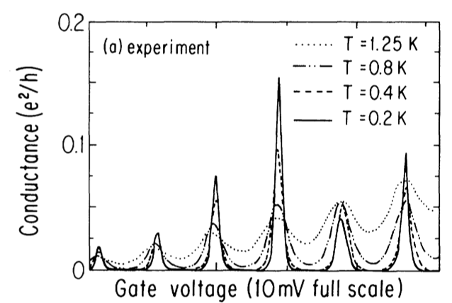
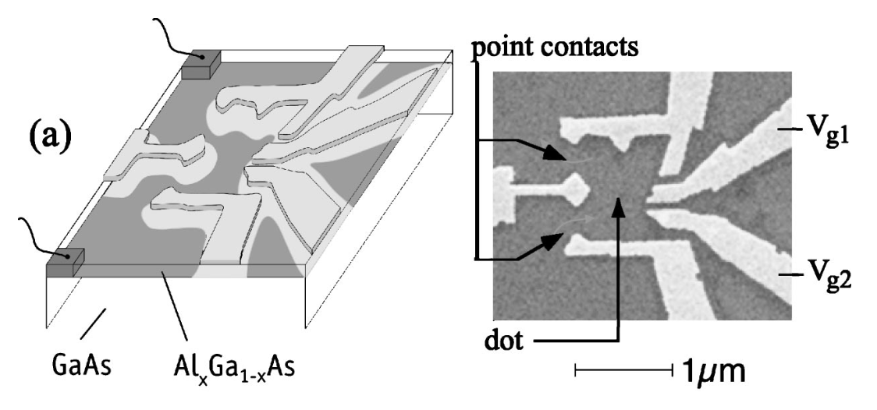
Quantum dots: samples and measurement of Coulomb blockade
Schematic
STM measurement
U. Meirav, M. A. Kastner, and S. Wind, Phys. Rev. Lett. 65, 6 (1990)
Y. Meir, N. S. Wingreen, and P. A. Lee, Phys. Rev. Lett. 66, 23 (1991)
J. A. Folk, et al., Phys. Rev. Lett. 76, 10 (1996)

