Slide 1

Computational Methods for Quantum Many-Body Systems (CMQMS) -
from artificial atoms to high-temperature superconductors
Lecture 7 – Feynman diagrams and perturbation theory
Prof. Dr. Thomas Schäfer Università degli studi di Trieste (UNITS), Winter Semester 2025

Slide 2

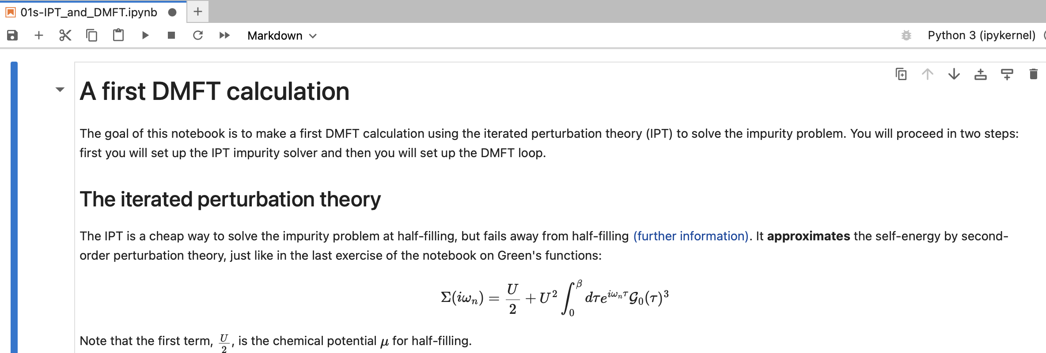
Tutorials
Please check, whether you can connect to:
http://sdsc-binder.flatironinstitute.org
Owner: ccq
Project: CMQMS
Toolbox for Research on Interacting Quantum Systems
Please do not forget your laptops tomorrow!

Slide 3
Lecture 7
Content and goals
Perturbation theory
Feynman diagrams and their categorization
Dyson equation and self-energy
(non-)Fermi liquid form of the self-energy

Slide 4
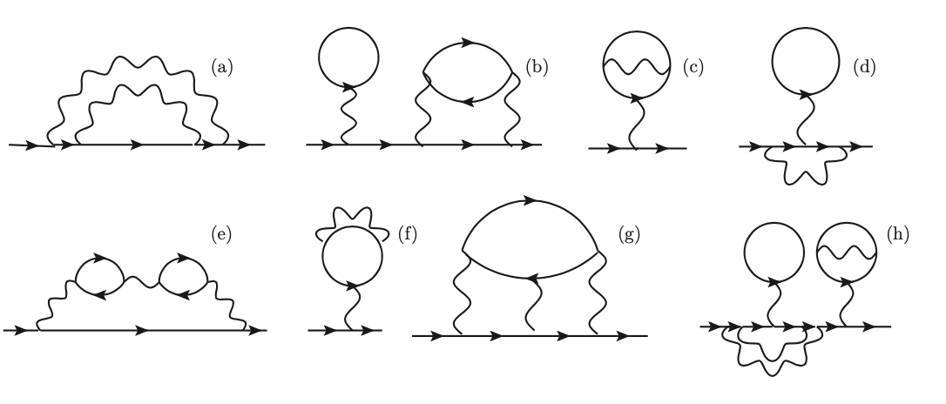
Feynman diagram quiz

