Slide 1

Computational Methods for Quantum Many-Body Systems (CMQMB) -
from artificial atoms to high-temperature superconductors
Lecture 11: Electron gases in 3, 2, 1, and 0 (!) dimensions
Prof. Dr. Thomas Schäfer Università degli studi di Trieste (UNITS), Winter Semester 2025

Slide 2
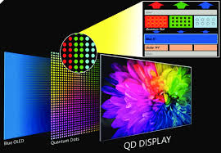
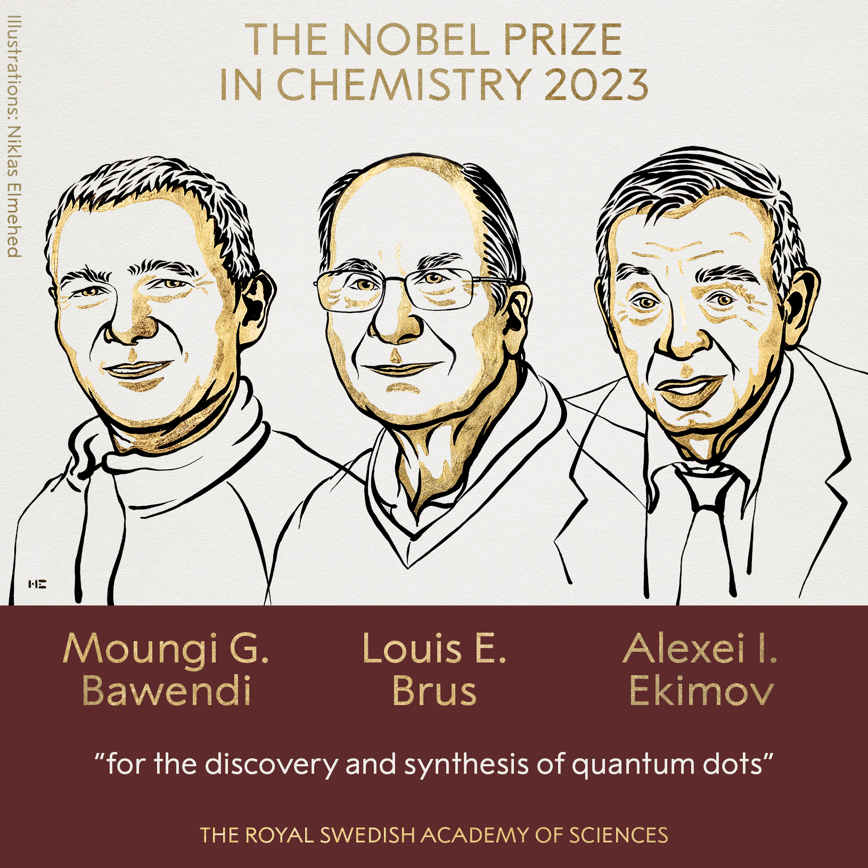
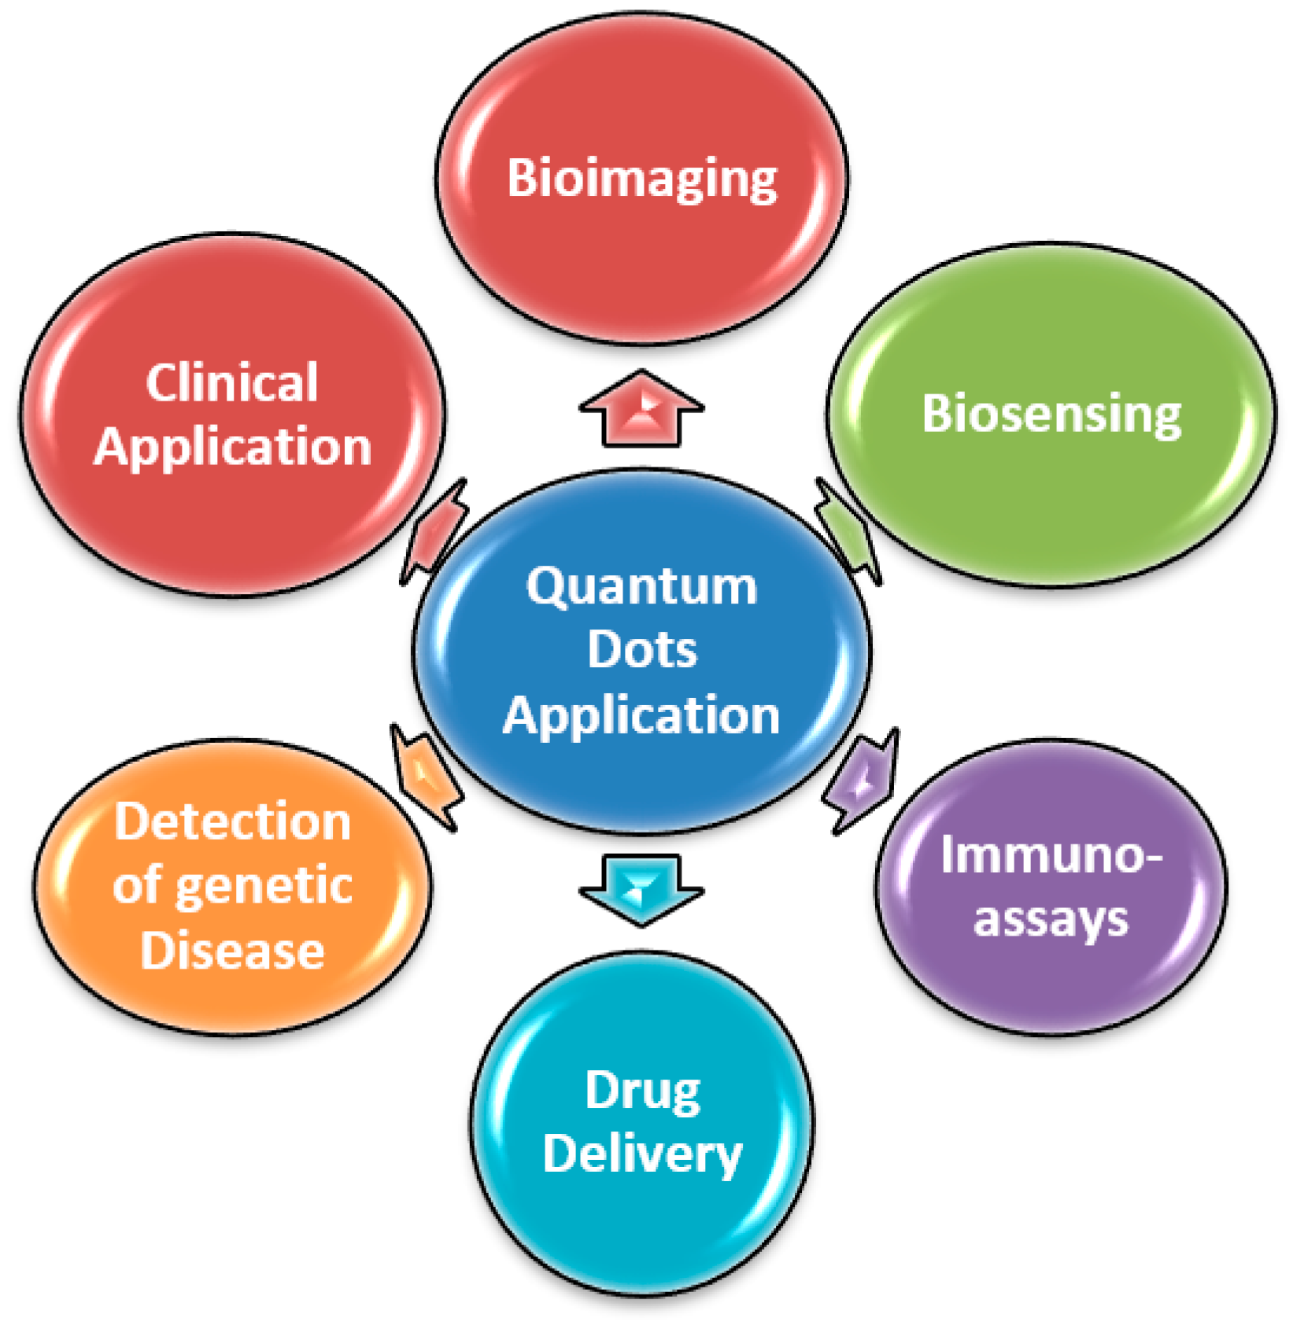
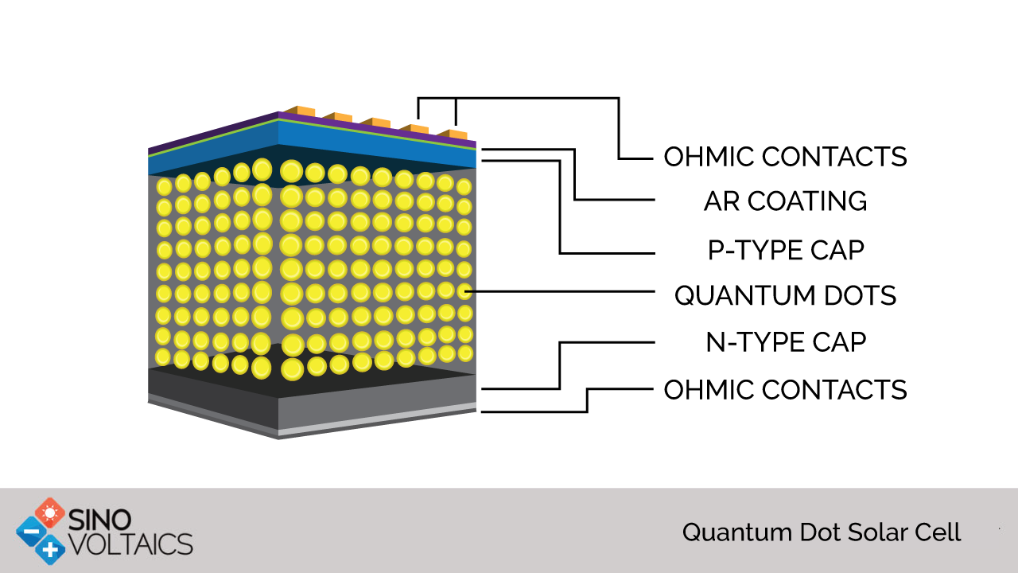
Quantum dots: Nobel prize 2023 and application potential

Slide 3
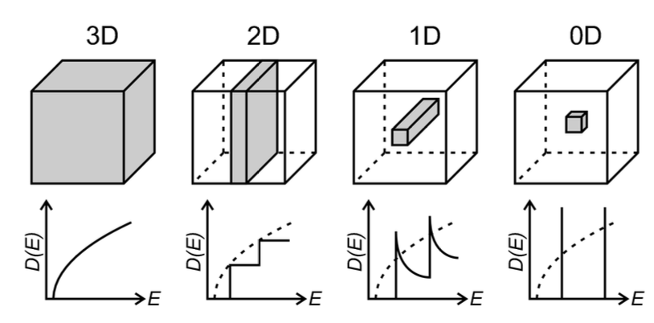
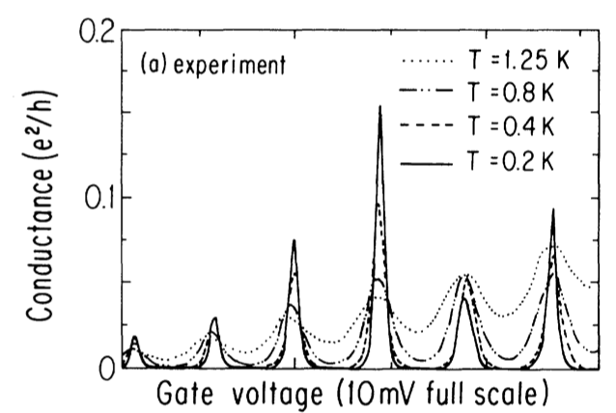
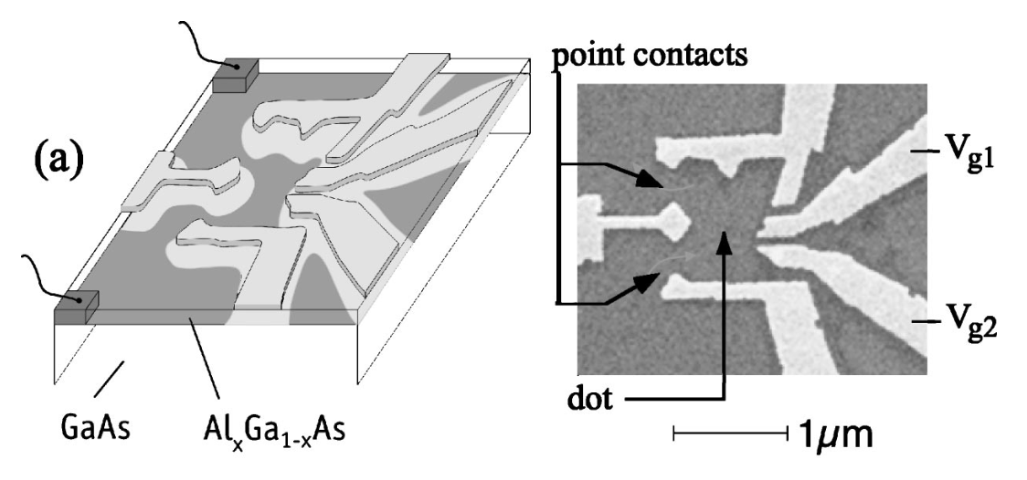
Quantum dots: density of states, samples and measurement of the Coulomb blockade
Schematic
STM measurement
U. Meirav, M. A. Kastner, and S. Wind, Phys. Rev. Lett. 65, 6 (1990)
Y. Meir, N. S. Wingreen, and P. A. Lee, Phys. Rev. Lett. 66, 23 (1991)
J. A. Folk, et al., Phys. Rev. Lett. 76, 10 (1996)

